Slide 1

HTTPS and the Lock Icon
Web security

Slide 2
Goals for this lecture
Brief overview of HTTPS:
How the SSL/TLS protocol works (very briefly)
How to use HTTPS
Integrating HTTPS into the browser
Lots of user interface problems to watch for

Slide 3

Threat Model: Network Attacker
Network Attacker:
Controls network infrastructure: Routers, DNS
Eavesdrops, injects, blocks, and modifies packets
Examples:
Wireless network at Internet Café
Internet access at hotels (untrusted ISP)

Slide 4
SSL/TLS overview
Public-key encryption:
Alice
Bob
m
Enc
c
c
Dec
m
PK_{Bob}
SK_{Bob}
Bob generates (SK_{Bob} , PK_{Bob} )
Alice: using PK_{Bob} encrypts messages and only Bob can decrypt

Slide 5

Certificates
How does Alice (browser) obtain PK_{Bob} ?
Browser Alice
CA
Server Bob
choose
(SK,PK)
PK and
proof “I am Bob”
check
proof
PK_{CA}
PK_{CA}
SK_{CA}
issue Cert with SK_{CA} :
Verify
cert
Bob’s key is PK
Bob’s key is PK
Bob uses Cert for an extended period (e.g. one year)

Slide 6
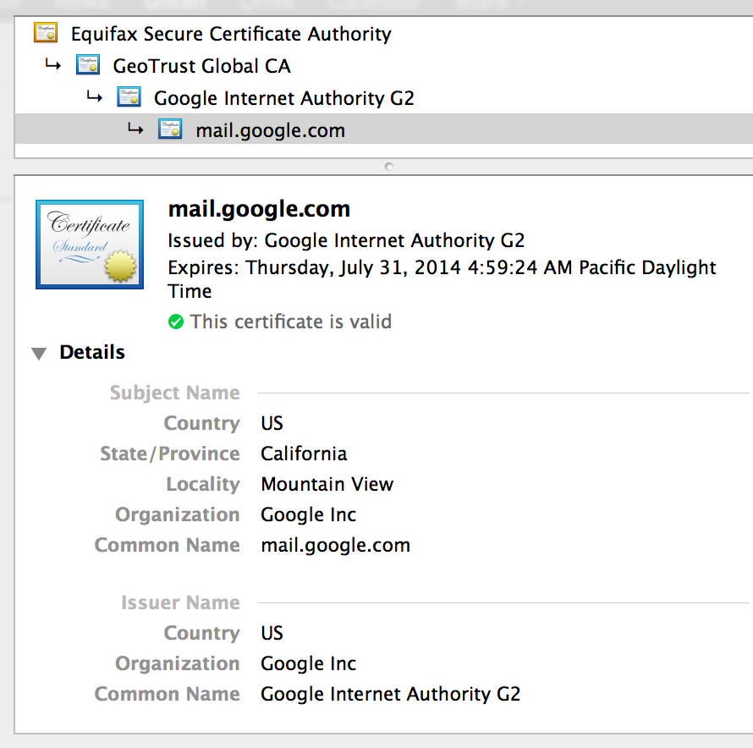
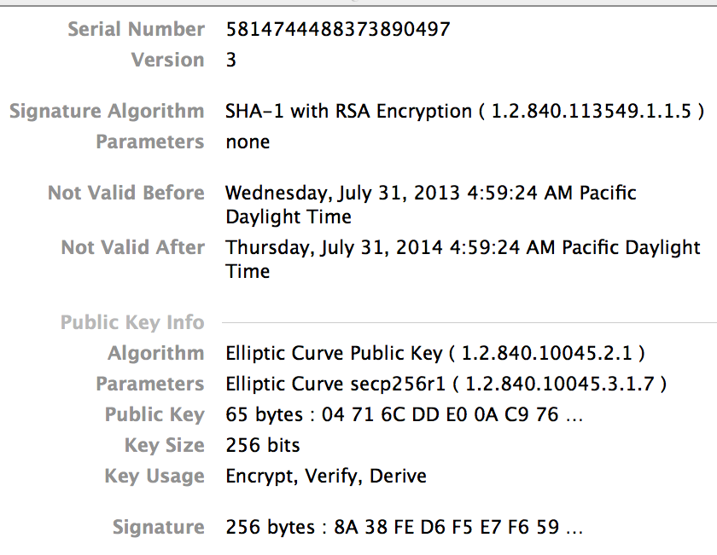
Certificates: example
Important fields:

Slide 7
Certificates on the web
Subject’s CommonName can be:
An explicit name, e.g. cs.stanford.edu , or
A wildcard cert, e.g. *.stanford.edu or cs*.stanford.edu
matching rules:
“*” must occur in leftmost component, does not match “.”
example: *.a.com matches x.a.com but not y.x.a.com
(as in RFC 2818: “HTTPS over TLS”)

Slide 8
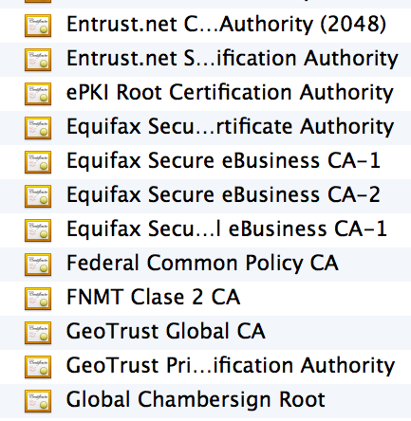
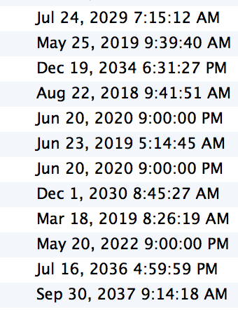
Certificate Authorities
⋮
Browsers accept certificates from a large number of CAs
Top level CAs ≈ 60
Intermediate CAs ≈ 1200
⋮

Slide 9
Brief overview of SSL/TLS
browser
server
client-hello
cert
server-hello + server-cert (PK)
SK
key exchange (several options): EC-DHE
server-key-exchange
client-key-exchange
k
Finished
k
HTTP data encrypted with KDF(k)
Most common: server authentication only

Slide 10
Integrating SSL/TLS with HTTP: HTTPS
web proxy
Two complications
Web proxies
solution: browser sends
CONNECT domain-name
before client-hello
Virtual hosting:
two sites hosted at same IP address.
solution in TLS 1.1: SNI (June 2003)
client_hello_extension: server_name=cnn.com
implemented since FF2 and IE7 (vista)
web server
corporate network
web server
client-hello
server-cert ???
cert_{CNN}
cert_{ABC}
Notes:
SNI: server name indication

Slide 11
Why is HTTPS not used for all web traffic?
Crypto slows down web servers (but not by much if done right)
Some ad-networks still do not support HTTPS
Reduced revenue for publishers
Incompatible with virtual hosting (older browsers)
March 2017: IE6 ≈ 1-5% in china (ie6countdown.com)
Aug 2014: Google boosts ranking of sites supporting HTTPS

Slide 12
HTTPS in the Browser

Slide 13
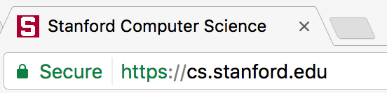
The lock icon: SSL indicator
Intended goal:
Provide user with identity of page origin
Indicate to user that page contents were not viewed or modified by a network attacker
In reality: many problems (next few slides)
Notes:
Network attacker: controls routers, DNS; can inject, delete, and modify packets

Slide 14
When is the (basic) lock icon displayed
All elements on the page fetched using HTTPS
For all elements:
HTTPS cert issued by a CA trusted by browser
HTTPS cert is valid (e.g. not expired)
Domain in URL matches: CommonName or SubjectAlternativeName in cert

Slide 15
The lock UI: Extended Validation Certs
Harder to obtain than regular certs
requires human at CA to approve cert request
no wildcard certs (e.g. *.stanford.edu )
Helps block “semantic attacks”: www.bankofthevvest.com
note: HTTPS-EV and HTTPS are in the same origin

Slide 16
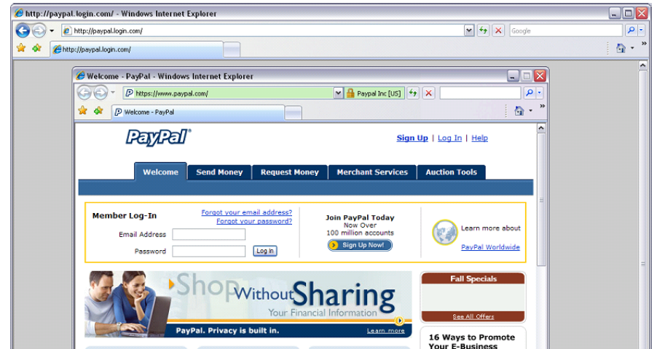
A general UI attack: picture-in-picture
Trained users are more likely to fall victim to this [JSTB’07]
Notes:
Both inner and outer windows are focused

Slide 17
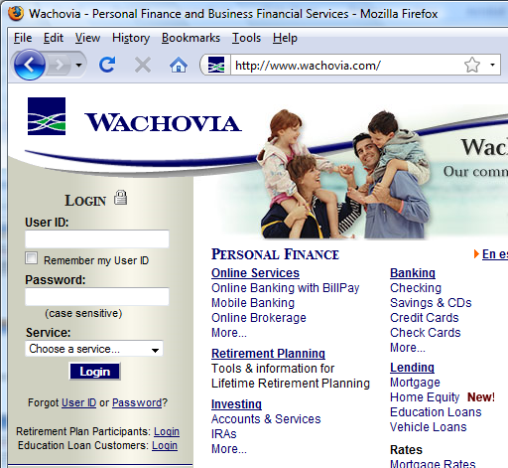
HTTPS and login pages: incorrect usage
Users often land on login page over HTTP:
Type HTTP URL into address bar
Google links to HTTP page
View source:
<form method="post"
action="https://onlineservices.wachovia.com/..."
(old site)
Notes:
User has no way to tell that his password is sent over HTTPS to site. Also has no way to tell that page wasn’t modified enroute (e.g. change form action).
Note the confusing lock next to “LOGIN” that suggests this is HTTPS.

Slide 18
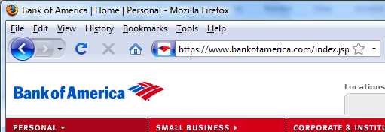
HTTPS and login pages: guidelines
General guideline:
Response to http://login.site.com should be Location: https://login.site.com
(redirect)
Should be the response to every HTTP request …

Slide 19
Problems with HTTPS and the Lock Icon

Slide 20
Problems with HTTPS and the Lock Icon
Upgrade from HTTP to HTTPS
Forged certs
Mixed content: HTTP and HTTPS on the same page
Does HTTPS hide web traffic?
Problems: traffic analysis, compression attacks

Slide 21
1. HTTP ⇒ HTTPS upgrade
Common use pattern:
browse site over HTTP; move to HTTPS for checkout
connect to bank over HTTP; move to HTTPS for login
SSL_strip attack: prevent the upgrade [Moxie’08]
<a href=https://…> ⟶ <a href=http://…>
Location: https://... ⟶ Location: http://... (redirect)
<form action=https://… > ⟶ <form action=http://…>
HTTP
SSL
attacker
web server
Notes:
ssl_strip: prevents browser from upgrading, but does the SSL upgrade when communicating with the server. Server has no idea this is taking place.
Similar attack done on SMTP STARTTLES : http://arstechnica.com/tech-policy/2014/11/condemnation-mounts-against-isp-that-sabotaged-users-e-mail-encryption/

Slide 22


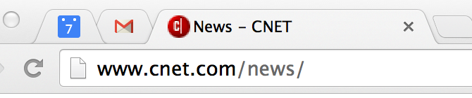
Tricks and Details
Tricks: drop-in a clever fav icon (older browsers)
⇒ fav icon no longer presented in address bar
Number of users who detected HTTP downgrade: 0
⟶

Slide 23
Defense: Strict Transport Security (HSTS)
Strict-Transport-Security: max-age=63072000; includeSubDomains
(ignored if not over HTTPS)
web server
Header tells browser to always connect over HTTPS
Subsequent visits must be over HTTPS (self signed certs result in an error)
Browser refuses to connect over HTTP or if site presents an invalid cert
Requires that entire site be served over valid HTTPS
HSTS flag deleted when user “clears private data” : security vs. privacy
Notes:
max-age is given in seconds: 63072000 is two years (most common value among top 1M sites). HSTS header only accepted over HTTPS.
HSTS preloaded list: list of HSTS sites embedded in browser … in source code.
Apr. 2017: 5,500 sites use of Alexa Top 100K sites. (http://trends.builtwith.com/docinfo/HSTS)
To examine HSTS database use: chrome://net-internals/#hsts

Slide 24

Preloaded HSTS list
https://hstspreload.org/
Strict-Transport-Security: max-age=63072000; includeSubDomains; preload
Preload list hard-coded in Chrome source code. Examples: Google, Paypal, Twitter, Simple, Linode, Stripe, Lastpass, …
Notes:
63072000: two years
Preload attribute tells Chrome team to add site to the preload list.
Preoad is in the Chrome source code … takes a while until widely deployed.

Slide 25
CSP: upgrade-insecure-requests
The problem: many pages use <img src=“http://site.com/img”>
Makes it difficult to migrate a section of a site to HTTPS
Solution: gradual transition using CSP
Always use protocol relative URLs <img src=“//site.com/img”>
Content-Security-Policy: upgrade-insecure-requests
<img src=“http://site.com/img”>
<img src=“http://othersite.com/img”>
<a href=“http://site.com/img”>
<a href=“http://othersite.com/img”>
<img src=“https://site.com/img”>
<img src=“https://othersite.com/img”>
<a href=“https://othersite.com/img”>
<a href=“http://othersite.com/img”>
Notes:
Resources and internal links are upgraded to HTTPS. External links are not.
Unlike HSTS, can be applied to sections of a site. Does not require changing page contents.

Slide 26
2. Certificates: wrong issuance
2011: Comodo and DigiNotar CAs hacked, issue certs for Gmail, Yahoo! Mail, …
2013: TurkTrust issued cert. for gmail.com (discovered by pinning)
2014: Indian NIC (intermediate CA trusted by the root CA IndiaCCA) issue certs for Google and Yahoo! domains
Result: (1) India CCA revoked NIC’s intermediate certificate
(2) Chrome restricts India CCA root to only seven Indian domains
2015: MCS (intermediate CA cert issued by CNNIC) issues certs for Google domains
Result: current CNNIC root no longer recognized by Chrome
⇒ enables eavesdropping w/o a warning on user’s session
Notes:
India CCA event: http://googleonlinesecurity.blogspot.com/2014/07/maintaining-digital-certificate-security.html
CNNIC event: http://googleonlinesecurity.blogspot.com/2015/03/maintaining-digital-certificate-security.html

Slide 27
Man in the middle attack using rogue cert
GET https://bank.com
BadguyCert
BankCert
ClientHello
attacker
ClientHello
bank
ServerCert (rogue)
ServerCert (Bank)
(cert for Bank by a valid CA)
SSL key exchange
SSL key exchange
k₁
k₁
k₂
k₂
HTTP data enc with k₁
HTTP data enc with k₂
Attacker proxies data between user and bank. Sees all traffic and can modify data at will.

Slide 28
What to do? (many good ideas)
Dynamic HTTP public-key pinning (RFC 7469)
Let a site declare CAs that can sign its cert (similar to HSTS)
on subsequent HTTPS, browser rejects certs issued by other CAs
TOFU: Trust on First Use
Certificate Transparency: [LL’12]
idea: CA’s must advertise a log of all certs. they issued
Browser will only use a cert if it is published on log server
Efficient implementation using Merkle hash trees
Companies can scan logs to look for invalid issuance
Notes:
Perspectives: Wendlandt, Anderson, Perrig
Google stores all certs it sees (stored in google DNS)

Slide 29
HPKP example (HTTP header from server)
Public-Key-Pins[-Report-only]: max-age=2592000;
pin-sha256="E9CZ9INDbd+2eRQozYqqbQ2yXLVKB9+xcprMF+44U1g=";
pin-sha256="LPJNul+wow4m6DsqxbninhsWHlwfp0JecwQzYpOLmCQ=";
report-uri="https://example.net/pkp-report"
Note: not currently supported by IE, Edge, and Safari
Max-age: 2,592,000 seconds is the most common max-age value used (30 days)
Examine browser’s pinning DB: chrome://net-internals/#hsts
Max-age statistics provided by Andrei Sabelfeld and Steven Van Acker in Apr. 2017.
Notes:
Public-Key-Pins-Report-only: Separate header. Only report errors, don’t block connection.

Slide 30
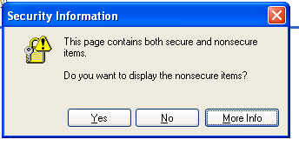
3. Mixed Content: HTTP and HTTPS
Page loads over HTTPS, but contains content over HTTP
(e.g. <script src=“http://.../script.js> )
⇒ Active network attacker can hijack session
by modifying script en-route to browser
never write this
IE7:
Old Chrome:
Mostly ignored by users …

Slide 31


https://badssl.com (Chrome 58, 2017)
Mixed script: <script src="http://mixed-script.badssl.com/nonsecure.js"></script>
Mixed image: <img class="mixed" src=http://mixed.badssl.com/image.jpg”>
(script is blocked, click to load)
Image loaded, but no HTTPS indicator

Slide 32
4. Peeking through SSL: traffic analysis
Network traffic reveals length of HTTPS packets
TLS supports up to 256 bytes of padding
AJAX-rich pages have lots and lots of interactions with the server
These interactions expose specific internal state of the page
BAM!
Chen, Wang, Wang, Zhang, 2010

Slide 33
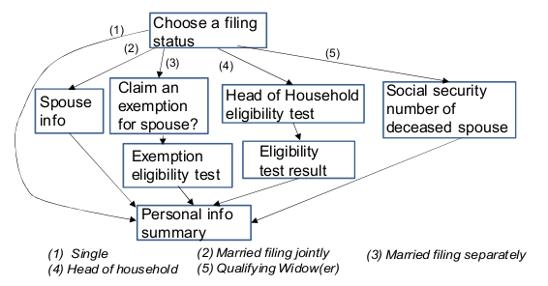
Peeking through SSL: an example [CWWZ’10]
Vulnerabilities in an online tax application
No easy fix. Can also be used to ID Tor traffic

Slide 34
THE END

