Slide 1

Control Hijacking: Defenses
Control Hijacking

Slide 2
Recap: control hijacking attacks
Stack smashing: overwrite return address or function pointer
Heap spraying: reliably exploit a heap overflow
Use after free: attacker writes to freed control structure, which then gets used by victim program
Integer overflows
Format string vulnerabilities
⋮

Slide 3

The mistake: mixing data and control
An ancient design flaw:
enables anyone to inject control signals
1971: AT&T learns never to mix control and data

Slide 4
Control hijacking attacks
The problem: mixing data with control flow in memory
local variables
SFP
ret
addr
arguments
stack frame
data overwrites
return address
Later we will see that mixing data and code is also the reason for XSS: a common web vulnerability

Slide 5
Preventing hijacking attacks
Fix bugs:
Audit software
Automated tools: Coverity, Prefast/Prefix.
Rewrite software in a type safe languange (Java, ML)
Difficult for existing (legacy) code …
Platform defenses: prevent attack code execution
Add runtime code to detect overflows exploits
Halt process when overflow exploit detected
StackGuard, CFI, LibSafe, …
Transform:
Complete Breach
Denial of service

Slide 6
Platform Defenses
Control Hijacking

Slide 7
Marking memory as non-execute (DEP)
Prevent attack code execution by marking stack and heap as non-executable
NX-bit on AMD Athlon 64, XD-bit on Intel P4 Prescott
NX bit in every Page Table Entry (PTE)
Deployment:
Linux (via PaX project); OpenBSD
Windows: since XP SP2 (DEP)
Visual Studio: /NXCompat[:NO]
Limitations:
Some apps need executable heap (e.g. JITs).
Can be easily bypassed using Return Oriented Programming (ROP)
Notes:
/NXCOMPAT: tells linker that app is compatible with DEP. :NO indicates don’t use DEP.
DEP: data execute prevention

Slide 8
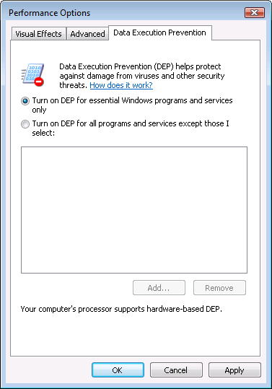
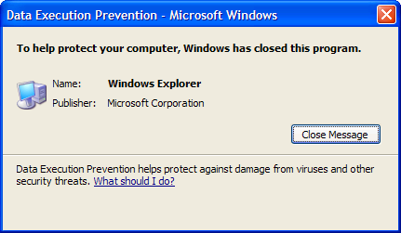
Examples: DEP controls in Windows
DEP terminating a program

Slide 9
Attack: Return Oriented Programming (ROP)
Control hijacking without injecting code:
stack
libc.so
args
ret-addr
exec()
sfp
printf()
local buf
“/bin/sh”
Notes:
NX wasted effort?

Slide 10
ROP: in more detail
To run /bin/sh we must direct stdin and stdout to the socket:
dup2(s, 0) // map stdin to socket
dup2(s, 1) // map stdout to socket
execve("/bin/sh", 0, 0);
execve("/bin/sh")
ret
dup2(s, 0)
ret
dup2(s, 1)
ret
Gadgets in victim code:
Stack (set by attacker):
overflow-str 0x408400 0x408500 0x408300
ret-addr
Stack pointer moves up on pop

Slide 11
ROP: in even more detail
dup2(s,0) implemented as a sequence of gadgets in victim code:
0x408100
0x408200
0x408300
0x408400
5f
pop rdi
ret
5e
pop rsi
ret
pop rax
ret
syscall
ret
c3
c3
Stack (by attacker):
overflow-str 0x408100 s 0x408200 0 0x408300 33 0x408400
ret-addr
(rdi ⟵ s)
(rsi ⟵ 0)
(rax ⟵ 33)
syscall #33
Notes:
Dup2(s,0): duplicated socket as stdin. RDI register is socket, RSI register is stdin, RAX is syscall #

Slide 12
What to do?? Randomization
ASLR: (Address Space Layout Randomization)
Map shared libraries to rand location in process memory
⇒ Attacker cannot jump directly to exec function
Deployment: (/DynamicBase)
Windows 7: 8 bits of randomness for DLLs
aligned to 64K page in a 16MB region ⇒ 256 choices
Windows 8: 24 bits of randomness on 64-bit processors
Other randomization methods:
Sys-call randomization: randomize sys-call id’s
Instruction Set Randomization (ISR)
Notes:
Combination of NX and ASLR is effective.
/DynamicBase: Visual Studio flag to indicate that application works with ASLR.

Slide 13
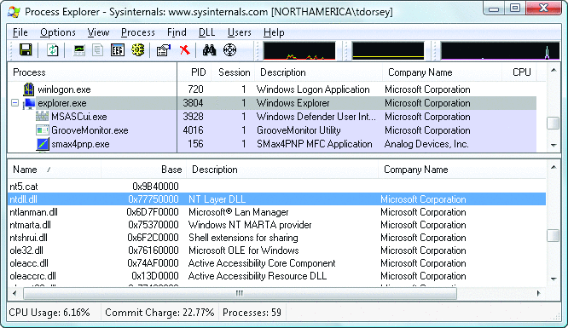
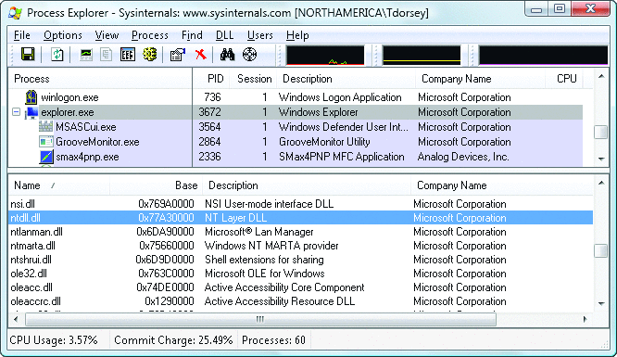
ASLR Example
Booting twice loads libraries into different locations:
Note: everything in process memory must be randomized
stack, heap, shared libs, base image
Win 8 Force ASLR: ensures all loaded modules use ASLR

Slide 14
A very different idea: kBouncer
kernel
pop rdi
ret
pop rsi
ret
pop rax
ret
syscall
ret
kBouncer
Observation: abnormal execution sequence
ret returns to an address that does not follow a call
Idea: before a syscall, check that every prior ret is not abnormal
How: use Intel’s Last Branch Recording (LBR)

Slide 15
A very different idea: kBouncer
kernel
pop rdi
ret
pop rsi
ret
pop rax
ret
syscall
ret
kBouncer
Inte’s Last Branch Recording (LBR):
store 16 last executed branches in a set of on-chip registers (MSR)
read using rdmsr instruction from privileged mode
kBouncer: before entering kernel, verify that last 16 rets are normal
Requires no app. code changes, and minimal overhead
Limitations: attacker can ensure 16 calls prior to syscall are valid

Slide 16
Hardening the executable
Control Hijacking Defenses

Slide 17
Run time checking: StackGuard
Many run-time checking techniques …
we only discuss methods relevant to overflow protection
Solution 1: StackGuard
Run time tests for stack integrity.
Embed “canaries” in stack frames and verify their integrity prior to function return.
Frame 2
Frame 1
top of stack
local
canary
sfp
ret
str
local
canary
sfp
ret
str

Slide 18
Canary Types
Random canary:
Random string chosen at program startup.
Insert canary string into every stack frame.
Verify canary before returning from function.
Exit program if canary changed. Turns potential exploit into DoS.
To corrupt, attacker must learn current random string.
Terminator canary: Canary = {0, newline, linefeed, EOF}
String functions will not copy beyond terminator.
Attacker cannot use string functions to corrupt stack.

Slide 19
StackGuard (Cont.)
StackGuard implemented as a GCC patch
Program must be recompiled
Minimal performance effects: 8% for Apache
Note: Canaries do not provide full protection
Some stack smashing attacks leave canaries unchanged
Heap protection: PointGuard
Protects function pointers and setjmp buffers by encrypting them: e.g. XOR with random cookie
Less effective, more noticeable performance effects

Slide 20
StackGuard enhancements: ProPolice
ProPolice (IBM) - gcc 3.4.1. (-fstack-protector)
Rearrange stack layout to prevent ptr overflow.
String Growth
args
ret addr
Protects pointer args and local pointers from a buffer overflow
SFP
CANARY
Stack Growth
local string buffers
local non-buffer variables
pointers, but no arrays
copy of pointer args
Notes:
/ProPolice: replicates pointers in arguments to bottom of local vars area.
ProPolicy: also called SSP – stack smashing protection.
/GS: Arguments, return address, cookie, arrays, local variables, copies of some pointer arguments, alloca

Slide 21
MS Visual Studio /GS [since 2003]
Compiler /GS option:
Combination of ProPolice and Random canary.
If cookie mismatch, default behavior is to call _exit(3)
Function prolog:
sub esp, 8 // allocate 8 bytes for cookie
mov eax, DWORD PTR ___security_cookie
xor eax, esp // xor cookie with current esp
mov DWORD PTR [esp+8], eax // save in stack
Function epilog:
mov ecx, DWORD PTR [esp+8]
xor ecx, esp
call @__security_check_cookie@4
add esp, 8
Enhanced /GS in Visual Studio 2010:
/GS protection added to all functions, unless can be proven unnecessary
Notes:
ANI bug happened because /GS was not applied to function LoadAniIcon() since it did not contain string buffers. Visual Studio 2010 applies /GS protection more aggressively.

Slide 22
/GS stack frame
args
String Growth
ret addr
Canary protects ret-addr and exception handler frame
SFP
exception handlers
CANARY
Stack Growth
local string buffers
local non-buffer variables
pointers, but no arrays
copy of pointer args
Notes:
/GS: Arguments, return address, cookie, arrays, local variables, copies of some pointer arguments, alloca

Slide 23
Evading /GS with exception handlers
When exception is thrown, dispatcher walks up exception list until handler is found (else use default handler)
After overflow: handler points to attacker’s code
exception triggered ⇒ control hijack
Main point: exception is triggered before canary is checked
0xffffffff
SEH frame
SEH frame
high
mem
next
handler
buf
next
next
ptr to attack code
handler
next
handler
Notes:
SEH: structured exception handler

Slide 24
Defenses: SAFESEH and SEHOP
/SAFESEH: linker flag
Linker produces a binary with a table of safe exception handlers
System will not jump to exception handler not on list
/SEHOP: platform defense (since win vista SP1)
Observation: SEH attacks typically corrupt the “next” entry in SEH list.
SEHOP: add a dummy record at top of SEH list
When exception occurs, dispatcher walks up list and verifies dummy record is there. If not, terminates process.
Notes:
SAFESEH: safe structured exception handling
SEHOP: structured exception handling overwrite protection. Enabled with a regkey DisableExceptionChainValidation.

Slide 25
Summary: Canaries are not full proof
Canaries are an important defense tool, but do not prevent all control hijacking attacks:
Heap-based attacks still possible
Integer overflow attacks still possible
/GS by itself does not prevent Exception Handling attacks
(also need SAFESEH and SEHOP)

Slide 26
Even worse: canary extraction
A common design for crash recovery:
When process crashes, restart automatically (for availability)
Often canary is unchanged (reason: relaunch using fork)
Danger:
canary extraction byte by byte
⋯
local buffer
A
C A N A R Y
ret addr
crash
⋯
B
C A N A R Y
ret addr
local
buffer
crash
⋯
C
C A N A R Y
ret addr
local buffer
No crash
⋯
local buffer
C A
C A N A R Y
ret addr
No crash

Slide 27
Similarly: extract ASLR randomness
A common design for crash recovery:
When process crashes, restart automatically (for availability)
Often canary is unchanged (reason: relaunch using fork)
Danger:
Extract ret-addr to de-randomize stack location
Extract stack function pointers to de-randomize heap
⋯
local buffer
A
C A N A R Y
ret addr
crash
⋯
B
C A N A R Y
ret addr
local
buffer
crash
⋯
C
C A N A R Y
ret addr
local buffer
No crash
⋯
local buffer
C A
C A N A R Y
ret addr
No crash

Slide 28
What if can’t recompile: Libsafe
Solution 2: Libsafe (Avaya Labs)
Dynamically loaded library (no need to recompile app.)
Intercepts calls to strcpy (dest, src)
Validates sufficient space in current stack frame: |frame-pointer – dest| > strlen(src)
If so, does strcpy. Otherwise, terminates application
top of stack
sfp
ret-addr
dest
src
buf
sfp
ret-addr
Libsafe strcpy
main

Slide 29
How robust is Libsafe?
low memory
sfp
ret-addr
dest
src
buf
sfp
ret-addr
high memory
Libsafe strcpy
main
strcpy() can overwrite a pointer between buf and sfp.

Slide 30
More methods …
StackShield
At function prologue, copy return address RET and SFP to “safe” location (beginning of data segment)
Upon return, check that RET and SFP is equal to copy.
Implemented as assembler file processor (GCC)
Control Flow Integrity (CFI)
A combination of static and dynamic checking
Statically determine program control flow
Dynamically enforce control flow integrity

Slide 31
Control flow integrity (CFI) [ABEL’05, …]
Ultimate Goal: ensure control flows as specified by code’s flow graph
Lots of academic research on CFI systems:
CCFIR (2013), kBouncer (2013), FECFI (2014), CSCFI (2015), …
and many attacks …
void HandshakeHandler(Session *s, char *pkt) {
...
s->hdlr(s, pkt)
}
Compile time: build list of possible call targets
Run time: before call, check validity of s->hdlr
Notes:
Builds table of valid function entry points at compile time.

Slide 32
Control Flow Guard (CFG) (Windows 10)
Poor man’s version of CFI:
Protects indirect calls by checking against a bitmask of all valid function entry points in executable
ensures target is the entry point of a function

Slide 33
Control Flow Guard (CFG) (Windows 10)
Poor man’s version of CFI:
Protects indirect calls by checking against a bitmask of all valid function entry points in executable
Does not prevent attacker from causing a jump to a valid wrong function
Hard to build accurate control flow graph statically
ensures target is the entry point of a function

Slide 34
An example
void HandshakeHandler(Session *s, char *pkt) {
s->hdlr = &LoginHandler;
... Buffer overflow in Session struct ...
}
void LoginHandler(Session *s, char *pkt) {
bool auth = CheckCredentials(pkt);
s->dhandler = &DataHandler;
}
void DataHandler(Session *s, char *pkt);
Attacker controls handler
Static CFI: attacker can call DataHandler to
bypass authentication

Slide 35
Cryptographic Control Flow Integrity (CCFI)
Threat model: attacker can read/write anywhere in memory,
program should not deviate from its control flow graph
CCFI approach: Every time a jump address is written/copied anywhere in memory: compute 64-bit AES-MAC and append to address
On heap: tag = AES(k, (jump-address, 0 ll source-address) )
on stack: tag = AES(k, (jump-address, 1 ll stack-frame) )
Before following address, verify MAC and crash if invalid
Where to store key k? In xmm registers (not memory)

Slide 36
Back to the example
void HandshakeHandler(Session *s, char *pkt) {
s->hdlr = &LoginHandler;
... Buffer overflow in Session struct ...
}
void LoginHandler(Session *s, char *pkt) {
bool auth = CheckCredentials(pkt);
s->dhandler = &DataHandler;
}
void DataHandler(Session *s, char *pkt);
Attacker controls handler
CCFI: Attacker cannot create a valid MAC for DataHandler address
Notes:
Example seems a bit complicated
add a picture of heap showing Session + buffer next to it

Slide 37
References on heap spraying
[1] Heap Feng Shui in Javascript, by A. Sotirov, Blackhat Europe 2007
[2] Engineering Heap Overflow Exploits with JavaScript M. Daniel, J. Honoroff, and C. Miller, WooT 2008
[3] Nozzle: A Defense Against Heap-spraying Code Injection Attacks,
by P. Ratanaworabhan, B. Livshits, and B. Zorn
[4] Interpreter Exploitation: Pointer inference and JiT spraying, by Dion Blazakis

Slide 38
THE END

