Slide 1
Uber Assignment

Slide 2
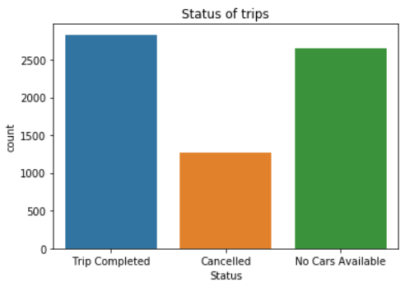

Slide 3
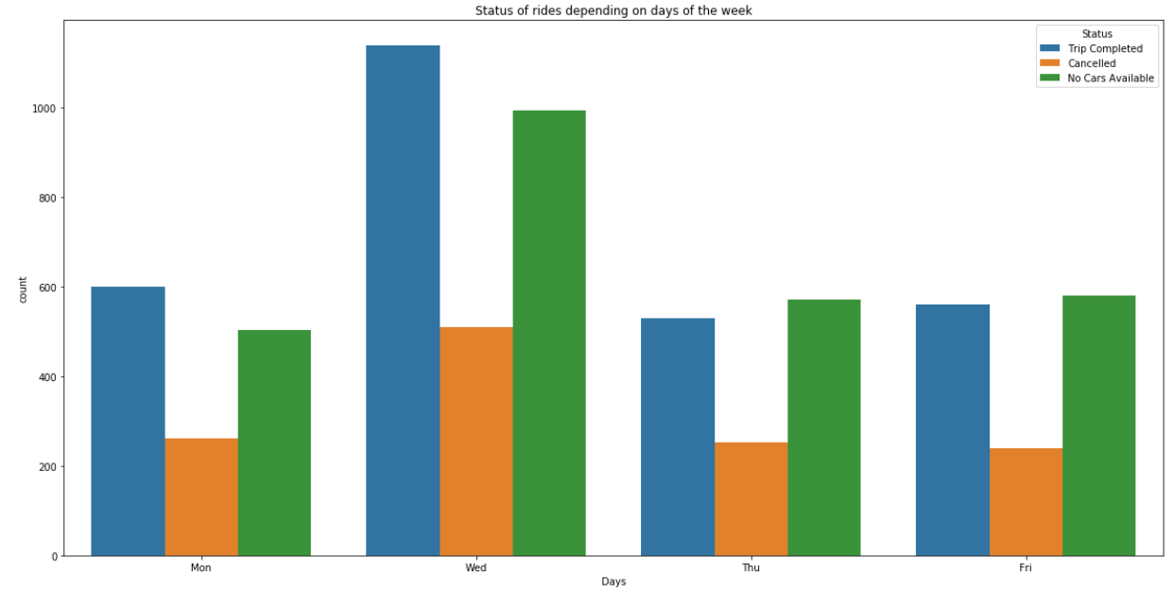

Slide 4
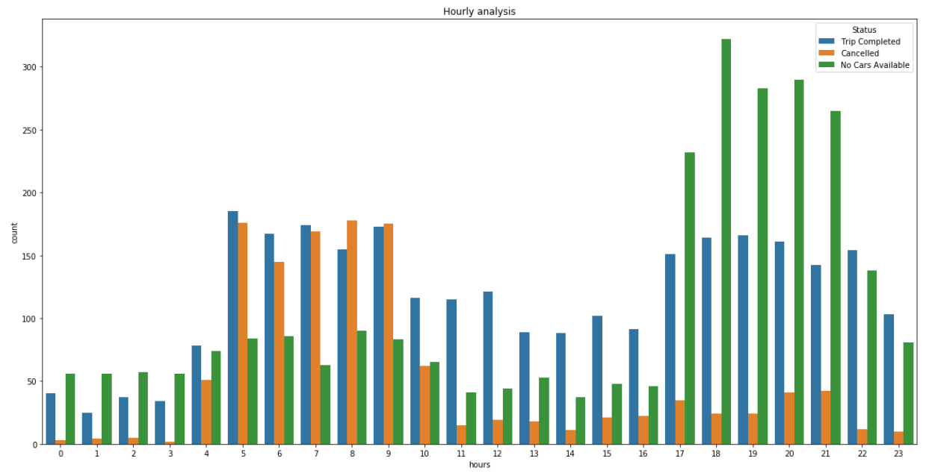

Slide 5
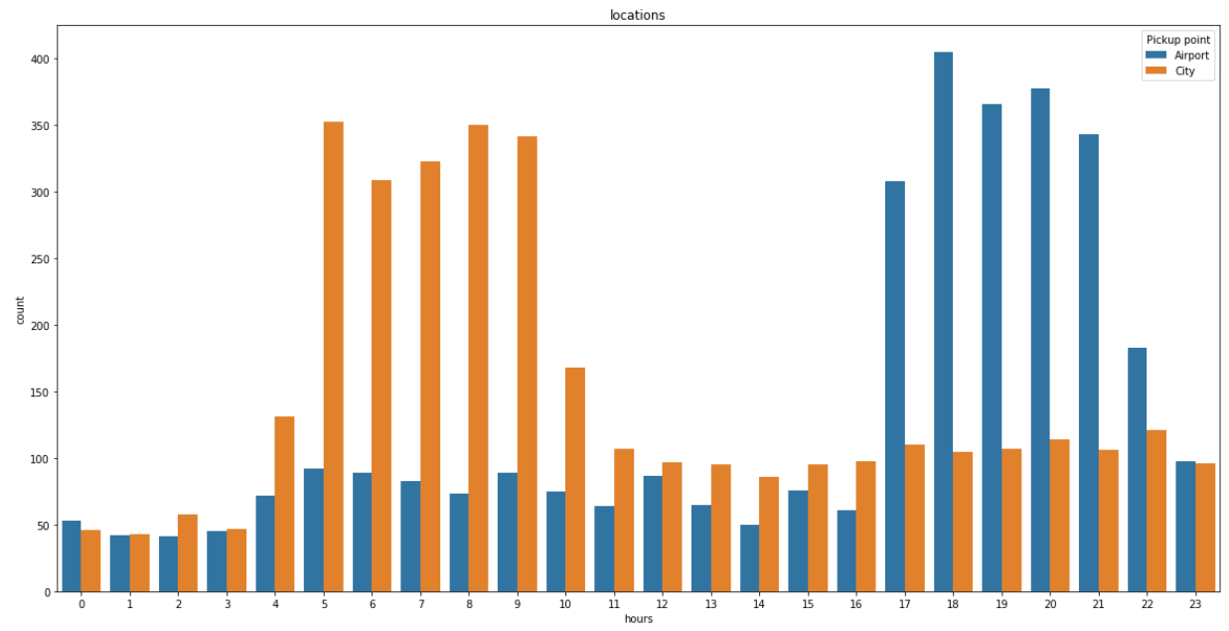

Slide 6
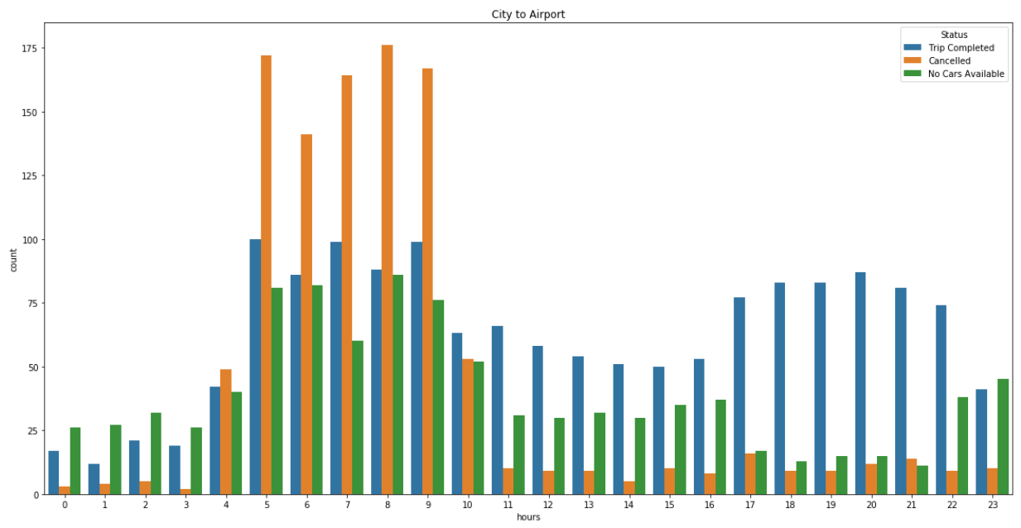

Slide 7
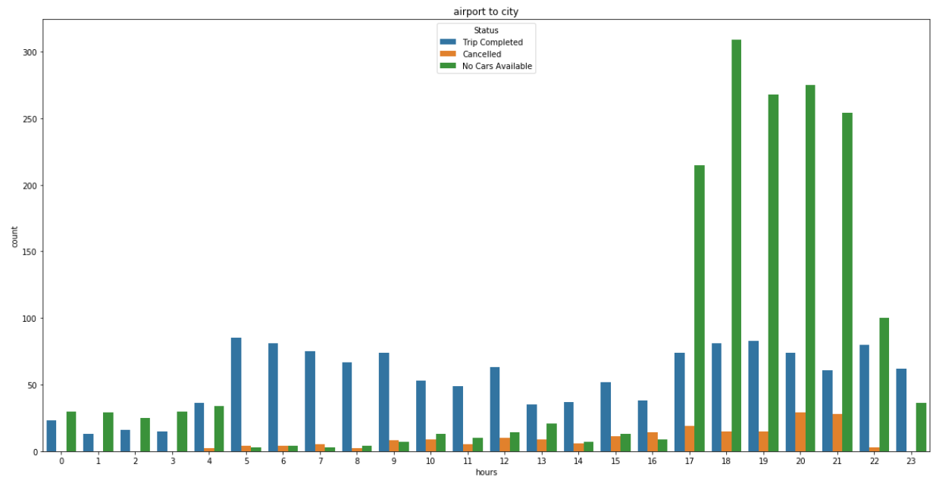

Slide 8
Suggestion
These very issues also impact the business of Uber. If drivers cancel the request of riders or if cars are unavailable, Uber loses out on its revenue. As a result of analysis it should increase more number of cabs

