Slide 1
Employee Skill Matrix & Training Tracker
A SharePoint + Excel + Power Automate + Outlook Integration Project
- BY TEAM 5

Slide 2
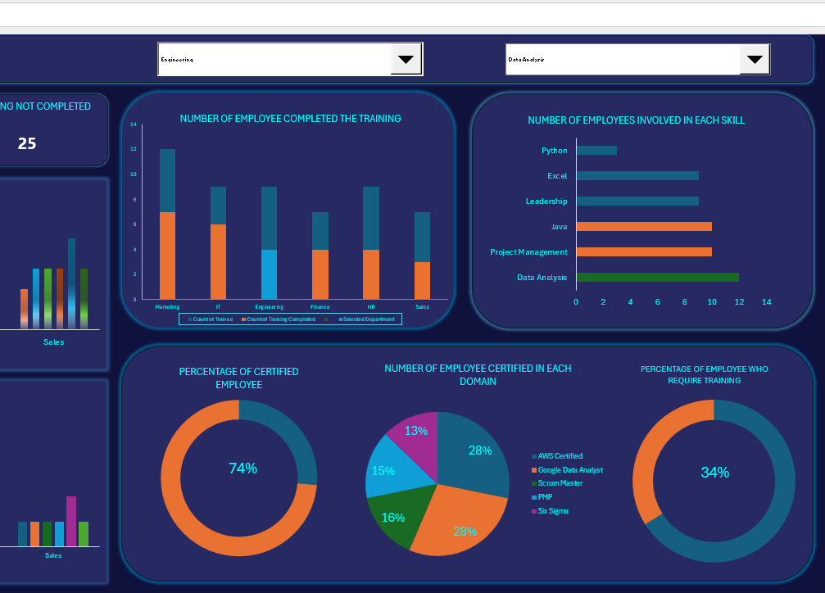
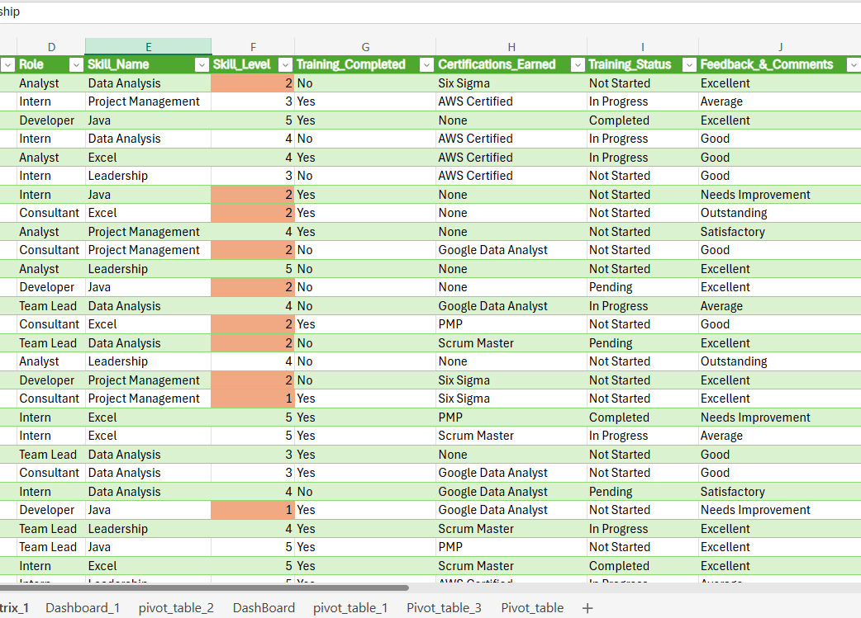
Excel
Power Automate streamlines the Employee Skill Dashboard and Training Tracker by automating workflows, email reminders, and data synchronization. It ensures seamless integration between SharePoint and Excel, enabling real-time updates and efficient tracking of training progress.

Slide 3

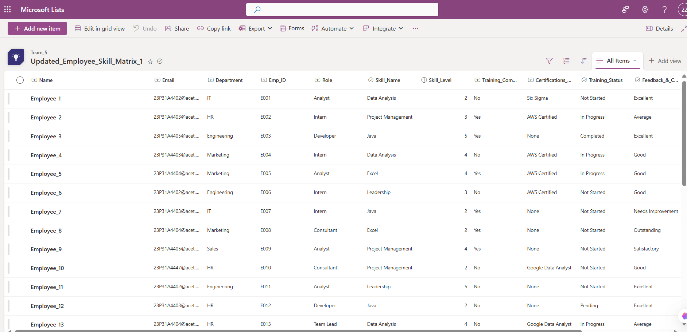

Share point
SharePoint is the core platform for your Employee Skill Dashboard and Training Tracker, enabling structured data management, automated workflows with Power Automate, role-based access for employees and managers, and real-time reporting through Excel

Slide 4
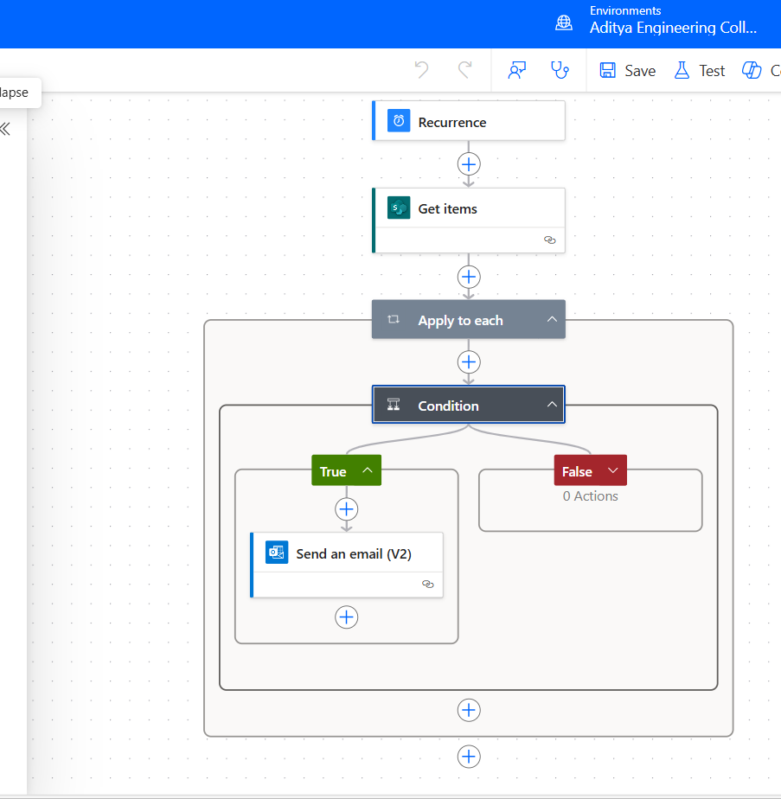
Power Automate
Excel organizes employee skills, tracks training progress, and visualizes data through interactive dashboards. It automates calculations, integrates with SharePoint and Power Automate, and helps monitor training effectiveness

Slide 5
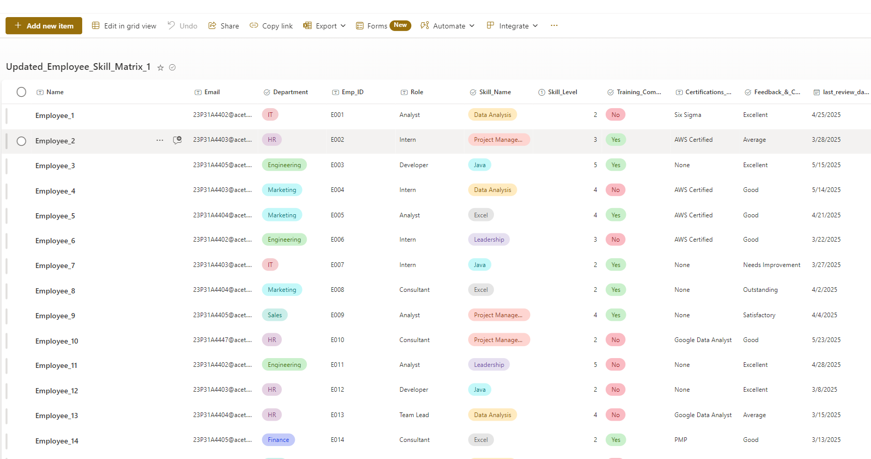
SharePoint Skill Matrix List
Columns Created:
• • Employee Name (Person)
• • Department (Choice)
• • Skill Name (Choice)
• • Skill Level (Number)
• • Training Completed (Yes/No)
• • Last Review Date (Date)

Slide 6
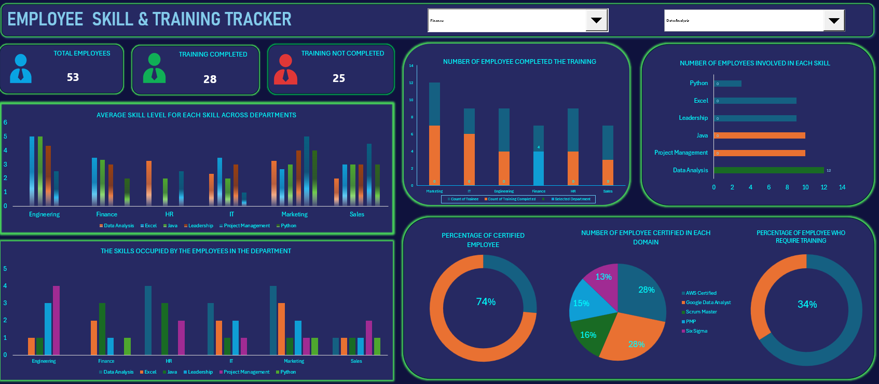
Skill Matrix Dashboard (Excel)
Pivot Table 1: Skill Levels by Department/Role
• Pivot Table 2: Training Completion % by Department
• Features Used:
• • Conditional Formatting for Skill Gaps (≤ 2)
• • Slicers to filter data
• • Pivot Charts for visualization

Slide 7
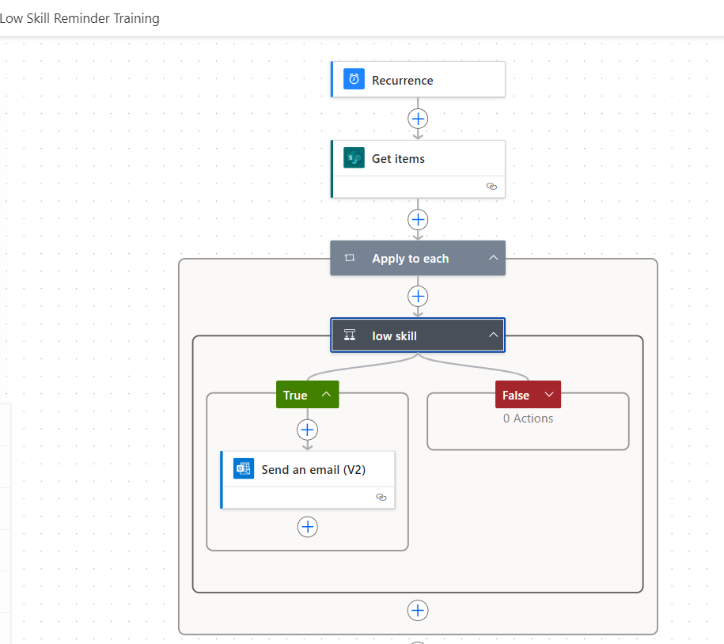
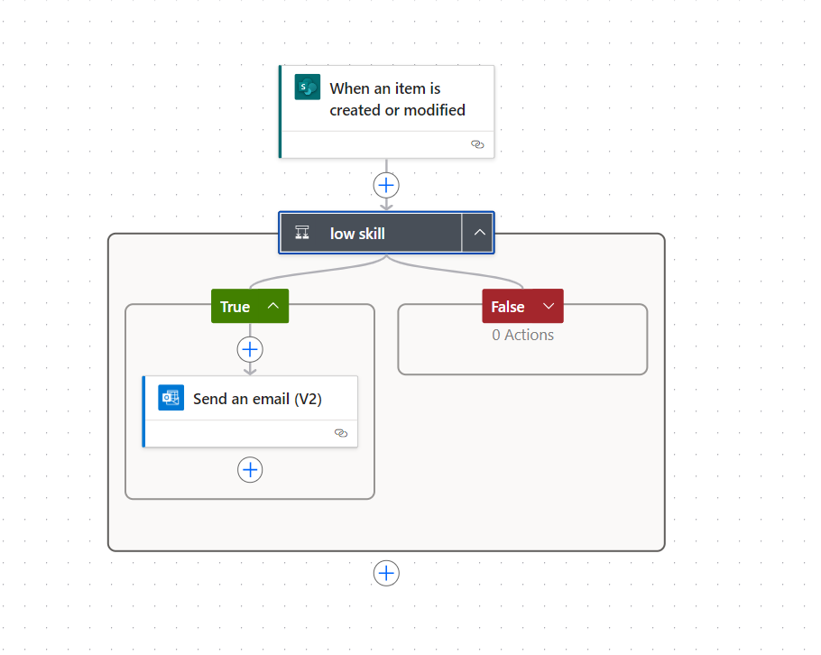
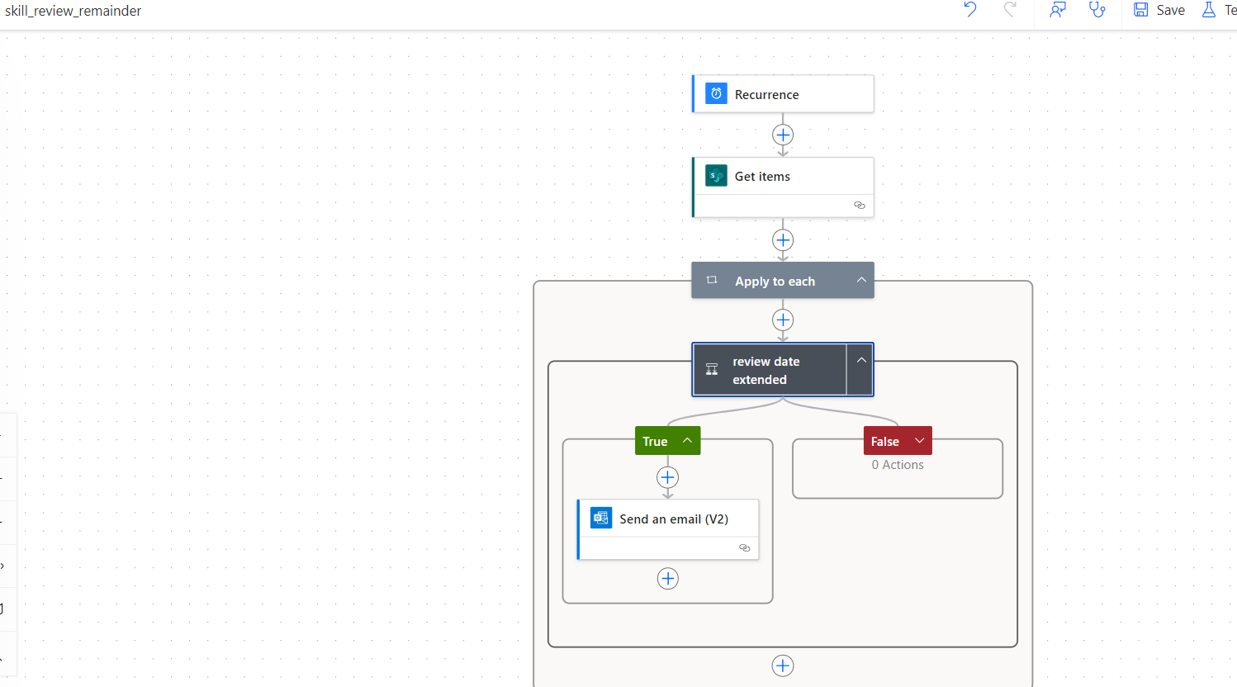
Automation with Power Automate
Flow 1: Notify Employee if Skill Level ≤ 2 & Training = No
• • Trigger: When item is created/updated
• Flow 2: Notify Manager if Review > 90 Days Old
• • Trigger: When item is modified
• • Condition: Last Review Date < Today - 90

Slide 8
Results & Impact
• Automated reminders → Increased compliance
• • Skill gap insights → Better training planning
• • Live dashboards → Improved decision-making
• • Easy integration with Outlook & SharePoint
• • Scalable & beginner-friendly implementation

