Slide 1

ANALYSIS OF AMCAT DATA
By:
Adarsh Korada
Internship ID:IN9249079

Slide 2

ABOUT ME
I completed my B.Tech, in stream of Electronics and Communication Engineering at Kakinada Institute of Engineering and Technology.
Present Data Science is one of the demands in this world. I’m a Data Science enthusiast currently interning at Innomatics Research Labs.
I choose to pursue further learning Data Science at Innomatics Research Labs.
Currently, I’m gaining hands-on experience as an intern in this field.
linkedin :- https://www.linkedin.com/in/adarsh-korada-146b9a1b4/
Github profile urls :- https://github.com/Adarsh1553/Projects

Slide 3
OBJECTIVE OF THE PROJECT
The study is primarily limited only to students with engineering disciplines.
The dataset contains the employment outcomes of engineering graduates as dependent variables (Salary, Job Titles, and Job Locations) along with the standardized scores from three different areas – cognitive skills, technical skills and personality skills.
The dataset also contains demographic features
The independent variables are both continuous and categorical in nature.
The dataset contains a unique identifier for each candidate.

Slide 4
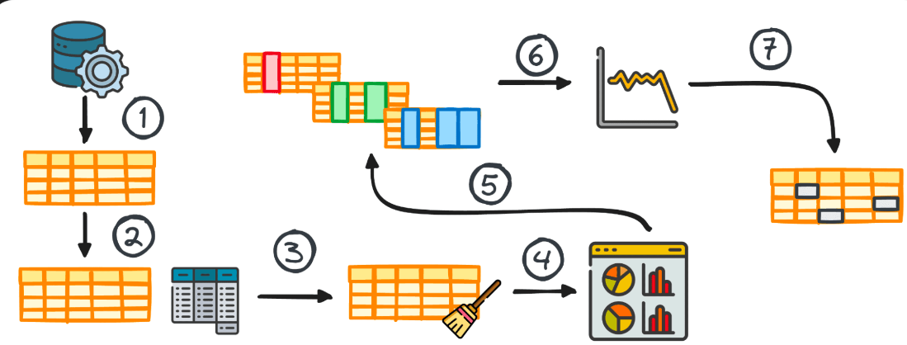
EXPLORATORY DATA ANALYSIS STEPS
Data Cleaning Steps
Data Manipulation Steps
Univariate Analysis Steps
Bivariate Analysis Steps

Slide 5
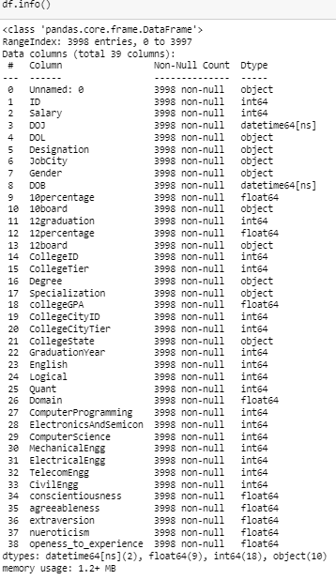
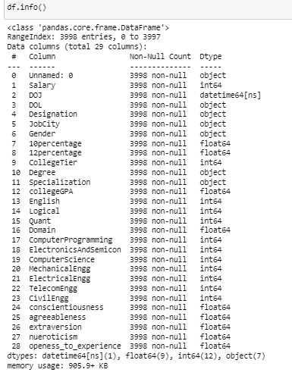
DROPED UNWANTED COLUMNS Removed 10 Un-importent column

Slide 6
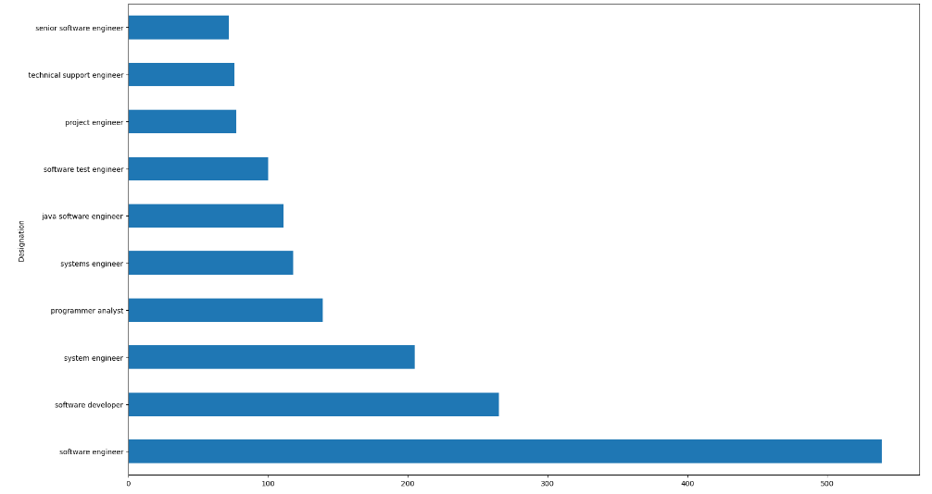
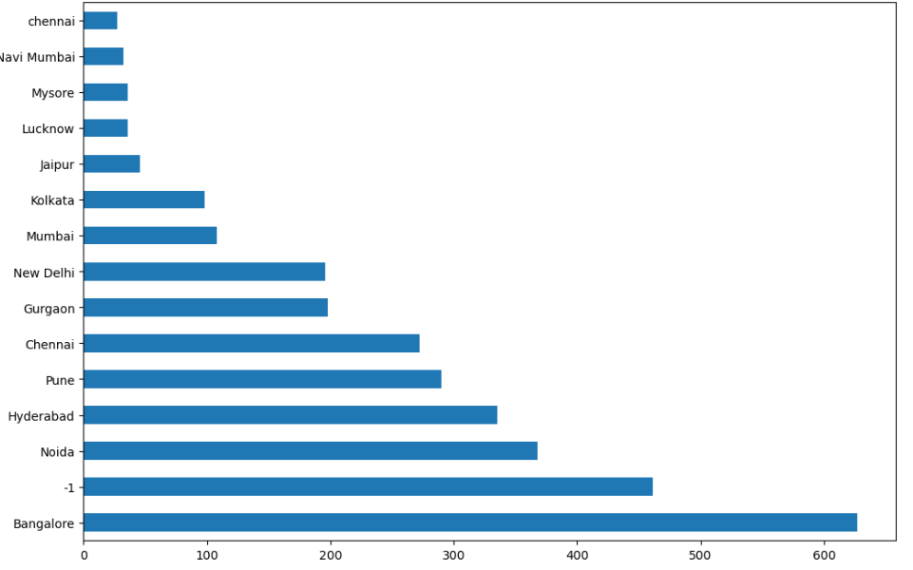
UNIVARIATE ANALYSIS ON CATEGORICAL DATA
From The Above plots we can identify that Most of the peoples Designation is Software Engineer, and Most of the people in this dataset are working in the Bangalore City.

Slide 7
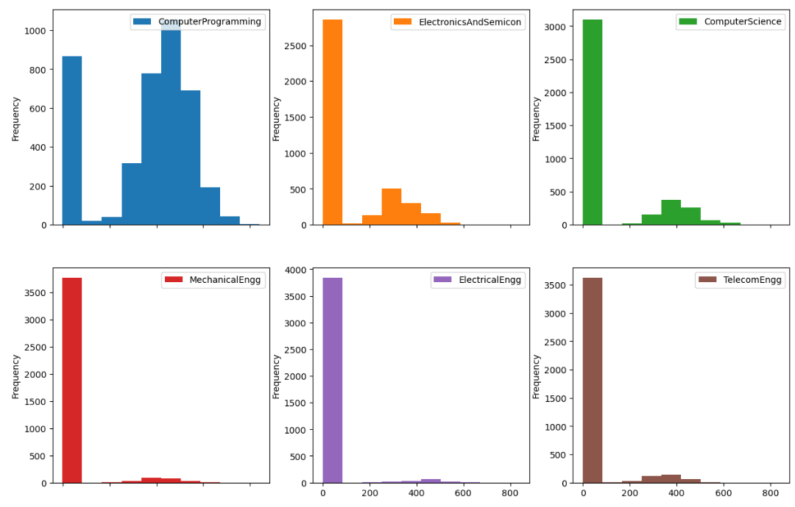
UNIVARIATE ANALYSIS ON NUMERICAL DATA
Computer Programming: More varied skill levels, peaking around 500-600, indicating a broader distribution of experience.
Electronics & Semiconductors: Mostly clustered in the 0-100 range, suggesting less experience or engagement.
Computer Science: Skewed toward beginners (0-100), with fewer advanced participants.
Mechanical Engineering: Majority in the 0-100 range, indicating limited higher-level engagement.
Electrical Engineering: Similar to Mechanical, with most in the 0-100 range.
Telecom Engineering: Also clustered around 0-100, with few advanced levels.

Slide 8
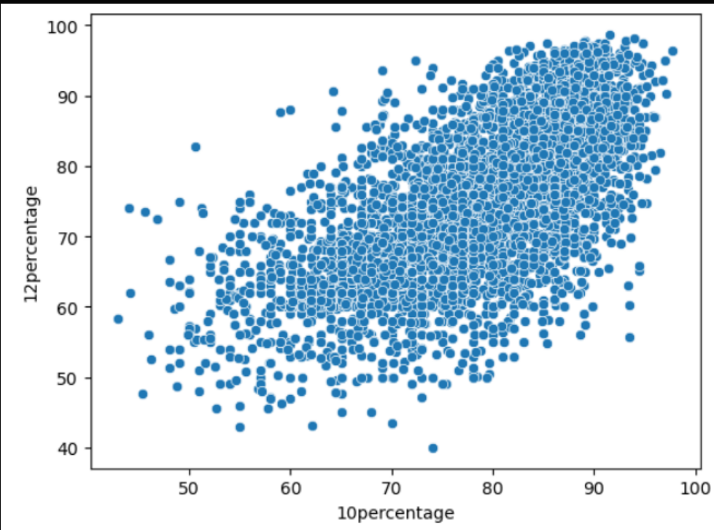
BIVARIATE ANALYSIS ON NUMERICAL VS NUMERICAL
The scatter plot shows a positive correlation between 10th and 12th grade percentages. Most students are clustered in the 60%-90% range for both exams. A few outliers exist, but high performers in the 10th grade generally maintain similar results in the 12th grade.

Slide 9
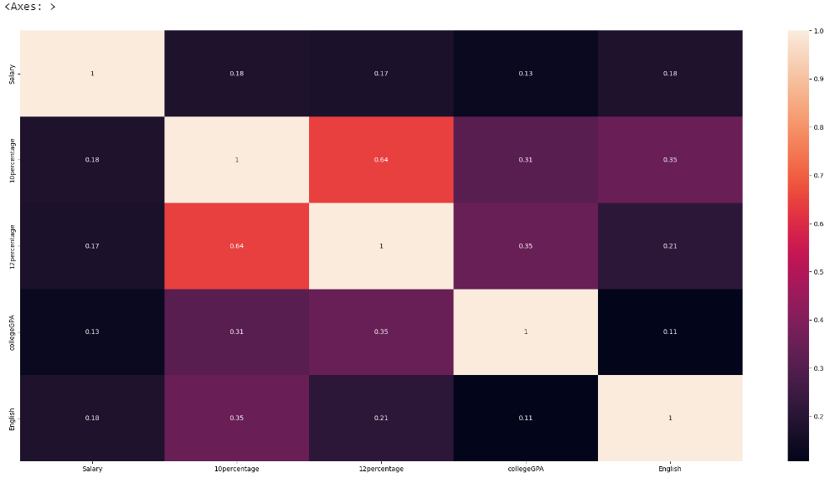
MULTIVARIATE ANALYSIS
Heatmap Description: A heatmap visually represents the strength of relationships between different variables. Darker colors typically indicate stronger correlations (positive or negative). For example, a dark color between 'Salary' and 'Experience Days' might suggest a strong correlation.
Example Correlations:
Salary vs. Experience Days: The correlation could be strong, with a value potentially around 0.8 or higher, indicating that salary increases with more experience.
Salary vs. Age Percentile: If there’s a moderate correlation, the value might be around 0.5 to 0.7.
Salary vs. Weight Kilo: If little to no correlation exists, the value could be close to 0.
English vs. Salary/Quant: If proficiency in English correlates with salary or quantitative skills, it could be around 0.3 to 0.5.

Slide 10
CONCLUSION
Key Insights: The analysis reveals valuable insights into salary distribution, emphasizing the influence of specialization and job roles in shaping salary levels.
Research Question Outcome: The data confirms that certain engineering positions offer starting salaries between 2.5-3 lakhs, supporting the article's claim.
Gender and Specialization: There appears to be a correlation between gender and specialization preferences, though additional analysis is needed for a more conclusive understanding

Slide 11

THANK YOU

