Slide 1
Project Title:
Retail Analytics Project
Name: Adarsh Gupta

Slide 2
Business Context and Objective
Business Context
The client is a leading firm in the Indian Retail market. It has partnered with AnalytixLabs so as to derive data driven insights from Point-of-sale data provided. The insights are required to shape their Customer Relationship Management, Marketing campaigns and Sales Strategy.
Business Objective
The objective is to generate insights that can be leveraged to drive sales growth and customer management . The analysis aims to undertand customer, product, channel, store performance across the business. Ultimately this will help the client enhance profitability, customer retention and decision-making efficiency.

Slide 3
Task Overview
Import the complete dataset into SQL Server for end-to-end analysis.
Conduct a comprehensive data audit and data cleansing in SQL to identify and resolve data related issues.
Create three master tables at Customer level, Orders level and Store level each with one row per entity.
Perform exploratory and diagnostic business analysis to discover key patterns and performance drivers.
Design and publish interactive Power BI dashboards for customers, products, orders and stores.

Slide 4
Data Summary
Table Name | Primary Key and Foreign Key | Columns | Relationship | Table Description
Customers | PK: CustId | Customer_City, Customer_State, Gender | One to many with Orders table on CustID | Master data on Customer details like Gender, Location
Orders | PK: OrderId, ProductId, Quantity FK: StoreId, CustomerId, OrderId, ProductId | Channel,Bill_date_timestamp,Quantity, Cost per Unit, MRP, Discount, TotalAmount | One to one with OrderPayments, Order Review on OrderId. Many to one with Customers, Product and Store Info table. | It is the fact table on which analysis shall be performed. It contains Customer order details at the Item level.
Order Payments | Pk: OrderId | Payment Type and Payment Value | One to one relation with Orders table on OrderId | Master data for transactions details at every transaction level with Payment type and value.
Order Review Rating | PK: OrderId | Customer Satisfaction Score | One to one relationship with Order Table on OrderId | Master data on Customer rating for each order placed.
Products Info | PK: ProductId | Category, Product name length, description length, photos quantity, weight, dimensions. | One to many relationship with Orders table on ProductId | Detailed information about all products available in company catalogue.
Store Info | PK: StoreId | Seller City, Seller State, Region | One to many relation with Orders Table on StoreId | Master data for store location details.

Slide 5
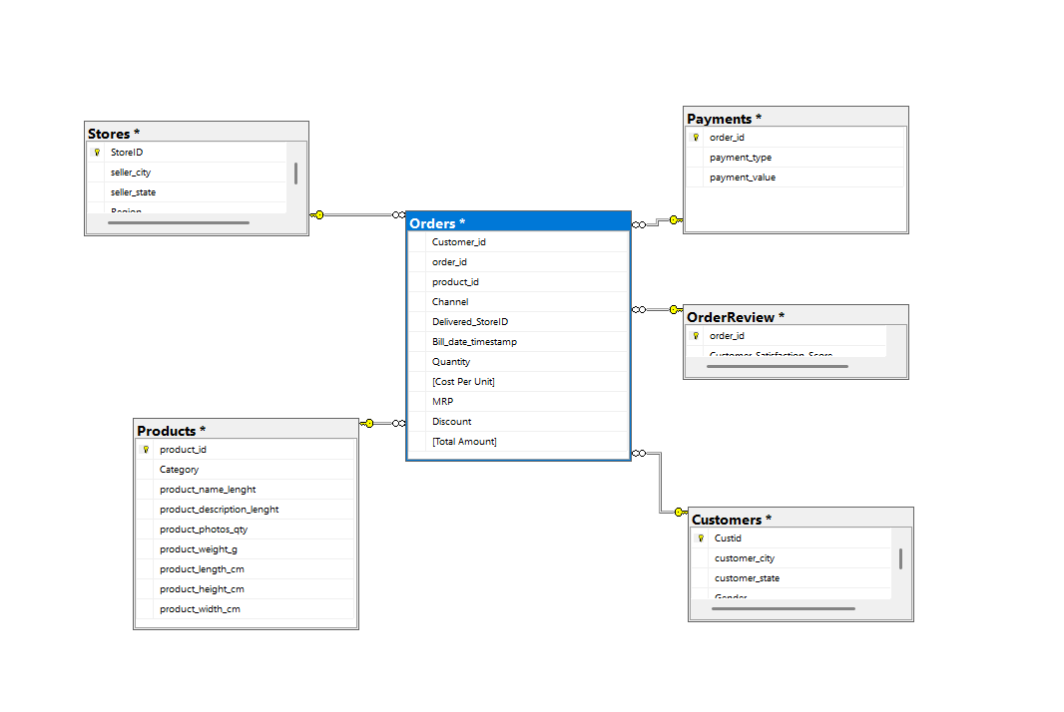
Table Relationship

Slide 6
Primary Key integrity
Customers Table and Product table
The Primary Key CustId and ProductId are found to be unique and non missing.
Orders Table
We see that there are 9803 duplicate OrderID's. The data is given at item level. Even if we consider composite key of orderID and ProductID we see duplicates of 10225. It is only when we consider a composite key of OrderId, ProductID and Quantity that we get unique and non missing values. So, it means that orders are disintegrated at level of Product quantity because same product has different MRP so different quantities are bought at different MRP’s.
Order Payments Table
The Primary Key is OrderId but there are 4446 duplicate OrderId’s. In order to resolve the issue, the table needs to be aggregated at OrderId level. In fact, there are 615 records that are duplicated and hence we need to remove these duplicate records.
Order Review Rating Table
The table has Issues with primary key OrderId as it has 559 duplicated OrderId’s but that can be due to the data being disintegrated at each review level.
Store Info table
The primary key of StoreId has 1 duplicated value of ST410. Since the entire record is duplicated we shall remove the duplicated record.

Slide 7
Foreign Key Consistency
We have to check if the data in the orders table (Fact Table) has all the corresponding information in the various Dimension tables i.e. Order Payments, Order Reviews, Product table, Customer Table and Store Info Table.
OrderReviews table has details on all OrderId’s in the Orders table so no foreign key inconsistency found.
Customers table has details on all Customer_Id’s in the Orders table so no foreign key inconsistency found.
Products Info table has details on all ProductId’s in the Orders table so no foreign key inconsistency found.
Stores Info table has details on all StoreId’s in the Orders table so no foreign key inconsistency found.
However, in case of Order Payments we have found that there is one OrderId in the Orders table that has no information in Order Payments table

Slide 8
Outliers Detection
Methodology Adopted
In the detection for outliers in the Orders table that would be used for analysis we have adopted the Central Limit Theorem and since the dataset is large so we can assume Normality of distribution. So, we can infer that if the data is not within 3 Std Dev difference from mean we have considered it as an outlier.
Results
Observed that there are 965 Orderid’s with aggregated quantities not within 3 times the Std Deviation from mean aggregated quantity so, these may be considered as outliers.
Observed that there are 1757 Orderid’s with average price not within 3 times the Std Deviation from mean of price aggregated at Orderid level so, these OrderId’s may be considered as outliers.
Observed that there are 1365 Orderid’s with Average discounts not within 3 times the Std Deviation from mean aggregated Discounts at OrderId level so, these can be considered as outliers
But if we find out outliers in terms of both quantity and MRP at the order level then we find that there are only 4 orderId’s that have prices as well as quantities as outliers.

Slide 9

Outlier Detection (Continued)
However, we are unable to find any orderId that has quantity, price and discount as outliers at the same time.
Recommendation
Since the outliers found are inconsequential with respect to size of our data (as it is less than 5%) so we can consider to remove the data while doing analysis because including them can give us biased analysis.

Slide 10
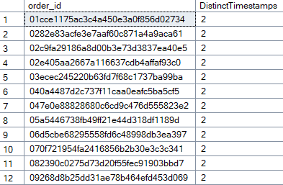
Logical Fallacies
The Bill Timestamp dates uses both formats i.e ‘DMY’ format as well as ‘MDY’ format. So, we need to universalize the format to ‘MDY’.
There are 623 #N/A entries in Category section. In order to get better analysis, we replace it with ‘Others’.
Observed 334 OrderId’s that have more than one Bill Timestamp corresponding to them. This shall not be the case because one order must be placed at single date/time only.

Slide 11
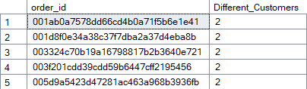

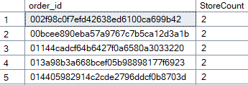
Same OrderId’s has been linked to multiple customers in the Orders table. Specifically, there are 5 Orderid’s that show such discrepancy .
There are 17313 records in orders table with consecutive quantities and amounts. We should only retain columns with highest quantity and amounts.
Observed that there are 1007 OrderId's that have different StoreId. This shall not be the case because one order must be placed at single store only.

Slide 12
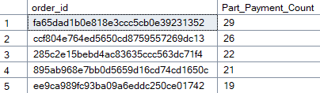
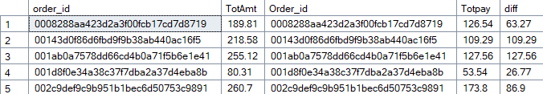
There are 2961 OrderId’s for which payment by part has been done.
There are OrderId’s where Total Amount and Payment Value does not match.

Slide 13
Data Cleaning(1/2)
Orders table
Originally we have 1,12,650 rows in the Orders table.
Since, we have to perform analysis on only the data between time frame 1 September,2021 and 31 December, 2023.
So, we have to drop out 13 records. This leaves us with 1,12,637 records.
Now, having identified cumulative count problem in 17183 records. After removing the cumulative count error we are left with 102492 records. So, we have lost 10,145 records due to cumulative count problem.
Now since one Order was linked to multiple stores, we have universalised with the Store from which maximum revenue for each order has been generated.
Each Order shall be updated with Billtimestamp of earliest instance and 371 rows have been updated.
Dropping Orders that do not have OrderPayments information. On this account 1 row has been deleted leaving us with 102491 records.
We have found one Order which allocated to 2 Customers so now we have updated the record with highest amount Customer.

Slide 14
Data Cleaning (2/2 )
NOTE: Even after cleaning Orders table into Orders_final we have found that 3476 order_id’s, for which Aggregated Total Amount and Aggregated Payment value does not match.
Store Table
There was 1 duplicated record, so we have to drop that record so this leaves us with 534 records in Store table.
Order Review Ratings Table
Since there are multiple reviews with respect to a single order, so we needed to aggregated the table at Order level into OrderReview_aggregated table. This table reduces the no. of records to 99441.
Order Payments Info Table
The Payment table is to be aggregated at order level and this is done in Payment_aggregated table. This table has 99440 records.

Slide 15
Sales Performance Dashboard
Objective: Monitor overall revenue, discount utilization, and order trends for performance tracking.
Stakeholders: Sales Team, Marketing, Leadership
Business Impact: Identifies trends, top categories, and discount effectiveness for profit optimization.
Key KPIs (with Calculation Logic):
Total Revenue = SUM(Total_Amount)
AOV = SUM(Tota_Amount)/Count(Order_ID)
Discount Utilization % = SUM(Discount)/SUM(Total_Amount)*100
Orders Count = COUNT(Order_ID)
Revenue Growth % = ((Current - Previous)/Previous)*100

Slide 16
Company Logo
Sales Performance Dashboard
Navigation: Home | Next | Previous
KPI ‘s Total Revenue (₹ 5.2 Cr), AOV, Discount Utilization % ,Orders Count ,Revenue Growth %
Slicer Example:
• Month / Quarter Filter
Region
Category
Payment_Type
• Monthly Revenue Trend (Area Chart), Category wise revenue, Region wise revenue share( Pie Chart)
Top 5 Product Categories (Bar Chart)
Bottom 5 Product categories( Bar Chart)

Slide 17
Customer Level Dashboard
Objective: Analyze customer behavior, retention, and value.
Stakeholders: Marketing Team, Leadership
Business Impact: Improves retention campaigns, targets high-value customers, reduces churn.
Key KPIs (with Calculation Logic):
• Total Customers = COUNT(DISTINCT Customer_ID)
• Repeat Purchase Rate = >1 / Total Customers
• LTV = SUM(Total_Amount) per Customer
• Churn Rate = Inactive(>90 days)/Total Customers

Slide 18
Company Logo
Customer Insights Dashboard
Navigation: Home | Next | Previous
KPI Example: Repeat Purchase Rate (35%)
Slicer Example:
• Customer Segment (RFM)
Region
Months
• New vs Repeat Customers (Donut Chart)
• Customer LTV by Segment (Bar Chart)

Slide 19
Store Level Dashboard
Objective: Compare store performance on revenue, efficiency, and ratings.
Stakeholders: Operations Team, Store Managers, Leadership
Business Impact: Identifies high-performing stores and areas for improvement.
Key KPIs (with Calculation Logic):
Revenue per Store = SUM(Total_amount) by Store_ID
AOV = SUM(Total_amount)/COUNT(Order_ID) per store
Store Rating = AVG(Customer Satisafaction review Rating) per Store

Slide 20
Company Logo
Store Performance
Navigation: Home | Next | Previous
KPI Card: Total Revenue per Store (₹), Avg Order Value, Store Ratings
Slicer Example:
• Region
City Filter
Months
• Revenue by Store (Column Chart)
• Store profits (Bar Chart)

Slide 21
Product & Review Analytics Dashboard
Objective: Evaluate product performance, category contribution, and satisfaction.
Stakeholders: Product Managers, Marketing, Data Analysts
Business Impact: Identifies top products, low-rated items, and supports inventory strategy.
Key KPIs (with Calculation Logic):
Top Selling Products = SUM(Quantity) per Product_ID
Revenue Share % = Product Revenue / Total Revenue * 100
Average Rating = AVG(Rating)
Low Rated % = COUNT(Rating<3)/COUNT(Reviews)*100

Slide 22
Company Logo
Product & Review Analytics
Navigation: Home | Next | Previous
KPI’s: Average Product Rating (4.2★), Top Selling Product, Profit Contribution by category
Slicer Example:
• Product Category
Rating Range
Top Chart Example:
• Top 10 Selling Products (Bar Chart)
Bottom Chart Example:
• Category-wise Rating Trend (Line Chart)

Slide 23
Exploratory Data Analysis (1/4)
Order Level Metrics
Metric | Value
Total Orders | 98,654
Average Revenue per order(AOV) | 165.86
Average Discount per order | 5.16
Average Profit per order | 36.64
Revenue Std Dev order wise | 235.08
Average Quantity per order | 1.20
Average Categories per order | 1.007379
Order Channels | 3
Median Order Revenue | 106.16

Slide 24
Exploratory Data Analysis (2/4)
Customer Level Metrics
Metrics | Value
No. of Customers | 98563
Average Revenue per Customer(AOV) | 166.01
Average Quantity per Customer | 1.20
Average Orders per Customer | 1.04
Average Profit per Customer | 36.68
Average Discount per Customer | 5.17
Customer Genders | 2
Customer State | 20
Customer City | 4110
Repeat Orders Customers | 35 only (0.0355%)
Average tenure between Orders | 75 days

Slide 25
Exploratory Data Analysis(3/4)
Product metrics
Metric | Value
Total Products | 32946
Categories | 14
Store metrics
Metric | Value
No. of Stores | 37
Store States | 7
Number of cities | 37

Slide 26
Exploratory Data Analysis (4/ 4)
Financial Totals
Metric | Value
Total Revenue | 1,63,62,897
Total Cost | 1,27,48,010
Total Discount | 5,09,155
Total Profit | 36,14,887
Total Quantity Sold | 117943
Profit percentage | 22.10%
Discount Percentage | 3.11%

Slide 27
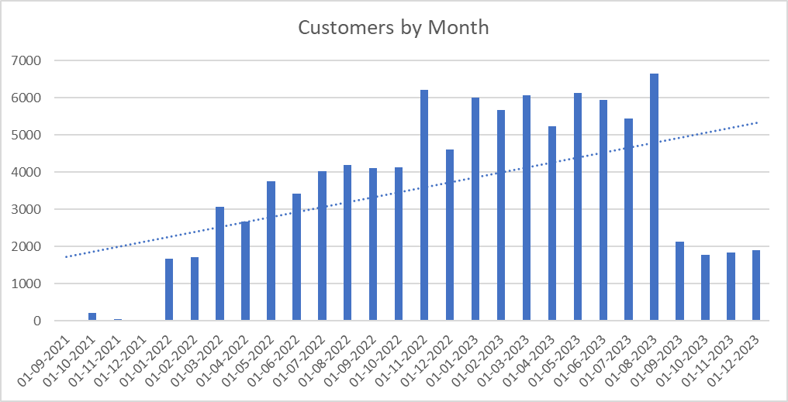
Customer Level Analysis
Customer growth Trend
We can infer from the graph that the Customer base has seen an upward rising trend that is a good indicator of an expanding business.

Slide 28
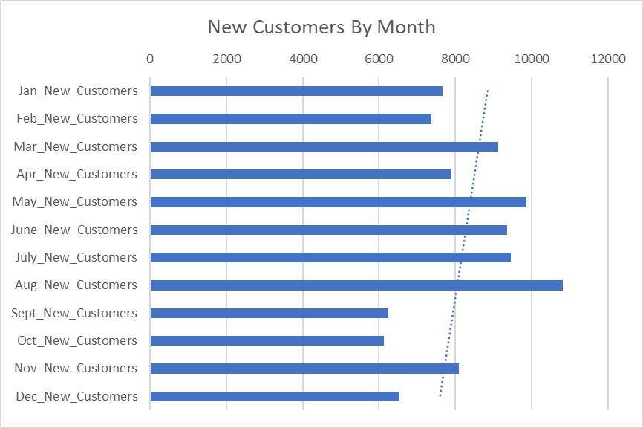
Customer Level Analysis
New Customers by Month
We see that most New Customers are onboarded in the months of May, June, July, August.
The trendline suggests that new customers are forthcoming in the initial months of the year. This gives us an opening to look out for onboarding new customers in the latter part of the year.

Slide 29
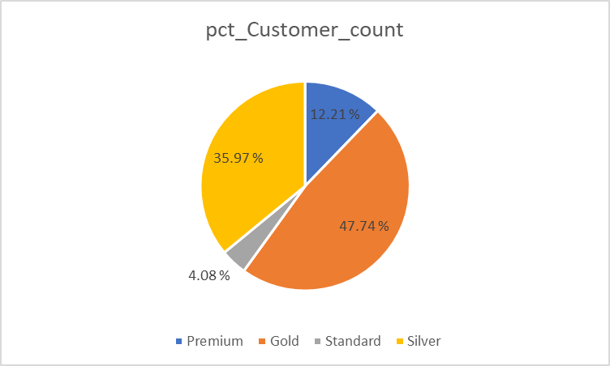
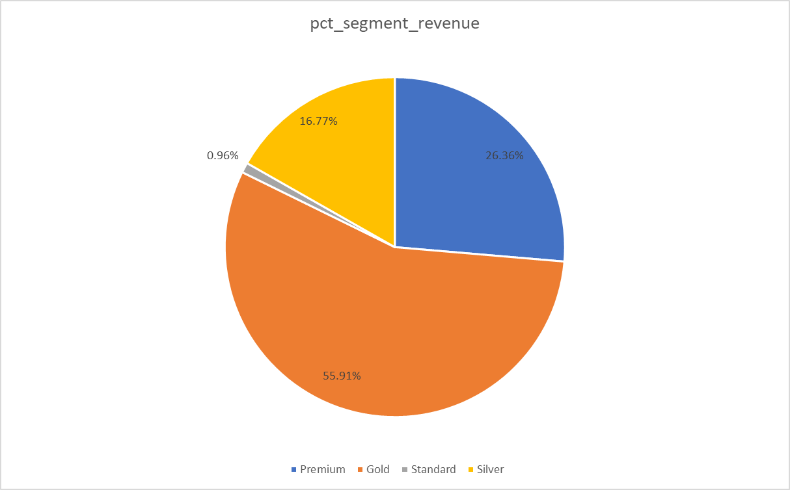
Customer Level Analysis
Recency, Frequency and Monetary segmentation

Slide 30
We can note that the although the premium customers constitute only 12.21% of total consumers, their contribution to revenue is around 26.36%, so we should adopt some customer retention strategy to attract them through some specific loyalty programs.
Similarly, there is quite an opportunity for upselling the Standard consumers because them despite being around 4% of the total customers, they contribute less than 1% of the revenue. It opens up huge avenues for upselling.

Slide 31
Customer Level Analysis
Cross Selling Opportunity
Customer Type | Share of total Customers | Average Order Value | Average Profit
Single Category Purchasers | 97814 | 164.04 | 21.5%
Multiple Category Purchasers | 749 | 378.61 | 52%
It should be noted that there is a huge opportunity for cross selling as 99.24% consumers are only purchasing single category products.
We can see that both the AOV as well as the Avg profit percentage both are considerably higher for customers who purchase multiple categories.

Slide 32
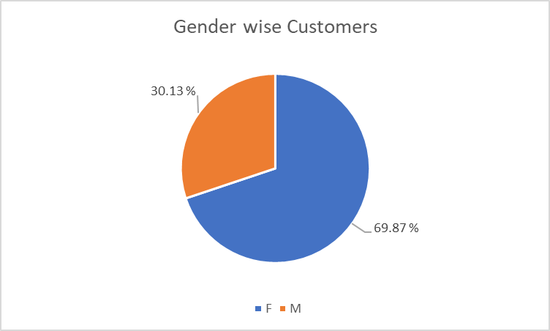
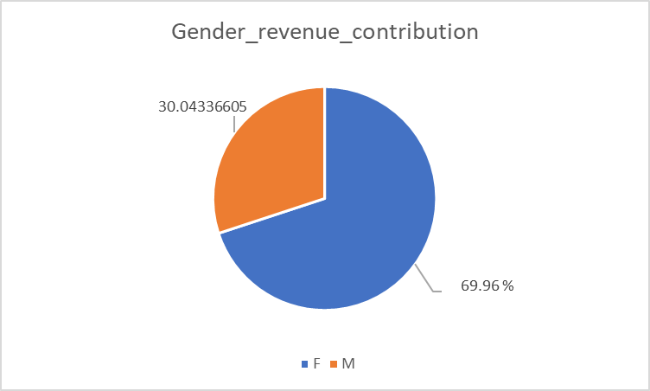
Customer Level Analysis
Gender Distribution
We see that around 70% of our customers are females so this gives us an opportunity to specialize in female products.
We also see that around 30% customer share and revenue contribution of the males also provides us with an avenue to increase the customer base among the males through some first time offers.

Slide 33
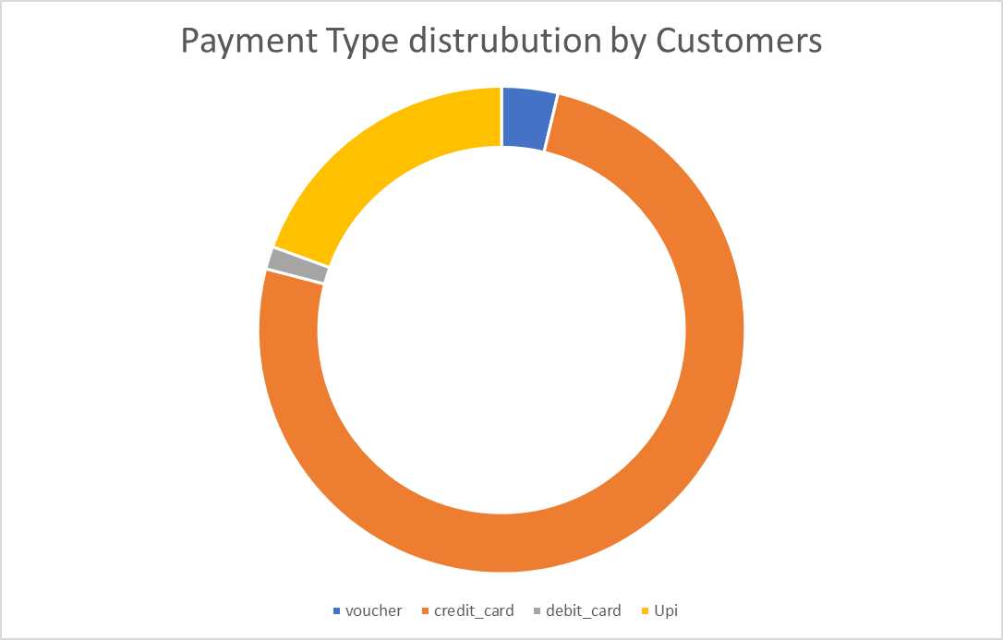
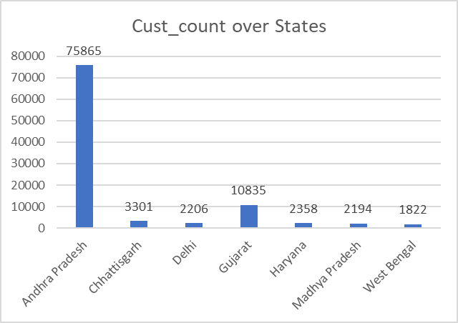
Customer Level Analysis
Payment Type distribution
Customer preference for Store State

Slide 34
Cross selling analysis
Category_1 | Category_2 | Orders together
Baby | Furniture | 90
Baby | Home Appliances | 77
Furniture | Home Appliances | 62
Baby | Construction tools | 36
Baby | Toys & Gifts | 25
Food & Beverage | Luggage Accessories | 24
Food & Beverage | Toys & Gifts | 18
Home Appliances | Luggage Accessories | 18
Furniture | Toys & Gifts | 17
Luggage Accessories | Toys & Gifts | 17
The categories that are sold together shows us avenues for further cross selling through bundle promotions.

Slide 35
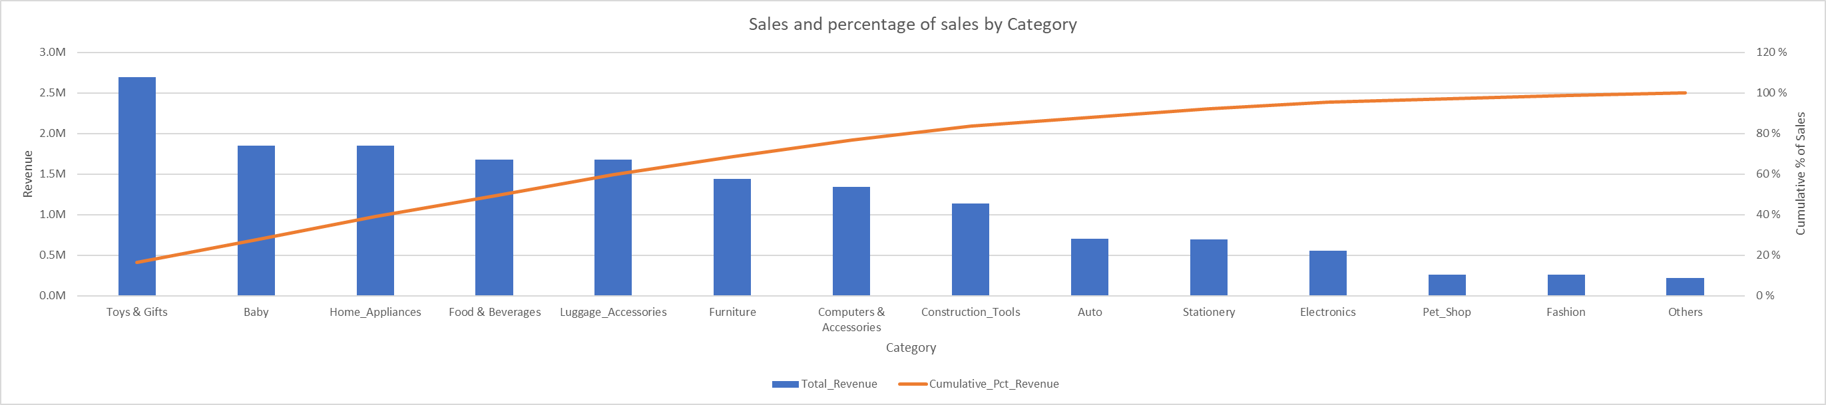
Category Level Analysis
Nearly 80% of total revenue is generated by a few key categories — primarily Toys & Gifts, Baby, Home Appliances, Food & Beverages, and Luggage Accessories.
Focus marketing, inventory, and cross-selling efforts on these top-performing categories to maximize ROI, while identifying strategies to boost visibility and sales of lower-contributing categories through targeted promotions or bundling.

Slide 36
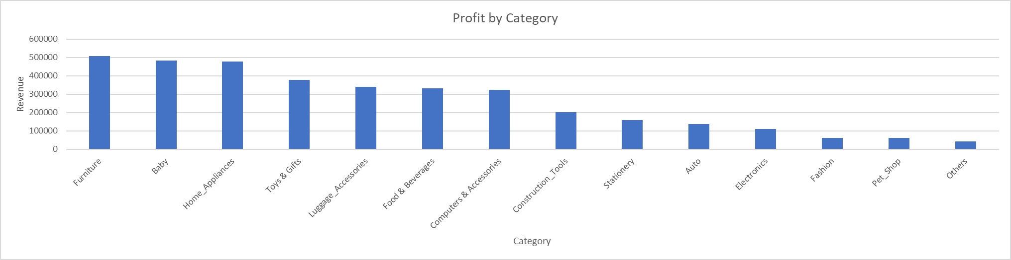
Category Level Analysis
The analysis shows that Furniture, Baby, Home Appliances, and Toys & Gifts are the top revenue-generating and profitable categories, contributing a major share to overall performance. In contrast, categories like Stationery, Auto, Electronics, and Pet Shop show minimal contribution, indicating low sales or limited customer interest
Maintain focus and inventory strength in top-performing categories to sustain profitability, while exploring targeted marketing, bundling, or discount strategies to uplift underperforming categories.

Slide 37
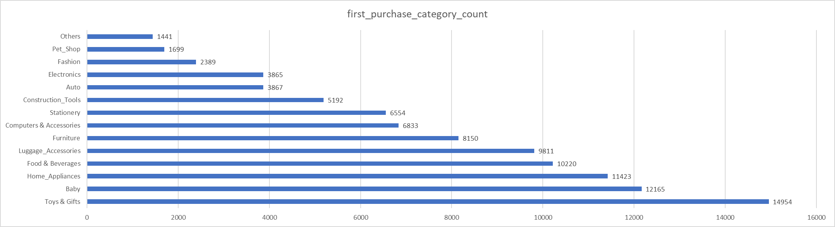
Category Level Analysis
The majority of first-time purchases come from Toys & Gifts, Baby, and Home Appliances categories, indicating that these are the primary entry points for new customers. In contrast, categories such as Pet Shop, Fashion, and Others show limited engagement at the acquisition stage.
Leverage high-entry categories like Toys & Gifts and Baby for customer acquisition campaigns. For low-entry categories, focus on visibility, bundled offers, or partnerships to increase initial purchase attraction.

Slide 38
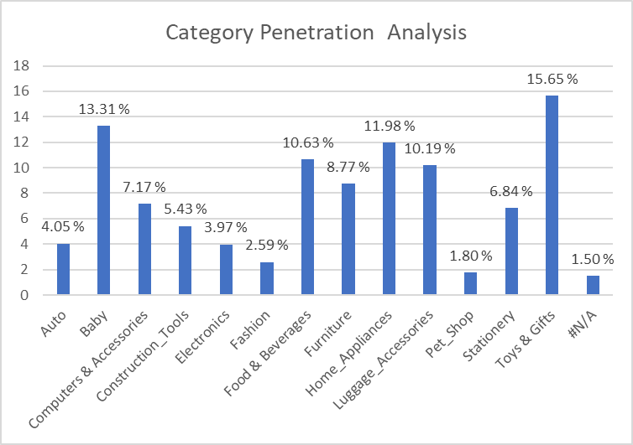
Category Level Analysis
Top categories like Toys & Gifts, Baby, and Furniture show the highest market penetration, driving most customer engagement.
Focus on retaining these customers while boosting visibility and offers for low-penetration categories like Auto and Fashion.

Slide 39
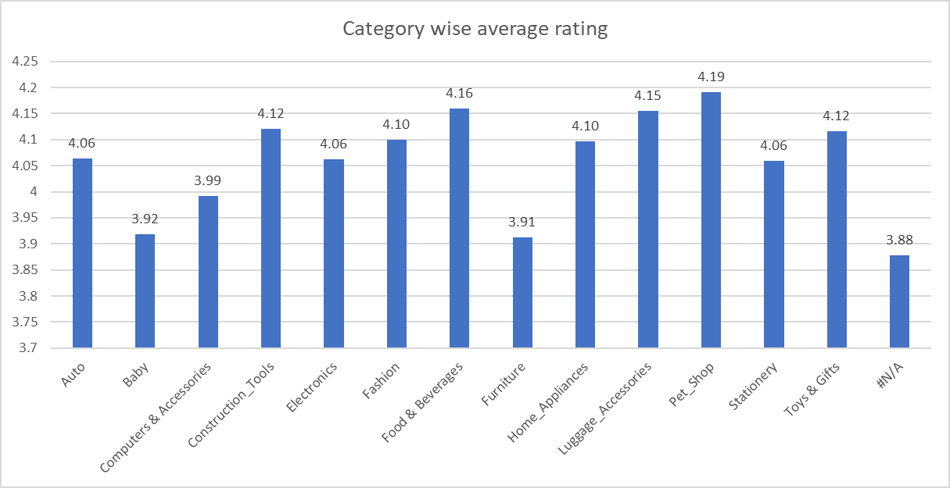
Customer Satisfaction Analysis
Average Rating by Category
Pet Shop has highest reviews of 4.19 whereas Furniture has lowest reviews of 3.19
However, the reviews are mostly above 4 for most of the categories, indicating good customer satisfaction.
Customer Satisfaction improvement program across categories for better customer experience specially aimed at low performing categories.

Slide 40
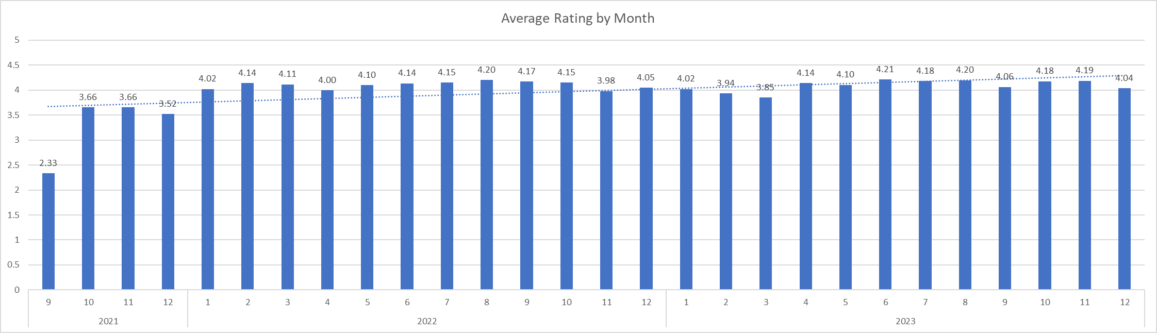
Customer Satisfaction Analysis
Average Rating by Month
Over time the reviews have been improving as shown by the positively sloping. trendline across the months.
The monthly analysis shows that the reviews are mostly consistent throughout the year although the trends suggest some dip in the months of December.

Slide 41
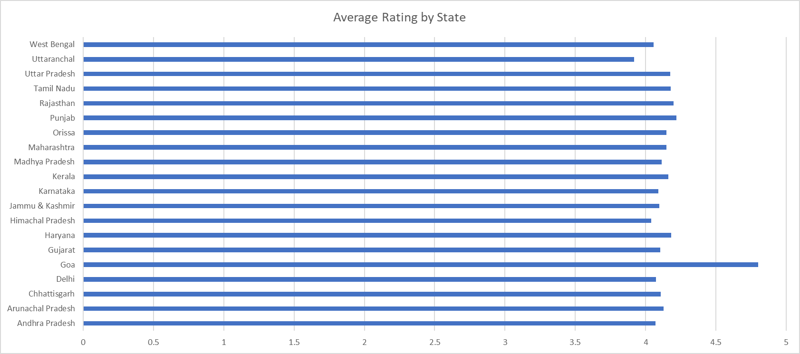
Customer Satisfaction Analysis
Average Rating by Customer State
Goa has highest reviews of 4.8 whereas Uttaranchal has lowest reviews of 3.91.
However, the reviews are above 4 for all States, indicating good customer satisfaction.
Strategies from Goa shall be replicated in the low performing states of Uttaranchal, Himachal and West Bengal.

Slide 42
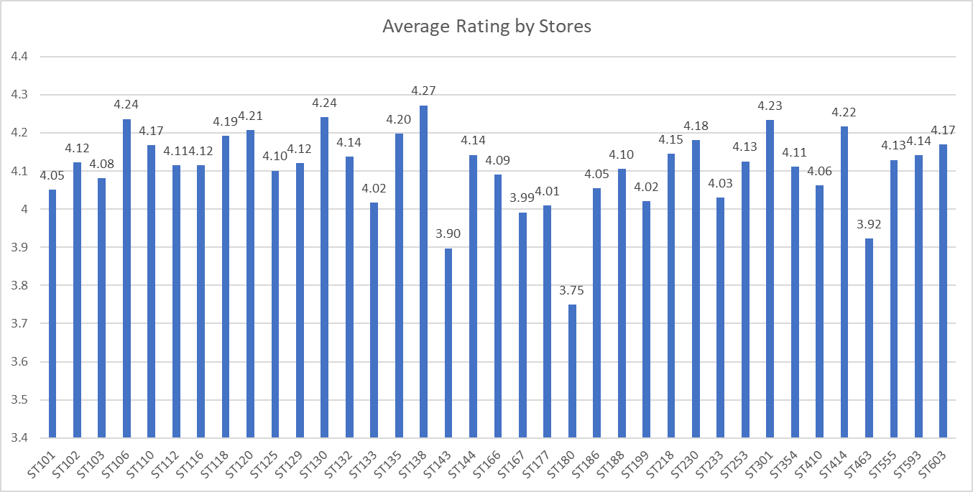
Customer Satisfaction Analysis
Average Rating by Store
ST138 has highest reviews of 4.27 whereas ST180 has lowest reviews of 3.75.
However, except in 4 stores the reviews are above 4 for all, indicating good customer satisfaction.
Customer feedback and audits from low performing stores.

Slide 43
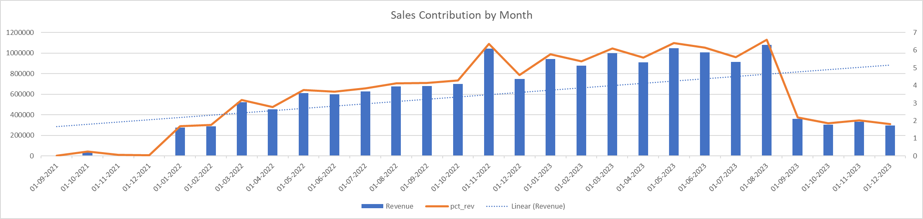
Sales Trend & Pattern Analysis
Yearly and Monthly Sales and Percentage Contribution
The upward trend line suggests that business is growing.
The recurring peaks and troughs reflect that there is some seasonal factors.
The total sales coincides with the percentage contribution as well reflecting that percentage is determined by sales volume.

Slide 44
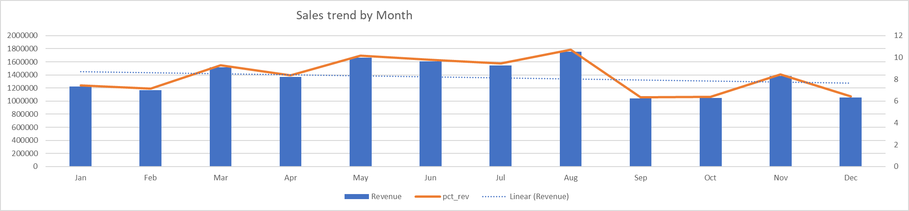
Sales Trend & Pattern Analysis
Sales Trend by Month
We can see that the first half of the year has more stable sales pattern whereas the latter half of the year experiences fall in sales.
This is also visible through the negatively sloping trend line.

Slide 45
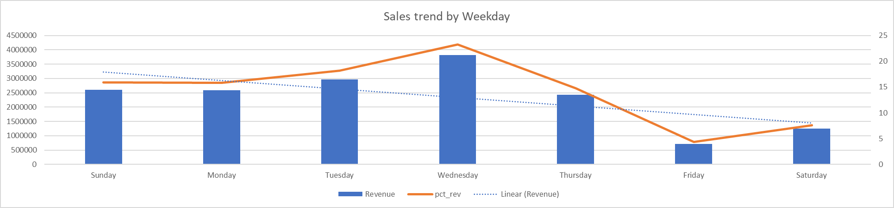
Sales Trend & Pattern Analysis
Sales Trend by Weekdays
We notice a dip in the sales and revenue over the course of the week viz Friday, Saturday.
We can introduce some special discounts on these days so as to enhance sales on these days.

Slide 46
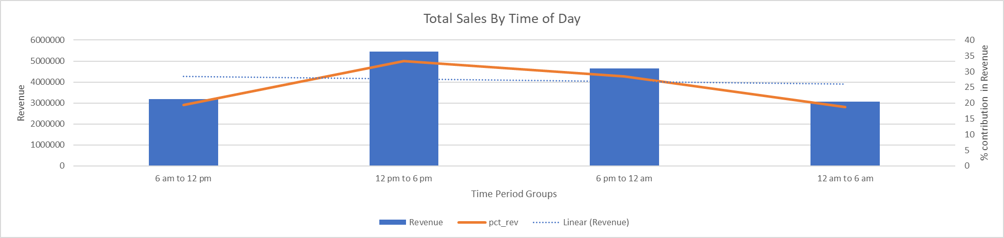
Sales Trend & Pattern Analysis
Sales Trend by Time of Day
Sales peaks in the Afternoon period. However, the least sales happen in the Late night 12 am to 6 am window. We can give like Happy Breakfast Hour in the period in which sales have fallen
The negatively sloping trendline suggests that as sales are more in the former part of the day than the latter.

Slide 47
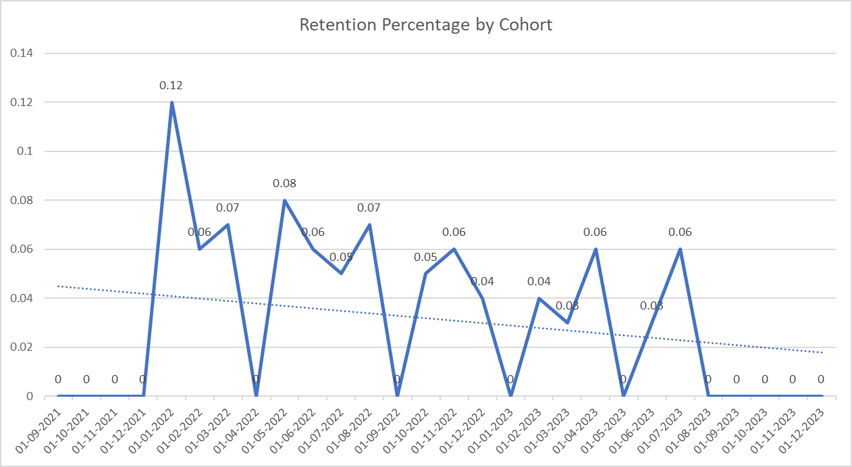
Cohort Analysis
The retention rate is very low and volatile, even less than 1%.
The customer base shows weak repeat behavior, suggesting short-term campaign effects rather than long-term loyalty.
Focus must shift from acquisition to engagement — personalized follow-ups, loyalty programs, and reactivation campaigns.

Slide 48
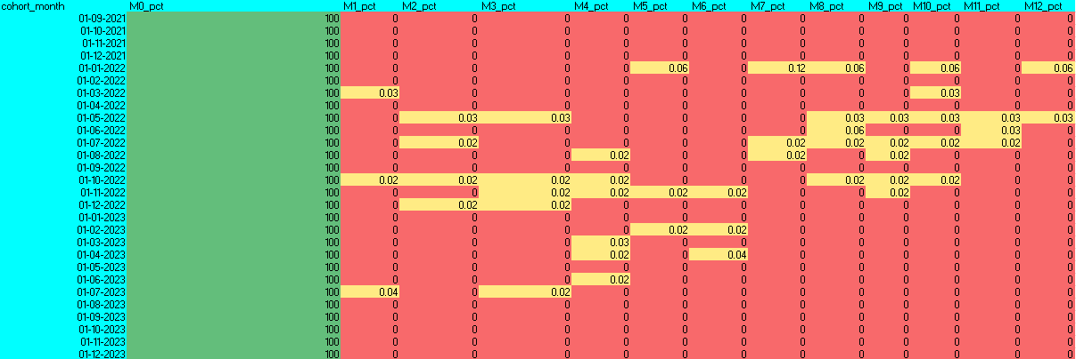
Cohort Analysis
Retention rates drop sharply after Month-1 — only 0.04–0.06% of customers make a repeat purchase, with almost zero retention after Month-3.
A few cohorts show higher retention (~0.10–0.12%) but these effects are temporary.
The business needs to focus on post-purchase engagement, second-order incentives, and loyalty programs to turn one-time buyers into repeat customers

Slide 49
THANK YOU!

