Slide 1

Optimizing Proof of Work through Memoization
By – Adarsh Agrawal

Slide 2

Proof of Work
Proof of Work (PoW) involves solving complex mathematical puzzles to validate transactions and create new blocks in a blockchain.
Miners compete to solve these puzzles, requiring significant computational power.
The first miner to solve the puzzle earns the right to add the next block to the blockchain and receives a reward in the form of cryptocurrency.
PoW ensures consensus in decentralized networks by making it computationally expensive to tamper with transaction history.
It's a key feature of many prominent cryptocurrencies like Bitcoin and Ethereum.

Slide 3

Problems with current Implementation
PoW is highly energy-intensive, making it a significant concern for environmental sustainability.
Bitcoin, utilizing PoW, consumed an estimated 107 terawatt hours in 2023, comparable to the energy consumption of a medium-sized country.
Traditional centralized solutions like VISA require less than 1 terawatt hour of energy consumption.
The crypto community is increasingly considering Proof of Stake (PoS) as a solution to reduce energy consumption.
PoS comes with the trade-off of reduced decentralization, potentially compromising the security of the system in trustless environments.

Slide 4

Proposed Solution
The work aims to enhance the power efficiency of Proof of Work (PoW) by introducing a method called Proof of Space (PoS).
PoS involves utilizing memoization to store and recall cryptographic hashes rather than regenerating them from scratch repeatedly.
Storing and retrieving cryptographic hashes from persistent storage is expected to be more power efficient than generating them afresh multiple times.
The approach involves two main components:
Hash Generation: Generating cryptographic hashes, which are then stored persistently.
Sorting: Organizing the stored hashes for quick retrieval on demand.
By focusing on these two aspects, the aim is to optimize the power efficiency of the blockchain system.

Slide 5
Implementation
The first stage employs the BLAKE3 hashing algorithm to generate a multitude of hashes in parallel, maximizing processing power utilization.
BLAKE3 is selected for its lightweight nature and high performance across various devices, from Raspberry Pi’s to many-core server systems.
Generated hashes are stored on disk based on predefined prefix values, facilitating in-memory sorting in the second stage.
The sorted collection of hashes enables rapid retrieval through binary search when a cryptographic hash is needed by the blockchain system.
This approach optimizes both hash generation efficiency and retrieval speed, enhancing the overall performance of the Proof of Space (PoS) mechanism.

Slide 6
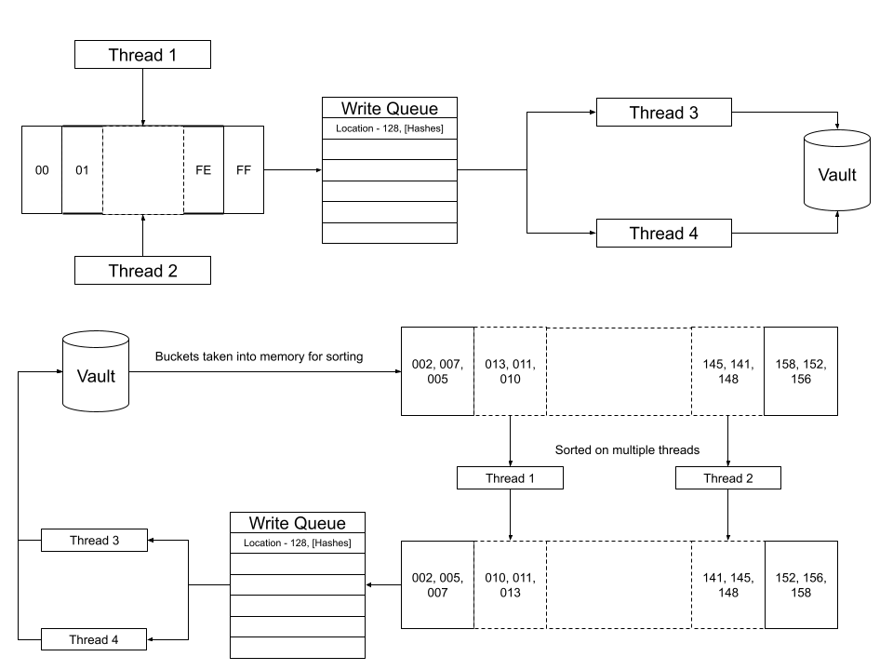
System Design

Slide 7
Systems Used
CPU Model | Sockets | Compute Power | RAM
ARM Cortex-A72 (Raspberry Pi 4) | 1 | 2.2 GHz | 1.8 GB
Intel(R) Xeon(R) Gold 5118 (Athena) | 2 | 2.3 GHz | 62 GB
AMD EPYC 7501 (Epyc) | 2 | 2.3 GHz | 330 GB

Slide 8
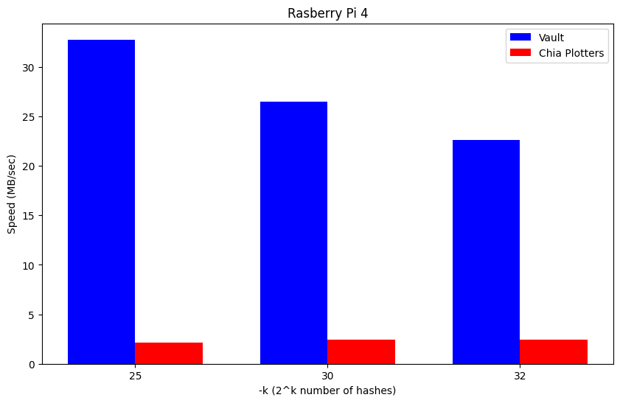
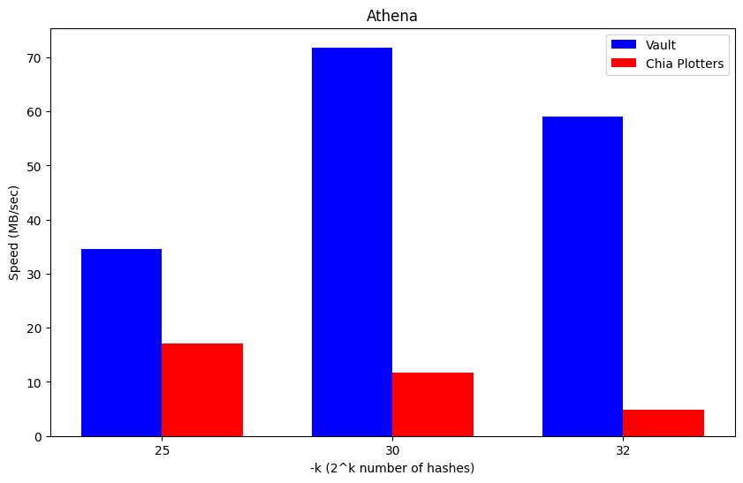
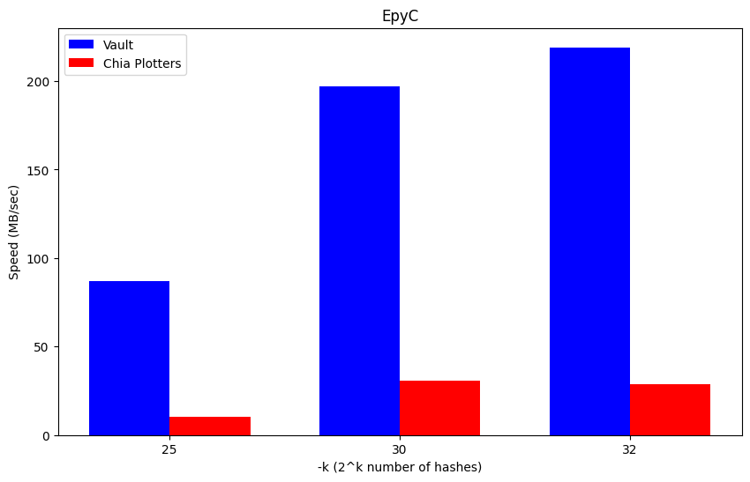
Results
We compared our implementation against the leading Proof of Space cryptocurrency Chia.
We ran simulations for 3 different scenarios k – 25, 30 and 32. Across 3 different systems.
Our implementation outperformed Chia in all 3 scenarios and on all 3 machines.

Slide 9
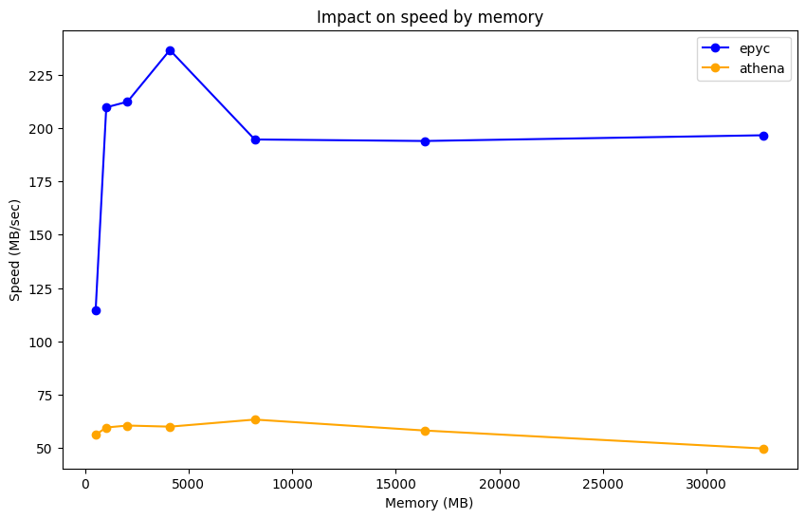
We also benchmarked the impact of different memory sizes on our code.
Although the impact we assumed would be that the performance would keep on increasing with memory sizes, even if it stagnated towards the end.
The impact we observed was quite different. In both cases the performance peaked at certain values and then fell down.

Slide 10
We also benchmarked the impact of different thread counts at different points of the code.
We have 3 parts of the code where thread count has impact.
1. Hash Generation
2. Sorting
3. Input / Output

Slide 11

Future Work
Right now, our code can compress the hash stored in memory from 27 bytes to 11 bytes and 3 bytes. We need to see if further compression is possible.
We need to run tests on bigger k sizes and compare it against Chia.
See if qsort can be replaced with a less memory hungry sorting method.

Slide 12
Thank You

