Slide 1
Building a Hybrid Model
for Food Recommendations
Team
Adarsh Narasimha Murthy
Alireza Mahinparvar
Aomkar Mathakar

Slide 2
Motivation/ Problems addressed
Online Recommendation Systems are mostly prevalent in many industries other than food like e-commerce, entertainment, etc.
People are increasingly becoming aware of the impact of food on health and hence have developed complex and constrained food habits.
People may choose to follow different types of diets like vegan or paleo diets
Some people may have different preferences based on the ingredients (allergic or strong liking to a certain ingredient, etc.) or flavors in recipes
Thus, with this project we have attempted to build a Recipe Recommender System using a hybrid approach combining Content based and Collaborative filtering models using LightFM

Slide 3
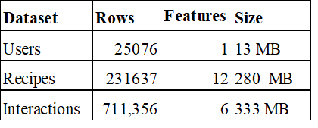
Data Set
Total no. users ~ 119k | Total no. of Recipes (items) ~ 231k
Total recipe records = 231637 *12 ~ 2.7M
Total records in Interaction Dataset = 1132367 * 5 ~ 5.6M

Slide 4
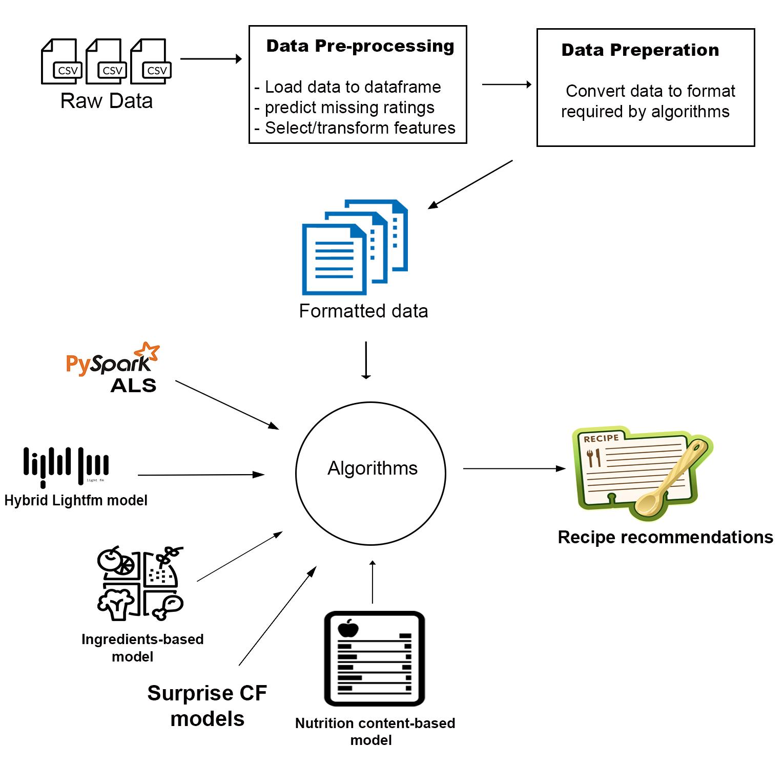
Architecture Diagram

Slide 5
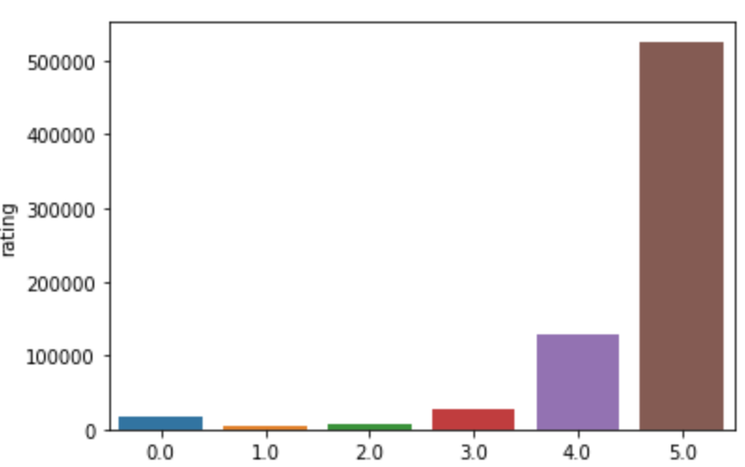
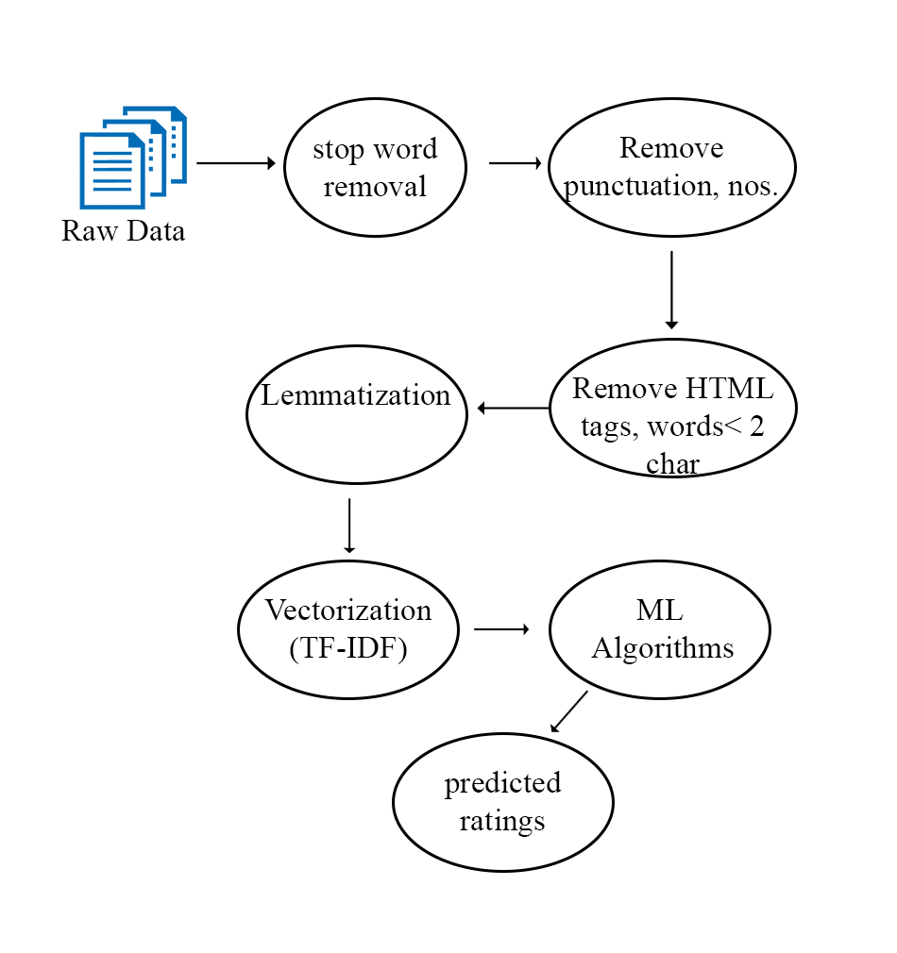
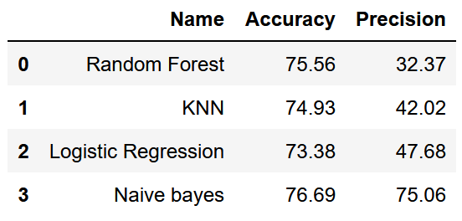
Pre-Processing & Feature Engineering
1. Ratings distribution in the dataset (0 rated datapoints - imputed using sentiment analysis)
3. ML Algorithms comparison for the sentiment analysis
2. Data Pre-processing on the review text

Slide 6
Algorithms Used
Tag/Ingredient Item model we build an ingredient vector for each recipe and compute the cosine similarity of the recipe to all other recipes. To predict ratings for an unknown recipe, we use the cosine distance of recipe X to top-N recipes rated by the user. A similar strategy is followed for tags.
Nutrition-based Hybrid model To predict a rating for recipe X, find cosine similarity of X to all other recipes. Then take a weighted average of the top-N similar recipes to compute the predicted rating for recipe X.

Slide 7
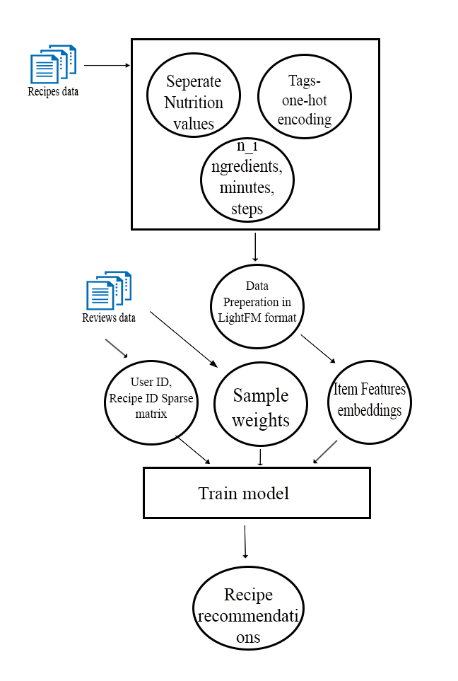
Algorithms Used
Spark ALS:
This is a Matrix Factorization collaborative filtering model provided by Apache Spark. It uses the Alternating Least squares (ALS) algorithm to learn latent factors
LightFM hybrid model
LightFM Model combines item features with user-item interactions. It considers the item features to make recommendation in case of item cold start.
Overview of building LightFM model

Slide 8
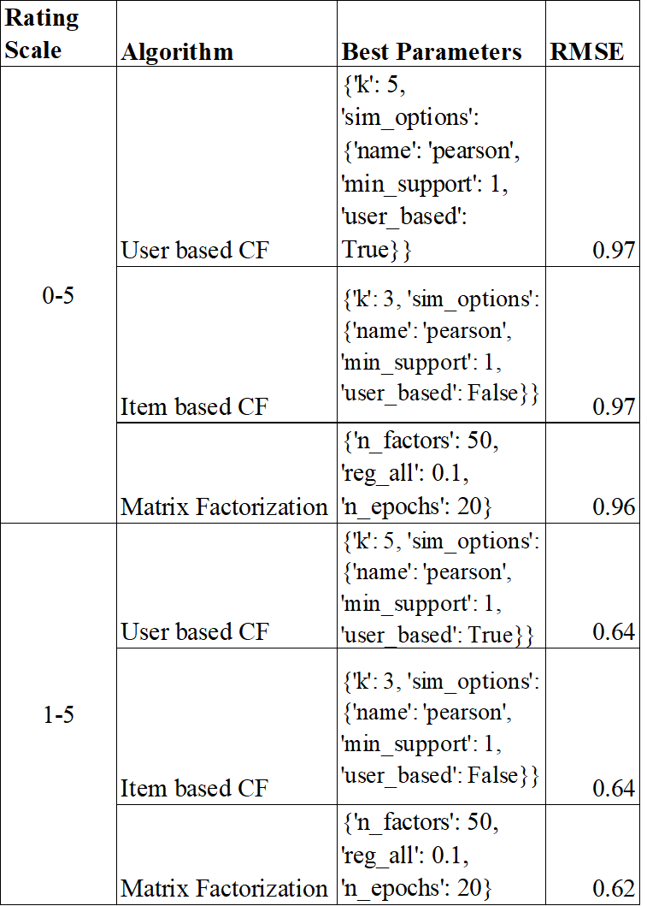
Evaluation: Surprise Implementations
Matrix Factorization had the best RMSE compared to other models
Imputing the missing ratings had a significant impact on RMSE.
Matrix Factorization took the least training time.
Hyperparameter tuning on a sample of 30k records

Slide 9
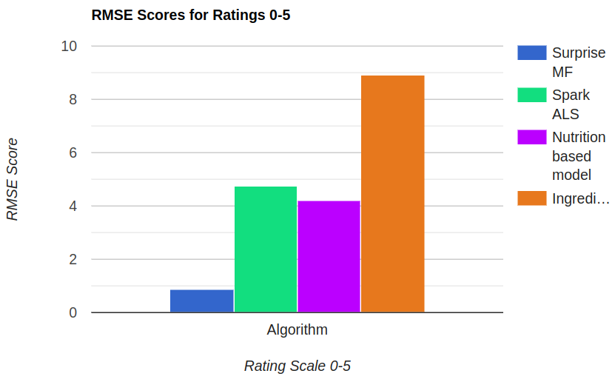
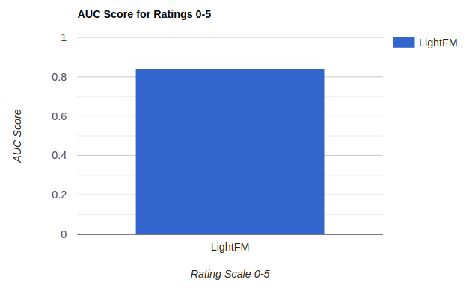
Evaluation of all algorithms over entire dataset

Slide 10
Conclusion
Things that worked?
Collaborative filtering model
Hybrid recommendation model using LightMF (AUC- 0.84)
Things that didn't work?
Tag/Ingredient network: Ingredient/Tag similarity calculation on whole dataset- scalability issues (>200 hrs training)
Nutrition based Hybrid model - scalability issues (>200 hrs training)
Spark ALS - bad RMSE
HPC timeouts after sometime

Slide 11
Thank You!

