Slide 1
WEEK-01:
Object-Oriented Programming using Java

Slide 2
Different Programming Paradigms
Functional/procedural programming:
  program is a list of instructions to the computer
Object-oriented programming
  program is composed of a collection objects that communicate with each other
Notes:
flexibility, easing changes to programs
easier to learn
simpler to develop, maintain and analysize

Slide 3
Object-Oriented Programming
In POP. Programs are organized around code
( code acting on data)
In OOP, code is organized around the data.
(data controlling access to code)
In OOP, we define the data and the routines that are permitted to act on the data.
In Java, a class encapsulates the data and the routines acting on the data.

Slide 4
Main Concepts
Object
Class
Inheritance
Encapsulation
• Polymorphism
• Method Overloading and Overriding
• this and super keywords
• Constructors
• Abstraction

Slide 5
Objects
identity – unique identification of an object
attributes – data/state
services – methods/operations
  supported by the object
  within objects responsibility to provide these services to other clients

Slide 6
Class
“type”
object is an instance of class
class groups similar objects
  same (structure of) attributes
  same services
object holds values of its class’s attributes

Slide 7
The Key traits of Object Oriented Programming
Encapsulation
Polymorphism
Inheritance

Slide 8
Encapsulation
Encapsulation - is the mechanism
  that binds together code and the data it manipulates,
  and keeps both safe from outside interference and misuse
Encapsulation
  Self-contained black box
  Object supports encapsulation
Encapsulation: Java
  Basic Unit of Encapsulation: Class
  Object: An instance of Class
  Clasa Members: Instance variables and methods

Slide 9
Polymorphism
Polymorphism - is a feature that
  allows one interface to be used for a general class of actions.
  The specific action is determined by the exact nature of the situation.
Example”
  get method – to retrieve next item from the list
    List: FIFO, FILO, Based on some priority
In general
  One interface, multiple methods
    A generic interface to a group of related activities
Helps to reduce complexity
  Compiler should select specific action as it applies to each situation

Slide 10
Inheritance
Inheritance - the process by which one object can acquire the properties of another object
Supports Hierarchical(top-down) classification
  Example: Food <– Fruit <– Apple <– Red Delicious Apple
Using Inheritance
  An object need only define its unique qualities
    It can inherit its general attributes from its parent

Slide 11
Why Java ?
Portable
Easy to learn
[ Designed to be used on the Internet ]

Slide 12
Java Buzzwords
Simple
  easy to learn, inherits c/c++ syntax, left out difficult constructs like pointers, memory management.
Pure Object oriented Language-
  classes and objects
Java is case sensitive language-
  variable val is different from Val, VAL, VaL
Robust-
  Ability to create robust, reliable programs
Exception handling
Strictly typed language
( checks for errors at both compile and run time)
Easy memory management
( automatic deallocation-garbage collection)

Slide 13
Java Buzzwords
Multi threaded
  write programs that do many things simultaneously
Architecture neutral
  compiled java programs will run on variety of processors using various OSs (The goal- “ Write once, run any where, any time, forever”)
Both compiled and interpreted
  enables creation of cross-platform programs

Slide 14
Java Buzzwords
Dynamic
  Resolves type information at run time
Distributed
  Designed for distributed environment of internet because it handles TCP/IP protocol, RMI
Security
  Execution is confined to JVM

Slide 15
Java and Internet
Java can be used to create two types of programs: applications and applets
An application is a program
  that runs on your computer, under the operating system of that computer
An applet is a tiny Java program
  designed to be transmitted over the Internet
  automatically downloaded across the network, just like an image, sound file, or video clip
  executed by a Java-compatible Web browser

Slide 16
Applets
Applets
  Allow some functionality to be moved from server to client like
  display data provided by the server
  handle user inputs
  provide simple functions ( loan calculator)
  that execute locally rather than on server
  Challenges: Introduces security and portability issues

Slide 17
SECURITY
Automatic downloading of applets might contain virus
  malicious code gains unauthorized access to system resources, passwords, credit card numbers etc.
But, when a Java-compatible Web browser used,
  One can safely download Java applets without fear of viral infection or malicious intent
Java achieves this protection
  by confining a Java program to the Java execution environment and
  not allowing access to other parts of the computer environment

Slide 18
Portability
Portability is the major aspect of Internet
  because many different types of computers and OSs are connected to it.
In case of applets,
  must be able to downloaded and must be executed by wide variety of computes and OSs.
Because Java is architecture neutral,
  Java programs are portable.
  They can be run on any platform without being recompiled.

Slide 19
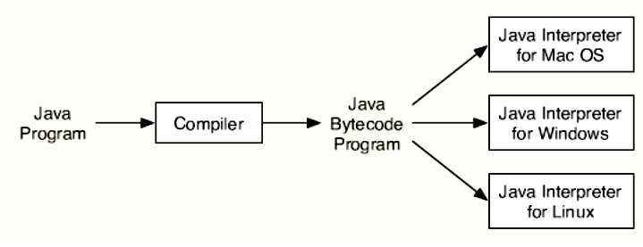
Java’s solution:
Execution of bytecode by JVM
  is the easiest way to create portable programs by implementing java interpreter for each platform.

Slide 20
Java bytecode
The output of a Java compiler(javac) is
  not executable code ; rather, it is bytecode
Bytecode is a highly optimized set of instructions
  designed to be executed by the Java run-time system, Java Virtual Machine (JVM)

Slide 21
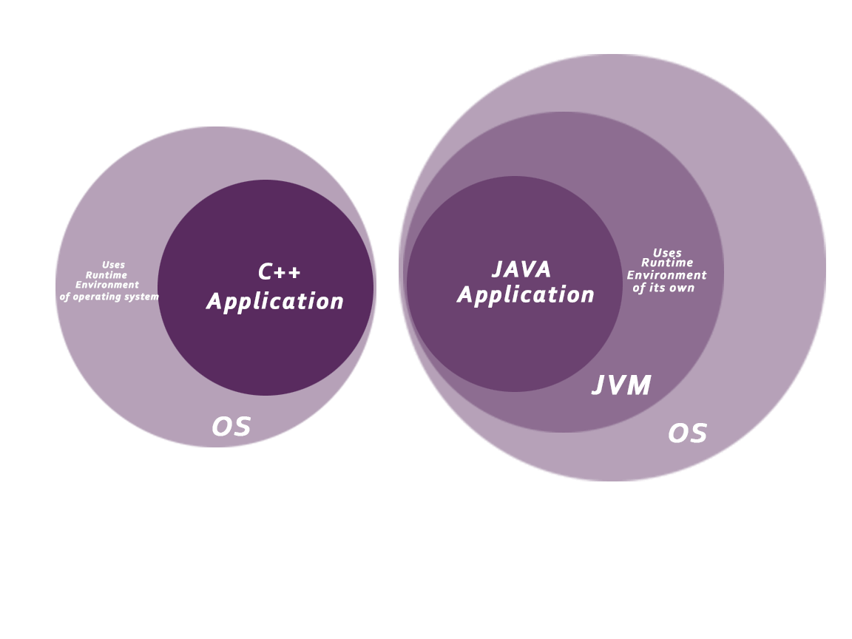
Java Virtual Machine(JVM)

Slide 22

A Picture is Worth…
Java’s solution:
The output of the compiler is .class file
The Interpreter's are sometimes referred to as Java Virtual Machines

Slide 23
Java Compilers and the JVM
Java compilers do not generate machine code for a CPU.
Java compilers generate machine code for the JVM (Java Virtual Machine).
The JVM machine code (called bytecode) is executed by a JVM interpreter program on each computer.
Copyright © 2013 by The McGraw-Hill Companies, Inc. All rights reserved.

Slide 24
Just –in-time Compiler(JIT)
When JIT is part of JVM
  Selected portions of bytecode are compiled into executable code at run time
    On a piece-by-piece, demand basis
  It does not compile an entire java program
  Furthermore, not all sequences of bytecode are compiled
    only those that will benefit from compilation

Slide 25
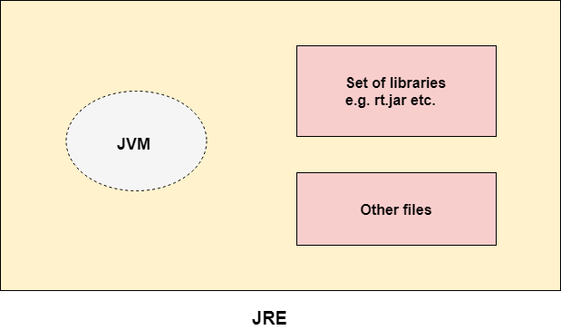
Java Runtime Environment (JRE)
a set of programming tools for developing Java applications:
  Java Virtual Machine (JVM),
  core classes ( libraries),
  supporting files.

Slide 26
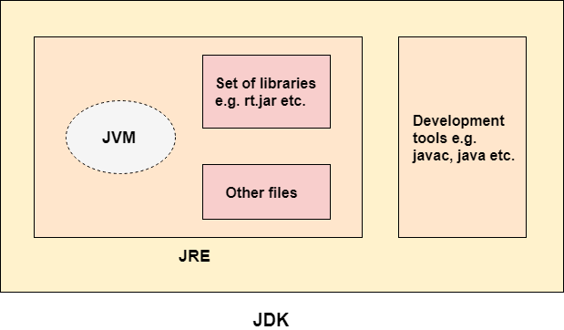
Java Development Kit(JDK)

Slide 27
PLATFORM DEPENDENT
myprog.c
gcc
myprog.exe
C source code
machine code
OS/Hardware
Platform Independent
javac
myprog.class
myprog.java
bytecode
Java source code
JVM
OS/Hardware

Slide 28
Primitive types
int 4 bytes
short 2 bytes
long 8 bytes
byte 1 byte
float 4 bytes
double 8 bytes
char Unicode encoding (2 bytes)
boolean {true,false}
Behaviors is exactly as in C++
Note:
Primitive type
always begin
with lower-case

Slide 29
Java Tokens
Smallest individual unit in source code.
Keywords
Identifiers
Literals
Operators
Separators

Slide 30
Java Data types
Data types in Java are classified into two types:
  Primitive—which include Integer, Character, Boolean, and Floating Point.
  Non-primitive—which include Classes, Interfaces, and Arrays.
Primitive Data Types
  1. Integer
    Integer types can hold whole numbers such as 123 and −96. The size of the values that can be stored depends on the integer type that we choose.
  2. Floating Point
    Floating point data types are used to represent numbers with a fractional part. Single precision floating point numbers occupy 4 bytes and Double precision floating point numbers occupy 8 bytes. There are two subtypes:
  3. Character
    It stores character constants in the memory. It assumes a size of 2 bytes, but basically it can hold only a single character because char stores unicode character sets. It has a minimum value of ‘u0000’ (or 0) and a maximum value of ‘uffff’ (or 65,535, inclusive).
  4. Boolean
    Boolean data types are used to store values with two states: true or false.

Slide 31
Java's "Building Blocks"
Java programs relies on software components called objects
  An object contains both data and behavior
  An object is defined by a class
A program is made up of one or more classes
  A class contains one or more methods
  A method contains program statements
Statements are
  Variable declarations: primitive data types and classes
  Operations: arithmetic, logical, bit-level, class access
  Control structures: selection, looping, etc.
  Object messages: i.e., calls to methods
A Java application always executes the main method

Slide 32
Primitive types - cont.
Constants
37 integer
37.2 float
42F float
0754 integer (octal)
0xfe integer (hexadecimal)

Slide 33
Java Versus C++
Java is a true object oriented language while C++ is basically C with an object oriented extension. Listed below are some major C++ features that were intentionally omitted from Java, or significantly modified:
Java does not support operator overloading.
Java does not have template classes.
Java does not support multiple inheritance of classes.
Java does not support global variables.
Java does not use pointers.
Java has replaced the destructor function with the finalize() function.
There are no header files in Java.

Slide 34
Wrappers
Java provides Objects which wrap primitive types and supply methods.
Example:
Integer n = new Integer(“4”);
int m = n.intValue();
Read more about Integer in JDK Documentation

Slide 35
Hello World
Hello.java
class Hello {
public static void main(String[] args) {
System.out.println(“Hello World !!!”); }
}
C:\javac Hello.java
C:\java Hello
( compilation creates Hello.class )
(Execution on the local JVM)

Slide 36
More sophisticated
class Kyle {
private boolean kennyIsAlive_;
public Kyle() { kennyIsAlive_ = true; }
public Kyle(Kyle aKyle) {
kennyIsAlive_ = aKyle.kennyIsAlive_;
}
public String theyKilledKenny() {
if (kennyIsAlive_) {
kennyIsAlive_ = false;
return “You are Welcome !!!”;
} else {
return “?”;
}
}
public static void main(String[] args) {
Kyle k = new Kyle();
String s = k.theyKilledKenny();
System.out.println(“Kyle: “ + s);
}
}
Default C’tor
Copy C’tor

Slide 37
Results
javac Kyle.java ( to compile )
java Kyle ( to execute )
Kyle: You are Welcome !!!

Slide 38
Arrays
Array is an object
Array size is fixed
Animal[] arr; // nothing yet …
arr = new Animal[4]; // only array of pointers
for(int i=0 ; i < arr.length ; i++) {
arr[i] = new Animal();
// now we have a complete array

Slide 39
Arrays - Multidimensional
In C++
Animal arr[2][2]
Is:
In Java
Animal[][] arr=
new Animal[2][2]
What is the type of
the object here ?

Slide 40
Static - [1/4]
Member data - Same data is used for all the instances (objects) of some Class.
Assignment performed
on the first access to the
Class.
Only one instance of ‘x’
exists in memory
Class A {
public int y = 0;
public static int x_ = 1;
};
A a = new A();
A b = new A();
System.out.println(b.x_);
a.x_ = 5;
System.out.println(b.x_);
A.x_ = 10;
System.out.println(b.x_);
a
b
Output:
1
5
10
0
0
y
y
1
A.x_

Slide 41
Static - [2/4]
Member function
  Static member function can access only static members
  Static member function can be called without an instance.
Class TeaPot {
private static int numOfTP = 0;
private Color myColor_;
public TeaPot(Color c) {
myColor_ = c;
numOfTP++;
}
public static int howManyTeaPots()
{ return numOfTP; }
// error :
public static Color getColor()
{ return myColor_; }
}

Slide 42
Static - [2/4] cont.
Usage:
TeaPot tp1 = new TeaPot(Color.RED);
TeaPot tp2 = new TeaPot(Color.GREEN);
System.out.println(“We have “ +
TeaPot.howManyTeaPots()+ “Tea Pots”);

Slide 43
Static - [3/4]
Block
  Code that is executed in the first reference to the class.
  Several static blocks can exist in the same class
  ( Execution order is by the appearance order in the class definition ).
  Only static members can be accessed.
class RandomGenerator {
private static int seed_;
static {
int t = System.getTime() % 100;
seed_ = System.getTime();
while(t-- > 0)
seed_ = getNextNumber(seed_);
}
}
}

Slide 44
String is an Object
Constant strings as in C, does not exist
The function call foo(“Hello”) creates a String object, containing “Hello”, and passes reference to it to foo.
There is no point in writing :
The String object is a constant. It can’t be changed using a reference to it.
String s = new String(“Hello”);

Slide 45
Flow control
Basically, it is exactly like c/c++.
do/while
switch
int i=5;
do {
// act1
i--;
} while(i!=0);
if/else
char c=IN.getChar();
switch(c) {
case ‘a’:
case ‘b’:
// act1
break;
default:
// act2
}
If(x==4) {
// act1
} else {
// act2
}
for
int j;
for(int i=0;i<=9;i++)
{
j+=i;
}

Slide 46
Packages
Java code has hierarchical structure.
The environment variable CLASSPATH contains the directory names of the roots.
Every Object belongs to a package ( ‘package’ keyword)
Object full name contains the name full name of the package containing it.

Slide 47
Access Control
public member (function/data)
  Can be called/modified from outside.
protected
  Can be called/modified from derived classes
private
  Can be called/modified only from the current class
default ( if no access modifier stated )
  Usually referred to as “Friendly”.
  Can be called/modified/instantiated from the same package.

Slide 48
Inheritance
class Base {
Base(){}
Base(int i) {}
protected void foo() {…}
}
class Derived extends Base {
Derived() {}
protected void foo() {…}
Derived(int i) {
super(i);
…
super.foo();
}
}
Base
Derived
As opposed to C++, it is possible to inherit only from ONE class.
Pros avoids many potential problems and bugs.
Cons might cause code replication

Slide 49
Polymorphism
Inheritance creates an “is a” relation:
For example, if B inherits from A, than we say that “B is also an A”.
Implications are:
  access rights (Java forbids reducing access rights) - derived class can receive all the messages that the base class can.
  behavior
  precondition and postcondition

Slide 50
Inheritance (2)
In Java, all methods are virtual :
class Base {
void foo() {
System.out.println(“Base”);
}
}
class Derived extends Base {
void foo() {
System.out.println(“Derived”);
}
}
public class Test {
public static void main(String[] args) {
Base b = new Derived();
b.foo(); // Derived.foo() will be activated
}
}

Slide 51
Inheritance (3) - Optional
class classC extends classB {
classC(int arg1, int arg2){
this(arg1);
System.out.println("In classC(int arg1, int arg2)");
}
classC(int arg1){
super(arg1);
System.out.println("In classC(int arg1)");
}
}
class classB extends classA {
classB(int arg1){
super(arg1);
System.out.println("In classB(int arg1)");
}
classB(){
System.out.println("In classB()");
}
}

Slide 52
Inheritance (3) - Optional
class classA {
classA(int arg1){
System.out.println("In classA(int arg1)");
}
classA(){
System.out.println("In classA()");
}
}
class classB extends classA {
classB(int arg1, int arg2){
this(arg1);
System.out.println("In classB(int arg1, int arg2)");
}
classB(int arg1){
super(arg1);
System.out.println("In classB(int arg1)");
}
class B() {
System.out.println("In classB()");
}
}

Slide 53
Method Overloading
Two methods in a class can share a name, as long as they have different parameter declarations.
Example:
class Overload {
void display() {
System.out.println("<nothing>");
}
void display(int x) {
System.out.println(x);
}
}

Slide 54
Overloading Methods
In Java it is possible to define two or more methods within the same class that share the same name, as long as their parameter declarations are different
When an overloaded method is invoked, Java uses the type and/or number of arguments as its guide to determine which version of the overloaded method to actually call
The return type alone is insufficient to distinguish two versions of a method

Slide 55
class Overload {
void test() {
System.out.println("No parameters");}
// Overload test for one integer parameter.
void test(int a) {
System.out.println("a: " + a);}
// Overload test for two integer parameters.
void test(int a, int b) {
System.out.println("a and b: " + a + " " + b);}
// overload test for a double parameter
double test(double a) {
System.out.println("double a: " + a);
return a*a;}
}

Slide 56
class OverloadDemo {
public static void main(String args[]) {
Overload ob = new Overload();
double result; // call all versions of test()
ob.test();
ob.test(10);
ob.test(10, 20);
result = ob.test(123.25);
System.out.println("Result of ob.test(123.25): " +
result);
}
}

Slide 57
In some cases Java’s automatic type conversions can play a role in overload resolution
Java will employ its automatic type conversions only if no exact match is found

Slide 58
// Automatic type conversions apply to overloading.
class Overload2 {
void test() {
System.out.println("No parameters");
}
// Overload test for two integer parameters.
void test(int a, int b) {
System.out.println("a and b: " + a + " " + b);
}
// overload test for a double parameter
void test(double a) {
System.out.println("Inside test(double) a: " + a);
}
}

Slide 59
class OverloadTypeCast {
public static void main(String args[]) {
Overload2 ob = new Overload2();
int i = 88;
ob.test();
ob.test(10, 20);
ob.test(i); // this will invoke test(double)
ob.test(123.2); //this will invoke test(double)
}
}
This program generates the following output:
No parameters
a and b: 10 20
Inside test(double) a: 88
Inside test(double) a: 123.2

Slide 60
Constructors
Used to initialize an object when it is created
Syntactically it is like a method.
Its name is the name of the class.
Have no return type, not even void
Automatically called when an object is created.
Example constructor for Vehicle class:
Vehicle() {
fuelCap = 12;
mpg = 25;
passengers = 5;
}

Slide 61
Default Constructors
Consider
Vehicle van = new Vehicle();
new Vehicle() is calling the Vehicle() constructor
When you do not explicitly define a constructor for a class, then Java creates a default constructor for the class
The default constructor automatically initializes all instance variables to zero

Slide 62
Constructors with Parameters
Example:
  In the Vehicle class:
  Vehicle(int p, int f, int m) {
  passengers = p; fuelCap = f; mpg = m;
  }
  In the VehicleDemo's main( ) method:
  Vehicle car = new Vehicle(5, 12, 25);
  Vehicle van = new Vehicle(7, 24, 21);
Notes:
fuelCap: fuel capacity in gallon
Mpg: miles per gallon

Slide 63
Constructor Overloading
You can overload constructors.
Example:
class Overload{
int data;
Overload(int x) {
data = x;
}
Overload(int x, int y) {
data = x+y;
}
}

Slide 64
The Keyword this
this is an implicit argument that refers to the object on which the method is called.
this is useful for making it clear that you are referring to an instance variable.
Example in Vehicle class:
double fuelNeeded(int distance) {
return (double) distance / this.mpg;
}

Slide 65
Instance variable hiding
It is illegal in java to declare two local variables with the same name inside the same or enclosing scopes.
Interestingly, you can have local variables, including formal parameters to methods, which overlap with the names of the class instance variables. We can see the following example for this explanation.
Example:
  Vehicle(int p, int f, int m) {
  passengers = p; fuelCap = f; mpg = m;
  }

Slide 66
Instance variable hiding
However, when a local variable has the same name as an instance variable, the local variable hides the instance variable. This is why passengers, fuelCap, mpg were not used as the names for the parameters to the Vehicle() constructor inside the Vehicle class. If they had been, then passengers would have referred to the formal parameter, hiding the instance variable passengers.
Example:
Vehicle(int passengers, int f, int m) {
passengers = passengers; // passengers refers to formal parameter
fuelCap = f;
mpg = m;
}

Slide 67
Instance variable hiding
While it is usually easier to simply use different names, there is another way around this situation. Because this lets you refer directly to the object, you can use it to resolve any name space collisions that might occur between instance variables and local variables.
// Use this to resolve name-space collisions.
Vehicle(double passengers, double fuelCap, double mpg) {
this. passengers = passengers;
this. fuelCap= fuelCap;
this.mpg = mpg;
}

Slide 68
Abstract
abstract member function, means that the function does not have an implementation.
abstract class, is class that can not be instantiated.
AbstractTest.java:6: class AbstractTest is an abstract class.
It can't be instantiated.
new AbstractTest();
^
1 error
NOTE:
An abstract class is not required to have an abstract method in it.
But any class that has an abstract method in it or that does
not provide an implementation for any abstract methods declared
in its superclasses must be declared as an abstract class.

Slide 69
Abstract - Example
package java.lang;
public abstract class Shape {
public abstract void draw();
public void move(int x, int y) {
setColor(BackGroundColor);
draw();
setCenter(x,y);
setColor(ForeGroundColor);
draw();
}
}
package java.lang;
public class Circle extends Shape {
public void draw() {
// draw the circle ...
}
}

Slide 70
Interface
Interfaces are useful for the following:
Capturing similarities among unrelated classes without artificially forcing a class relationship.
Declaring methods that one or more classes are expected to implement.
Revealing an object's programming interface without revealing its class.

Slide 71
Interface
abstract “class”
Helps defining a “usage contract” between classes
All methods are public
Java’s compensation for removing the multiple inheritance. You can “inherit” as many interfaces as you want.
* - The correct term is “to implement”
an interface

Slide 72
Interface
interface IChef {
void cook(Food food);
}
interface BabyKicker {
void kickTheBaby(Baby);
}
interface SouthParkCharacter {
void curse();
}
class Chef implements IChef, SouthParkCharacter {
// overridden methods MUST be public
// can you tell why ?
public void curse() { … }
public void cook(Food f) { … }
}
* access rights (Java forbids reducing of access rights)

Slide 73
When to use an interface ?
Perfect tool for encapsulating the classes inner structure. Only the interface will be exposed

