Slide 1

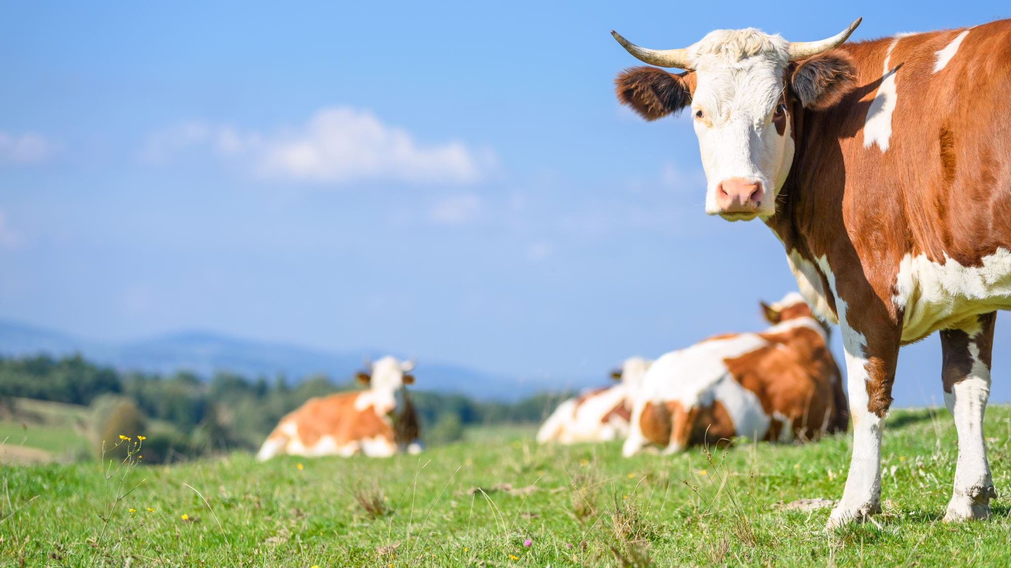
Dairy Management
Solution Ideation

Slide 2
Data points to consider
Identification Tags
Vaccination details
Rumination measures
Temperature measures
Manually entered data

Slide 3
Technical Aspects
BI
Dashboards
Accessed at managerial level
Can provide access to area managers
Cow profile through app for farmers
Neck Tracker
Data Receiver
Data Processing / Analysis
Reporting
Can provide individual reports at village level
Managerial reports
Performance Scorecards
Ear Tag / RFID
Alerts
Build business rules to set up alerts
Alerts can be at various level – area level managers, farmers, etc.

Slide 4
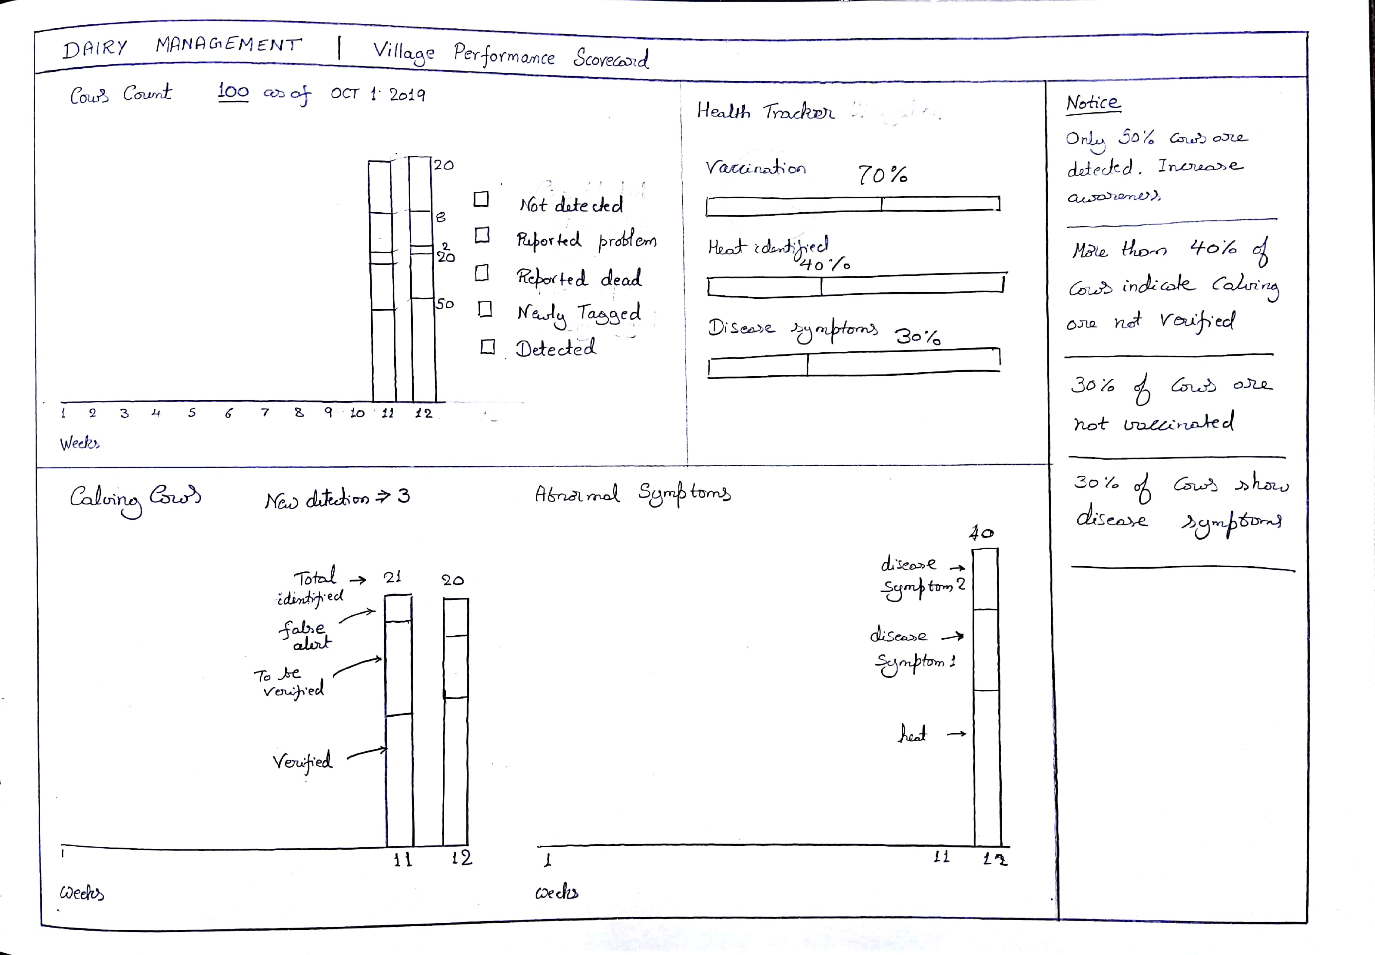

Slide 5
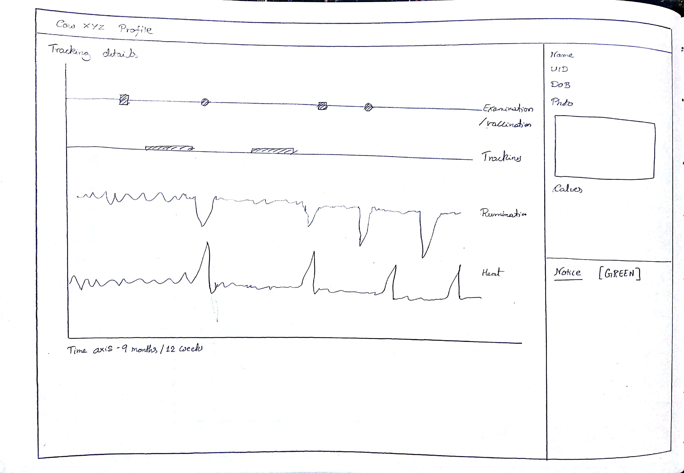

Slide 6
BI Dashboard
A detailed approach to understand health performance of cows across the state.
Identify problem areas and take measures to improve performance
Insights and quick action plans
Analyse impact of technology
Budgeting and fund allocation
Geography based analysis
Staff level performance
Insurance

Slide 7
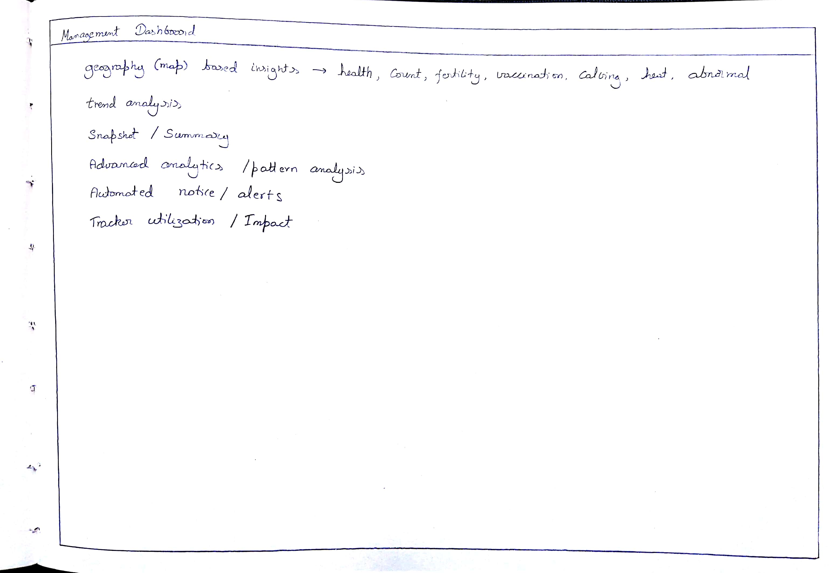

Slide 8
How the solution can help
Online access to information at individual cow level
Cow population and demography information at finger tips
Increase in health index, due to timely alert and disease preventation
Early detection of calving cows and thereby growth in population
Early identification of health abnormalities and effective use of vaccines
Identify illegal activities through tracking

