Slide 1
Software Measurement Winter 2019
TEAM - J
SRAVAN KUMAR THUMATI – 40070088
NAREN MORABAGAL SOMASEKHAR – 40082567
ADARSH ARAVIND – 40082585
KUNDANA GANGAM– 40085658
EMMANUEL AMBELE - 40050295

Slide 2
OUTLINE...
Metrics
Subject Projects
Data collection process of metrics
Results of metrics
Correlation analysis between metrics

Slide 3
METRICS SELECTED
Statement Coverage
Branch Coverage
Test Suite Effectiveness (Mutation Test)
McCabe Code Complexity
Fix Backlog and Backlog Management Index
Post Release Defect Density

Slide 4
PROJECTS SELECTED
We have changed the subject projects from milestone 2, new projects selected meets the project requirements and help us for better analysis.
Apache Commons Configuration - Version 2.4 (105 KLOC)
Apache Commons Collections - Version 4-4.2 (132 KLOC)
JFreeChart - Version 1.5.0 (228 KLOC)
Apache Commons IO - Version 2.6 (50 KLOC)
Apache Commons FileUpload - Version 1.4 (7.7 KLOC)

Slide 5
METRICS 1 & 2 (Collection process)
Metrics 1 & 2 are collected using Eclipse IDE (select and right click project → Coverage As → Junit Test → Export data in HTML format).
Statement and Branch coverage depicts the test case coverage which in turn depicts the reliability of application.
Formula :

Slide 6
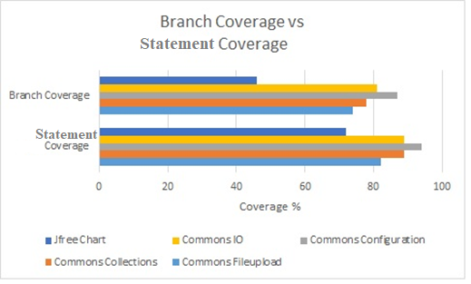
METRICS 1 & 2 (Result Analysis)
All the subject Projects are comparatively good in both Statement and Branch coverage with an exception of JFreeChart.

Slide 7
METRIC 3 (Collection process)
We have used ‘Pitclipse’ plugin in eclipse for generating the mutation score for each subject programs (Right click on main file → Run as PIT Mutation Test).
Mutation score depicts the test suite effectiveness.
Formula : Mutation Score = (Killed Mutants)/(Total No. Mutants)
Challenge Faced: The test suite should be green with no errors for the Pitclipse plugin to run in the eclipse. There is recognizable effort dedicated to rectify the issues in projects.

Slide 8
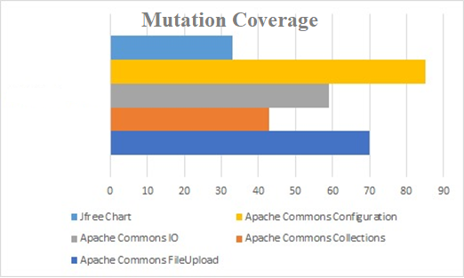
METRIC 3 (Result Analysis)
Among the subject projects, JFreeChart has low mutation score which implies low test suite effectiveness and Apache Commons Configuration has higher mutation score which implies better test suite.

Slide 9
METRIC 4 (Collection process)
We have used MetricsReloaded plugin in IntelliJ to generate McCabe code complexity. (Select Project → Run the plugin → Select Complexity metric)
McCabe complexity depicts the structural efficiency, maintenance effort required, etc.,
Calculates the cyclomatic complexity of each non-abstract method. Cyclomatic complexity is a measure of the number of distinct execution paths through each method. This can also be considered as the minimal number of tests necessary to completely exercise a method's control flow. In practice, this is 1 + the number of if's, while's, for's, do's, switch cases, catches, conditional expressions, &&'s and ||'s in the method.

Slide 10
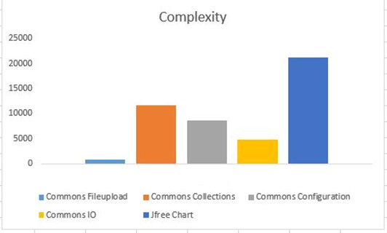
METRIC 4 (Result Analysis)
Among the subject projects we chose, we observed that JFreeChart has high Complexity and Apache Commons FileUpload has low complexity.

Slide 11
METRIC 5 - Fix Backlog and Backlog Management Index (Introduction and Collection process)
This metric is very common and important metric for software maintenance.
It is a count of reported problems that remain at the end of a certain period (e.g. a week, a month). This metric can provide meaningful information for managing the maintenance process.
Used to manage the backlog of open and unresolved problems.

Slide 12
Cont..
Formula:
BMI = (𝐝𝐞𝐟𝐞𝐜𝐭𝐬 𝐜𝐥𝐨𝐬𝐞𝐝 𝐝𝐮𝐫𝐢𝐧𝐠 𝐭𝐡𝐞 𝐦𝐨𝐧𝐭𝐡
/ 𝐝𝐞𝐟𝐞𝐜𝐭𝐬 𝐚𝐫𝐫𝐢𝐯𝐞𝐝 𝐝𝐮𝐫𝐢𝐧𝐠 𝐭𝐡𝐞 𝐦𝐨𝐧𝐭𝐡) * 100
Data gathering was done manually through Issue Trackers
Apache open issues
Github
Challenge Faced: Obtaining bug data from issue trackers manually was tedious and time taking.

Slide 13
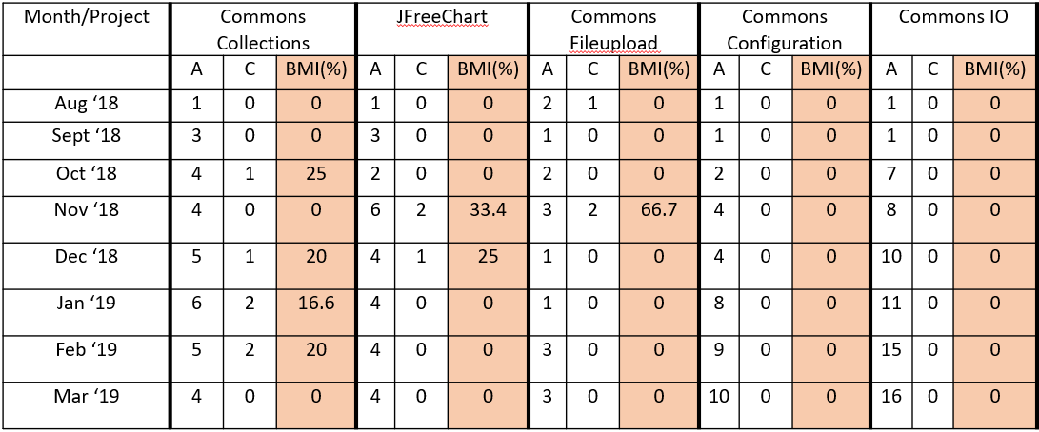
METRIC 5 (Result Analysis)
A → #Arrived defects C → #Closed defects BMI → Backlog Management Index

Slide 14
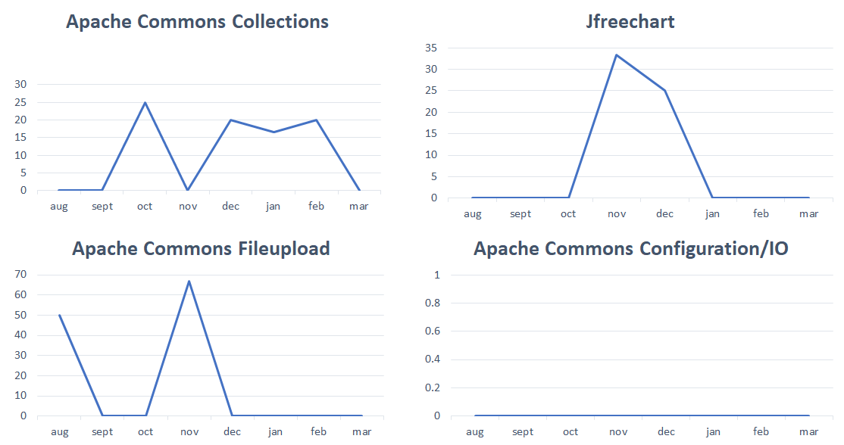
Cont..

Slide 15
METRIC 6 - Post Release Defect Density (Introduction and Collection process)
Post Release Defect Density: It is the measure of code quality per unit, identified after a particular version is released.
It measures the defects relative to the software size expressed as Lines of Code(LOC) or Function Point(FP).
Defect Density = Defect count/Size of release(KLOC)

Slide 16
Cont..
We calculated the defect count with the help of Jira reports, based on the selected project versions.
(Issue Tracking → All apache bugs → Select version fix and affect version → Export csv).
We have collected Size of release using SciTools..
(Import project → Select project from directory → Metrics → Metric summary).
Limitation(For Metrics 5 and 6): Some bugs may have not been reported leaving us to rely fully on issue trackers only.

Slide 17
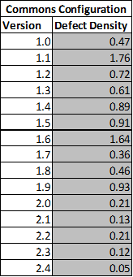
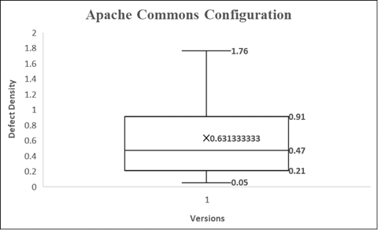
METRIC 6 (Result Analysis)
Sample Maximum | 1.76
Upper Quartile | 0.91
Mean | 0.63
Median | 0.47
Lower Quartile | 0.21
Sample Minimum | 0.05

Slide 18
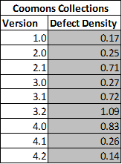
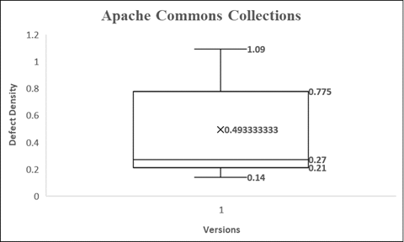
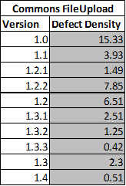
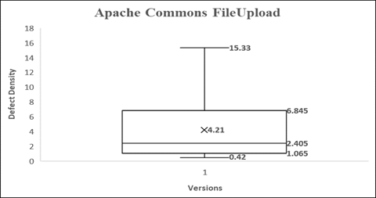
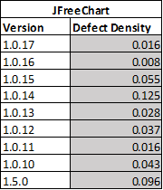
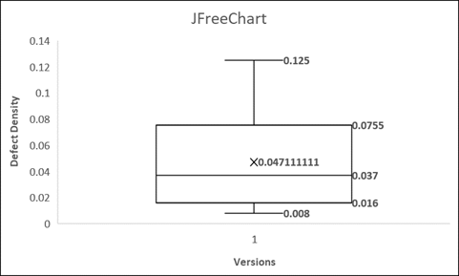
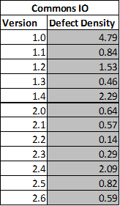
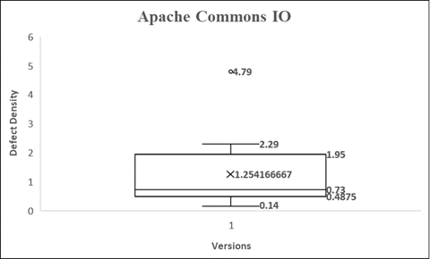

Slide 19
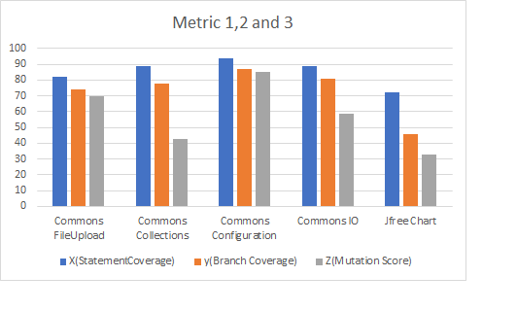
CORRELATION BETWEEN 1&2 AND 3
With a minor exception of Apache Commons FileUpload, metrics 1&2(Statement and Branch Coverage) are positively correlated with metric 3(Test Suite Effectiveness)
The Spearman Coefficient between Metrics 1 & 3 is 0.66 and Metrics 2 & 3 is 0.70

Slide 20
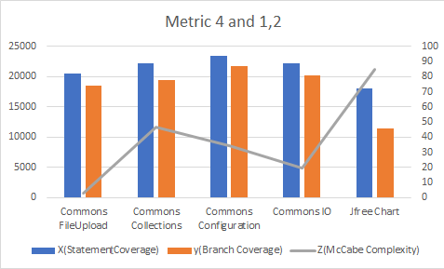
CORRELATION BETWEEN 4 AND 1&2
As per Spearman coefficient obtained, 0.86 (for Metrics 1 and 4), 0.76 (for Metrics 2 and 4) there is strong, positive correlation between Metrics 4 and 1,2.
With an exception of Apache Commons FileUpload project and Apache Commons Configuration project, the metrics are inversely correlated.

Slide 21
CORRELATION BETWEEN 1&2 AND 6
This correlation between Metrics 1,2 and 6 is based on selected version of the project.
The Spearman coefficient between Statement Coverage and Defect Density is -0.02 and Branch Coverage and Defect Density is 0. These values show that there is negative and weak correlation between statement coverage and defect density, and there is no correlation between branch coverage and defect density.
Results of working on different versions will be collected in future work.

Slide 22
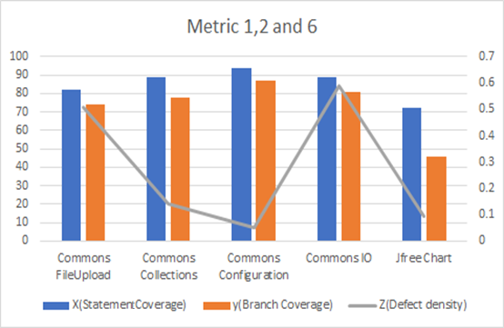
Cont..

Slide 23
CORRELATION BETWEEN 5 AND 6
This correlation between Metrics 5 and 6 is the average of density defect and Fix Backlog and Backlog Management Index based on selected version of the projects within the time period of 8 months.
The Spearman coefficient between Fix Backlog and Backlog Management Index(BMI) and Defect Density is 0.87. This value shows that there is a positive and strong correlation between the subject metrics.
This means BMI is inversely proportional to Defect Density.

Slide 24
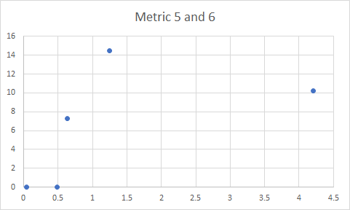
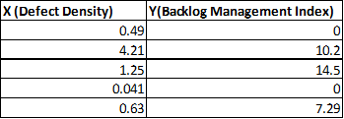
Cont..

Slide 25
REFERENCES…
[1] Sharma, R. (2014). TOOLS AND TECHNIQUES OF CODE COVERAGE TESTING. International Journal of Computer Engineering and Technology (IJCET), Available at: http://www.iaeme.com/MasterAdmin/UploadFolder/TOOLS%20AND%20TECHNIQUES%20O F%20CODE%20COVERAGE%20TESTING2/TOOLS%20AND%20TECHNIQUES%20OF%20CODE%20COVERAGE%20TESTING2.pdf, [online] 5(9), pp.165-171.
[2] M. Moghadam and S. Babamir, "Mutation score evaluation in terms of object-oriented metrics", 2014 4th International Conference on Computer and Knowledge Engineering (ICCKE), 2014. Available: 10.1109/iccke.2014.6993419
[3] Madi, A & Zein, O.K. & Kadry, Seifedine. (2013). On the improvement of cyclomatic complexity metric. Available at: https://www.researchgate.net/publication/288695710_On_the_improvement_of_cyclomatic_ complexity_metric, International Journal of Software Engineering and its Applications. 7. 67-82.
[4] Stephen H. Kan, Metrics and models in software quality engineering. Addison-Wesley Longman Publishing Co., Inc. Boston, MA, USA ©2002 ISBN:0201729156
[5] M. O. Elish and D. Rine. Design structural stability metrics and post-release defect density: An empirical study. In COMPSAC ’06: Proceedings of the 30th Annual International Computer Software and Applications Conference, pages 1–8, Washington, DC, USA, 2006. IEEE Computer Society
[6] DANA H HALABI1 & ADNAN SHAOUT (June’16) “MUTATION TESTING TOOLS FOR JAVA PROGRAMS – A SURVEY”, Available at: https://www.researchgate.net/publication/303401556_MUTATION_TESTING_TOOLS_FOR_JAVA_PROGRAMS_-_A_SURVEY
[7] L. Vinke (June 2011) “Estimate the post-release Defect Density based on the Test Level Quality”. Available at: https://research.infosupport.com/wp-content/uploads/2017/08/MasterThesis-LammertVinke-Final.pdf

Slide 26


If (Queries)
System.out.println(“Please clear them by questioning ”);
else
System.out.println(“Thank you so much for your patience ”);

