Slide 1

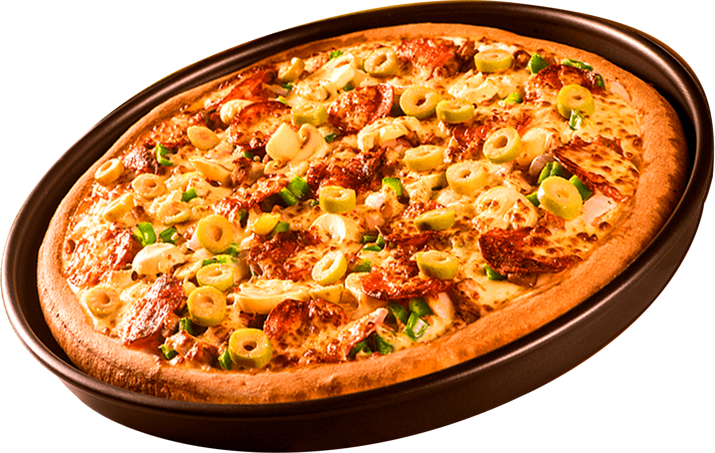
PIZZA SALES ANALYSIS USING SQL
Adarsh Gandhi

Slide 2
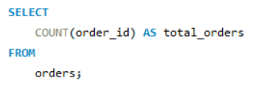
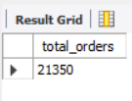
Retrieve the total number of orders placed.
QUERY :
OUTPUT :

Slide 3
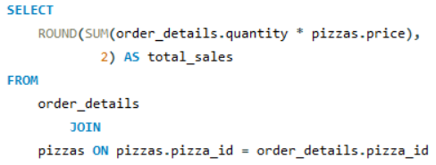

Calculate the total revenue generated from pizza sales.
QUERY :
OUTPUT :

Slide 4
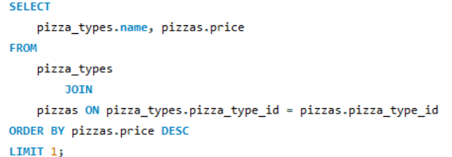

Identify the highest-priced pizza.
QUERY :
OUTPUT :

Slide 5
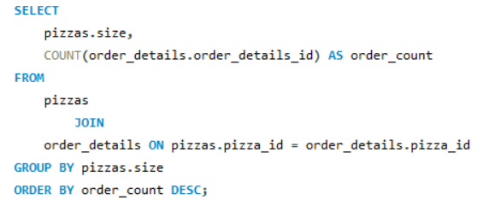
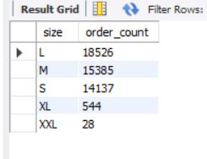
Identify the most common pizza size ordered.
QUERY :
OUTPUT :

Slide 6
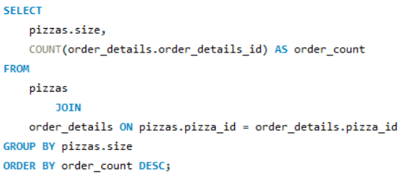
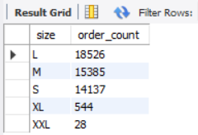
List the top 5 most ordered pizza types along with their quantities.
QUERY :
OUTPUT :

Slide 7
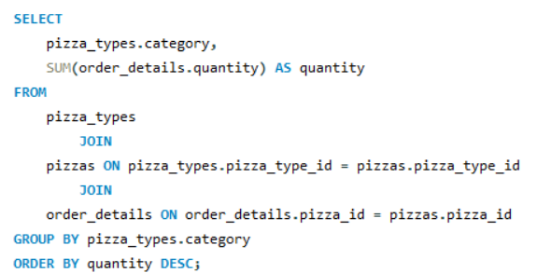
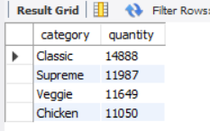
Join the necessary tables to find the total quantity of each pizza category ordered.
QUERY :
OUTPUT :

Slide 8
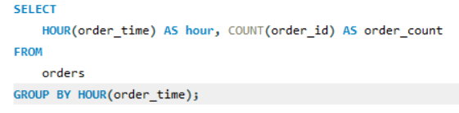
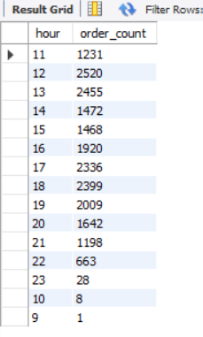
Determine the distribution of orders by hour of the day.
QUERY :
OUTPUT :

Slide 9
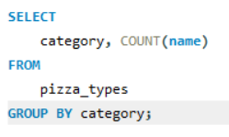
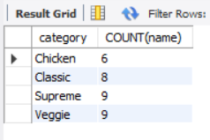
Join relevant tables to find the category-wise distribution of pizzas.
QUERY :
OUTPUT :

Slide 10
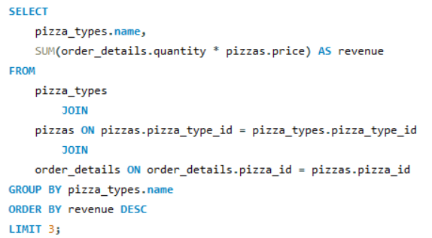
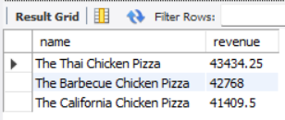
Determine the top 3 most ordered pizza types based on revenue.
QUERY :
OUTPUT :

Slide 11
THANK YOU
FOR ATTENTION

