Slide 1

Support Vector Machine
Adarsh Kumar M.tech(IEM)
Department of Management Studies
Indian Institute of Technology (ISM), Dhanbad
E-mail: adarsh.19mt0016@ms.iitism.ac.in

Slide 2


Table of Contents
What is Support Vector Machine?
Terminology
Linear Separable Data
Non-linear Separable Data
Support Vector
Hyper-plane
Margin
How does it work?
Implement SVM in Python
Pros and Cons associated with SVM
2 / 30

Slide 3
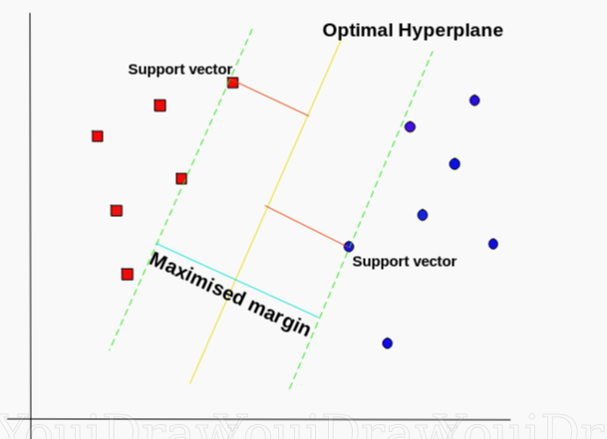
What is Support Vector Machine?
A support-vector machine constructs a hyperplane or set of hyper-planes in a high- or infinite-dimensional space, which can be used for classification, regression, or other tasks like outliers detection. It is a Supervised learning algorithm.
3 / 30

Slide 4
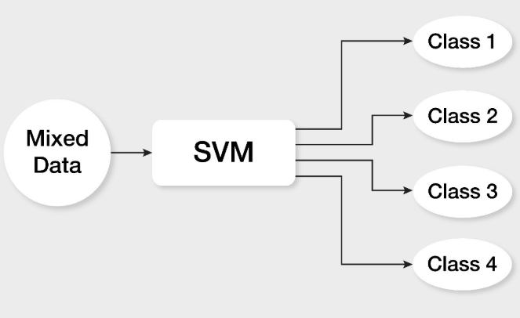

Slide 5
Terminology
Linear Separable Data :A dataset is said to be linearly separable if it is possible to draw a line that can separate the dataset.
Non-linear Separable Data : A dataset is said to be non-linearly separable if it is impossible to draw a line that can separate the dataset.
Support Vectors : Support vectors are the data points that lie closest to
the decision surface (or hyperplane).
Hyper-plane :An hyperplane is a n−1 subspace in a n dimensional
vector space. For 2D spaces, the set of points in a line define an
hyperplane. For 3D spaces, the points in a 2D surface (e.g plane).
Margin : It is distance between two support vectors.
5 / 30

Slide 6
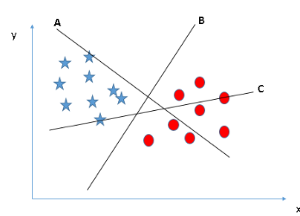
How to select the Hyper Plane
B is right Hyper Plane as it separates two class of data.
6 / 30

Slide 7
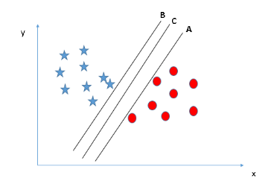
Scenario-1
You can see that the margin for hyper-plane C is high as compared to both A and B. So, the right hyper-plane as C.
7 / 30

Slide 8
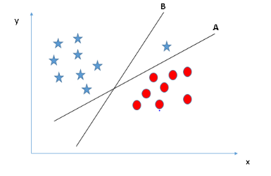
Scenario-2
Hyper-plane B as it has higher margin compared to A. But, here is the catch, SVM selects the hyper-plane which classifies the classes accurately prior to maximizing margin. Here, hyper-plane B has a classification error and A has classified all correctly. So, the right hyper-plane is A.
8 / 30

Slide 9
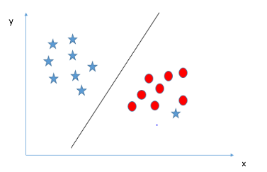
Scenario-3
Unable to segregate the two classes using a straight line?
SVM has a feature to ignore outliers and find the hyper-plane that has maximum margin.
9 / 30

Slide 10
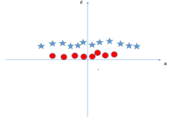
Scenario-5
How does SVM classify these two classes?
Till now, we have only looked at the linear hyper-plane. SVM can solve this problem by introducing additional feature. Here, we will add a new feature z=x^2+y^2 and plot the data points on axis x and z.
10 / 30

Slide 11
Implement SVM in Python

Slide 12
Pros and Cons associated with SVM
Pros:
It works really well with clear margin of separation
It is effective in high dimensional spaces.
It is effective in cases where number of dimensions is greater than the number of samples.
It uses a subset of training points in the decision function (called support vectors), so it is also memory efficient.
Cons:
It doesn’t perform well, when we have large data set because the required training time is higher
It also doesn’t perform very well, when the data set has more noise i.e. target classes are overlapping
SVM doesn’t directly provide probability estimates, these are calculated using an expensive five-fold cross-validation. It is related SVC method of Python scikit-learn library.
10 / 30

Slide 13

IIT (ISM) Dhanbad
10 May, 2018

