Slide 1
Web Developer Machine Test
Development Time: 4 hours
There are two tests in this round
First test is related to HTML and CSS skill
Second test is related to problem solving ability

Slide 2
HTML and CSS Test
Create a responsive layout
Please refer the layout from the slide 3 to 6. You can find the images in zip package.
Use flex, grid, media query and Bootstrap
Development Time: 3 hours

Slide 3
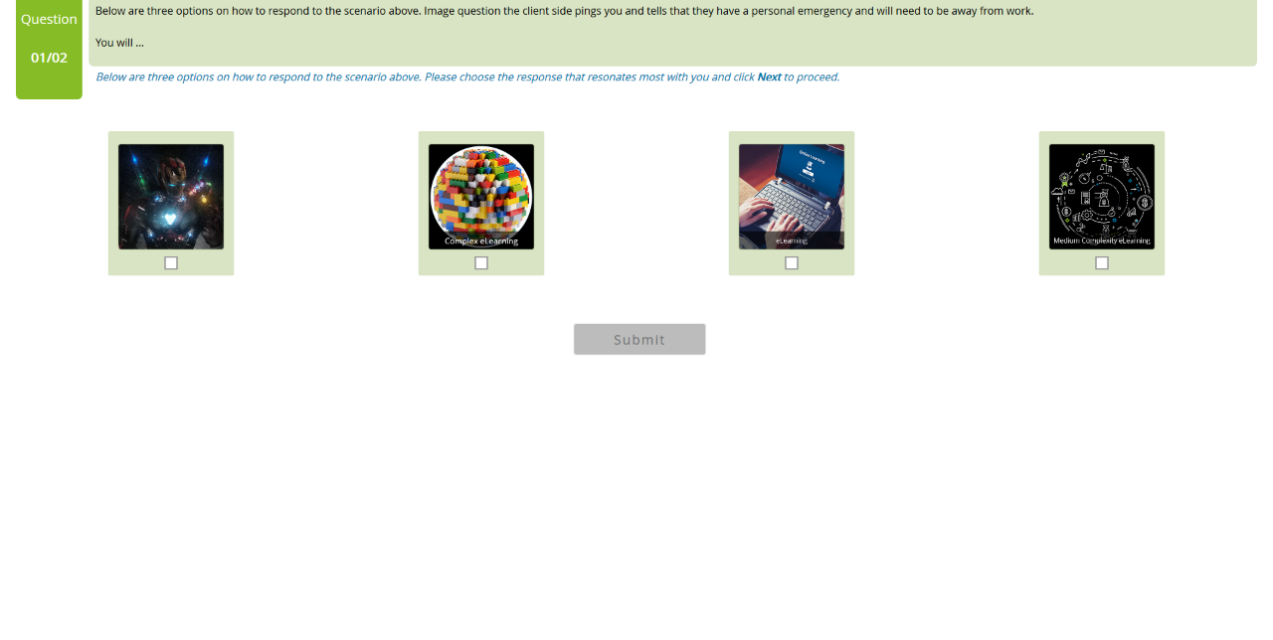

Slide 4
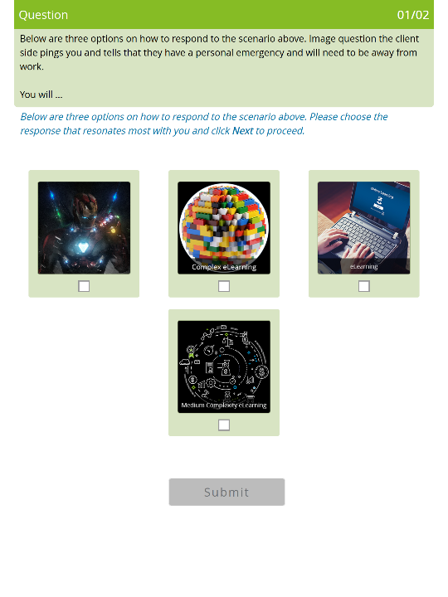

Slide 5
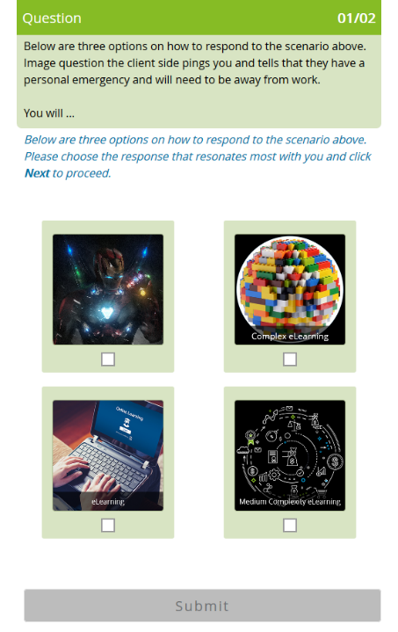

Slide 6
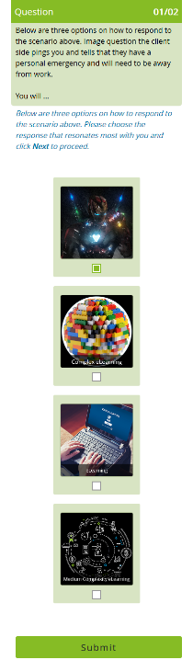

Slide 7
Problem solving Test
Please go through the problem statement in the next slides and use JavaScript to solve the problem
Development Time: 1 hour

Slide 8
Problem
Roy wants to change his profile picture on Facebook. Now Facebook has some restriction over the dimension of picture that we can upload. Minimum dimension of the picture can be L x L, where L is the length of the side of square.
Now Roy has N photos of various dimensions. Dimension of a photo is denoted as W x H where W - width of the photo and H - Height of the photo
When any photo is uploaded following events may occur:
[1] If any of the width or height is less than L, user is prompted to upload another one. Print "UPLOAD ANOTHER" in this case. [2] If width and height, both are large enough and (a) if the photo is already square then it is accepted. Print "ACCEPTED" in this case. (b) else user is prompted to crop it. Print "CROP IT" in this case.
(quotes are only for clarification)
Given L, N, W and H as input, print appropriate text as output.

Slide 9
Input: First line contains L. Second line contains N, number of photos. Following N lines each contains two space separated integers W and H.
Output: Print appropriate text for each photo in a new line.
Sample Input
L=180
N=3
Photo=[
{W:640,H:480}
{W:120,H:300}
{W:180,H:180}
]
Sample Output
CROP IT
UPLOAD ANOTHER
ACCEPTED

