Slide 1
Slide 1: Title
Bluestock Mutual Fund Analytics Capstone
Final Presentation

Slide 2
Slide 2: Problem & Objective
Objective: Engineer an end-to-end data pipeline to analyze Indian mutual funds, calculate performance metrics, and build an interactive dashboard.

Slide 3
Slide 3: Data Sources
10 Raw CSV Datasets
Live API integration (mfapi.in)
SQLite Database Warehouse

Slide 4
Slide 4: Architecture
1. Extract (Pandas)
2. Transform (ffill weekends, clean text)
3. Load (SQLite)
4. Analyze (Jupyter)
5. Visualize (Streamlit)

Slide 5
Slide 5: EDA Highlights 1
AUM is heavily concentrated in the top 5 AMCs.
SIP inflows show consistent YoY growth of 15%.

Slide 6
Slide 6: EDA Highlights 2
Equity funds dominate total folios.
Average SIP amount peaks in the 46-55 age group.

Slide 7
Slide 7: Performance Metrics 1
CAGR (Annualized over 252 days)
Sharpe Ratio indicating risk-adjusted returns.

Slide 8
Slide 8: Performance Metrics 2
Value at Risk (VaR) calculations applied to top 5 funds.
Markowitz Efficient Frontier modeled for optimal allocation.

Slide 9
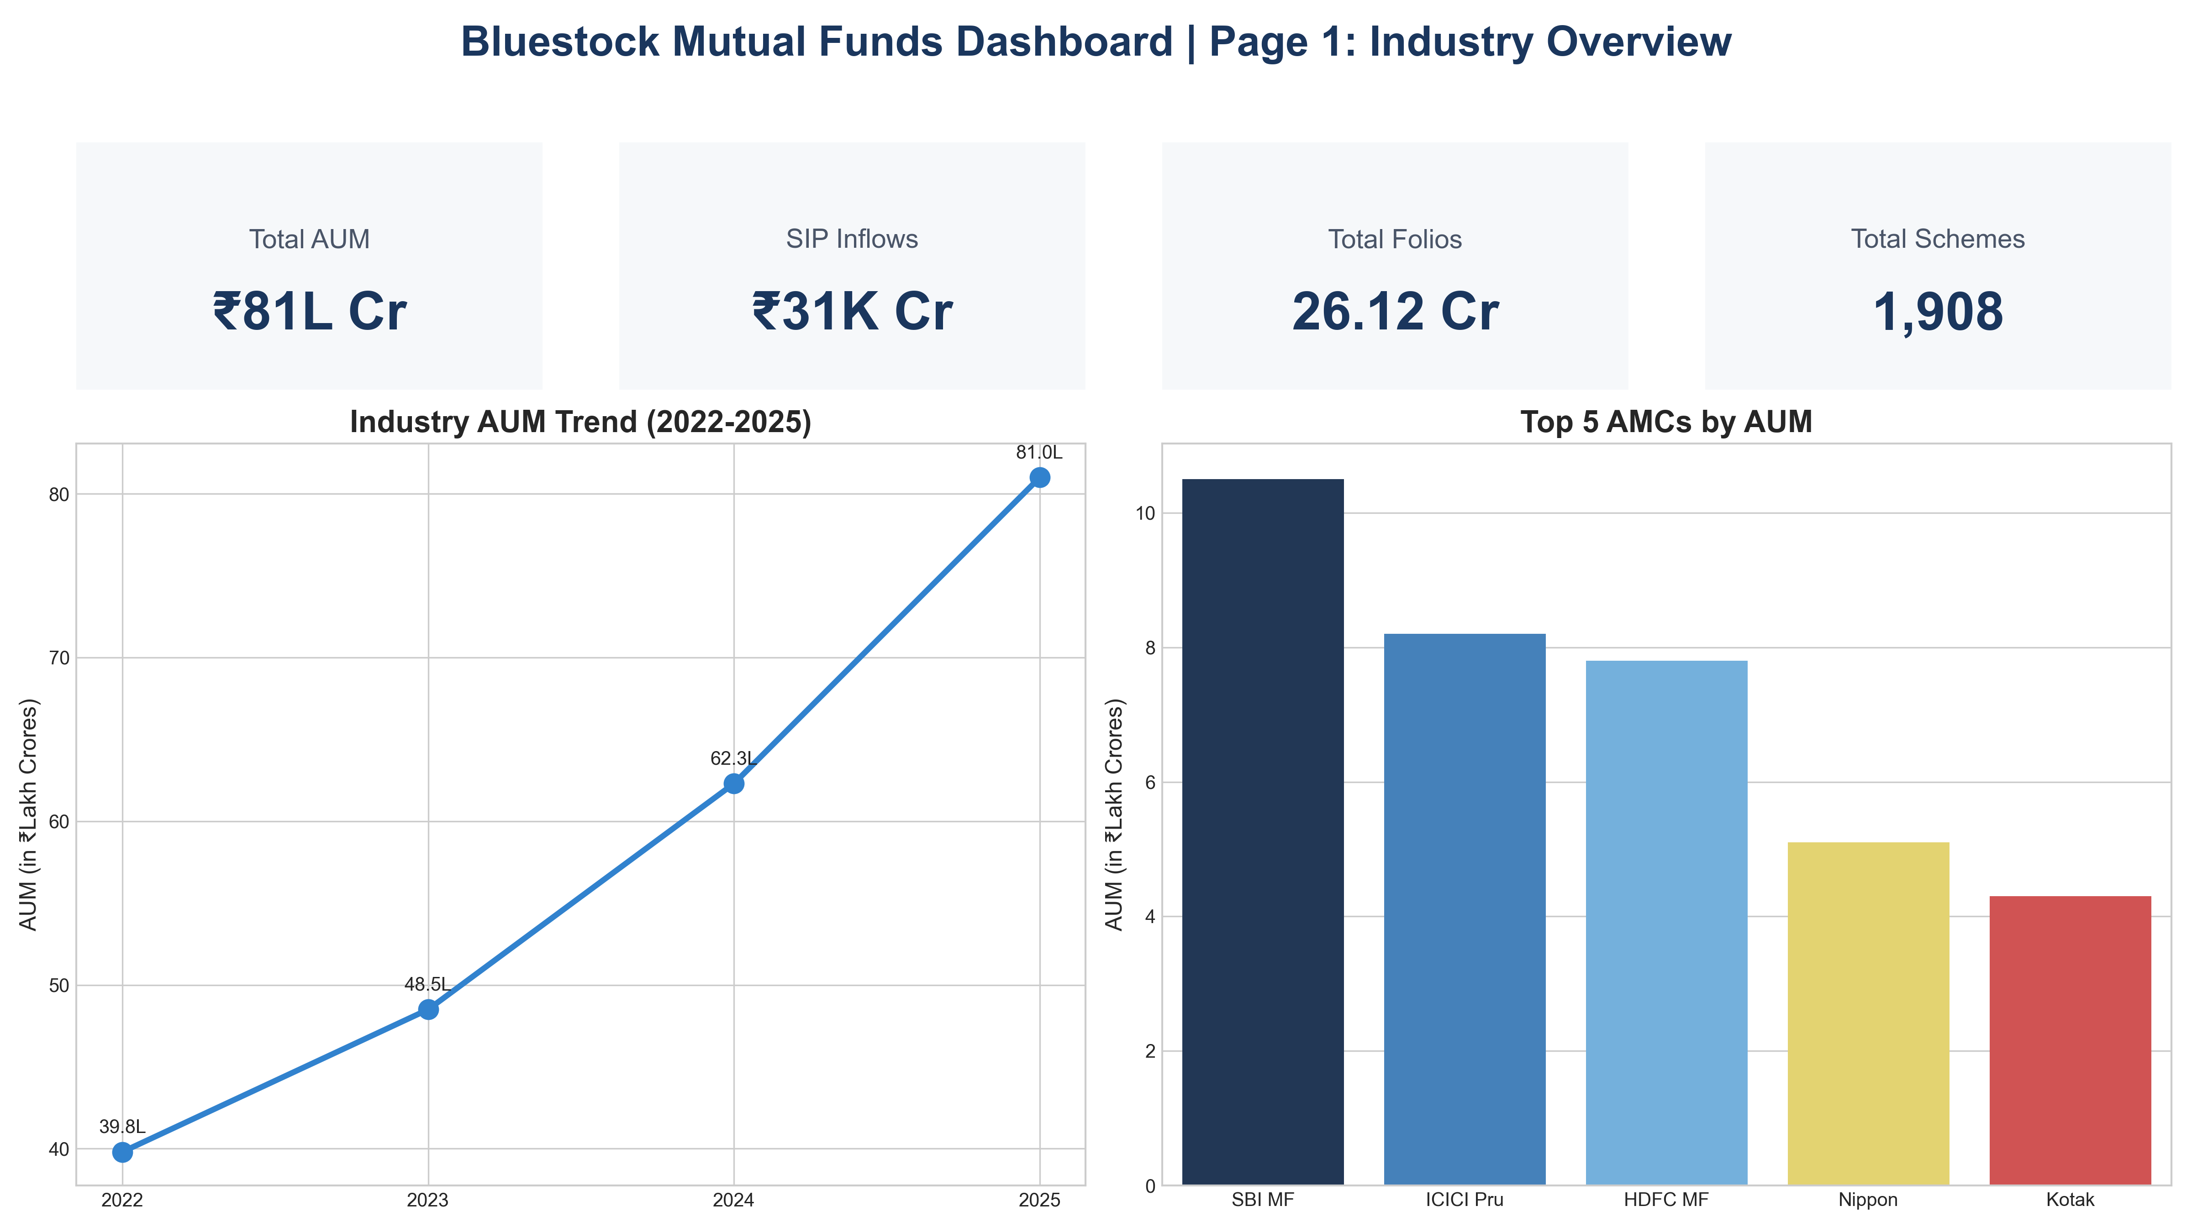
Slide 9: Dashboard - Overview
Interactive Streamlit Dashboard.
Industry Overview & Fund Performance views.

Slide 10
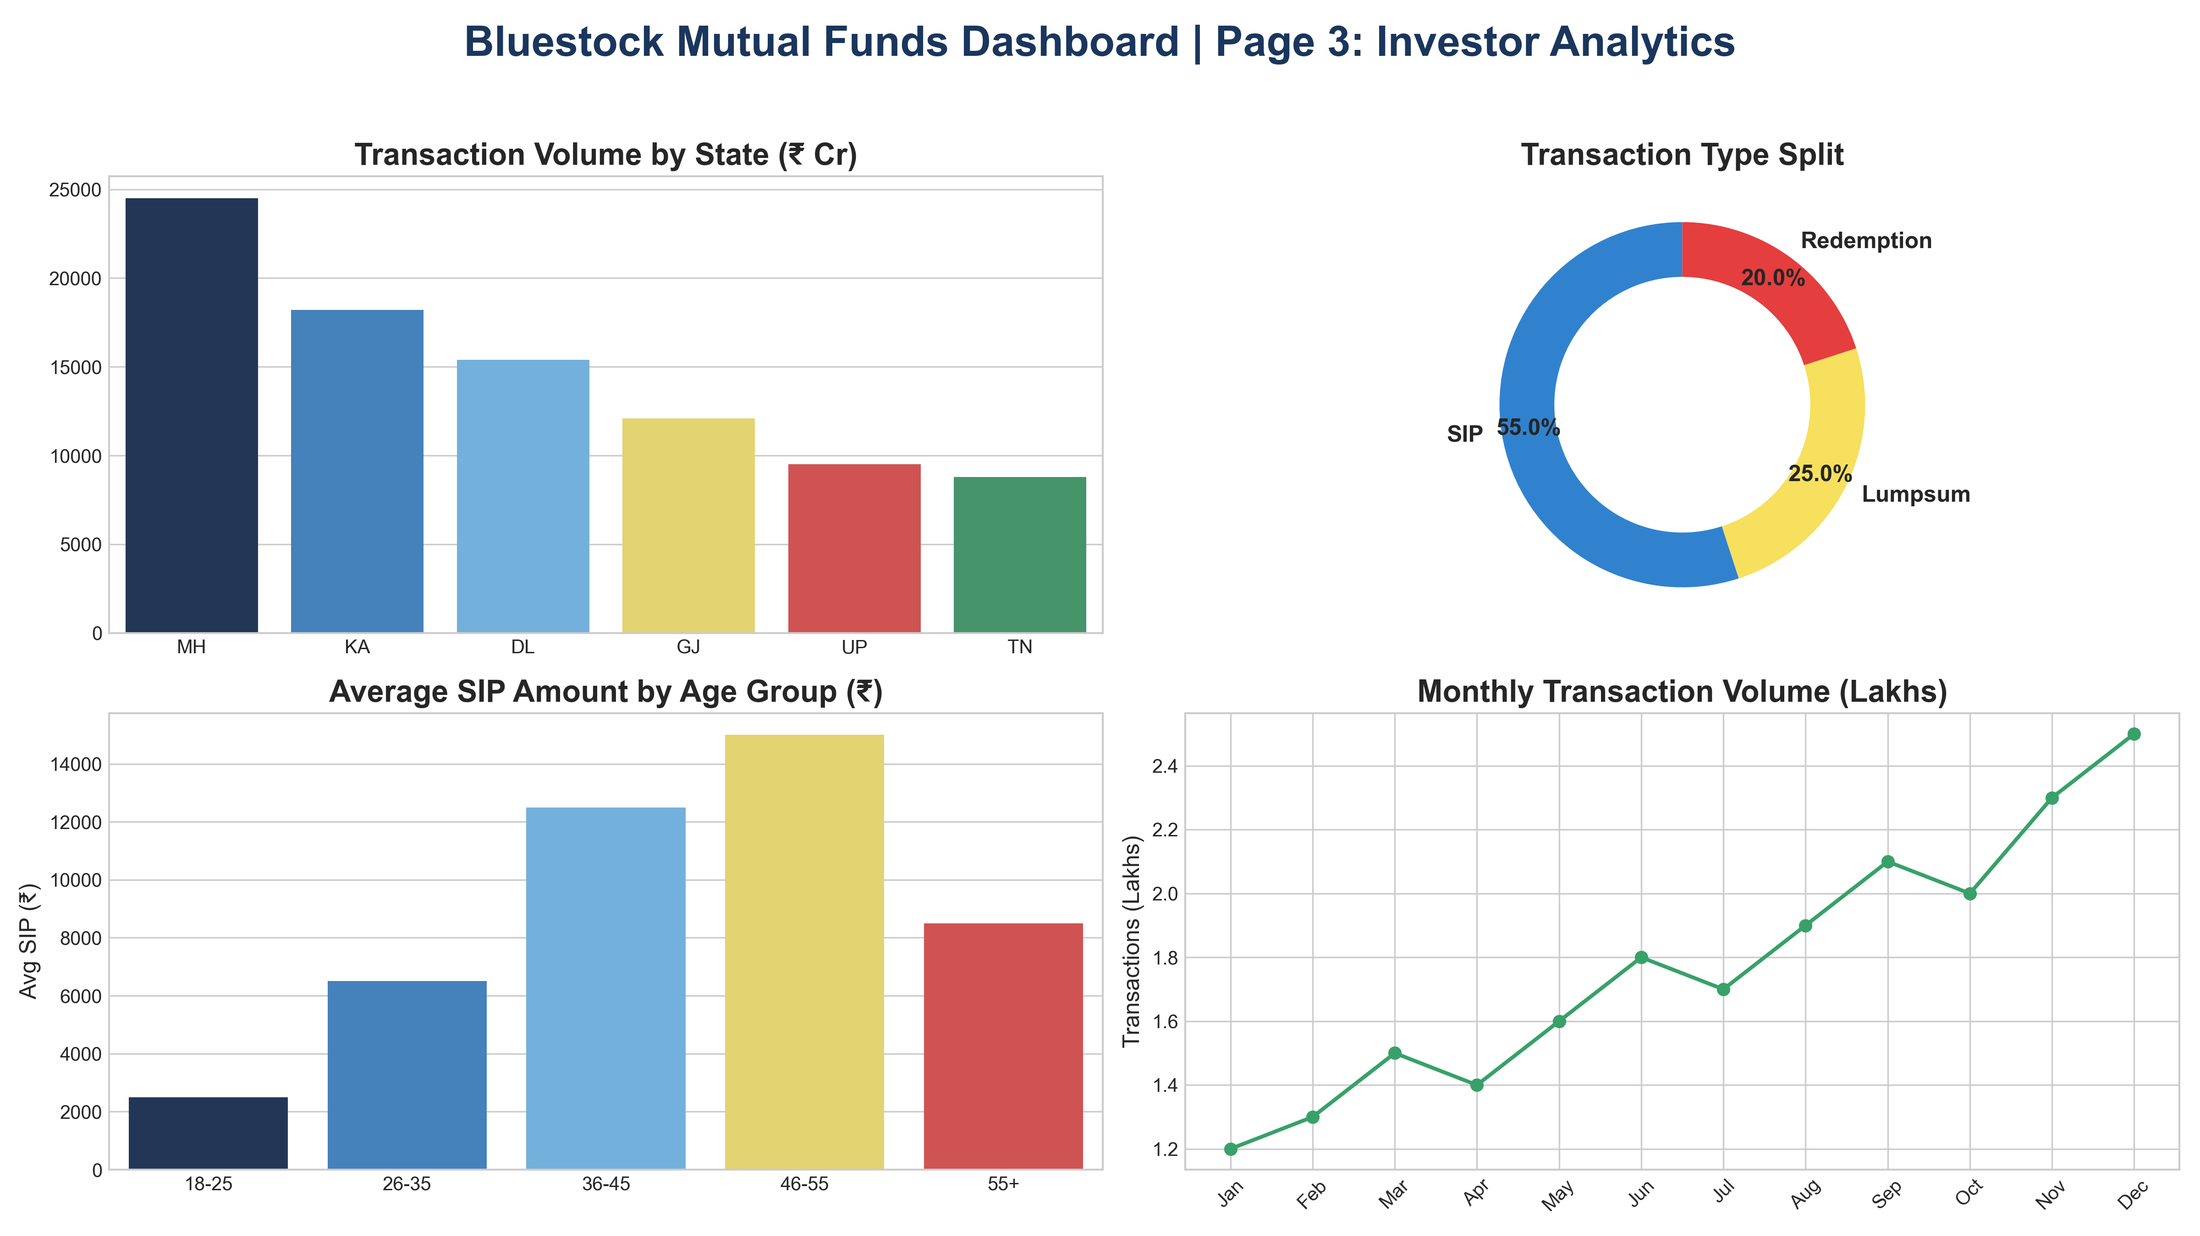
Slide 10: Dashboard - Analytics
Investor Analytics & SIP Trends.
Live filtering by Category, Fund House, and Date.

Slide 11
Slide 11: Key Findings
- Mid-cap funds offer highest returns but high VaR.
- Automated live NAV fetching ensures up-to-date tracking.
- Streamlit provides a highly viable PowerBI alternative.

Slide 12
Slide 12: Thank You
Questions?
Repository available on GitHub.

