Slide 1
Thermal Hotspot
Prediction in
Electronic Chips
🔥
Using Machine Learning
Saumya Singhal | 230940
ME644 • IIT Kanpur

Slide 2
Why Chips Overheat
The thermal challenge in modern electronics
⚡
Billions of transistors
Traditional Simulation
Each switching event dissipates heat. Modern CPUs generate heat densities of 10–100 W/mm².
✓ Highly accurate ✗ Hours per simulation ✗ Cannot explore 1000s of designs ✗ Not feasible in design flow
🌡️
Uneven heat distribution
CPU cores run 10–15× hotter than memory blocks, creating localised 'thermal hotspots'.
🐌
Thermal throttling
Chip automatically slows down to prevent damage — visible as sudden performance drops.
ML Surrogate Model
✓ Millisecond inference ✓ 1000s of designs explored ✓ Trained once, used forever
⏳
Electromigration & aging
High temperatures push metal atoms apart, causing microscopic breaks and shortened lifespan.

Slide 3
Physics of Heat Flow
Fourier's law, thermal resistance stack & the Gaussian hotspot model
Thermal Stack (Cross-Section)
HIGH T
Governing Equation (Fourier's Law)
Heat Sink
∇ · [k(x)∇T(x)] + Q(x) = 0
TIM Layer
k = conductivity Q = heat generated T = temperature
Heat Spreader (IHS)
Metal Interconnects (Cu/W)
Ohm's Law Analogy
Silicon Die (Active Layer)
ΔT = Q × Rθ,total
Package Substrate
Like V = IR — more resistance → more temperature rise
PCB / Motherboard
LOW T
Gaussian Hotspot Temperature Model
T(x,y) = T_boundary + Q_base × R_total + Q_block × exp[-(x-x₀)² + (y-y₀)²) / 2σ²] × R_local

Slide 4
Dataset Generation
12,000 physics-informed synthetic samples with 14 input features
Why Synthetic?
Heat Source
Packaging
Real chip thermal data is highly confidential (Intel, AMD, NVIDIA treat it as IP). We use the known physics equation to generate unlimited, realistic, labelled samples — called a physics-informed dataset.
▸ power_density (1–8 W/mm²)
▸ tim_hs_conductance (0.3–1.2 W/cm²K)
▸ block_power_map (0.5–15 W/mm²)
▸ boundary_temp (290–330 K)
▸ metal_cond_Cu
▸ metal_cond_W
💡 Key Insight
r_sq is derived from x, y, hotspot_cx, hotspot_cy — but pre-computing it gives linear models a chance to approximate the Gaussian decay.
Silicon Die
Spatial / Hotspot
▸ thermal_cond_si (100–170 W/m·K)
▸ x, y (query coordinates)
12,000
Total Samples
▸ die_thickness (0.3–0.8 mm)
▸ hotspot_cx, hotspot_cy
▸ sigma_spot (spread radius)
9,600 / 2,400
▸ r_sq = (x-x₀)² + (y-y₀)²
Train / Test Split

Slide 5
Data Preprocessing & Feature Insights
Correlation analysis, scaling, and quality checks
Pearson Correlation with Temperature
Feature Scaling (Z-score)
boundary_temp
+0.697
x̃ⱼ = (xⱼ − μⱼ) / σⱼ
• Applied to OLS and MLP (not RF)
• Scaler fitted on training set only — prevents data leakage
• Ensures equal gradient weight across all features
power_density
+0.516
die_thickness
+0.349
⚠️ Why is block_power_map correlation so low?
thermal_cond_si
-0.194
Despite being physically crucial (drives the hotspot), block_power_map has r = 0.063 with temperature.
Reason: Its effect depends entirely on proximity (r_sq). At hotspot centre: huge effect. Far away: negligible effect. This spatial interaction is inherently nonlinear — linear correlation misses it entirely.
This is exactly why nonlinear models outperform linear ones.
r_sq
-0.122
block_power_map
+0.063

Slide 6
Machine Learning Models
📐 Linear Regression
🌲 Random Forest
🧠 Neural Network (MLP)
Linear Baseline
Nonlinear Ensemble
Smooth Nonlinear
Weighted sum of 14 features + regularisation. Interpretable coefficients. Cannot model the Gaussian exponential.
200 decision trees, each seeing a random data subset. Piecewise-constant approximation of the nonlinear physics.
Architecture: 14→128→64→32→1, ReLU activations, Adam optimiser. Smooth differentiable function approximator.

Slide 7
Model Performance — Quantitative Results
Test set (n = 2,400) across all metrics
Model | R² ↑ | RMSE (K) ↓ | MAE (K) ↓ | Max Error (K) ↓ | CV R²
OLS Linear Reg. | 0.9186 | 4.720 | 3.413 | 40.53 | 0.920 ± 0.004
Random Forest | 0.9524 | 3.610 | 2.315 | 31.95 | 0.950 ± 0.002
Neural Net (MLP) ★ | 0.9797 | 2.355 | 1.831 | 10.45 | 0.982 ± 0.002
🎯 MLP wins all metrics
⚠️ Max Error matters most
✓ No overfitting
Best R², RMSE, MAE and Max Error — comprehensive superiority
OLS worst-case: 40.53 K. MLP: 10.45 K. 4× safety improvement.
CV R² tracks test R² closely for all models.

Slide 8
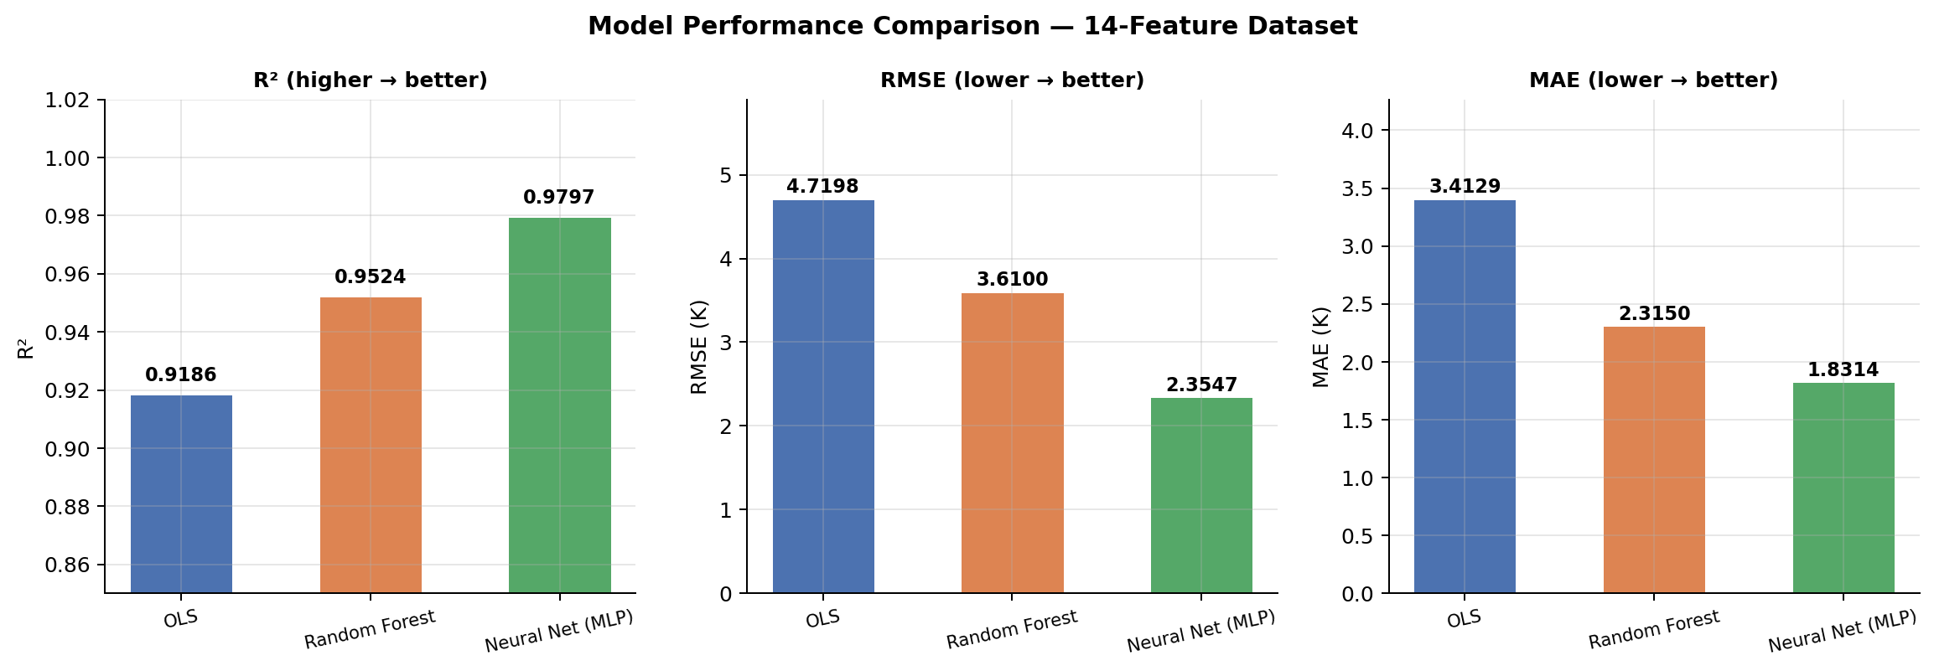
Performance Comparison Charts
R², RMSE, and MAE across all models
Clear trend: OLS → RF → MLP | Each step adds nonlinear expressiveness and reduces error

Slide 9
Why Max Error Matters — The Hotspot Challenge
The Gaussian nonlinearity is where models fail or succeed
Worst-Case Prediction Error
The Gaussian Nonlinearity Challenge
ΔT_hotspot = Q_block × exp(−r²/2σ²) × R_local
OLS
40.53 K
This 3-way interaction (Q_block, r², σ) inside an exponential is fundamentally nonlinear. Errors are worst at hotspot centres where this term peaks.
Random Forest
31.95 K
OLS:
Can only fit w·r² — misses the exponential entirely. Predicts too LOW at hotspot centre.
MLP
10.45 K
Random Forest:
Piecewise-constant approximation. Blocky prediction near the sharp peak.
4× improvement in worst-case error
MLP:
Smooth function composition across layers. Approximates the exponential decay almost perfectly.

Slide 10
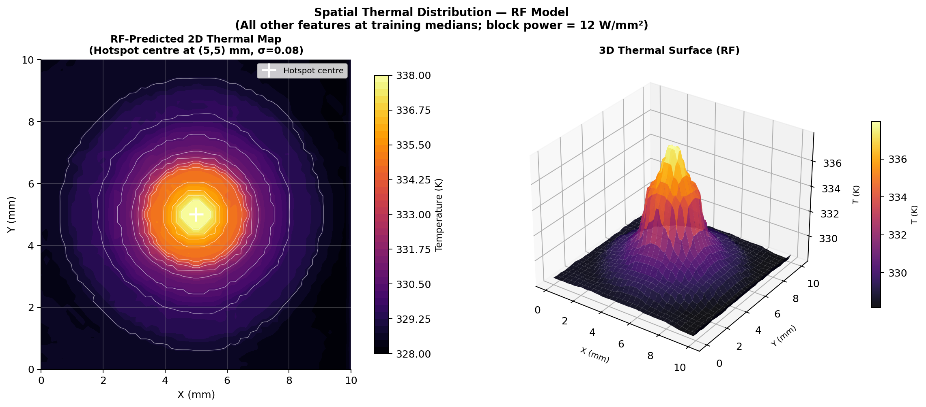
Spatial Thermal Map & 3D Surface
Gaussian hotspot shape predicted by the models — hotspot at (5,5) mm, σ=0.08
Temperature Cross-Section Insights
OLS: Severely underestimates hotspot peak. Cannot follow exponential — systematic error pattern. Too low at centre, too high at mid-distance. Random Forest: Captures peak shape but in a 'blocky', stepped manner. Piecewise-constant nature can't follow smooth curves. MLP: Follows the true physics curve almost perfectly, including the sharp central peak.
RF Predicted Thermal Map
Hotspot at (5,5) mm, σ=0.08

Slide 11
Discussion: Why Each Model Performs As It Does
Physical reasoning behind the performance gap
📐 Linear Models — Hard Ceiling at R² = 0.92
🌲 Random Forest — Piecewise Approximation at R² = 0.95
🧠 Neural Network — Near-Perfect at R² = 0.98
The governing equation contains exp(−r²/2σ²) — a 3-way nonlinear interaction
Approximates Gaussian via recursive binary splits on r², σ, Q_block
Universal approximation theorem: MLP can approximate any smooth function
Linear models can only fit: w₁·r² + w₂·σ + w₃·Q_block (additive)
E.g. 'if r² < 0.01 AND σ < 0.1 AND Q > 10 → predict 370 K'
Smooth, differentiable predictions — can follow the exponential curve exactly
Cannot represent the product-inside-exponential structure
200 trees average away individual variance — strong ensemble effect
Layer 1 learns linear combinations; Layer 2–3 compose nonlinear interactions
No amount of data or tuning can overcome this structural limitation
OOB R² = 0.9524 matches test R² exactly — robust validation
Early stopping prevents overfitting — generalises to unseen test data
The 0.08 gap in R² directly quantifies the 'locked-in' nonlinear physics
Remaining gap: piecewise-constant predictions can't follow smooth curves
Result: smooth, physically-accurate thermal surface prediction

Slide 12
Limitations & Scope
✅ What This Model DOES
❌ What This Model Does NOT Do
Predicts temperature at any spatial point given chip properties and known hotspot location
Does NOT discover where hotspots are — hotspot location is a required input
Works for steady-state (equilibrium) thermal conditions
Does NOT handle multiple overlapping heat sources (real chips have many)
Models a single Gaussian hotspot per sample
Does NOT model transient (time-varying) workloads or thermal dynamics
Provides fast surrogate predictions (milliseconds vs hours for FEM)
Does NOT use real chip measurements — synthetic data needs real-world validation
Delivers physically consistent, interpretable results
Does NOT generalise to chip architectures outside the training parameter ranges

Slide 13
Conclusions & Future Work
MLP is the best model
Physical consistency
1
3
R² = 0.9797, RMSE = 2.355 K, Max Error = 10.45 K — near-perfect thermal prediction
All models learn correct sign and magnitude relationships — physically trustworthy
Nonlinear gap quantified
Top 5 features = 96.8%
2
4
Linear models ceiling at R² = 0.919 due to the Gaussian physics. The 0.06 gap is structurally locked.
boundary_temp, power_density, die_thickness, thermal_cond_si, r_sq dominate chip temperature
3
Future Work:
▸ Physics-Informed NNs (PINNs)
▸ CNN for full thermal map
▸ Graph NNs for multi-hotspot
▸ Transient LSTM modelling
▸ Real chip validation

