Slide 1

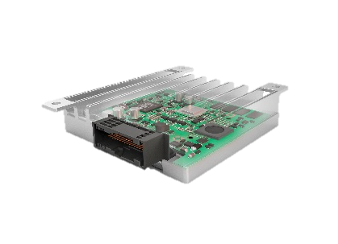
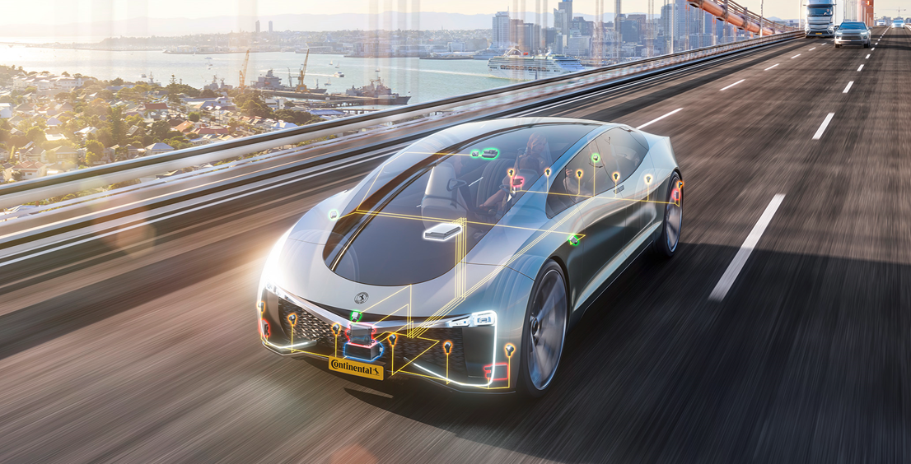
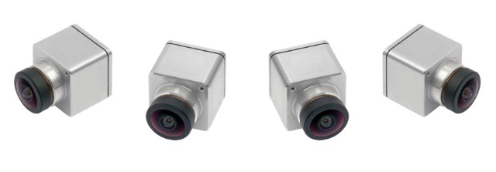
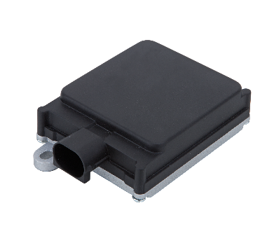
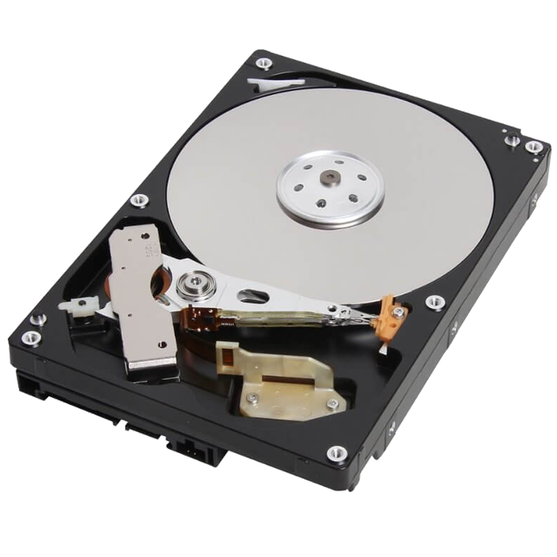
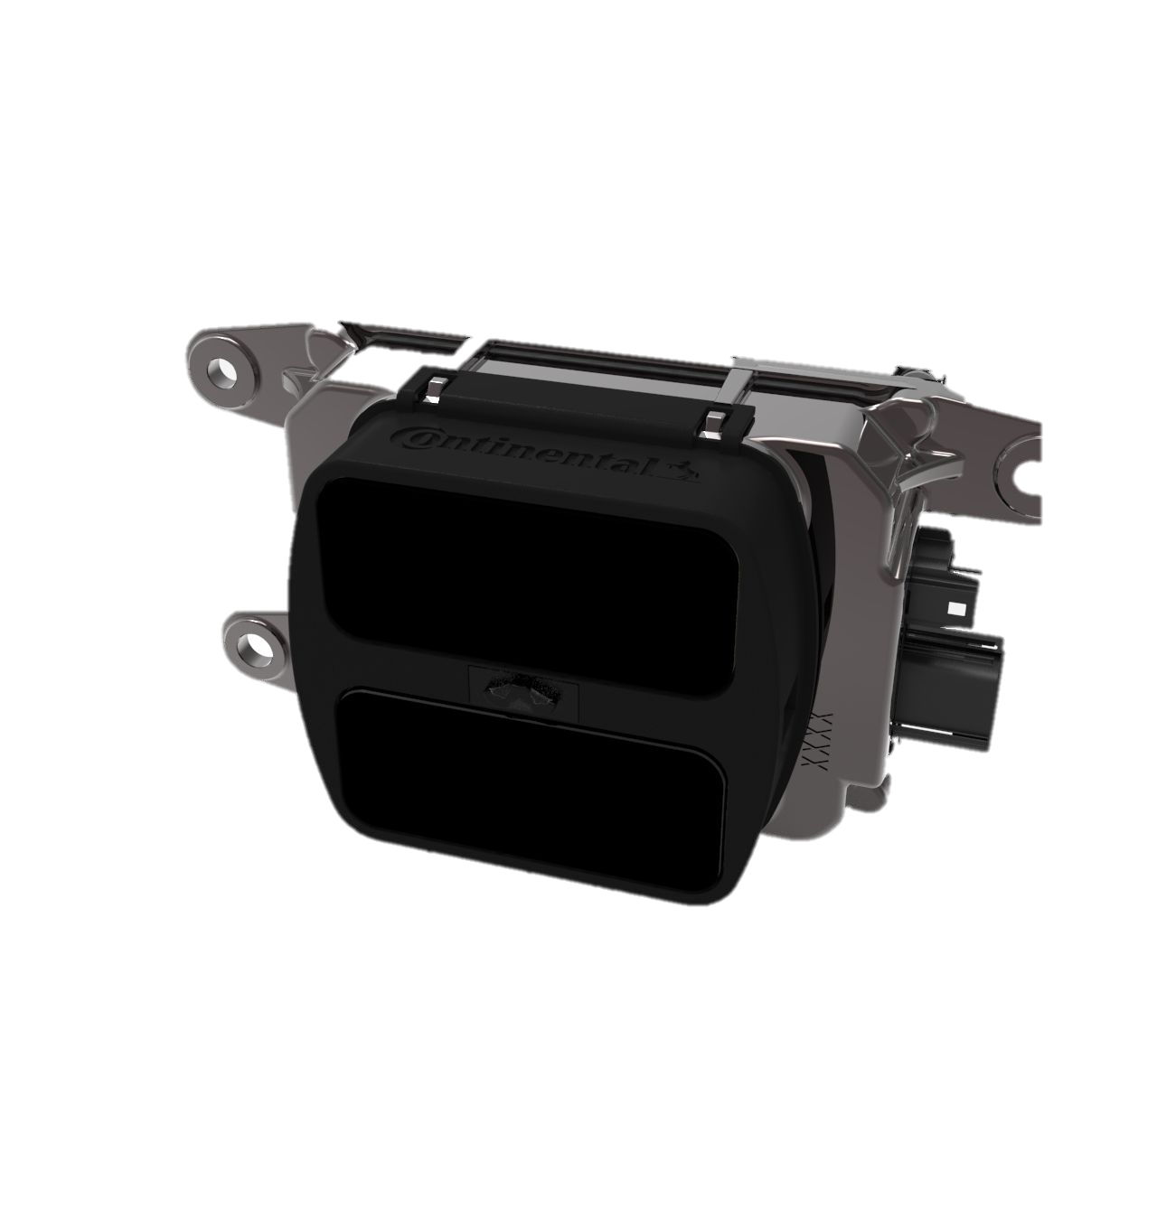
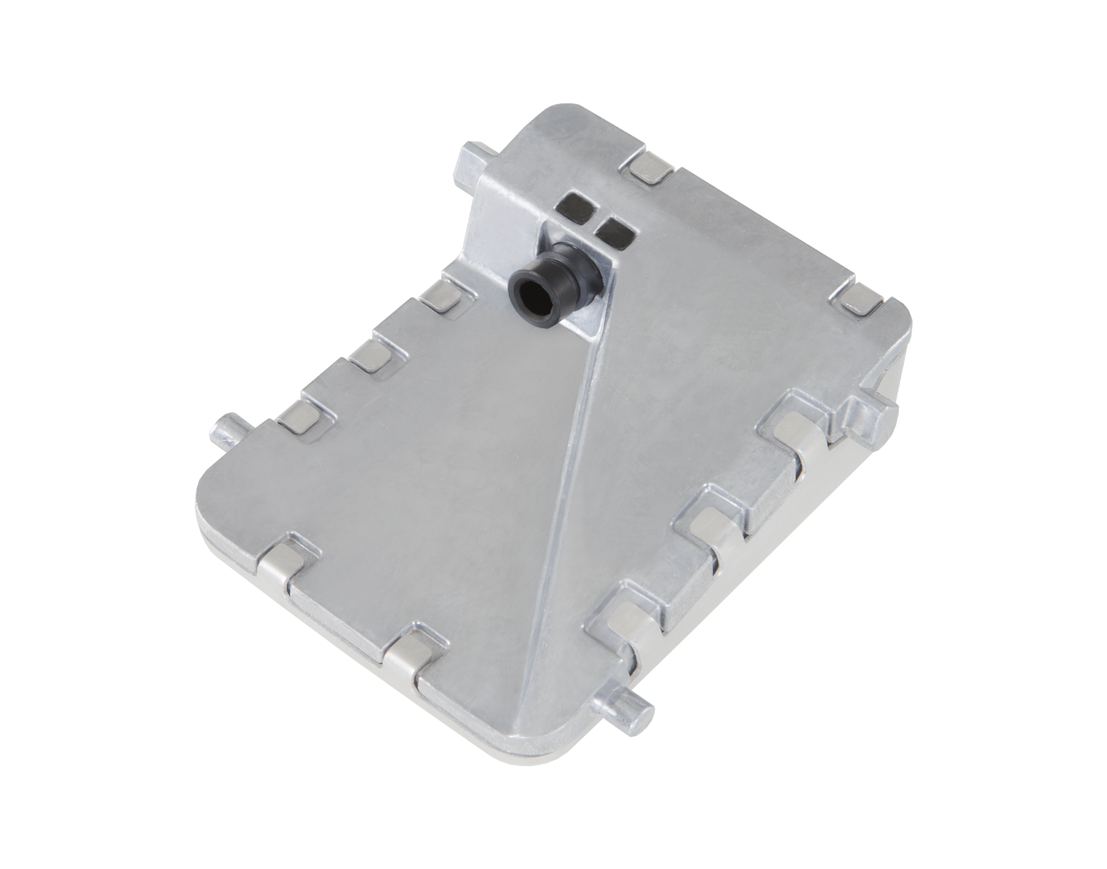








enhanced Communication Abstraction Layer
Automated Driving
Control Unit
eCAL connects distributed components
eCAL package includes:
eCAL Core communication library
eCAL Mon for introspection and debugging
eCAL Rec for recording live data
eCAL Play for replaying data
eCAL Sys for managing in-vehicle startups
Develop components with C, C++, C# & Python
Camera
Radar
Recording
System
Lidar
Camera
Lane Marker Detection
GPS Position
Vehicle Localization
Wheel Ticks
Position Estimation
eCAL Recording
Typical eCAL Autonomous Driving use case
eCAL Recorder

