Slide 1
8” WAFER FAB PROCESS
By - Adarsh Mishra

Slide 2
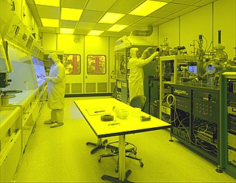
Clean ROOM
SCL has Cleanrooms of class 1,10, 100 and 1000
Types of contamination
1. Particles
2. Metallic impurities
3. Organic contamination
4. Native oxides
Contamination Control
1. Filtration
2. Cleanroom Garments
3. Commodities and Cosmetics
4. Measurement and Instrumentation

Slide 3
DIFFUSION
Diffusion is the process by which a species moves in the presence of a concentration gradient and energy.
If there is an Dopant concentration gradient present, ∂C/∂ x, in a finite volume, there will be a tendency for the dopant material to move so that a decrease in the gradient is produced.
Concentration gradient and energy ( in the form of heat) are the major requirements for diffusion.
- Dopants can be in solid, liquid or gaseous form.

Slide 4
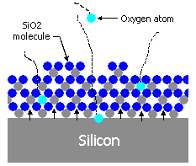
OXIDATION
Definition
Oxidation of Si is a process in which either O₂ or water vapor (H₂O) react with the silicon and produce SiO₂ layer.
SiO2 on a Silicon wafer is a chemically stable protective layer₂ which makes silicon the most widely used semiconductor substrate.
There are two type of oxidation :–
-WET
- DRY

Slide 5
WET OXIDATION
Si + 2H₂ O(Vapor) SiO₂ + 2H₂
Water vapor Formation by Pyrogenic/Hydrox Torch
H₂ (15slm) + O₂( 8 slm) H₂O (Vapor)
Rate of Wet oxidation is around approximately 4 times more than that of dry oxidation.
Changes in the OH content of the oxide (i.e SiOH) tends to “loosen” the structure of SiO₂ with change in the viscosity, R.I, film density. Thus the quality of the WOX film is poorer than that of DOX.

Slide 6
DRY OXIDATION/ DRY OXIDATION + DCE
Si + O₂ SiO₂
For removal of contaminants and cleaning of the quartz tube DCE (C₂H₂Cl₂) is used, which decomposes at oxidation temp and produces Cl¯ as follows
2C₂H₂Cl₂ + O₂ 2CO₂ + 2H₂+4Cl ¯
4Cl ¯ + 4Na⁺ 4NaCl (vapor)
Moreover, the addition of DCE enhances the oxidation rate by 4% and increases breakdown strength of the SiO₂.

Slide 7
Oxide Furnace CV Qualification
C-V (Capacitance-Voltage) measurement is done periodically for quartz tube qualification. This is the most common oxide quality monitoring diagnostic employed in semiconductor device manufacturing. C–V plot provides useful information like mobile ion concentration, substrate doping and oxide charges etc. These are the main sources of furnace contamination as well as device failure.

Slide 8
Phototlithography
Photolithography is transfer of the required geometric pattern onto the wafer or layer using light.
One of the most important processes in CMOS fabrication
Determines the minimum feature size of the device

Slide 9
PROCESS FLOW
Priming
Wafer is coated with a primer (HMDS).
This is done to ensure the photo resist adhesion to the surface.
ARC
An anti-reflective coating is applied to the substrate to minimize reflection and enhance the contrast during the exposure step.
Pre heating of the wafer is done to remove any moisture present.
The wafer is placed on a chill plate to ensure that the coated resist does not evaporate too rapidly due to its high temperature.

Slide 10
A layer of photoresist material is spin-coated onto the substrate.
The wafer is rotated at high speed to evenly spread out the dispensed photo resist.
Photoresist
The wafer is rotated at high speed to evenly spread out the dispensed photo resist.
Spin Dry

Slide 11
This is done to vaporize any solvent remaining in the photo resist and to improve the uniformity and adhesion of the resist layer.
Soft
Bake
The photoresist-coated substrate is aligned with a photomask, which contains the desired pattern to be transferred.
The substrate is exposed to ultraviolet (UV) light through the photomask. The UV light passes through the transparent areas of the mask, exposing the corresponding regions of the photoresist.
Mask Alignment & Exposure

Slide 12
The exposed substrate is subjected to a post-exposure bake process. This step enhances the chemical reactions in the photoresist and helps to define the desired pattern.
Post Exposure Bake
The substrate is immersed in a developer solution that selectively removes the exposed regions of the photoresist.
The substrate is rinsed with a solvent, such as DI water, to remove any remaining developer solution and photoresist residues.
Development
also known as post development bake.
This is done to harden the photo resist and improve its adhesion to the substrate for further processes like diffusion and ion implantation.
Hard Bake
(optional)

Slide 13
PHOTORESISTS
The word Photoresist comes from the combination of photosensitive and acid resistant, i.e. a photoresist can be photographically patterned and will stand up to acid etch, enabling patterned etching.
They serve two important functions:
Transferring the pattern from the mask onto the wafer.
Protecting the underlying substrate in subsequent processes.

Slide 14
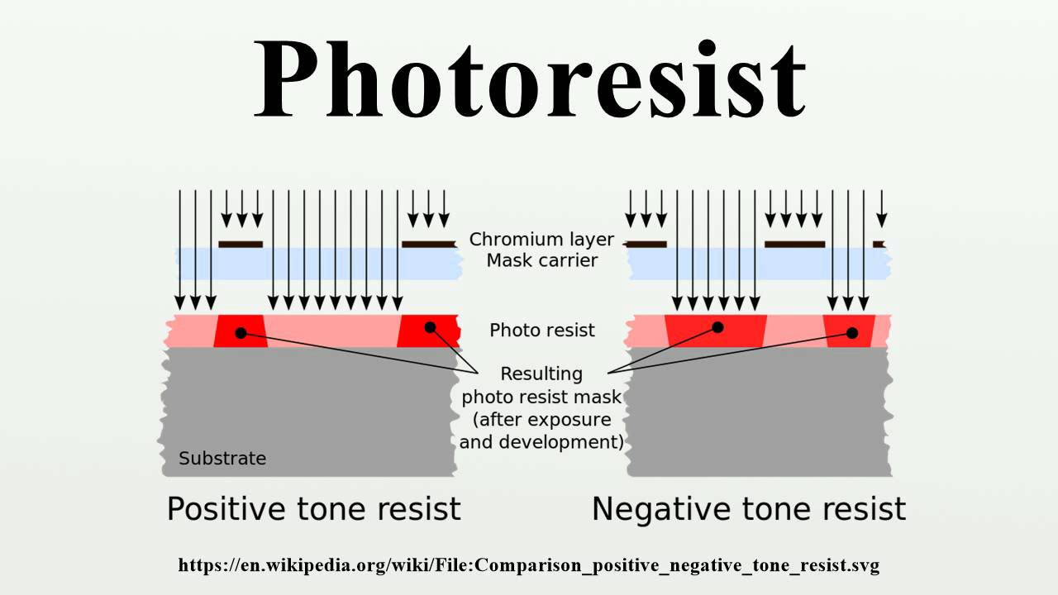
TYPES OF PHOTORESISTS
There are two types of Photo resist:
Positive photoresist: The section which gets more exposed to light becomes soluble in developer solution.
Negative photoresist: The solution which on exposure to light becomes insoluble in developer solution

Slide 15
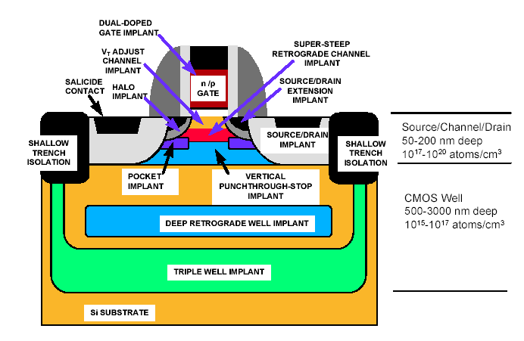
ION Implantation
Ion implantation is a materials engineering process by which ions of a material are accelerated in an electric field and impacted into a solid.
This process is used to change the physical, chemical, or electrical properties of the solid.
Ion implantation is performed with an electric field which accelerates the ionized atoms or molecules so that these particles penetrate into the target material until they come to rest because of interaction with the silicon atoms.

Slide 16
Advantages
Advantage:
Low-temperature process (can use photoresist as mask)
Wide selection of masking materials, e.g. photoresist, oxide, poly-Si, metal
Less sensitive to surface cleaning procedures.
Very fast (6" wafer can take as little as 6 seconds for a moderate dose)
Complex profiles can be achieved by multi-energy implants.

Slide 17
Disadvantages
Disadvantage:
Very expensive equipment ( $1M or more).
At high dose values, throughput is less than diffusion (chemical source pre-deposition on surface).
Ions damage the semiconductor lattice. Not all the damage can be corrected by annealing.
Very shallow and very deep doping are difficult or impossible.
Masking materials can be “knocked” into the wafer creating unwanted impurities, or even destroying the quality of the interface.

Slide 18
THIN FILM
Films of thickness typically < 2µm are called as thin films.
The deposition of metal and dielectric films.
Most of thin film activities are in back-end.
Some properties of an acceptable thin film for wafer fabrication are good step coverage, ability to fill high aspect ratio gaps, good thickness uniformity, high purity and density, controlled stoichiometries and excellent adhesion.

Slide 19
Deposition Method
CVD
PVD
Chemical vapour deposition
Precursors diffuse on the surface
Uniform step coverage
For dielectric layers
Good for deposition of film over uneven surfaces & gap fill.
E.g., APCVD, LPCVD, PECVD, HDP-CVD
Physical vapour deposition
No surface diffusion
Poor step coverage
For metal layers
Good for depositing films on flat surface.
E.g., evaporation, sputter deposition

Slide 20
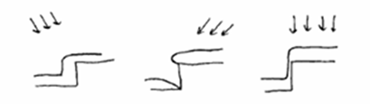
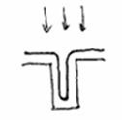
PVD
Everything sticks where it hits
CVD
Deposits evenly over the surface

Slide 21
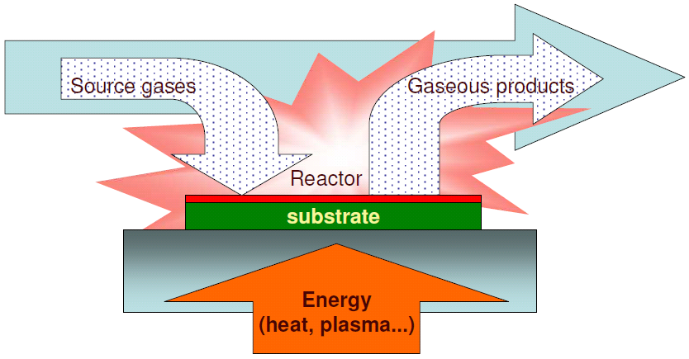
CVD – Chemical Vapor Deposition
Chemical vapour deposition (CVD) is a process where one or more volatile precursors are transported via the vapour phase to the reaction chamber, where they decompose on a heated substrate.
Reactions in the gas-phase is most often unwanted

Slide 22
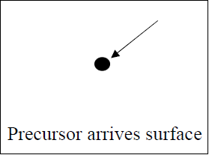
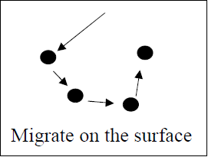
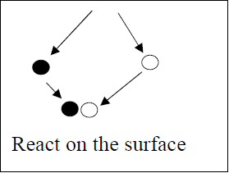
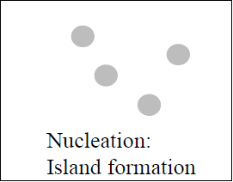
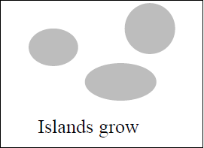
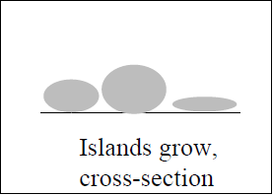
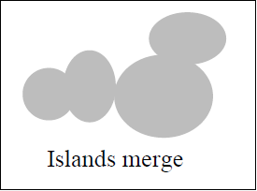
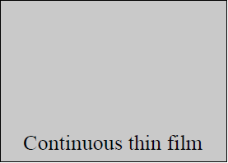
Deposition process

Slide 23
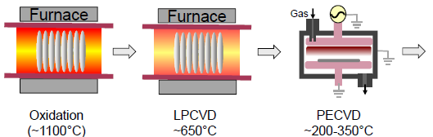
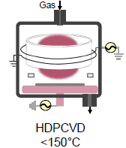
TYPES of CVD
APCVD (Atmospheric pressure CVD) :- simple and fast process, non uniform film thickness, poor step coverage
LPCVD (Low Pressure CVD) :- Excellent uniformity and conformity, Low deposition rate
PECVD (Plasma Enhanced CVD) :- Low temperature, risk for chemical and particle contamination
HDP-CVD (High density plasma CVD) :- better gap filling, better step coverage

Slide 24
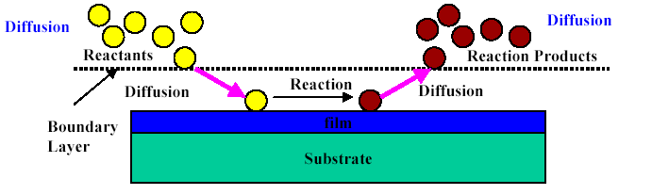
Etching
Etching is the process whereby unwanted material is removed from a wafer
Etching consists of 3 processes:
Mass transport of reactants (through a boundary layer) to the surface to be etched.
Reaction between reactants and the film to be etched at the surface.
Mass transport of reaction products from the surface boundary layer

Slide 25
WET ETCHING
The removal of excess material from the surface of the wafer by using liquids is called Wet etching.
In this method, a solution which can etch the material is kept in a tank and the wafer is dipped in the tank for a given time, at a given temperature.
After etching, the wafers are taken out and rinsed in DI water and dried by spinning. If they are dried without spinning, some water may remain on the wafer leaving ‘water mark’.
Hence spin drying is employed. Even with spin drying, watermarks may form sometime, and in order to avoid it, isopropyl alcohol (IPA) is used for final rinse and spin drying.

Slide 26
Limitation of WET ETCHING
There are some disadvantages of wet etching are as follows:
Wet etching is isotropic
Requires large amount of etchant chemical
Pattern transfer leads to undercut in the layer
No control for precious etching

Slide 27
DRY ETCHING
Gaseous form can obtain highly anisotropic etching profiles, mainly avoid the undercutting problem of wet etching.
Common used dry etching techniques:
Plasma systems
Ion milling
Reactive ion etching(RIE)

Slide 28
CMP & YIELD
CMP is the process of smoothening and polishing the wafer surface, aided by chemical and mechanical forces.
Yield is fraction of total number of good chips to the total number of chips manufactured. A good chip means that it passes all functions tests that are specified for the product.
Defect inspection basically scanning wafer for defects. In this defects are found to improve yield. Defect review involves classifying defects captured during wafer inspection. In this defect images are stored for future references.

