Slide 1

Machine Learning Hackathon CG 2022
Team Name-Ashwamedh
Team Leader Name- Adarsh pal
Team Leader Email Address-adarshpal740@gmail.com

Slide 2
Brief description of the problem at hand:
Phishing Detection
To identify if the website is legitimate or a phishing website.
Phishing is a type of social engineering where an attacker sends a fraudulent (e.g., spoofed, fake, or otherwise deceptive) message designed to trick a person into revealing sensitive information to the attacker or to deploy malicious software on the victim's infrastructure like ransomware.

Slide 3
Solution proposed and description:
Creating a machine learning model which identify if the website is legitimate or a phishing website.
Here, we have used the random forest classifier to create our ML model
We have trained our model on 8955 different data sample each having 30 features.

Slide 4
Technology/Tool Stack Used:
Jupyter notebook
Vs code
Scikit learn
Pandas
NumPy
Seaborn
matplotlib

Slide 5

Approach:
Imported required libraries.
Read training dataset.
Plotted correlation heatmap.
Separated dataset into target variable and feature matrix.
Trained our model on dataset.
Predicting result through our model.
Creating csv file of our prediction.

Slide 6
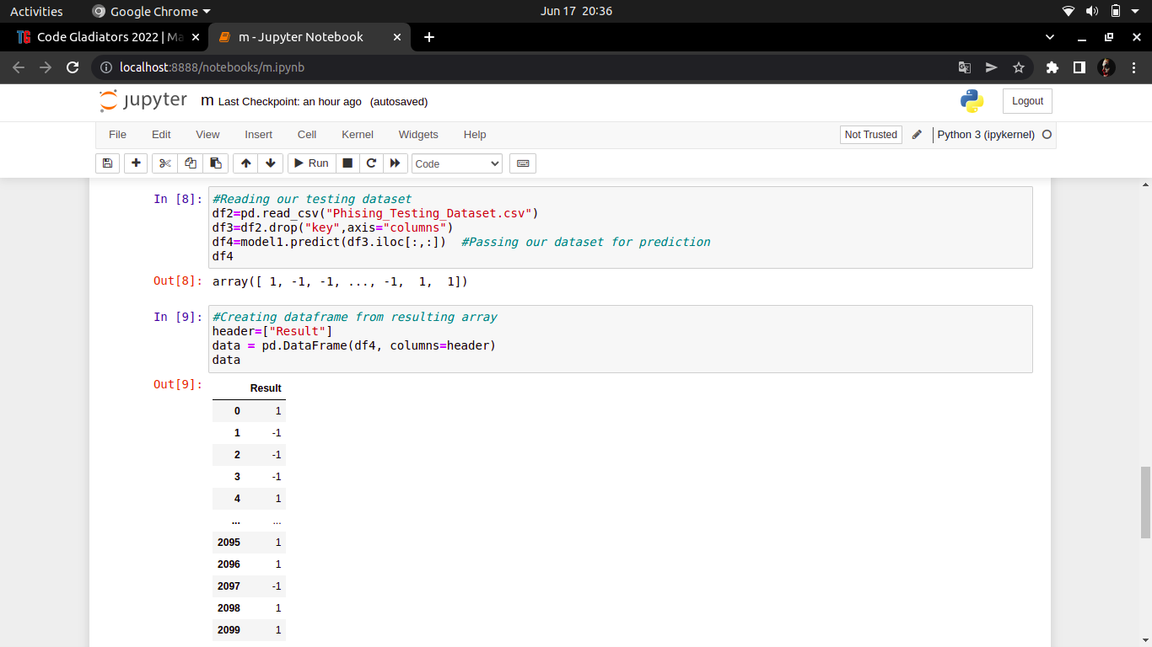
Execution Demo(Video/Screenshots) of the solution:

Slide 7
Source code as ZIP or Github URL:
https://github.com/AdarshPal740/tech-gig-project

Slide 8
THANK YOU

