Slide 1
Microstrip Patch Antenna Design for X Band Applications & Military Satellite Communication
Presented By:-
Adarsh Panda(2002020029)
Siddhi Panigrahy (2002070006)
Himanshu Marothia (2002070045)
Ranjit Panigrahi (2002070141)
Meenakshi Murmu (2002070112)
Guided By:-
Prof. Debasish Mishra
Dept. of Electronics And Telecommunication Engineering

Slide 2
TABLE OF CONTENTS
Introduction
Calculation for Design Parameters
MPA design for X Band Application
MPA design for Military Satellite Communication
Improvements in MPA
Conclusion

Slide 3
INTRODUCTION
Advanced virtual technology gadget needs compact, well matched and low priced antennas. Microstrip patch antennas (MPAs) are popular due to their compact size, affordability, and low profile.
Microstrip antennas are compatible with MMIC designs with easy production and low cost using modern printing technology and due to the need for low profile antennas in application satellites, aircraft, missiles, microstrip antennas with small dimensions are actively used in these areas.
However, microstrip antennas have narrow bandwidth and low gain compared to other antennas thus a substrate with high thickness and low dielectric constants is often used to achieve good design performance.

Slide 4
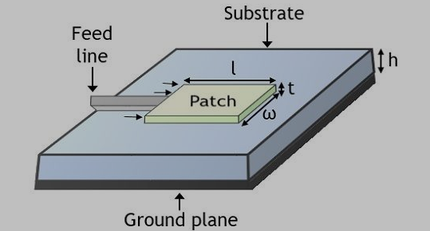
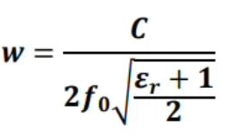

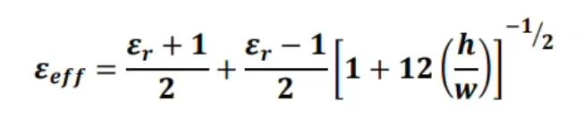

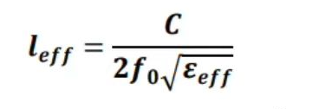

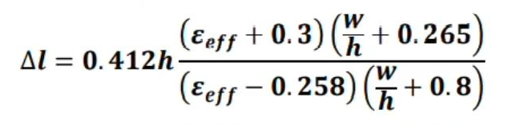

Calculation for Design Parameters
Design Specifications :-
Frequency of Operation
Substrate material
Relative Permittivity of the Substrate
Height of the Substrate
$$(ε_{r})$$
Width of Patch:
Effective Dielectric constant of Substrate:
Actual Length of Patch:
Length of Substrate:
Effective Length:
Width of Substrate:
Extension of Length:

Slide 5
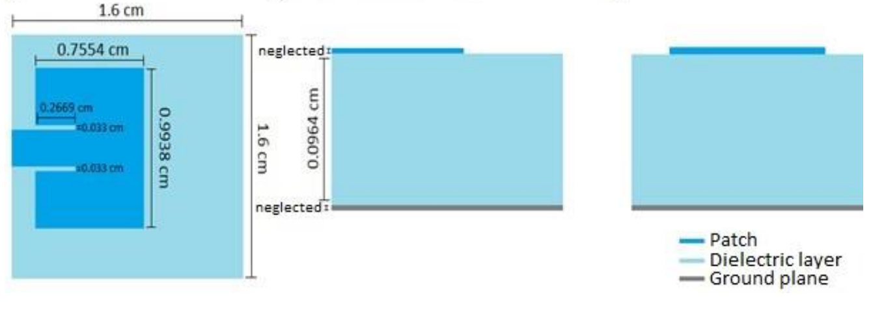
MPA design for X Band Application
Design Parameters | Values
Operating Frequency | 10 GHz
Substrate Material | RO4003
Length of Substrate | 1.6 cm
Width of Substrate | 1.6 cm
Height of Substrate | 0.0964 cm
Relative Permittivity of Substrate | 3.4
Patch Length | 0.7554 cm
Patch Width | 0.9938 cm
Embedded feed Length | 0.2669 cm
Embedded feed Width | 0.03313 cm
Bandwidth at -10dB = 0.35 GHz
Bandwidth % = 3.5 %

Slide 6
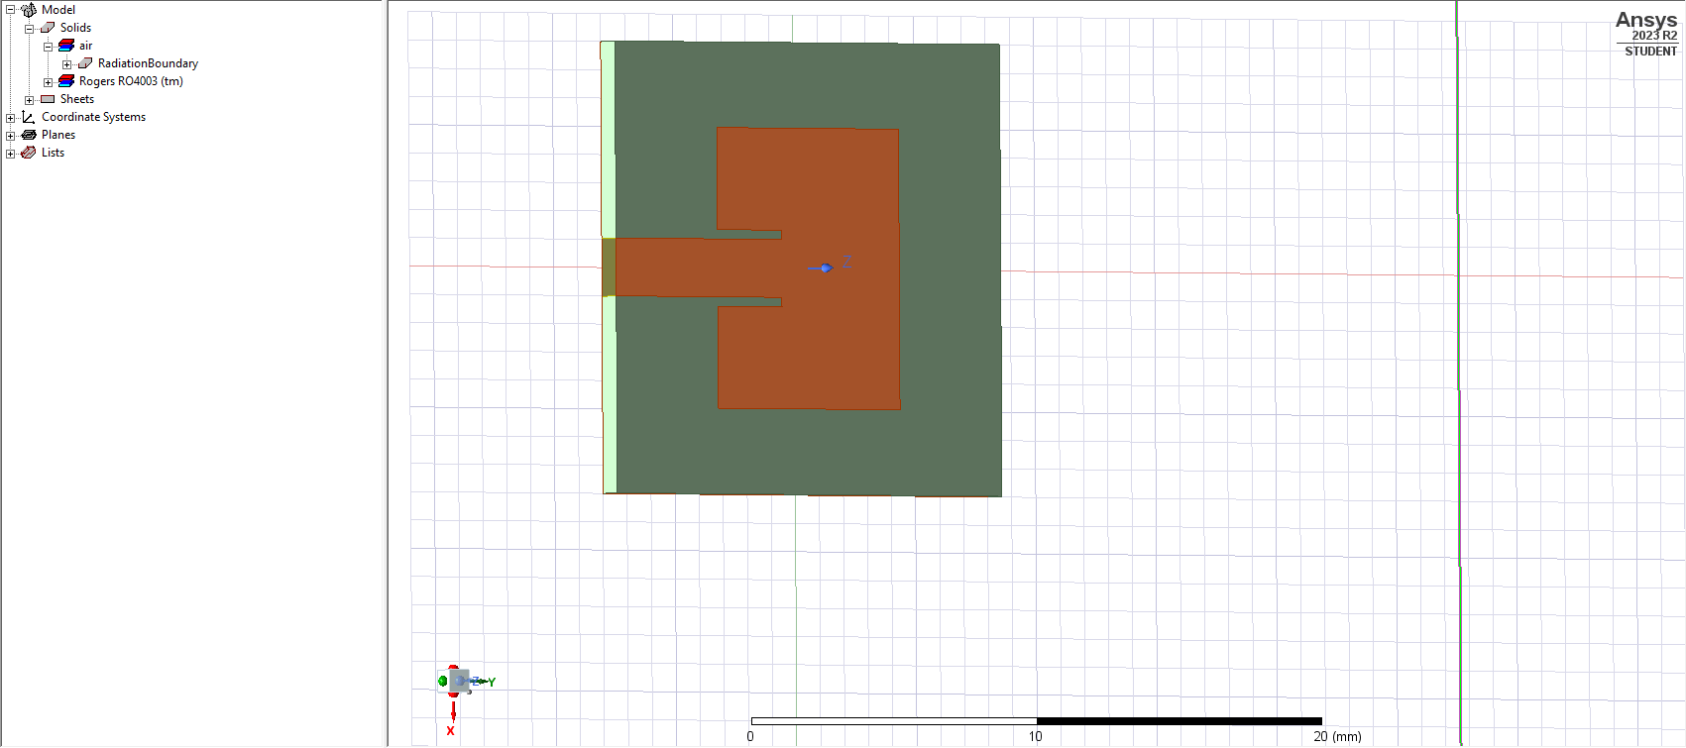
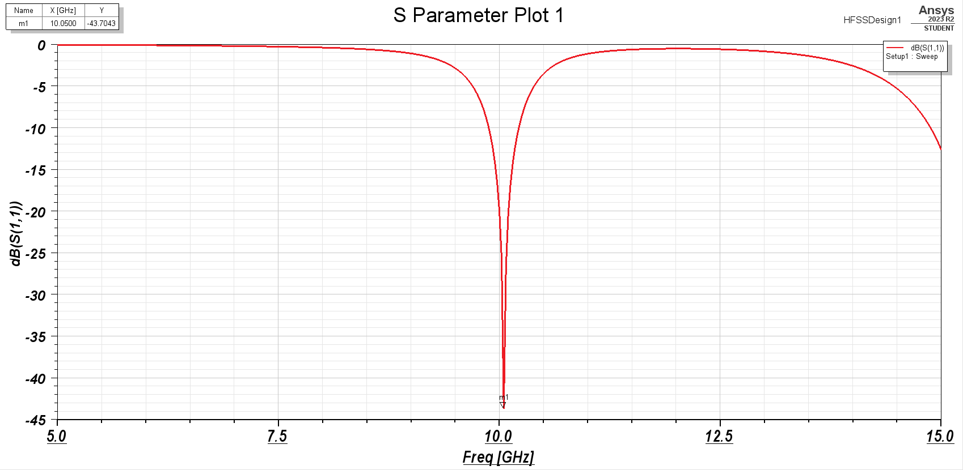
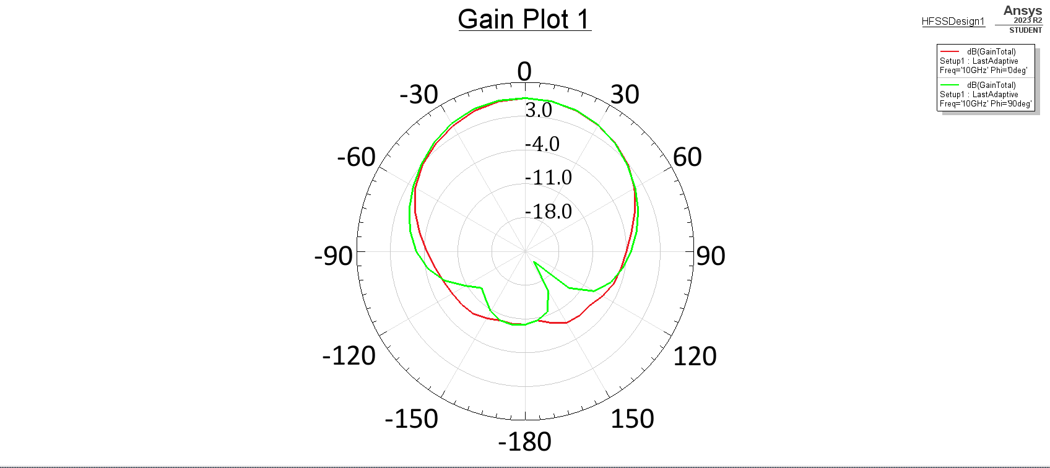
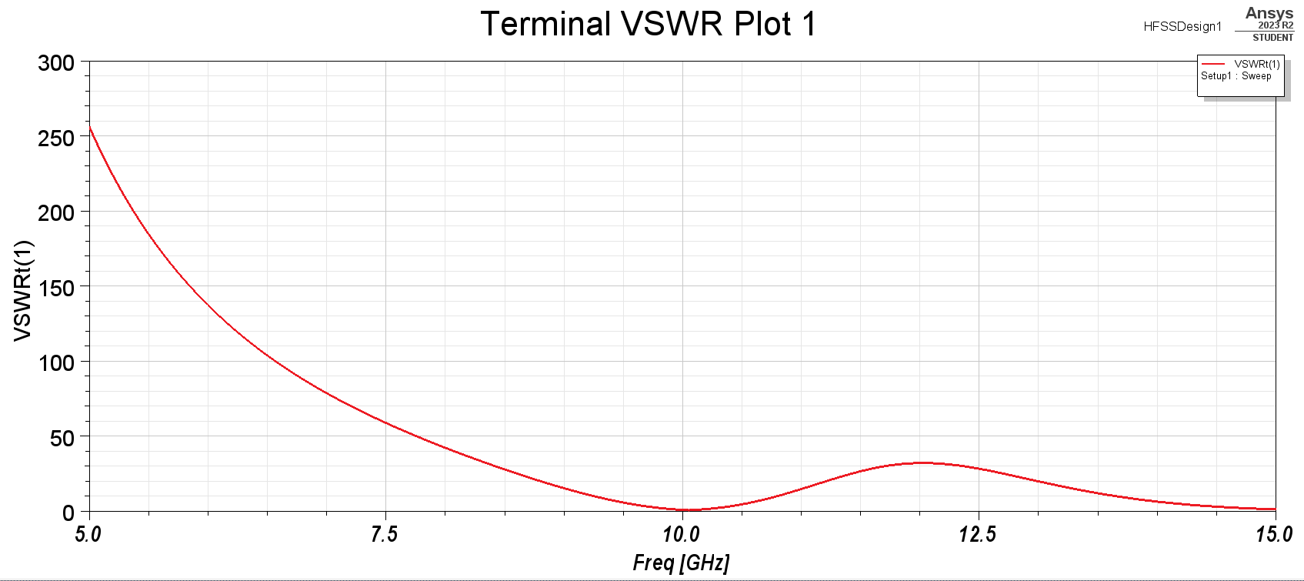
Results of MPA of frequency 10 GHz :
Drafting & CAD Technology
Major for college

Slide 7
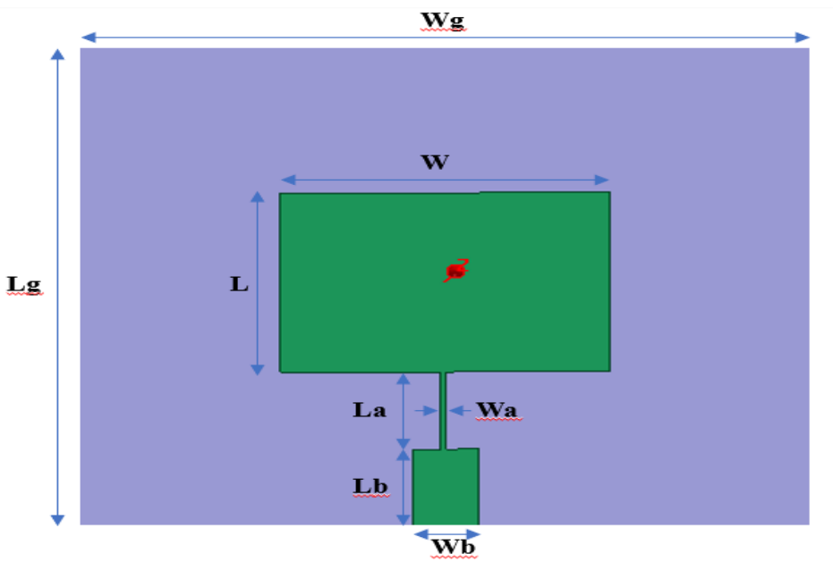
MPA design for Military Satellite Communication
First Antenna
Design Parameters | Values
Wg | 34.19 mm
Lg | 29.72 mm
W | 15.14 mm
L | 10.87 mm
Wa | 0.125 mm
La | 4.7925 mm
Wb | 3 mm
Lb | 4.7325 mm
Substrate Material | Rogers RT / duroid 5880
Height of Substrate | 3.175 mm
Relative Permittivity of Substrate | 2.2
This Antenna operates in the frequency ranges of 7.06 - 8.41 GHz. The 7.8 GHz center frequency has -34.5 dB return loss.

Slide 8
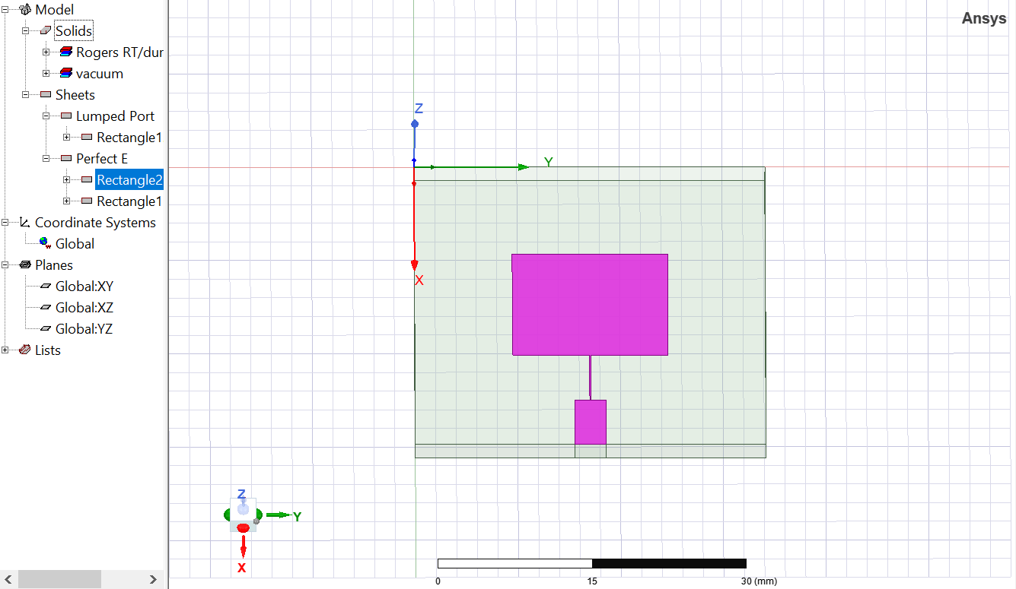
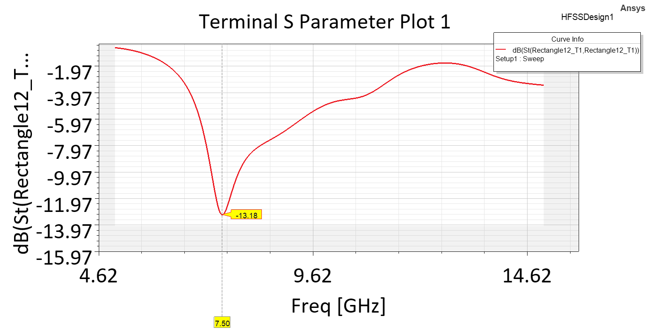
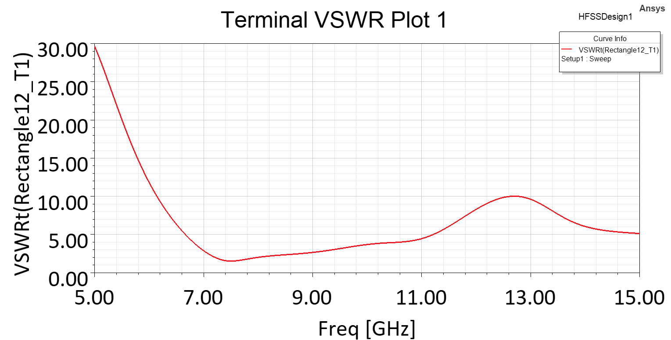
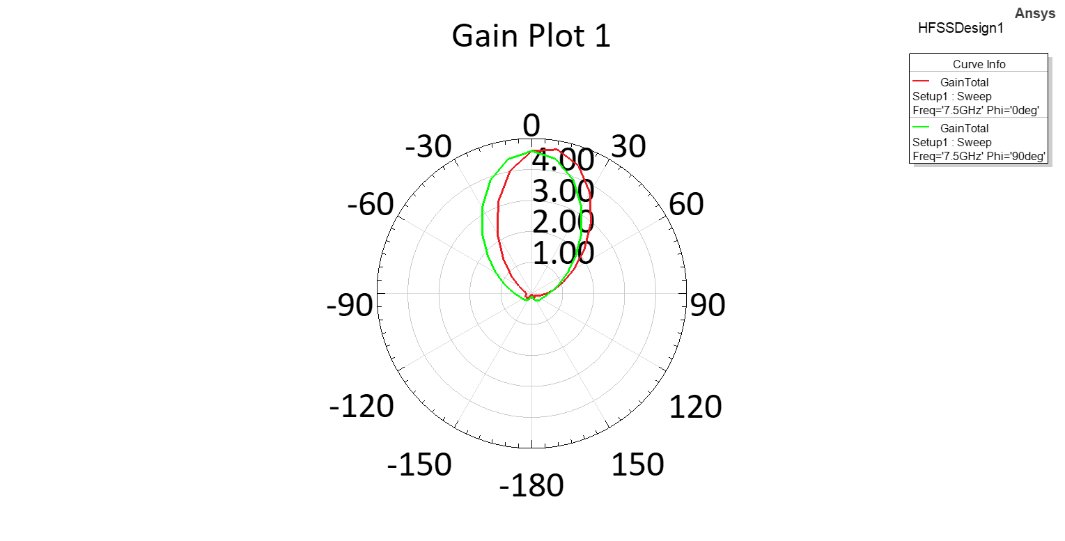
Results of First Antenna:
Drafting & CAD Technology
Major for college

Slide 9
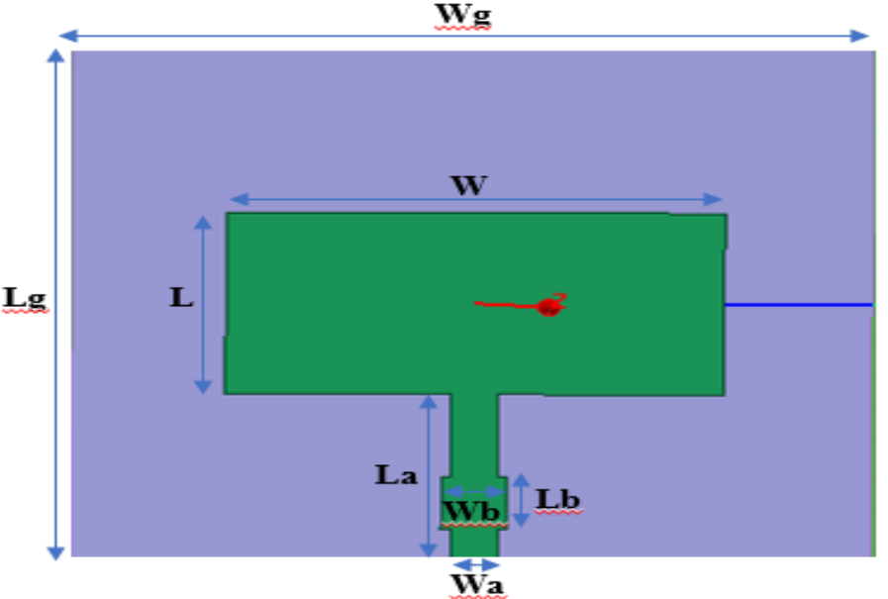
Second Antenna
Design Parameters | Values
Wg | 34.19 mm
Lg | 29.72 mm
W | 21 mm
L | 10.45 mm
Wa | 1.946 mm
La | 9.635 mm
Wb | 2.8 mm
Lb | 3 mm
Substrate Material | Rogers RT / duroid 5880
Height of Substrate | 3.175 mm
Relative Permittivity of Substrate | 2.2
This Antenna operates in the frequency ranges of 6.73 - 9.69 GHz. The 7.8 center frequency has -25.4 dB return loss.

Slide 10
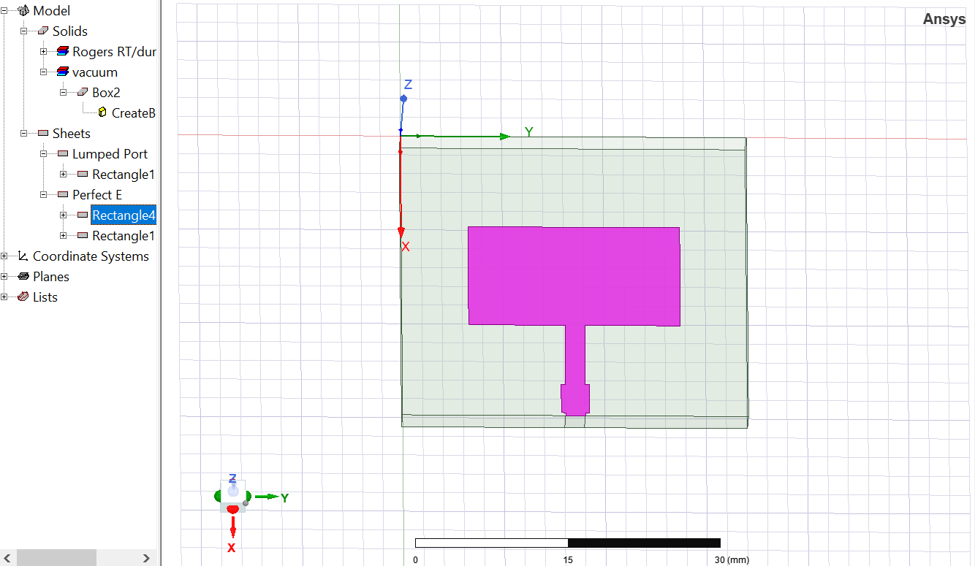
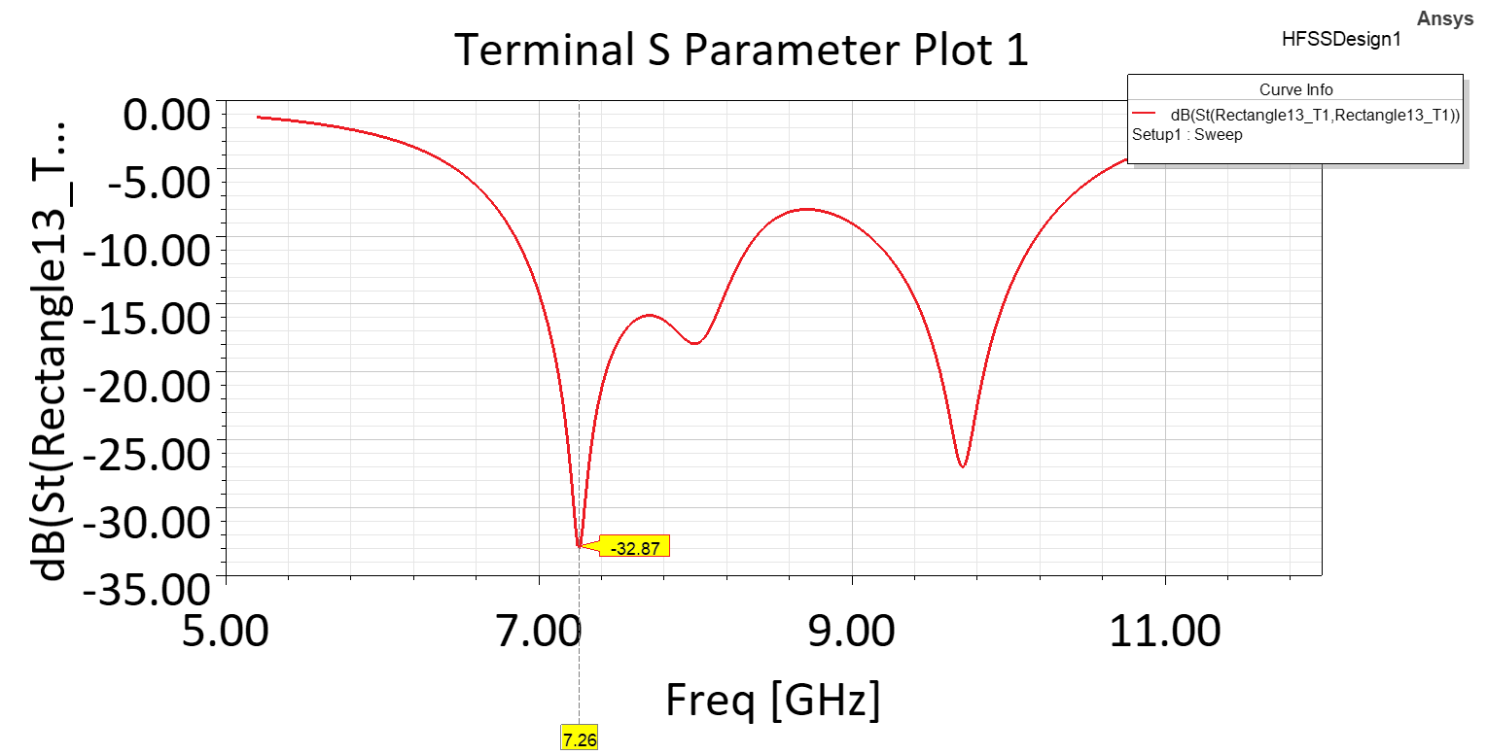
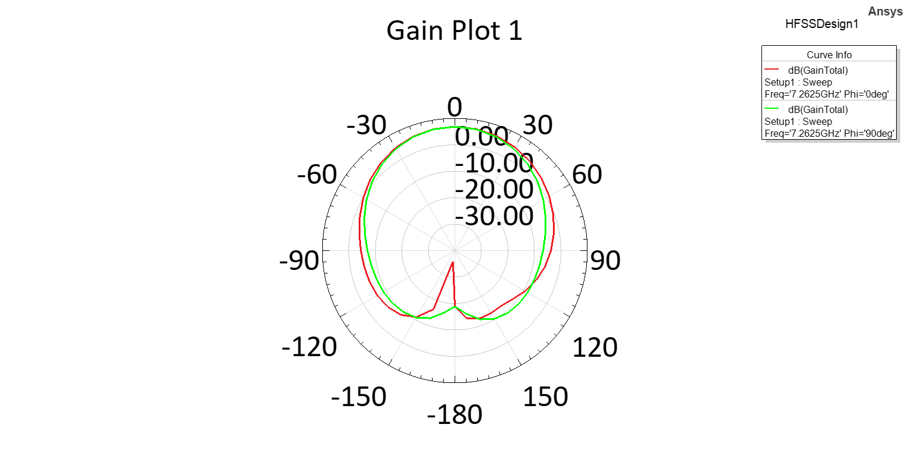
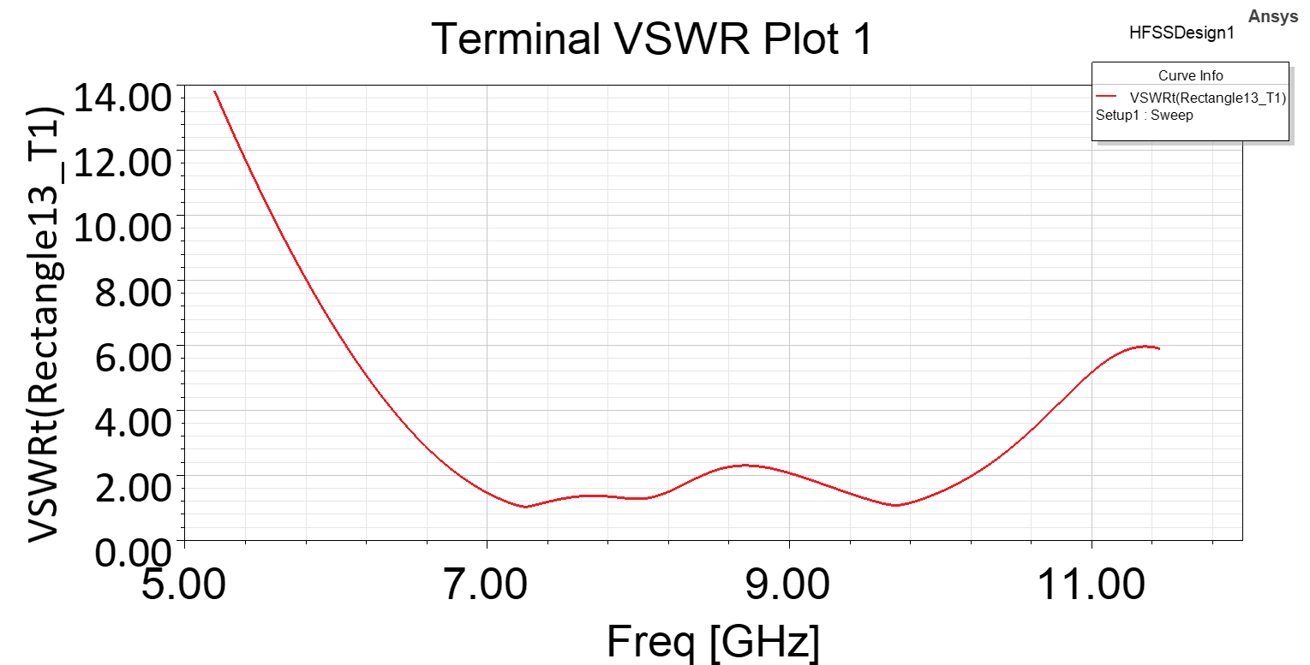
Results of Second Antenna:
Drafting & CAD Technology
Major for college

Slide 11
Final Outcomes
The 1st Antenna designed as a result of the studies, covers all the up and down frequency ranges allocated for military satellite communication and has a bandwidth of 1.35 GHz = 17.25%.
The 2nd Antenna, designed as a result of the changes made on the 1st Antenna, operates in the frequency ranges of 6.74 - 9.69 and has a bandwidth of 1.6 GHz more than the 1st Antenna.

Slide 12
IMPROVEMENTS IN MPA
Bandwidth Improvement: Stacked Patches, Slots and Modifications, Different Feeding Techniques
Radiation Efficiency: Optimize Substrate, Refine Dimensions, Improved Feeding Mechanism.
Directivity and Gain: Adding a Reflector, Higher Gain Feed
Miniaturization: Advanced Materials, Advanced Manufacturing Techniques
Environmental Stability: Material Selection, Protective Coatings
Since the antenna sizes calculated by numerical methods are difficult to adjust to operate in appropriate frequency ranges, the dimensions of the antenna can be designed using the genetic algorithm, which is a part of artificial intelligence optimisation algorithms.

Slide 13
CONCLUSION
First we designed a MPA at 10 GHz frequency for X Band applications and obtained schematic drawings.
In the simulation section, S11 characteristic graphics, E and H plane radiation patterns and antenna gain graphics were drawn. Simulation results show that the antenna works as desired and meets the X Band design criteria.
Thereafter we designed a microstrip patch antenna operating in the range of downlink frequency 7.25-7.75 GHz and uplink frequency 7.9-8.4 GHz allocated for military satellite communication.
Then we designed a 2nd Antenna as a result of the changes made on the 1st Antenna, operates in the frequency ranges of 6.74 - 9.69 and has a bandwidth of 1.6 GHz more than the 1st Antenna.

Slide 14
THANK YOU

