Slide 1

Sepsis Analysis and Predictions
Team Details:
Jay Khatri 160280107038
Shah Adarsh 160280107097
Shah Rushi 160280107105
Team Mentor:
Prof. Zishan Noorani

Slide 2
Introduction

Slide 3
PROJECT OBJECTIVE :
To predict whether a patient has Sepsis Disease or not on the basis of his/her ICU data with help of a Deep neural network

Slide 4
Features of the Project
Used Mimic-III Database
Keras Framework Based Deep NN model
Website to interact with model
API to take in Patient’s ICU Data

Slide 5
MIMIC – III Database
MIMIC-III is a large, freely-available database comprising deidentified health-related data associated with over forty thousand patients who stayed in critical care units of the Beth Israel Deaconess Medical Center between 2001 and 2012.
The database includes information such as demographics, vital sign measurements made at the bedside (~1 data point per hour), laboratory test results, procedures, medications, caregiver notes, imaging reports, and mortality (including post-hospital discharge).

Slide 6
Deep Neural Network Model
Neural Network created on Keras Framework
6 Layers – 45561 Total Trainable Paramters
Takes 96 Input Variables (Patient’s ICU data)
Output (0 or 1)
Performance Metrics :
F1 Score : 74.78%
Recall Score : 61.31%
Precision Score : 95.83%

Slide 7
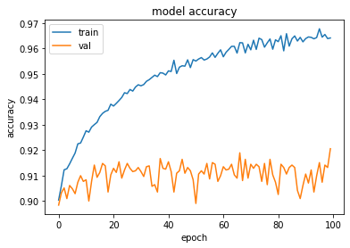
Neural Network Accuracy Graph

Slide 8
Summary for Neural Network Model
Layer(type) Output Shape Param #
dense_12 (Dense) (None, 200) 19000
dense_13 (Dense) (None, 100) 20100
dense_14 (Dense) (None, 50) 5050
dense_15 (Dense) (None, 25) 1275
dense_16 (Dense) (None, 5) 130
dense_17 (Dense) (None, 1) 6
Total params: 45,561
Trainable params: 45,561
Non-trainable params: 0

Slide 9
Website and Api to interact with the users
Website for user convinience and ease of interaction with model
API to take the input from the Patient’s ICU Record and feed it directly to the Model

Slide 10
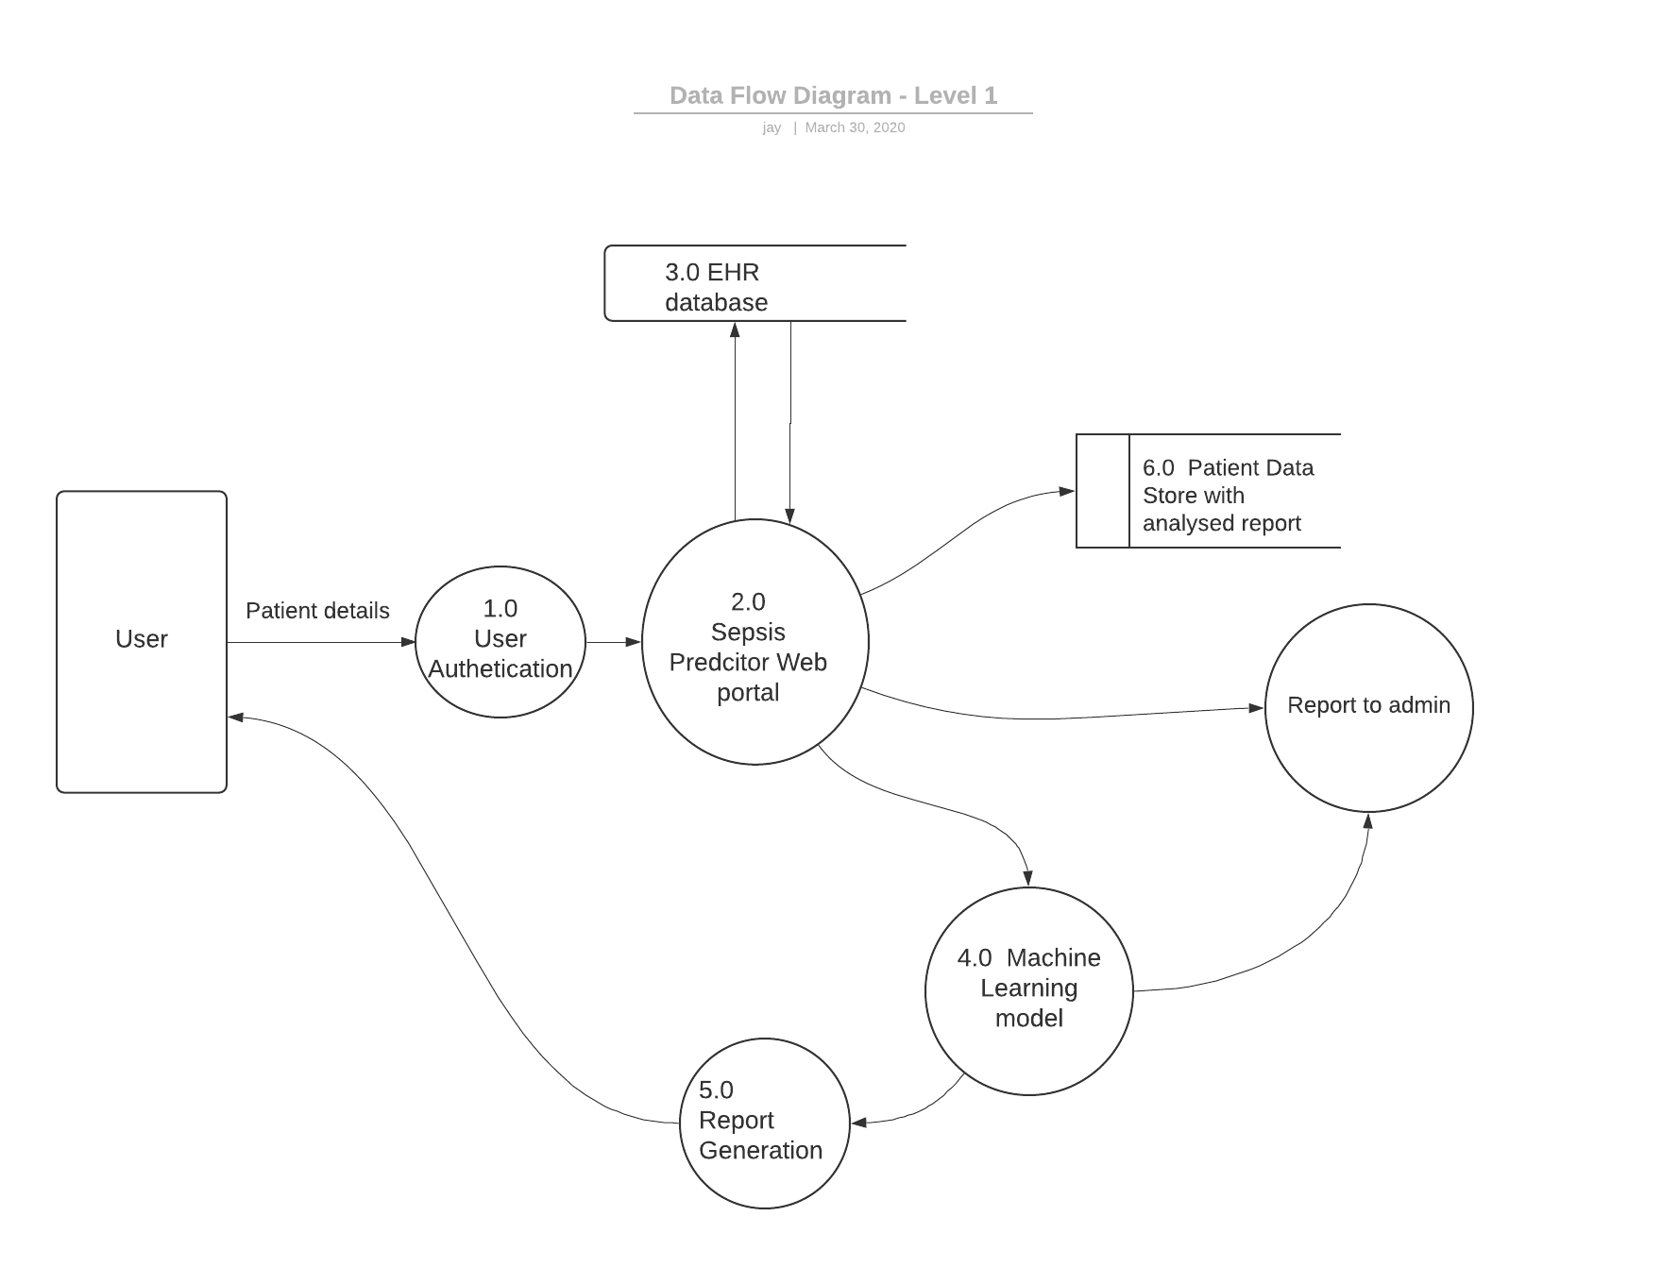
DATA FLOW DIAGRAM

Slide 11
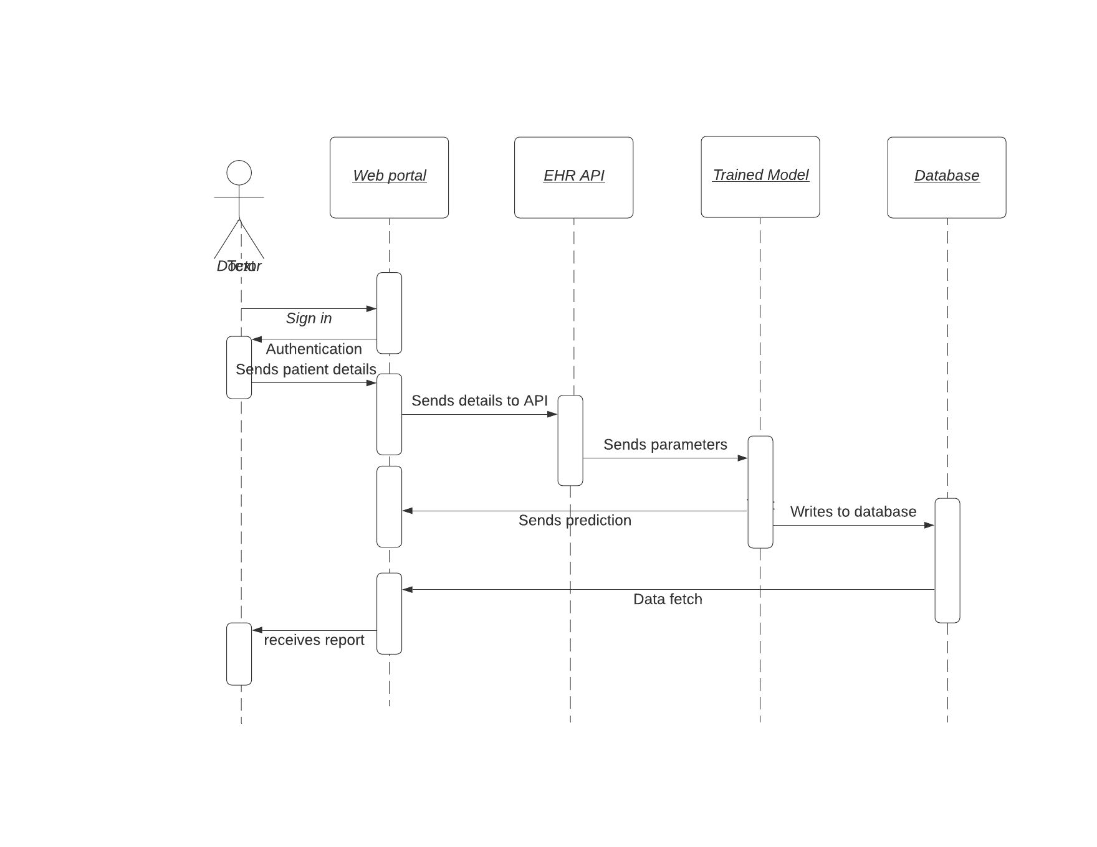
SEQUENCE DIAGRAM

Slide 12
Thank you !!

