Slide 1
Major Project presentation
on
“Wireless power harvesting in Body Area Network for Healthcare”
Under the guidance of:
Dr. Vijay B T
Assistant Professor,
Dept. of ECE,NIE.
Presented By:
ADARSH S SRIVATSA 4NI16EC002 AKSHAY VISHWANATH 4NI16EC008 ANUKTHA K C 4NI16EC012
MAHAMMED HARIS G A 4NI15EC053
Presented on: 29/05/2020

Slide 2
Introduction
Wireless Sensor Network (WSN) for detection of vital signs and data collection.
Wide Body Area Network (WBAN) for continuous remote healthcare monitory.
Wireless energy harvesting (WEH) solutions for portable Electronics and low power applications.

Slide 3
Problem Statement
Vital healthcare monitoring and data collection using wireless sensor networks.
Wireless power harvesting is suitable power source in place of conventional batteries.
RF energy source is ambient and very less dependency on external conditions.

Slide 4
Literature Survey
Authors | Title | Advantages | Disadvantages
Liu Yang, Yong Jin Zhou, Chao Zhang, Xin Mi Yang | Compact multiband wireless energy harvesting based battery free body area network sensor for mobile health care | ➢ Multiband operation ➢ Self-monitoring | ➢ Size of the device
K. L. Narayana, P. Rajani | Design and simulation of rectenna for RF energy harvesting | ➢ Simple construction | ➢ Power only small device
S. Kahng, C. Lee, H. Park, G. Namgoong1, J. Kwon | A WBAN Reader Antenna to Improve the Wireless Link with an In-Body WBAN Antenna | ➢ Wide band antenna | ➢ Short range ➢ Attenuation due to body
R. Meena, S. Ravishankar, J. Gayathri | Monitoring physical activities using WBAN | ➢ Low power modules ➢ Light weight, low cost and compact | ➢ Poor latency ➢ Limit on real time performance

Slide 5
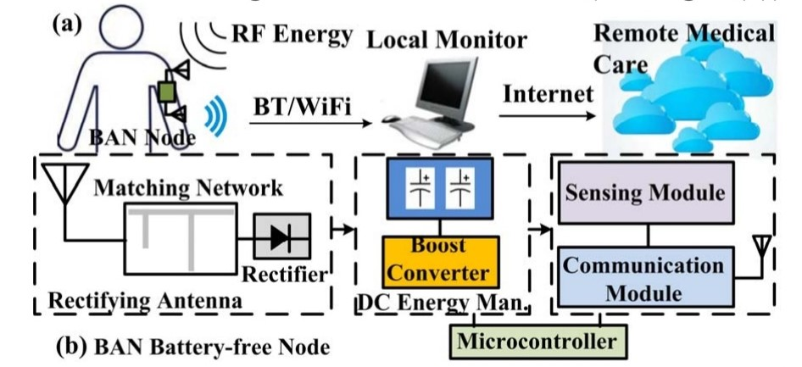
System Design

Slide 6
Gears of the System…
Antenna design
Rectifier design
DC convertor and booster
Microcontroller and communication module

Slide 7
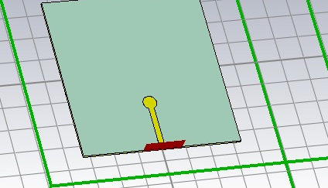
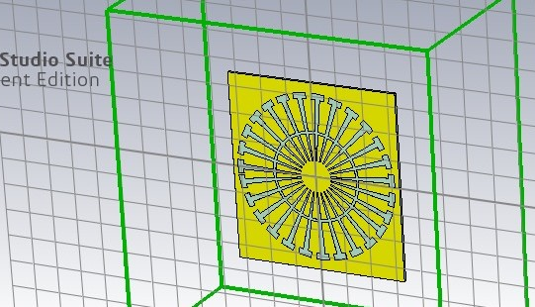
Antenna Design
CST MICROWAVE STUDIO
It is a specialist tool for the 3D EM simulation of high frequency components.
Slot Antenna
A rectangular slot is made on the conducting sheet.
Split-Ring Resonator (SRR)
An artificially structure common to metamaterials, which produce the desired magnetic susceptibility.

Slide 8
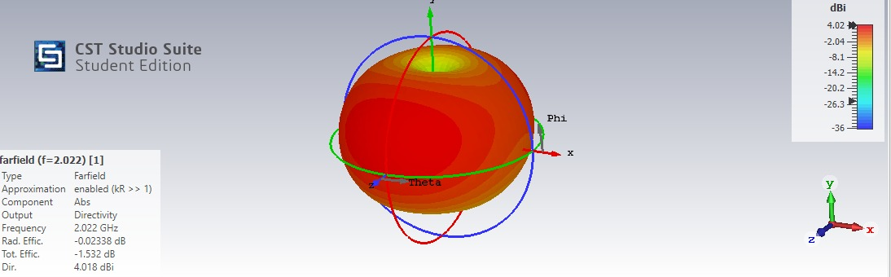
Far Field Analysis

Slide 9
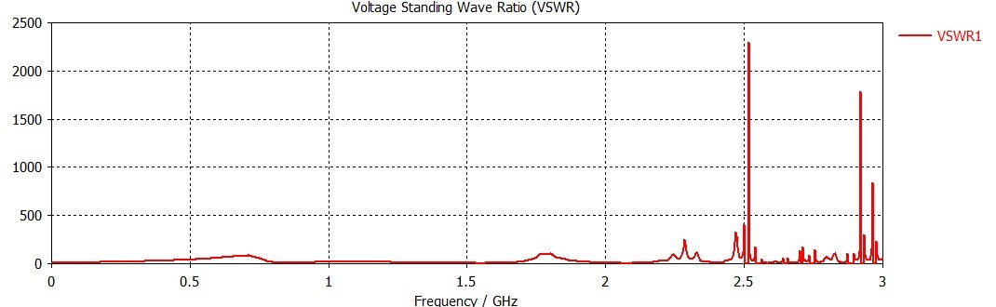
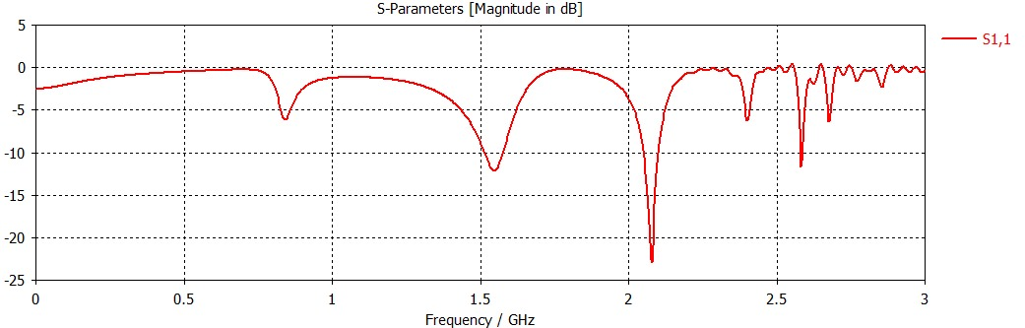
VSWR Vs Frequency
S – parameter Vs Frequency

Slide 10
Rectifier Design
NI AWR Design Environment
A comprehensive electronic design automation (EDA) platform for developing RF/microwave products
Impedance Matching Network
A matching network is connected between a source and a load
Schottky diode
High power rectifiers, High current density and low forward voltage.

Slide 11
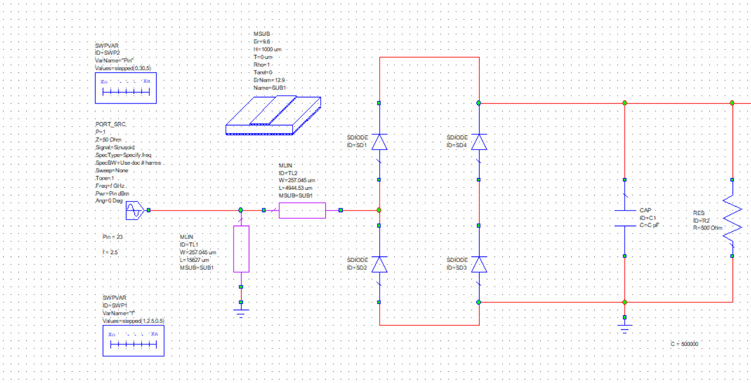
Schematic circuit

Slide 12
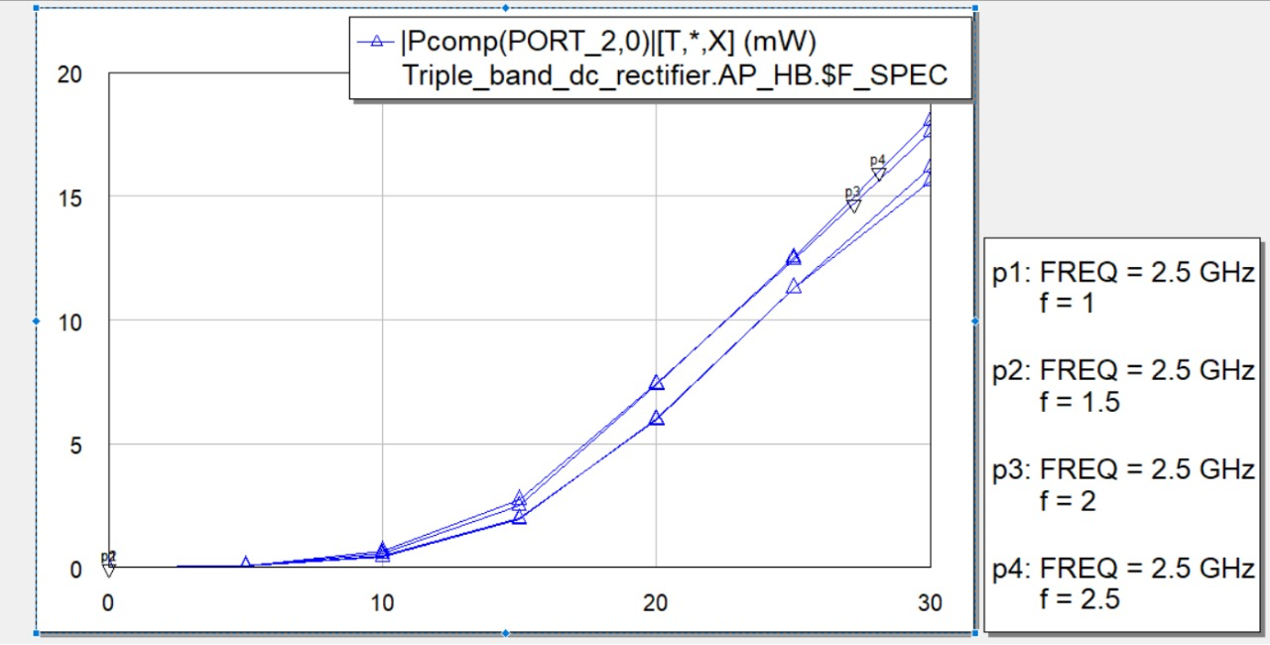
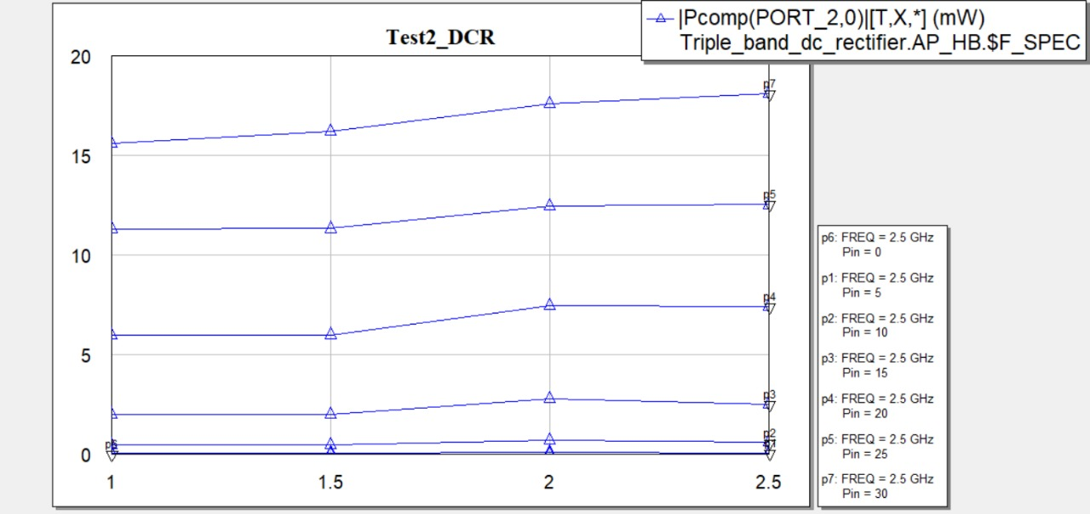
Rectification results for
Variable frequency
Constant Input power
Rectification results for
Constant frequency
Variable inputs

Slide 13
DC ENERGY MANAGEMENT
DC/DC boost converter
Controls the voltage delivered to capacitor from rectifier circuit.
High efficiency step-up DC/DC chip (LTC3105).
Super capacitor
The use super-capacitor storing system for the energy harvested from EM waves .
The microcontroller use this energy stored for its management activity with different modes.

Slide 14
BAN NODE DESIGN
Micro Controller
MSP430F5529LP - ultra-low-power microcontroller
Communication module
nRF24L01 - Very low current consumption
Temperature sensor
TMP102 - NTC/PTC thermistor, High accuracy
Energia
Arduino framework to the Texas Instruments MSP430 based Launchpad.

Slide 15
Conclusions
The simulated designs of antenna and rectifier performance met with the requirement goals.
The energy management system effectively meet the power requirements of the wireless nodes.
WBAN will enhance the mobility and cost effectiveness of the mobile healthcare systems.

Slide 16
Future Scope
High gain miniature antenna for reliable transmission and minimum interference with multi stack layer structure.
Effective energy management by different modes of microcontroller to reduce power consumption.
Integrating vital health monitoring for remote assist programme in health care with more compact sensors.

Slide 17
References
R.Meena, S.Ravishankar and J.Gayathri ,“Monitoring Physical Activities Using WBAN”. International Journal of Computer Science and Information Technologies, Vol. 5 (4) , 2014, 5880-5886
A. Darwish and A. Hassanien, “Wearable and implantable wireless sensor network solutions for healthcare monitoring,” Sensors, vol. 11, no. 6, pp. 5561–5595, June 2011.
Parna Kundu (Datta), Juin Acharjee and Kaushik Mandal,“Design of an Efficient Rectifier Circuit for RF Energy Harvesting System” International Journal of Advanced Engineering and Management Vol. 2, No. 4, pp. 94-97, 2017

Slide 18
THANK YOU

