Slide 1
Design and Implementation of a Database Management System for
Campus Placement and Recruitment Drive Management System
Adarsh | 25WU0102293
[Member 2 name] | [Roll no.]
[Member 3 name] | [Roll no.]
Woxsen University | Project No. 22 | [Faculty name] | 2026-27

Slide 2
Problem Description
Problem: placement data lives in spreadsheets, emails and notice boards, leading to duplicate entries, missed eligibility checks and no single view of a drive.
Objective: one centralised MySQL database to manage students, companies, drives, job roles, applications, interview rounds and offers.
Scope: eligibility (CGPA, backlogs), application tracking, round-wise results, offer management, placement statistics.
Intended users: Training and Placement Cell, students, recruiters, department heads.
DBMS Course Project | Campus Placement and Recruitment Drive Management System

Slide 3
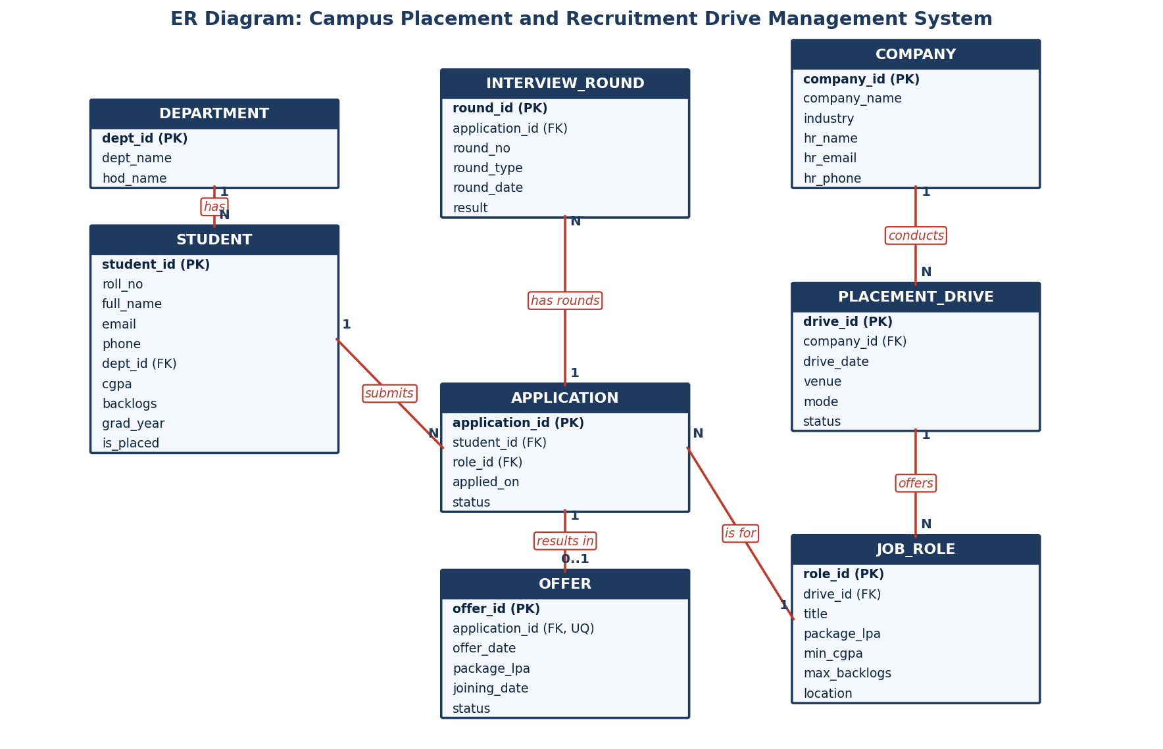
ER Diagram
DBMS Course Project | Campus Placement and Recruitment Drive Management System

Slide 4
Relational Schema and Normalization
Table | Primary key | Foreign keys
department | dept_id | -
student | student_id | dept_id
company | company_id | -
placement_drive | drive_id | company_id
job_role | role_id | drive_id
application | application_id | student_id, role_id
interview_round | round_id | application_id
offer | offer_id | application_id (unique)
Normalization to 3NF
1NF: atomic values, every table has a key.
2NF: no partial dependency; non-key columns depend on the whole key (e.g. role details moved out of application).
3NF: no transitive dependency; department and company data stored once and referenced by FK.
Unique (student, role) blocks duplicate applications.
DBMS Course Project | Campus Placement and Recruitment Drive Management System

Slide 5
Database Creation: DDL and DML
CREATE TABLE application (
application_id INT AUTO_INCREMENT PRIMARY KEY,
student_id INT NOT NULL,
role_id INT NOT NULL,
applied_on DATE NOT NULL,
status ENUM('Applied','Shortlisted',
'Rejected','Selected') DEFAULT 'Applied',
UNIQUE (student_id, role_id),
FOREIGN KEY (student_id) REFERENCES student(student_id)
ON DELETE CASCADE,
FOREIGN KEY (role_id) REFERENCES job_role(role_id)
ON DELETE CASCADE
);
8 tables with PK, FK, UNIQUE, CHECK, NOT NULL, DEFAULT and ENUM constraints
CHECK: cgpa 0 to 10, package > 0
5 to 9 sample records per table
Full script: campus_placement.sql
DBMS Course Project | Campus Placement and Recruitment Drive Management System

Slide 6
Queries: Joins and Aggregates
SELECT c.company_name, COUNT(a.application_id) AS total
FROM company c
JOIN placement_drive pd ON pd.company_id = c.company_id
JOIN job_role jr ON jr.drive_id = pd.drive_id
LEFT JOIN application a ON a.role_id = jr.role_id
GROUP BY c.company_name ORDER BY total DESC;
Company | Applications
TechNova Solutions | 4
DataBridge Analytics | 2
FinEdge Capital | 2
Infracore Constructions | 1
AutoMech Industries | 0
More queries: department-wise average package, highest/lowest/average package, eligible unplaced students per role, placement percentage (28.6%).
DBMS Course Project | Campus Placement and Recruitment Drive Management System

Slide 7
User Interface Demo
Flask web app connected to MySQL (mysql-connector-python)
Insert: add student, company, drive, application
Delete: remove an application or student, with cascade
View: tables with joins, eligibility and statistics
Each change is shown in MySQL Workbench / CLI
Insert screenshot of the running UI here
DBMS Course Project | Campus Placement and Recruitment Drive Management System

Slide 8
Conclusion and Future Enhancements
A normalized (3NF) database that enforces eligibility, prevents duplicate applications and tracks every drive to the final offer.
Future: role-based login, resume upload, email notifications, analytics dashboard, trigger to auto-update student placement status.
GitHub: DBMS-Course-Project | Thank you. Questions?
DBMS Course Project | Campus Placement and Recruitment Drive Management System

