Slide 1

CodeCartographer
THEME 01 · AGENTIC CODE INTELLIGENCE
Find the right code in a JavaScript repo far larger than any context window. Agentic, CPU-only, and every file:line it cites is verified
Team: SRM_SpaceX
College: SRM Institute of Science and Technology · Members: <Member 1>, <Member 2>, <Member 3>
Notes:
Introduce the team and the theme. CodeCartographer is our entry for Theme 01, Agentic Code Intelligence.

Slide 2



The repo never fits in the context window
Voice-assistant codebases spread dozens of agents and tools across thousands of files. New developers, and LLMs, lose the thread: finding where something happens is the slow part of every fix.
Too big to read
Search misses structure
LLMs guess locations
~237K tokens at just 860 files. No LLM can hold the whole repo, so the answer has to be found, not read.
“Which files call tool A before tool B?” is about execution order across functions and branches, not keywords.
Unverified answers invent file paths and line numbers, which costs more time than it saves.
Notes:
Problem in our own words: the repo is too large for any context window, keyword search can't answer structural questions, and LLMs hallucinate locations.

Slide 3




One agent, four kinds of questions
Semantic
Usage
“Where do we retry failed network requests with backoff?”
“Where is the Bluetooth-settings deeplink used?”
Hybrid BM25 + code embeddings + symbols, multi-query rewrite, call-graph expansion
Symbol → references → 2-hop alias tracking through lookup tables
Structural
Callers & optimise
“Which files call tool checkPermission before openDeeplink?”
“Who calls getUserLocation?” “What is slow in device discovery?”
Inter-procedural, branch-aware call-order analysis over the AST call graph
Call graph + 8 static performance detectors on surfaced code paths
Notes:
Every answer is a list of verified file:line locations with snippets, plus a call graph and optimisation tips.

Slide 4
Architecture
INDEX · incremental, CPU
AGENT LOOP
INTERFACES
tree-sitter AST
Plan & rewrite
classify query, code-vocabulary rewrites
Web UI
live agent trace, call graph
Ordered call graph + branch guards
Call tools
search_code · find_symbol · find_references · call_order · callers · read_code
CLI
index · ask · search
Tool invoke → handler edges
Symbols · refs · strings
Refine
alias-table hops, call-graph expansion
MCP server
Claude Code · Cursor · VS Code
BM25 + jina-code embeddings
Verify
file exists · lines in range · evidence present
REST + SSE API
/api/ask streams events
Optimisation detectors
Optional LLM: Gemini · Groq · OpenAI · Ollama
Notes:
Indexer builds AST facts, an ordered call graph and embeddings. The agent plans, calls tools, refines and verifies. Optional LLM only refines; the deterministic planner runs offline.

Slide 5
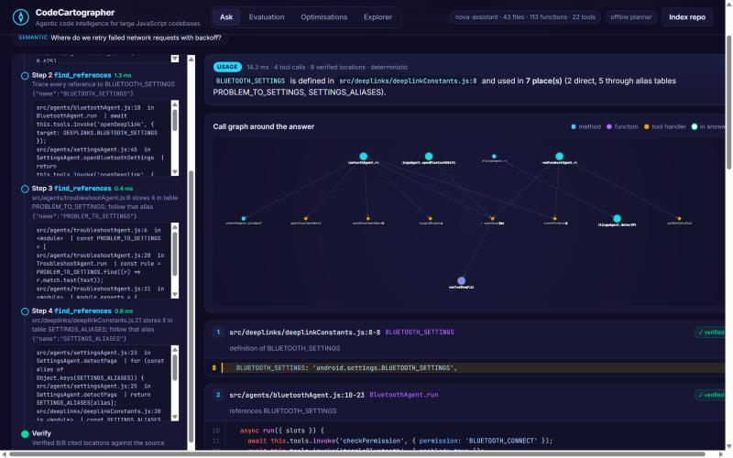
The agent refines its own search
“Where is the Bluetooth-settings deeplink used?”
1
find_symbol
BLUETOOTH_SETTINGS in deeplinks/deeplinkConstants.js:8 (the word “deeplink” matched the path)
2
find_references
2 direct uses: BluetoothAgent.run, SettingsAgent.openBluetoothSettings
3
alias hop
stored in table PROBLEM_TO_SETTINGS → TroubleshootAgent.run
4
alias hop
stored in SETTINGS_ALIASES → SettingsAgent.detectPage, resolveDeeplink
Two functions never mention the constant by name. Keyword search and embeddings alone miss them.
✓
verify
8 / 8 cited file:line spans confirmed against the source, in 3 ms
Notes:
Walk through the trace: symbol, references, then the agent notices the constant is stored in lookup tables and follows them.

Slide 6


“Tool A before tool B”, computed rather than guessed
// SettingsAgent.run
await this.ensurePermission(page);
→ tools.invoke('checkPermission')
await this.launch(page);
→ tools.invoke('openDeeplink')
// AccessibilityAgent.run (bug)
await tools.invoke('openDeeplink');
await tools.invoke('checkPermission');
// CallAgent.run
if (confirm) invoke('openDeeplink')
else invoke('placeCall')
Inter-procedural
Follows helpers 3 calls deep, so SettingsAgent is found through ensurePermission() → launch().
Order-aware
AccessibilityAgent opens the deeplink first, so it is correctly excluded and flagged by the negated query.
Branch-aware
Calls in exclusive if/else, ternary or switch arms are never reported as ordered.
Notes:
Call sites are recorded in evaluation order with branch guards; tool invocations resolve to registered handlers.

Slide 7
Measured on 42 labelled queries
98%
Recall@5
BM25: 78%
0.88
MRR
BM25: 0.58
2.9×
less noise
share of returned spans that are relevant
Notes:
Deterministic agent, no API key. The negative query (placeCall before openDeeplink) is answered correctly only by the agent.

Slide 8
Where the agent wins, and how it scales
Recall@5 | Callers | Semantic | Structural | Usage
BM25 | 0.90 | 0.90 | 0.54 | 0.33
Dense | 0.75 | 0.98 | 0.75 | 0.60
Hybrid | 0.95 | 0.94 | 0.75 | 0.65
Agent | 1.00 | 1.00 | 1.00 | 0.85
SCALE TEST · repo replicated 20×: 860 files, 27,300 LOC, ~237K tokens
0.84s
re-index after a change
49 ms
agent latency p50 (CPU)
Negative query (correct answer: no file): BM25 ✗ Dense ✗ Hybrid ✗ Agent ✓
Optimisation detectors: precision 1.00, recall 1.00 on 12 expected findings
Index (43 files): parse 0.039s · CPU embedding 18s · 1.0 MB
5 min
cold index, 99% embedding
Notes:
Structural and usage queries are where retrieval-only systems fail. Incremental indexing keeps the index fresh in under a second.

Slide 9
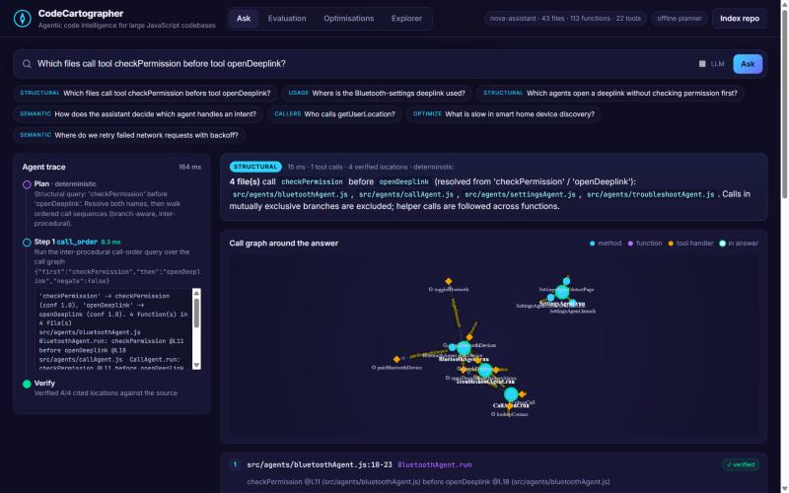
Working prototype
Live agent trace
every plan, tool call and observation streams in
Verified snippets
exact lines highlighted, ✓ verified badge
Interactive call graph
click a node to open its code
Evaluation dashboard
metrics recomputed by one command
Run it: docker compose up → http://localhost:8000
Notes:
Show the UI. Docker one-liner reproduces everything.

Slide 10








Tools & tech stack
Parsing
tree-sitter + tree-sitter-javascript
Embeddings (CPU)
jina-embeddings-v2-base-code via ONNX Runtime (fastembed)
Retrieval
Custom BM25, NumPy vector search, weighted RRF fusion
Graph
Ordered call graph, branch guards, tool-handler resolution
LLM (optional)
Gemini · Groq · OpenAI · Ollama over plain HTTP
Serving
FastAPI + Server-Sent Events, vanilla JS UI, Cytoscape.js
Integrations
CLI and MCP stdio server (Claude Code, Cursor, VS Code)
Ops & quality
Docker / Compose, pytest (15 tests), eval harness
Notes:
Everything runs on CPU; no GPU or paid API is required.

Slide 11
Innovation highlights
01
Branch-aware, inter-procedural call order
Structural answers are computed from the AST, including the negated “B without A” form that works as a policy check.
02
Alias-tracking usage search
Follows constants through lookup tables to code that never names them.
03
Verifier: zero hallucinated locations
LLM or planner, every file:line is checked against the source before it is shown.
04
Works with no API key
The deterministic planner is offline and reproducible. An LLM adds rewrites and explanations when available.
05
Incremental and IDE-native
Sub-second re-index after edits, and an MCP server for any coding agent.
Notes:
What makes this more than RAG over code.

Slide 12


Limitations & next steps
Limitations
Next steps (worklet)
Dynamic dispatch (computed calls, DI) is resolved only for globally unique names
Early return and try/catch paths are approximated
Cold CPU embedding is about 0.1 s per chunk
Gold set is built on our sample repo; we will label the provided codebase next
Type-aware resolution via the TypeScript compiler API (JS + TS)
Policy checks in CI: “every deeplink must follow a permission check”
PR impact analysis: which agents and tools does a change affect?
Quantised / smaller code model for faster cold indexing
Notes:
Be honest about limitations; frame next steps as a PRISM worklet.

Slide 13
Thank you
CodeCartographer: find it, prove it, fix it.
GitHub: github.com/AdarshXGupta07/CodeCartographer (tag PRISM_GENAI_HACKATHON_Y2026)
Demo video: <YouTube / Drive link>
Notes:
Questions.

