Slide 1
ARRAYS

Slide 2
Introduction
An array is a homogeneous and linear collection of the same type of elements.
In array, the memory allocated is contiguous.
It is basically a group of similar variables that are referred under a common name.
It is dynamically allocated.

Slide 3
Types of array
One dimensional Array
Multi-dimensional array

Slide 4
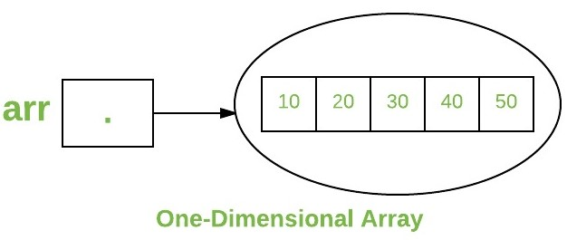

One-dimensional array
How to create it

Slide 5
To be continued
There are two ways to create a one dimensional array.
type var-name[];
type[] var-name;
Type determines the data type of each element that comprises the array.
E.g. int intArray[];
But no actual array exits here.
It just tells the compiler that the variable will hold an array of integer type.
To link variable with an actual, physical array of integers, you must allocate one using new and assign to it.
E.g. var-name = new type [size]

Slide 6
Array Literals
In a situation, where the size of the array and variables of array are already known, array literals can be used.
int[] intArray = { 1,2,3,4,5,6,7,8,9,10 };

Slide 7
Accessing array elements
You access an array element by referring to the index number.
Index starts from 0 to (array size -1).
E.g. String[] cars = {"Volvo", "BMW", "Ford", "Mazda"};
System.out.println(cars[0]);
//Output is Volvo
To change the value of a specific element, refer to the index number.
cars[0] = "Opel";
System.out.println(cars[0]);
//Output is Opel

Slide 8
To be continued
To find out how many elements an array has, use the length property.
String[] cars = {"Volvo", "BMW", "Ford", "Mazda"};
System.out.println(cars.length);
// Outputs 4
All the elements can be accessed using for loop at a time.
E.g. for(int i=0;i<cars.length:i++)
{
System.out.println(cars[i]);
}
//Displays all the elements present in cars

Slide 9
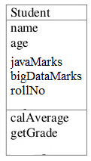
Array of objects
An array of objects is created just like an array of primitive type data items in the following way.
Student[] arr = new Student[7];
The Student objects have to be instantiated using the constructor of the Student class and their references should be assigned to the array elements in the following way.
arr[0]=new Student();
arr[1]=new Student(“adarsha”,21,90,89,1001);

Slide 10
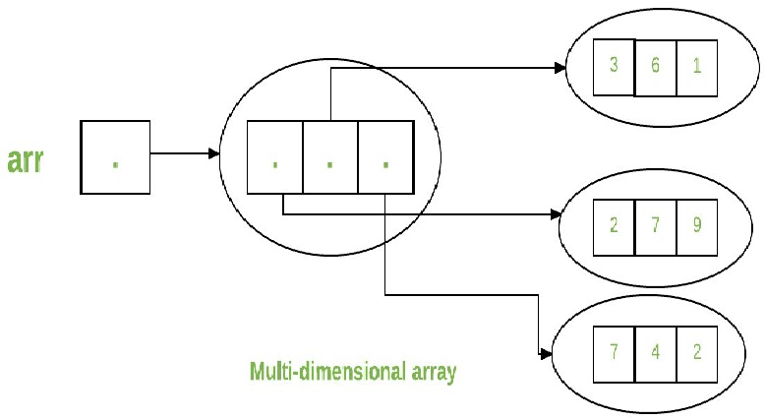
Multi-dimensional array
Multidimensional arrays are arrays of arrays with each element of the array holding the reference of other array.

Slide 11
To be continued
A multidimensional array is created by appending one set of square brackets ([]) per dimension.
int[][] intArray = new int[10][20]; //a 2D array or matrix
int[][][] intArray = new int[10][20][10]; //a 3D array
int[][] myNumbers = { {1, 2, 3, 4}, {5, 6, 7} };

Slide 12
Jagged Array
Jagged Array is array of arrays such that member arrays can be of different sizes
We can create a 2-D arrays but with variable number of columns in each row.
E.g. int arr[][] = new int[2][] // Declaring 2-D array with 2 rows
arr[0] = new int[3] //First row has 3 columns
arr[1] = new int[2] //Second row has 4 columns
To display the contents of jagged array
E.g. System.out.println("Contents of 2D Jagged Array");
for (int i=0; i<arr.length; i++)
{
for (int j=0; j<arr[i].length; j++)
System.out.print(arr[i][j] + " ");
System.out.println();
}

Slide 13
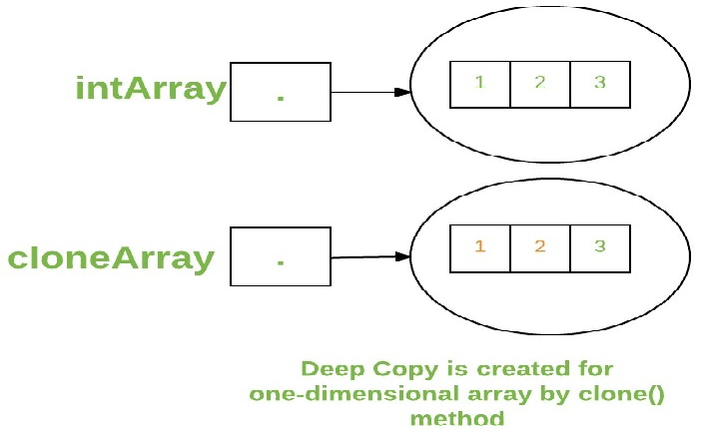
CLONING OF ARRAYS
When you clone a single dimensional array, such as Object[], a “deep copy” is performed with the new array containing copies of the original array’s elements as opposed to references.
It is done by using the function clone().
E.g. int intArray[] = {1,2,3};
int cloneArray[] = intArray.clone();

Slide 14
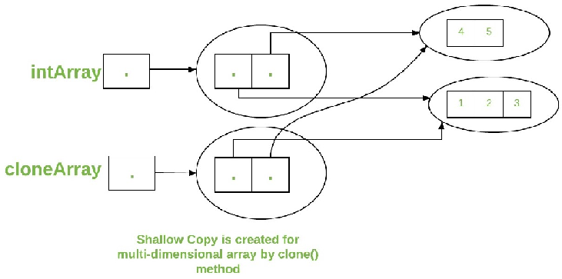
A clone of a multidimensional array (like Object[][]) is a “shallow copy” however, which is to say that it creates only a single new array with each element array reference to an original element array but sub arrays are shared.
E.g. int intArray[][] = {{1,2,3},{4,5}};
int cloneArray[][] = intArray.clone();

Slide 15


