Slide 1
ARRAYS

Slide 2
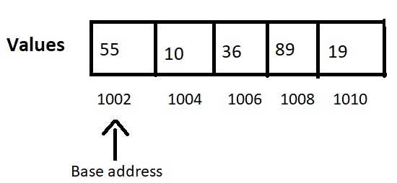
Introduction
An array is a homogeneous and linear collection of the same type of elements.
In array, the memory allocated is contiguous.
It is basically a group of similar variables that are referred under a common name.

Slide 3
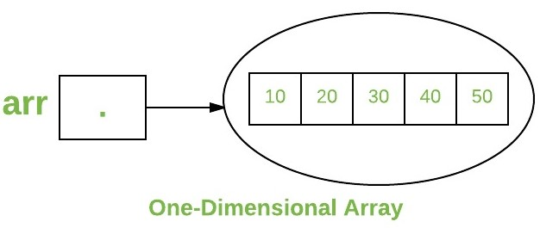
One-dimensional array

Slide 4

There are two ways to create a one dimensional array.
type var-name[];
type[] var-name;
To link variable with an actual, physical array of integers, you must allocate one using new and assign to it.
E.g. var-name = new type [size]

Slide 5
Array Literals
In a situation, where the size of the array and variables of array are already known, array literals can be used.
int[] intArray = { 1,2,3,4,5,6,7,8,9,10 };

Slide 6
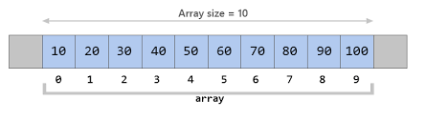
Accessing array elements
You access an array element by referring to the index number.
To change the value of a specific element, refer to the index number.
To find out how many elements an array has, use the length property. i.e. array. length

Slide 7
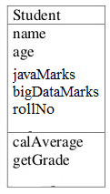
Array of objects
An array of objects is created just like an array of primitive type data items in the following way.
Student[] arr = new Student[7];
The Student objects have to be instantiated using the constructor.
arr[0]=new Student();
arr[1]=new Student(“adarsha”,21,90,89,1001);

Slide 8
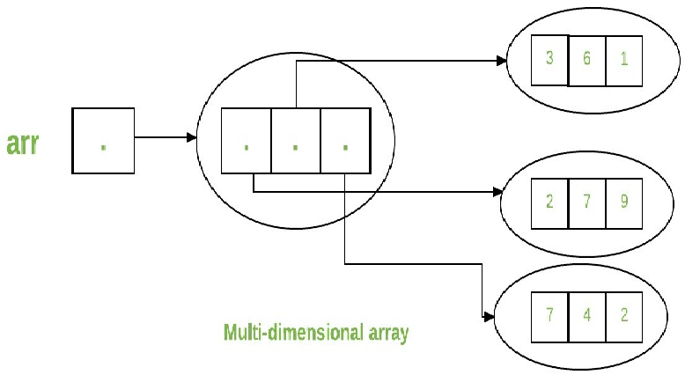
Multi-dimensional array
Multidimensional arrays are arrays of arrays with each element of the array holding the reference of other array.

Slide 9
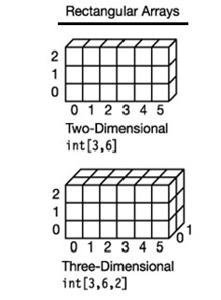
A multidimensional array is created by appending one set of square brackets ([]) per dimension.
int[][] intArray = new int[3][6]; //a 2D array or matrix
int[][][] intArray = new int[3][6][2]; //a 3D array
int[][] myNumbers = { {1, 2, 3, 4}, {5, 6, 7} };

Slide 10
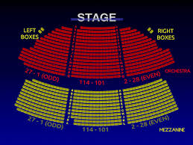

Slide 11
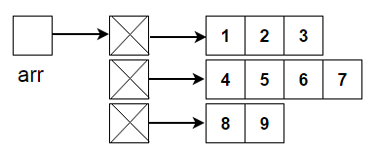
Jagged Array
Jagged Array is array of arrays such that member arrays can be of different sizes
We can create a 2-D arrays but with variable number of columns in each row.
E.g. int arr[][] = new int[3][] // Declaring 2-D array with 3 rows
arr[0] = new int[3] //First row has 3 columns
arr[1] = new int[4] //Second row has 4 columns
arr[2] = new int[2] //Third row has 2 columns

Slide 12
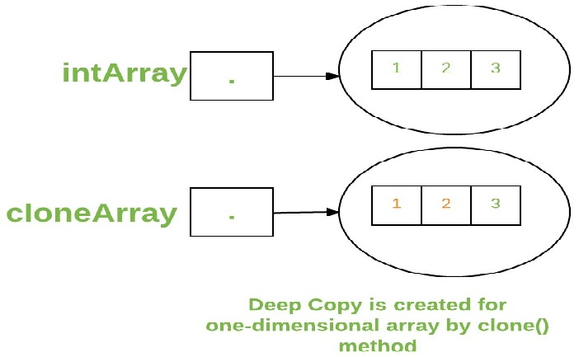
CLONING OF ARRAYS
When you clone a single dimensional array, such as Object[], it is a “deep copy” .
It is done by using the function clone().
E.g. int intArray[] = {1,2,3};
int cloneArray[] = intArray.clone();

Slide 13
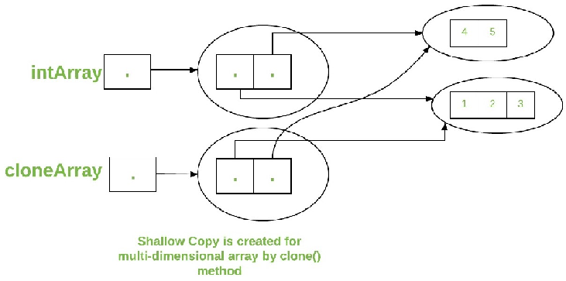
A clone of a multidimensional array (like Object[][]) is a “shallow copy” .
E.g. int intArray[][] = {{1,2,3},{4,5}};
int cloneArray[][] = intArray.clone();

Slide 14


