Slide 1
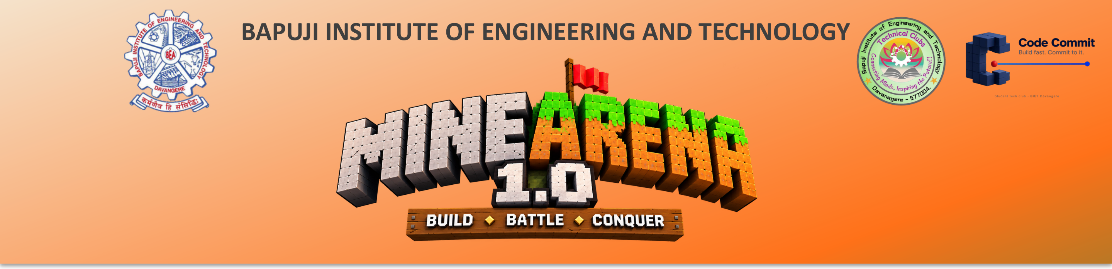
Team Name : ChaiGPT
Team Leader Name :
Which domain does your idea address : Cybersecurity & Data Privacy (AI Safety)
Project : PS-02 Privacy Gateway – use AI on Indian personal data without exposing it
Notes:
Team ChaiGPT. We built a privacy gateway that lets banks, fintechs and support teams use AI like Gemini on documents full of Aadhaar, PAN and other Indian personal data, without the AI ever seeing the real values.

Slide 2
What problem are you solving?
Teams now paste customer documents into AI (Gemini, ChatGPT) to summarise, review and reply
These documents carry Aadhaar, PAN, GSTIN, Voter ID, passport, phone, address
Once sent, the data sits on a third-party server – it can't be recalled
India's DPDP Act 2023: penalties up to ₹250 crore per breach
Deleting the data breaks the AI's answer; generic tools miss Indian IDs and Hinglish
Today: raw data goes straight to the AI
Loan application
Rahul Sharma
Cloud AI
PAN BNZPM2501F
Aadhaar 4991 1866 5246
+91 98765 43210
MG Road, Bengaluru
Result: every value is exposed outside the company
Notes:
AI is now part of daily work, but the documents people paste into it contain Indian identity data. Once it is sent it cannot be recalled, and the DPDP Act makes that a legal risk. Just deleting the data does not work, because the AI's answer then loses meaning.

Slide 3
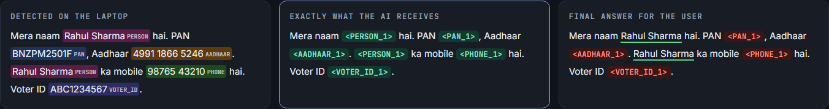
Our solution – how it is different and how it solves the problem
A privacy gateway between the user and the AI: hide the personal data, let the AI work on tags, put the real values back
How it solves the problem
 | Generic redaction | Our gateway
Indian IDs with checksum check | ✗ | ✓
Hinglish names & text | ✗ | ✓
AI answer gets real values back | ✗ | ✓
Blocks the send if anything leaks | ✗ | ✓
Audit log with zero raw data | ✗ | ✓
Real values never leave – the AI only sees <PERSON_1>
Same value → same tag, so the AI still understands the document
Answer comes back with real values restored – only those the purpose allows
Notes:
The screenshot is our live demo. Left: what we detect on the laptop. Middle: exactly what the AI receives – only tags. Right: the final answer. Unlike generic redaction, we validate Indian IDs, handle Hinglish, restore values in the answer and block the request if anything leaks.

Slide 4
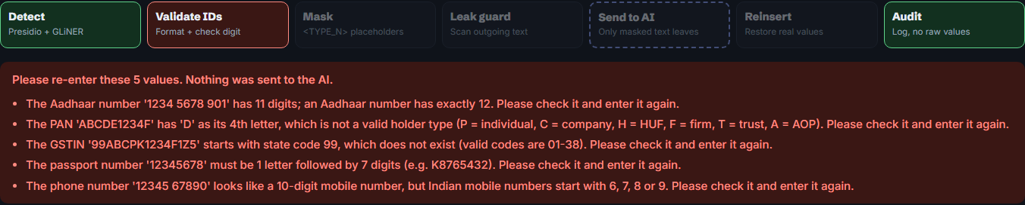
List of features offered by the solution
1
Detects 9 PII types
2
English + Hinglish
3
ID validator
4
Reversible tags
Aadhaar, PAN, GSTIN, Voter ID, passport, phone, email, name, address
“Mera naam Rahul hai” is understood like English
Aadhaar checksum, PAN & GSTIN rules – asks user to re-enter wrong IDs
<PERSON_1>, <PAN_1> – same value always gets the same tag
5
Leak guard
6
Smart reinsertion
7
Purpose-based policy
8
Safe audit log + drills
Scans the outgoing text; blocks the request if any real value is left
Handles tags the AI reformats; flags tags it drops or invents
Restores only what the chosen purpose allows
Every request logged with zero raw data; failure drills built in
Live demo – wrong IDs are caught and explained; nothing is sent to the AI
Notes:
Eight features. Highlight 3 (ID validator) using the screenshot: a wrong Aadhaar, PAN and GSTIN are caught with the exact reason, and the request never reaches the AI.

Slide 5
Workflow / Idea
1. Input
2. Detect
3. Validate
4. Mask
5. Leak guard
6. Ask AI
7. Reinsert
8. Audit
Paste text
or document
Find 9 types
of PII
Check ID
numbers
Swap values
for tags
Nothing raw
left?
Only tags
are sent
Real values
put back
Log with no
raw data
Wrong ID → stop, ask user to re-enter
Leak found → block, nothing sent
Technology stack
Detection: Microsoft Presidio · spaCy · GLiNER (multilingual NER) · custom Indian ID rules
Validation: Verhoeff checksum (Aadhaar) · GSTIN mod-36 check · phonenumbers
Backend & API: Python 3 · FastAPI · Uvicorn
AI model: Google Gemini (live) · offline Mock AI for demos and tests
Storage: SQLite audit log (no raw values) · mapping kept in memory only
Frontend & QA: HTML/JS demo UI · pytest automated tests · evaluation scripts
Notes:
Every request goes through these 8 steps. Two stop points protect the user: wrong IDs are sent back for correction, and the leak guard blocks the request if any real value is left. Only step 6 talks to the internet, and it only carries tags.

Slide 6
High-level architecture
Inside your laptop / company network – real data stays here
Privacy Gateway (FastAPI)
Tag map
in memory only, gone after the request
Detector Presidio + GLiNER + rules
Google Gemini
cloud AI
User
Web UI / API
ID validator checksums & formats
only tags
Masker + policy values → <TYPE_N>
answer with tags
Leak guard final check before send
Audit log
SQLite – counts and tags, zero raw values
Internet sees: <PERSON_1>, <PAN_1>
Never: names, Aadhaar, PAN, phone
Reinserter tags → real values
Notes:
Everything inside the green dashed line runs locally. The only thing that crosses to the cloud is text with tags. The tag-to-value map lives in memory for one request, and the audit log stores only counts and tags.

Slide 7
Results – tested, not just promised
0
100%
33/33
0.45 s
leaks
recall & precision
tags restored
gateway time
on 328 labelled values
in 50 test documents
all 7 ID/name/address
types detected
live Google Gemini run
(5/5 documents, 12 Nov)
median per request,
excluding the AI call
Notes:
On our 50-document test set: zero leaks and 100% detection after tuning – it started at 52 leaks. On a live Gemini run every tag came back. We are honest about limits: on 22 unseen hard cases we protected 20; the two misses were a first name used alone and a passport number with no keyword – those are our next fixes, along with PDF and image support.

