Slide 1
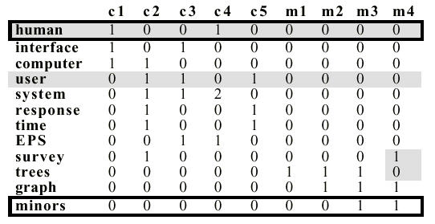
Semantic Matrix Model
c1: Human machine interface for ABC computer applications
c2: A survey of user opinion of computer system response time
c3: The EPS user interface management system
c4: System and human system engineering testing of EPS
c5: Relation of user perceived response time to error measurement
m1: The generation of random, binary, ordered trees
m2: The intersection graph of paths in trees
m3: Graph minors IV: Widths of trees and well-quasi-ordering
m4: Graph minors: A survey
corpus
Document vector
Word vector
Word-document matrix
Notes:
Please don’t be intimidated by this slide, I am simply showing you what we did with the Hadoop word count demo, where we turned a giant corpus into a matrix consist of potentially millions even billions of documents. A two dimensional matrix is simply a table. In our case, we have each column represent a document, and each row consist of words that appeared in that corpus. If the a word didn’t appear in a particular document, that position in the matrix is 0, if the word appeared 1- n times, we put a corresponding # there.
As you can see the matrix can become very large, and since we can have millions of documents, the workload of doing the work may not fit on a signal machine. That’s why we needed a system like Hadoop to distribute the workload across a cluster of computers for both Data and computation.
Document = context; interchangeable.
D1 = c1
Counting words
M documents talk about a different subject than D for demo purposes.

