Slide 1
AI-Powered Study Buddy
Presented By:
Student Name- Adarsha Jash
AICTE Student ID - STU69eae3047c88a1777001220
College Name- Institute of Engineering and Management (IEM), Kolkata
Department- CSIT

Slide 2
OUTLINE
Problem Statement
Proposed System/Solution
System Development Approach (Technology Used)
Algorithm & Deployment
Result
Conclusion
Future Scope
References

Slide 3
Problem Statement
.
Students often struggle to understand complex concepts while studying.
Online searches provide lengthy and sometimes irrelevant information.
Preparing notes, quizzes, and study plans manually takes time.
There is a need for an AI-based system that can explain topics, summarize notes, generate quizzes, and create study plans instantly.

Slide 4
Proposed Solution
AI-Powered Study Buddy is a web application developed using Streamlit and Google Gemini API.
Key Features: • Concept Explainer • Notes Summarizer • Quiz Generator • Study Planner
The system helps students learn faster and improve exam preparation through AI-generated content.

Slide 5
System Approach
Frontend: • Streamlit
Backend: • Python
Libraries Used: • Google Generative AI • PyPDF2 • Python Dotenv
Working Flow: User Input → Prompt Generation → Gemini API → AI Response → Display the Output

Slide 6
Algorithm & Deployment
Algorithm:
Accept user input.
Generate prompt based on selected feature.
Send prompt to Gemini API.
Receive AI-generated response.
Display result on Streamlit interface.
Deployment:
• Developed in VS Code • Executed using Streamlit • Local Deployment using localhost:8501

Slide 7
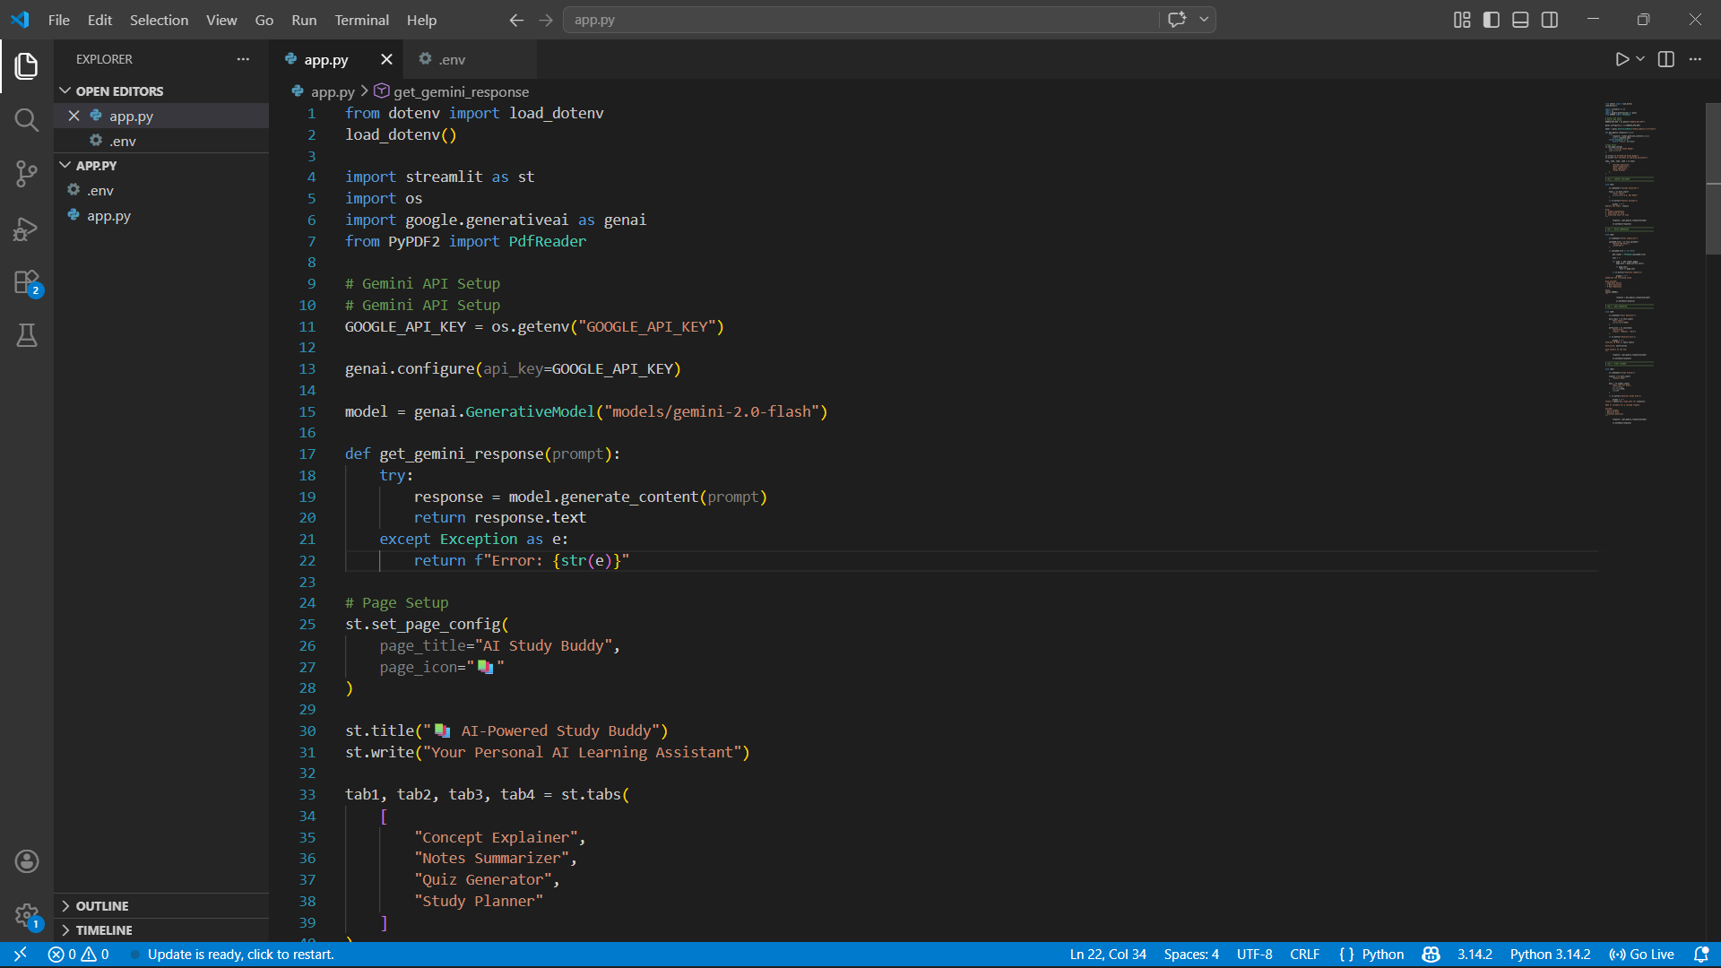
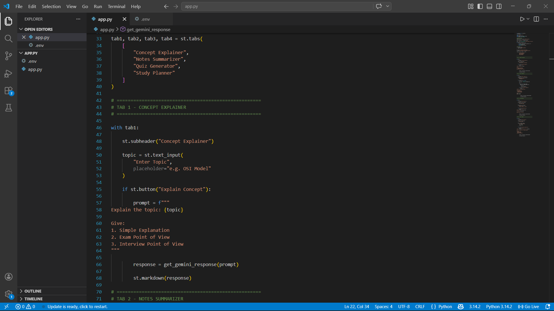
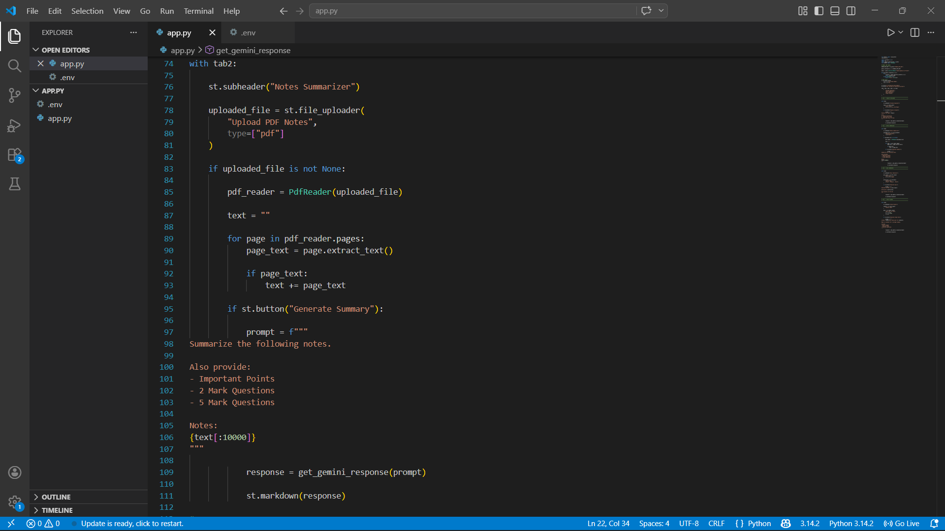
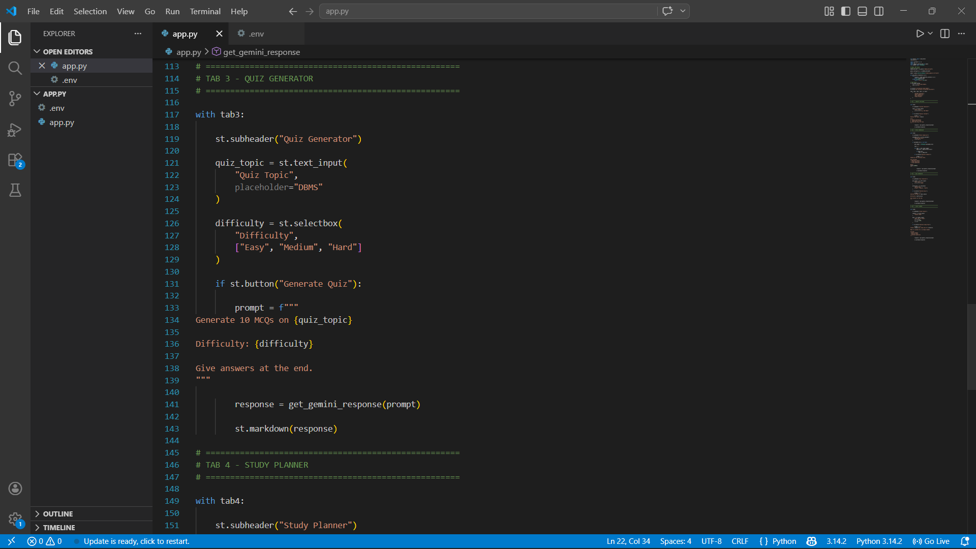
Python Code:

Slide 8
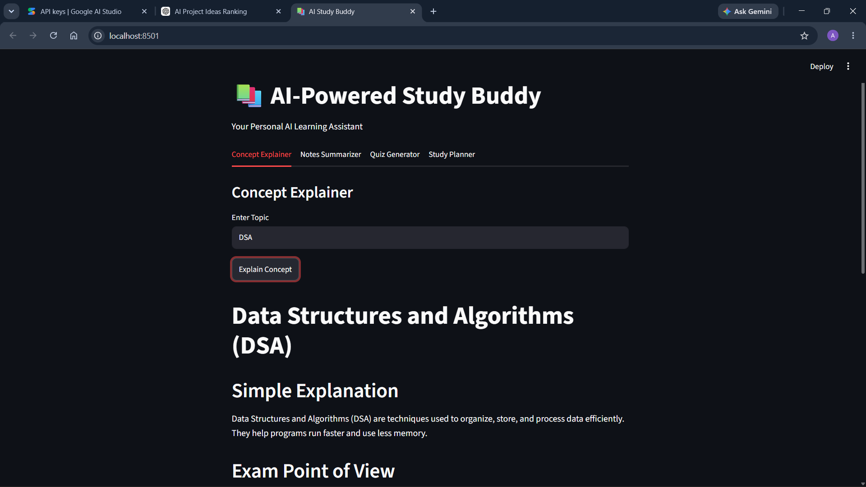
Result

Slide 9
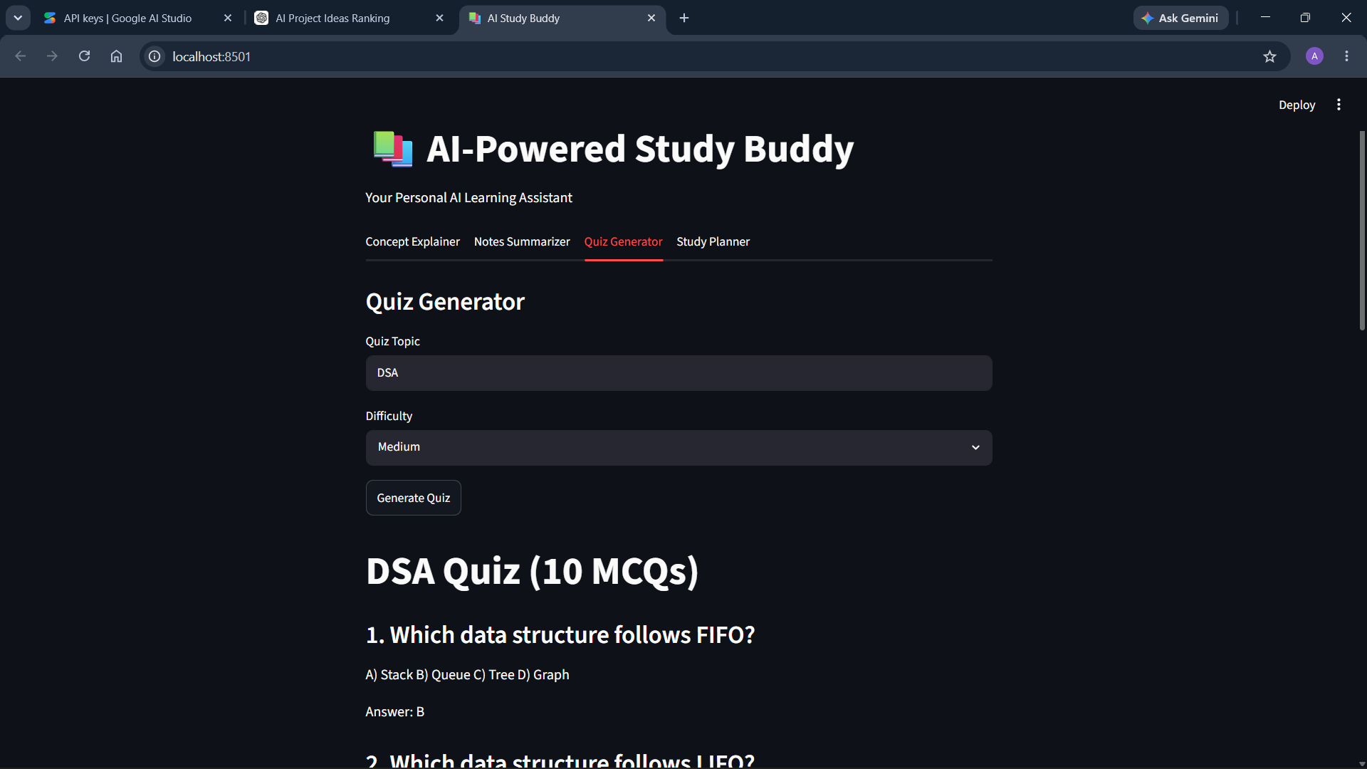
RESULT

Slide 10
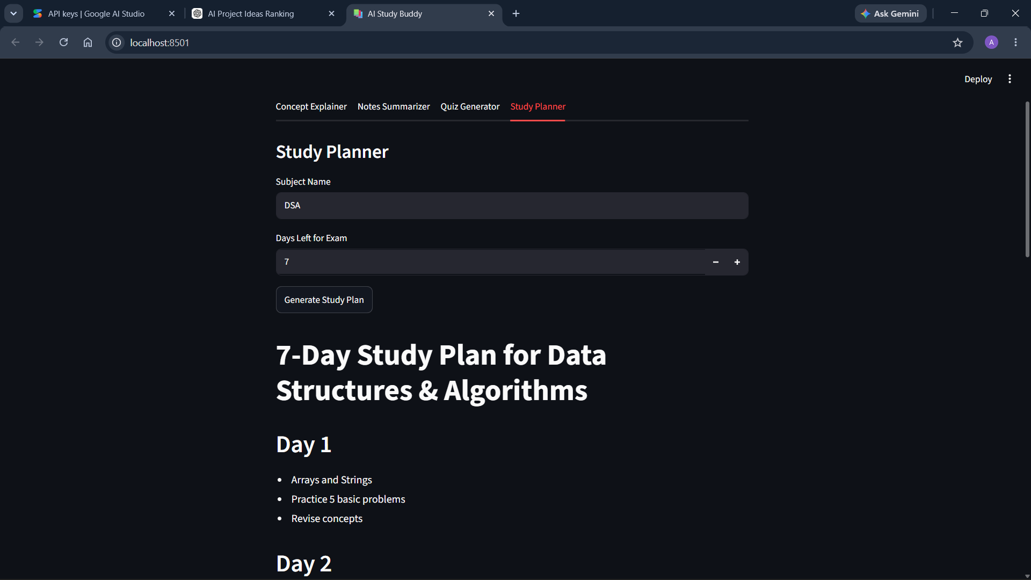
RESULT

Slide 11
Conclusion
AI-Powered Study Buddy simplifies learning by providing:
Instant explanations
Summaries
Quizzes
Study plans.
This project demonstrates the practical use of Generative AI in education and improves student productivity.

Slide 12
Future scope
• Voice-based learning assistant • Flashcard generation • Multi-language support • Performance tracking dashboard • Mobile application integration • Personalized learning recommendations

Slide 13
References:
Hugging Face – The AI community building the future.
Streamlit • A faster way to build and share data apps
Welcome to Python.org
1. Supervised learning — scikit-learn 1.8.0 documentation

Slide 14
Github link:
Github Link : https://github.com/AdarshaJash/AICTE-B1---May-2026
Deployment Link: https://aicte-b1---may-2026-54auzfyihvvdkymbwjvhaa.streamlit.app/

Slide 15
THANK YOU

