Slide 1



Name of Project:
Solar Power Generation Forecasting using Machine Learning
SUBMITTED BY: Adarsh Kumar Tiwari

Slide 2

Learning Objectives
Understand the relationship between solar irradiation, temperature, and power generation.
Preprocess and merge solar plant generation data with weather data.
Apply machine learning models for forecasting solar power output.
Evaluate models using performance metrics (MAE, RMSE, R²).
GOAL
Goal To build a forecasting model that predicts future solar power output using historical generation and weather sensor data.
Source :
www.freepik.com/

Slide 3
Tools and Technology used
Programming Language: Python
Libraries: NumPy, Pandas, Matplotlib, Seaborn, Scikit-learn, Joblib
Models: Linear Regression, Random Forest Regressor
Environment: Jupyter Notebook
Techniques: Time-series analysis, Data Aggregation, Regression Analysis

Slide 4
Methodology
Data Collection – Imported generation and weather datasets.
Data Preprocessing – Converted datetime formats, handled missing values, merged datasets.
Exploratory Data Analysis (EDA) – Visualized AC/DC power vs irradiation & temperature.
Feature Engineering – Created aggregated datasets for meaningful insights.
Model Building – Trained Linear Regression and Random Forest models.
Model Evaluation – Compared accuracy using MAE, RMSE, R² score.
Forecasting – Predicted solar energy generation under varying conditions.

Slide 5
Problem Statement:
The energy industry faces challenges in predicting solar power generation due to varying weather conditions. An accurate forecasting system is needed to:
Ensure grid stability and reliability.
Optimize renewable energy integration.
Reduce dependency on non-renewable power sources.

Slide 6
Solution:
Merged generation & weather datasets to create a unified dataset.
Applied feature scaling and data transformations for accuracy.
Trained two models:
Linear Regression (baseline performance)
Random Forest Regressor (better accuracy and robustness)
Model evaluation showed that Random Forest performed best, making it suitable for real-time forecasting.

Slide 7
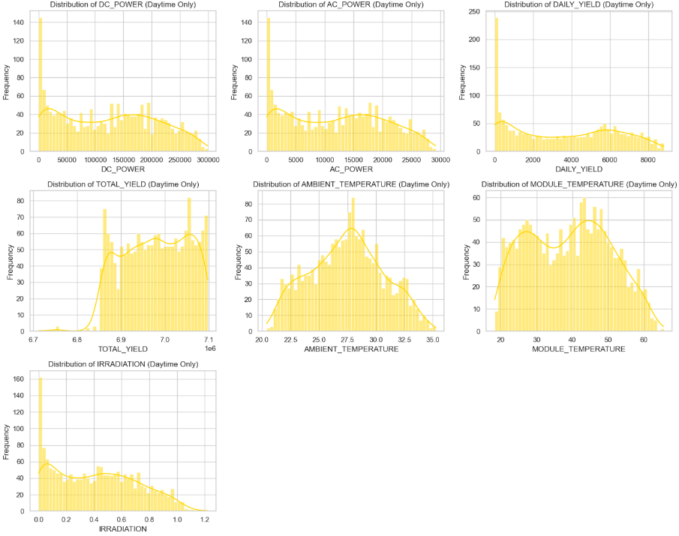
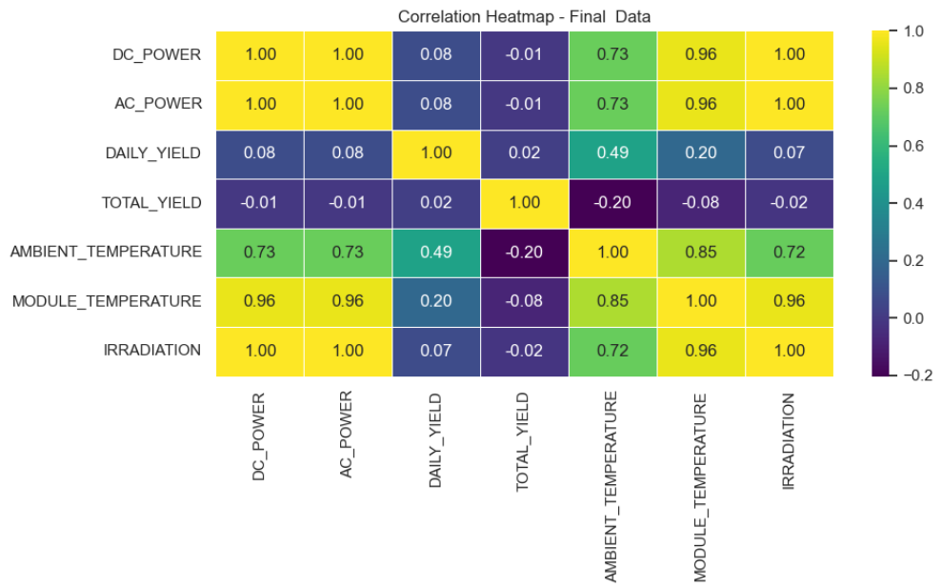
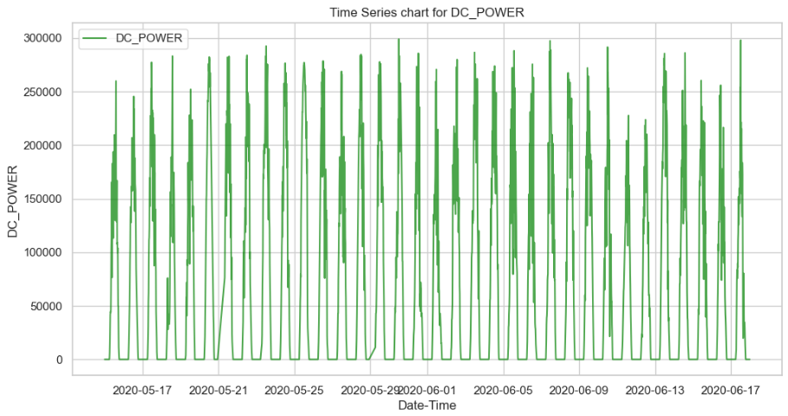
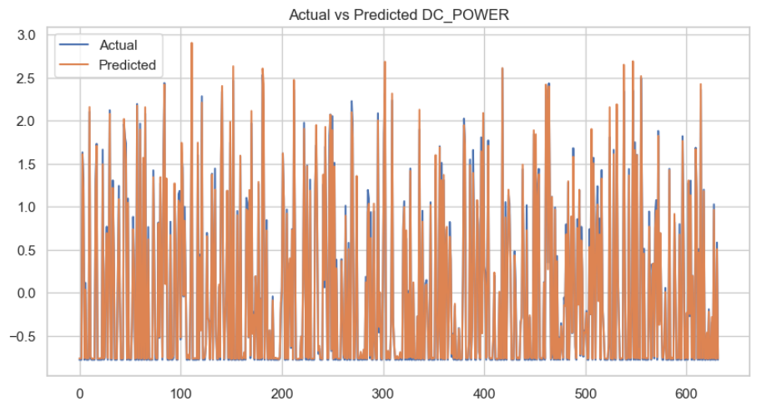
Screenshot of Output:

Slide 8
Conclusion:
Irradiation is the most influential feature affecting solar power generation.
Random Forest model outperformed Linear Regression, with higher R² and lower error values.
The forecasting model can help in:
Better scheduling of renewable power supply.
Reducing energy wastage.
Improving reliability of solar plant operations.
This project demonstrates how AI and ML can contribute to sustainable energy management.

