Slide 1
Neuromorphic Computing Simulator

Slide 2
Introduction
What is Neuromorphic Computing?
Neuromorphic computing is an emerging field that designs hardware and algorithms inspired by the structure and function of the human brain. Instead of traditional sequential processing, neuromorphic systems use networks of artificial neurons and synapses to achieve efficient, adaptive, and parallel computation.
However, real neuromorphic hardware is expensive and not easily accessible. A simulator provides a low-cost, flexible, and scalable environment for research, prototyping, and education.
Why Simulation?
Real neuromorphic hardware is expensive and complex to access. A simulator provides:
Flexibility: Rapid prototyping and testing of neuron models, networks, and learning rules.
Scalability: Ability to examine large-scale brain-like networks.
Accessibility: Educational benefits for students and researchers without hardware

Slide 3
Project Goals
Implement customizable neuron and synapse models.
Support various network configurations and learning algorithms.
Visualize neural activity (spike rasters, learning curves).
Offer modularity for easy extension and integration with future hardware.
Technologies & Tools
Programming Language - Python
Simulation Libraries – Nengo, Brian2
Visualization – Matplotlib, Plotly
Development Environment - Jupyter Notebook
Code Management & Sharing - GitHub

Slide 4
Algorithm
1. Initialize Environment
Import necessary libraries: Nengo/Brian2, NumPy, Matplotlib.
Set up Jupyter Notebook environment for interactive coding.
2. Define Neuron Model
Choose model: Leaky Integrate-and-Fire (LIF), Izhikevich, etc.
Set model parameters (e.g., membrane potential, threshold, reset).
3. Build Neural Network
Specify number of neurons and network topology (feedforward, recurrent, etc.).
Define connectivity matrix (who connects to whom, synapse weights).
Initialize synaptic model (static or plastic: STDP/Hebbian).
4. Design Input Encoding
Convert input data (e.g., image, signal) into spike trains using scheme like Poisson encoding.

Slide 5
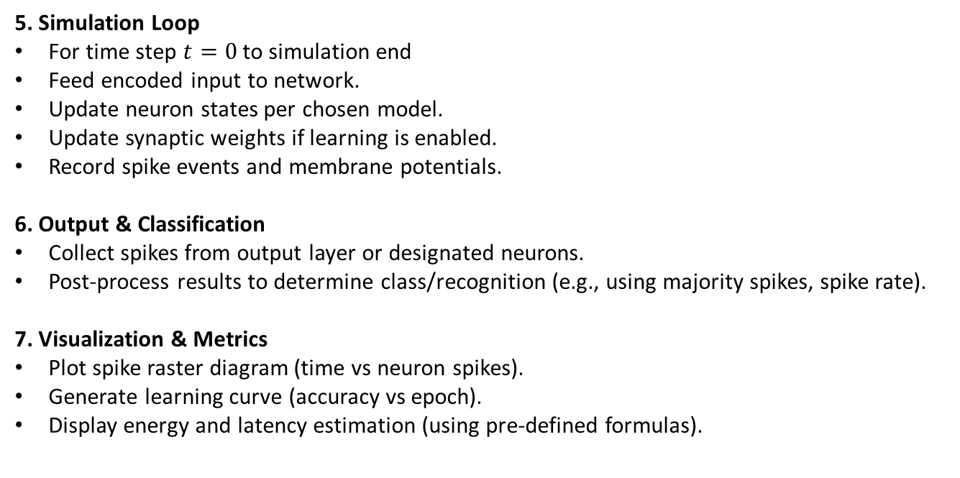
5. Simulation Loop
For time step $t=0$ to simulation end
Feed encoded input to network.
Update neuron states per chosen model.
Update synaptic weights if learning is enabled.
Record spike events and membrane potentials.
6. Output & Classification
Collect spikes from output layer or designated neurons.
Post-process results to determine class/recognition (e.g., using majority spikes, spike rate).
7. Visualization & Metrics
Plot spike raster diagram (time vs neuron spikes).
Generate learning curve (accuracy vs epoch).
Display energy and latency estimation (using pre-defined formulas).

Slide 6
Version 1: Basic Simulator
Single neuron model (LIF)
Feedforward network with fixed weights
Basic spike raster visualization
Version 2: Modular Expansion
Multiple neuron models (LIF, Izhikevich, Hodgkin-Huxley)
STDP/Hebbian learning rules
Configurable topologies
Weight change visualization
Version 3: Educational Demos & Dashboard
Practical tasks (digit recognition, edge detection)
Performance dashboards (accuracy, energy, latency)
Data persistence and improved usability
Output –
Basic Spike Raster Visualization - shows when each neuron fires over time as vertical tick marks.
Weight Change Visualization - compares synaptic connection strengths before and after learning.
Performance Dashboards - track accuracy improvement, energy efficiency, and latency reduction across training epochs.

Slide 7
