Slide 1
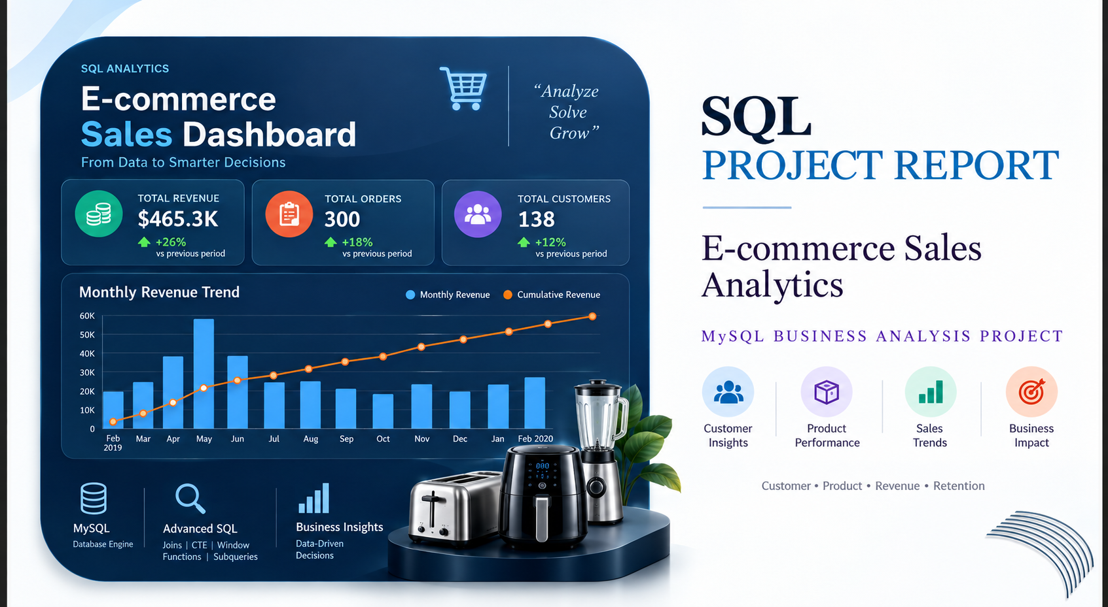
E-commerce
Sales Dashboard
$
#

Slide 2
PROJECT OVERVIEW
From raw transactions to business-ready insights
01
DB
02
$
DATA LAYER
REVENUE METRIC
customers • orders
product_orders • products
quantity × unit_price
core sales calculation
03
SQL
04
BI
SQL SKILLS
BUSINESS AREAS
Joins • CTEs • Subqueries
Window functions • Aggregations
Customers • Products
Product types • Monthly revenue
05
PROJECT GOAL
Turn transaction data into actionable insights for customer, product and revenue decisions.
→
02

Slide 3
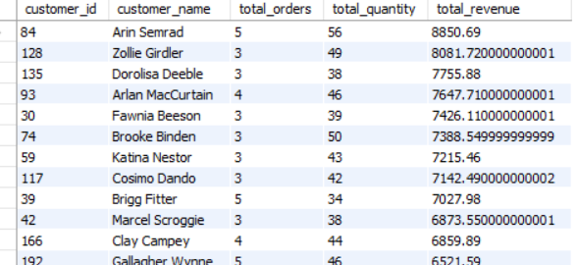
Q01
Customer Revenue Analysis
PROBLEM STATEMENT
Find every customer who has placed at least one order. Show: - customer_id - customer name - number of orders - total quantity purchased - total revenue Sort by total revenue from highest to lowest.
FULL SQL QUERY
BUSINESS INSIGHT
select c.customer_id,
concat(c.first_name,' ' ,c.last_name) as customer_name,
count(distinct o.order_id) as total_orders ,
sum(po.quantity) as total_quantity ,
sum(po.unit_price *po.quantity) as total_revenue
from customers c
join orders o
on c.customer_id=o.customer_id
join product_orders po
on o.order_id=po.order_id
group by c.customer_id,customer_name
having count(o.order_id) >=1;
• Customer revenue is concentrated among the leading customers. The displayed leaders include Arin Semrad ($8,850.69), Zollie Girdler ($8,081.72) and Dorolisa Deeble ($7,755.88), giving the business a clear high-value customer group to protect and grow.
OUTPUT SAMPLE
3

Slide 4
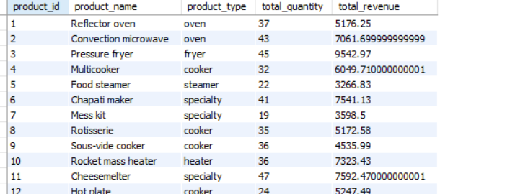
Q02
Product Performance
PROBLEM STATEMENT
Find the total revenue and total quantity sold for every product. Show: - product_id - product_name - product_type - total_quantity - total_revenue Include only products that have been ordered.
FULL SQL QUERY
BUSINESS INSIGHT
select p.product_id,
p.product_name,p.
product_type,
sum(po.quantity) as total_quantity ,
sum(po.unit_price*po.quantity) as total_revenue
from products p
join product_orders po
on p.product_id=po.product_id
group by p.product_id,p.product_name,p.product_type;
• Product revenue varies materially across the catalog. The result provides a basis for prioritising products with stronger sales volume and revenue, while identifying lower-performing products that may need pricing, promotion or assortment review.
OUTPUT SAMPLE
4

Slide 5
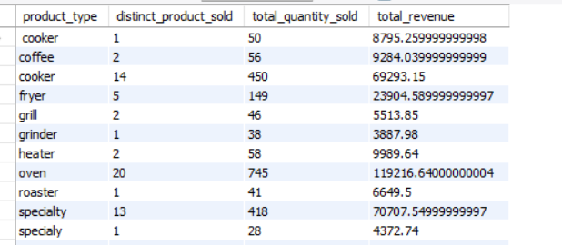
Q03
Product-Type Revenue Analysis
PROBLEM STATEMENT
Find total revenue generated by each product type. Show: - product_type - number of distinct products sold - total quantity sold - total revenue
FULL SQL QUERY
BUSINESS INSIGHT
select p.product_type,
count(distinct po.product_id) as distinct_product_sold ,
sum(po.quantity) as total_quantity_sold,
sum(po.unit_price*po.quantity) as total_revenue
from products p
join product_orders po
on p.product_id=po.product_id
group by p.product_type;
• Revenue and sales volume differ by product type, so category-level performance should guide inventory and commercial focus. The analysis helps identify product types that generate substantial revenue without relying on a single product.
OUTPUT SAMPLE
5

Slide 6
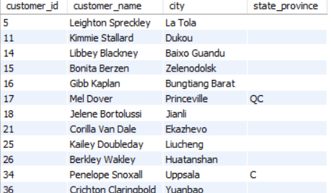
Q04
Customers With No Orders
PROBLEM STATEMENT
Find customers who have never placed an order. Show: - customer_id - customer name - city - state_province
FULL SQL QUERY
BUSINESS INSIGHT
select c.customer_id,
concat(c.first_name,' ' ,c.last_name) as customer_name,
c.city,
c.state_province from customers c
left join orders o
on c.customer_id=o.customer_id
where o.order_id is null;
• A measurable group of customers has no recorded orders. These customers represent a reactivation opportunity; targeted offers or reminders can be used to test whether dormant customers can be converted into repeat buyers.
OUTPUT SAMPLE
6

Slide 7
Q05
Products Never Ordered
PROBLEM STATEMENT
Find products that have never appeared in product_orders. Show: - product_id - product_name - product_type
FULL SQL QUERY
BUSINESS INSIGHT
select p.product_id,
p.product_name,
p.product_type
from products p
left join product_orders po
on p.product_id =po.product_id
WHERE po.order_id IS NULL;
• Products with no orders represent unused inventory/assortment potential. Before investing further in these products, the business should review demand, pricing, product positioning and availability.
OUTPUT SAMPLE
No matching result screenshot was supplied for this question.
7

Slide 8
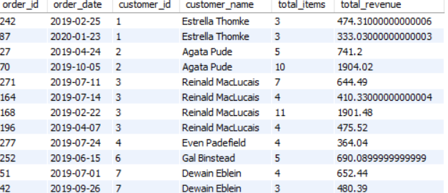
Q06
Order-Level Revenue
PROBLEM STATEMENT
For every order, calculate the total order value. Also show: - order_id - order_date - customer_id - customer name - total items - order_value
FULL SQL QUERY
BUSINESS INSIGHT
select o.order_id,
o.order_date,
c.customer_id,
concat(c.first_name,' ' ,c.last_name) as customer_name,
sum(po.quantity) as total_items,
sum(po.unit_price*po.quantity) as total_revenue from customers c
join orders o
on c.customer_id=o.customer_id
join product_orders po
on o.order_id=po.order_id
group by o.order_id,
o.order_date,
c.customer_id,
customer_name;
• Order-level revenue makes transaction size visible. This supports basket-value analysis and helps identify unusually large or small orders that may explain changes in overall revenue.
OUTPUT SAMPLE
8

Slide 9
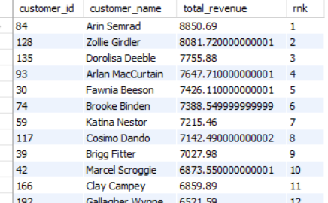
Q07
Rank Customers by Revenue
PROBLEM STATEMENT
Calculate each customer's total revenue and rank customers from highest to lowest revenue using DENSE_RANK(). Show: - customer_id - customer_name - total_revenue - revenue_rank
FULL SQL QUERY
BUSINESS INSIGHT
select c.customer_id ,
concat(c.first_name,' ' ,c.last_name) as customer_name,
sum(po.unit_price*po.quantity) as total_revenue ,
dense_rank() over(order by sum(po.unit_price*po.quantity) desc) as rnk
from customers c
join orders o
on c.customer_id=o.customer_id
join product_orders po
on o.order_id=po.order_id
group by c.customer_id ,customer_name
;
• Customer revenue ranking identifies the highest-value customers. The displayed ranking places Arin Semrad first at $8,850.69, providing a practical starting point for retention and high-value customer strategies.
OUTPUT SAMPLE
9

Slide 10
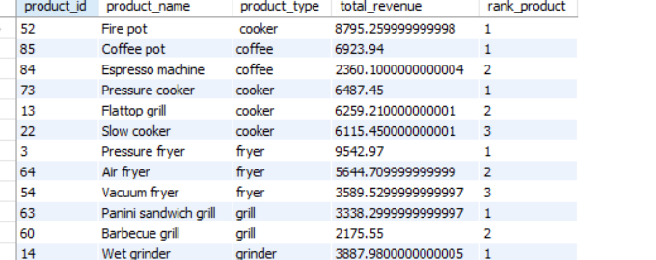
Q08
Top 3 Products Within Each Product Type
PROBLEM STATEMENT
Calculate revenue for every product and return the top 3 products within each product_type using ROW_NUMBER().
FULL SQL QUERY
BUSINESS INSIGHT
select * from
(select p.product_id ,p.product_name,p.product_type ,
sum(po.unit_price*po.quantity) as total_revenue ,
Row_number() over(partition by p.product_type order by sum(po.unit_price*po.quantity) desc)
as rank_product
from products p
join product_orders po
on p.product_id=po.product_id
group by p.product_id ,p.product_name,p.product_type) as t
where rank_product<=3;
• Top products differ within product types. Comparing the top three in each type helps the business concentrate inventory and promotion on the strongest products while avoiding a one-size-fits-all category strategy.
OUTPUT SAMPLE
10

Slide 11
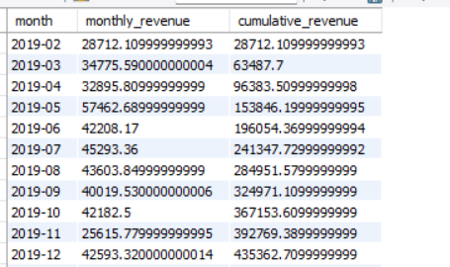
Q09
Running Monthly Revenue
PROBLEM STATEMENT
Calculate total revenue for each month and the cumulative (running) revenue over time. Show: - month - monthly_revenue - cumulative_revenue
FULL SQL QUERY
BUSINESS INSIGHT
select * , sum(revenue) over( order by month asc) as cumulative_revenue from
(select MONTH(
o.order_date
) AS month
,
sum(po.unit_price*po.quantity) as revenue
from orders o
join product_orders po
on o.order_id=po.order_id
group by month) as t
where month is not null;
• Cumulative revenue rises from about $28.7K in Feb-2019 to about $465.3K by Feb-2020 in the supplied output. This gives management a clear view of total revenue accumulated over the analysis period.
OUTPUT SAMPLE
11

Slide 12
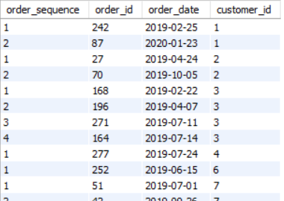
Q10
Customer Order Sequence
PROBLEM STATEMENT
For every order, show the customer's: - order sequence number - order_id - order_date - customer_id The first order for a customer should have sequence number 1.
FULL SQL QUERY
BUSINESS INSIGHT
select row_number() over(partition by c.customer_id order by o.order_date asc) order_sequence
,o.order_id,
o.order_date,
c.customer_id
from customers c
join orders o
on c.customer_id=o.customer_id ;
• Customers show different purchase sequences, with some having multiple orders. This supports lifecycle analysis: first purchase, repeat purchase and subsequent buying behaviour can be treated as different customer stages.
OUTPUT SAMPLE
12

Slide 13
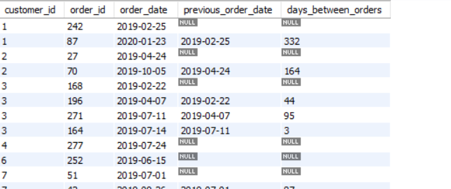
Q11
Days Between Customer Orders
PROBLEM STATEMENT
Use LAG() to calculate the number of days between each customer's current order and previous order.
FULL SQL QUERY
BUSINESS INSIGHT
select * , DATEDIFF(order_date, previous_order_date) AS days_between_orders from
(select c.customer_id ,
o.order_id,
o.order_date,
lag(o.order_date) over(partition by customer_id ORDER BY o.order_date) as previous_order_date
from customers c
join orders o
on c.customer_id=o.customer_id)as t;
• The time between orders varies considerably across customers. Large gaps can indicate slower repurchase cycles and can help define when a customer should receive a re-engagement message.
OUTPUT SAMPLE
13

Slide 14
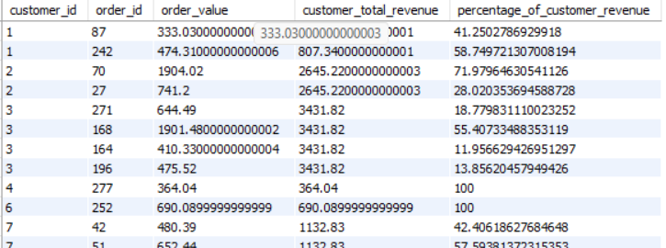
Q12
Order Contribution to Customer Revenue
PROBLEM STATEMENT
For every order, calculate: - order value - customer's total revenue - percentage of customer revenue contributed by that order Use a window function to calculate the customer total.
FULL SQL QUERY
BUSINESS INSIGHT
with cte as (select *, sum(order_value) over(partition by customer_id) as customer_total_revenue
from
(select c.customer_id , o.order_id,sum(po.unit_price*po.quantity ) as order_value
from customers c
join orders o
on c.customer_id=o.customer_id
join product_orders po
on o.order_id=po.order_id
group by c.customer_id , o.order_id) as t)
select * , ( order_value / customer_total_revenue)*100 from cte;
• Revenue contribution differs by order within the same customer. For repeat customers, some orders account for a much larger share of lifetime revenue, helping identify the transactions and behaviours that drive customer value.
OUTPUT SAMPLE
14

Slide 15
Q13
Highest-Value Order for Every Customer
PROBLEM STATEMENT
Return only the highest-value order for each customer. If two orders have the same value, use the earlier order.
FULL SQL QUERY
BUSINESS INSIGHT
with cte as(select * , row_number() over(partition by customer_id order by order_value desc ,
order_date asc) as rnk from
(select c.customer_id ,o.order_id,o.order_date, sum(po.quantity* po.unit_price) as order_value
from customers c
join orders o
on c.customer_id=o.customer_id
join product_orders po
on o.order_id=po.order_id
group by c.customer_id ,o.order_id,o.order_date) as t)
select * from cte where rnk=1 ;
• Each customer has a highest-value order that can be compared with their other purchases. This helps identify customers capable of larger baskets and can inform cross-sell or upsell strategies.
OUTPUT SAMPLE
No matching result screenshot was supplied for this question.
15

Slide 16
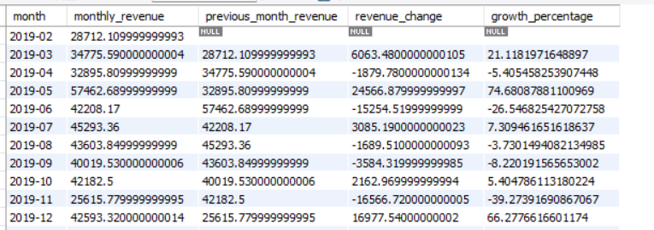
Q14
Monthly Revenue Growth
PROBLEM STATEMENT
Calculate monthly revenue and compare each month with the previous month using LAG(). Show: - month - monthly_revenue - previous_month_revenue - revenue_change - growth_percentage
FULL SQL QUERY
BUSINESS INSIGHT
with cte as(select *,lag(monthly_revenue) over(order by months asc) as previous_month_revenue
from
(select month(o.order_date) as months ,
sum(po.quantity* po.unit_price) as monthly_revenue
from orders o
join product_orders po
on o.order_id =po.order_id
group by months) as t)
select * ,
monthly_revenue-previous_month_revenue as revenue_change ,((monthly_revenue - previous_month_revenue)
/ NULLIF(previous_month_revenue, 0)) * 100 as growth_percentage
from cte;
• Monthly revenue is volatile. May-2019 is the highest displayed month at about $57.46K with 74.68% growth, while Jan-2020 and Feb-2020 show declines. Management should investigate the drivers of these month-to-month swings.
OUTPUT SAMPLE
16

Slide 17
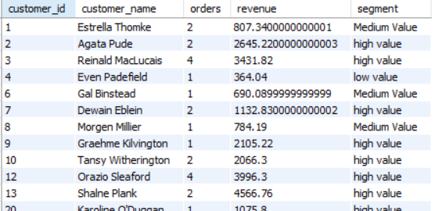
Q15
Customer Purchase Segmentation
PROBLEM STATEMENT
Using a CTE, calculate each customer's: - total orders - total revenue Then classify customers as: - High Value: revenue >= 1000 - Medium Value: revenue >= 500 and < 1000 - Low Value: revenue < 500 Return customer_id, customer_name, orders, revenue, segment.
FULL SQL QUERY
BUSINESS INSIGHT
with cte as (
select c.customer_id ,
concat(c.first_name,' ',c.last_name) as customer_name,
count(distinct o.order_id) as total_orders,
sum(po.quantity*po.unit_price) as total_revenue from customers c
join orders o
on c.customer_id=o.customer_id
join product_orders po
on o.order_id=po.order_id
group by c.customer_id, c.first_name,c.last_name
)
,classify as ( select *,case when total_revenue >= 1000 then 'high value'
when total_revenue >= 500
AND total_revenue < 1000 THEN 'Medium Value'
else 'low value'
end as segment from cte)
select customer_id,customer_name, total_orders as orders ,total_revenue as revenue ,segment from classify;
• Customer segmentation creates actionable value groups. High-value customers (revenue ≥ $1,000) can receive retention and upsell attention, while medium/low-value groups can be approached with conversion and repeat-purchase campaigns.
OUTPUT SAMPLE
17

Slide 18
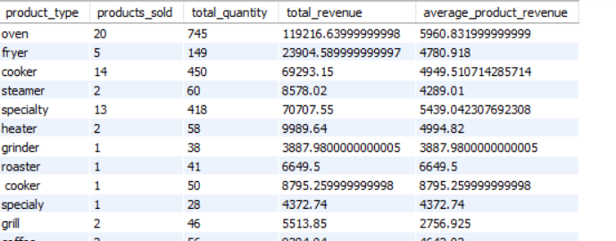
Q16
Product Type Performance
PROBLEM STATEMENT
Using CTEs, calculate revenue for every product and then summarize the results by product_type. Show: - product_type - products_sold - total_quantity - total_revenue - average_product_revenue
FULL SQL QUERY
BUSINESS INSIGHT
with cte as
(select
p.product_type ,
p.product_id,
sum(po.quantity) as total_quantity,
sum(po.quantity*po.unit_price) as total_revenue from products p
join product_orders po
on p.product_id=po.product_id
group by p.product_type ,p.product_id
)
select product_type ,
COUNT(product_id) AS products_sold ,
sum(total_quantity) as total_quantity ,
sum(total_revenue) as total_revenue,
avg(total_revenue) as average_product_revenue from cte
group by product_type ;
• Product-type performance highlights differences in product breadth, quantity and revenue. The displayed output shows oven as a major revenue contributor, while types with fewer products can still generate meaningful revenue, so both scale and productivity matter.
OUTPUT SAMPLE
18

Slide 19
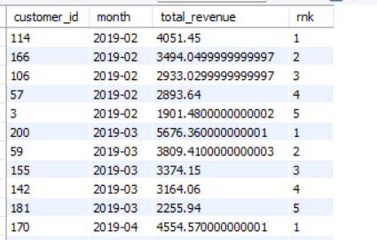
Q17
Top 5 Customers in Each Month
PROBLEM STATEMENT
Using a CTE and ROW_NUMBER(), find the top 5 customers by revenue in every month.
FULL SQL QUERY
BUSINESS INSIGHT
with cte as
(select o.customer_id ,
month(o.order_date) as months
,sum(po.quantity*po.unit_price) as total_revenue from orders o
join product_orders po
on o.order_id=po.order_id
group by o.customer_id, month(o.order_date))
, ranked as (select * ,
row_number() over(partition by months order by total_revenue desc) as rnk
from cte)
select * from ranked
where rnk <=5 );
• The monthly top-five view shows which customers drive revenue in each month. This can support monthly account management, retention monitoring and identification of customers whose contribution changes over time.
OUTPUT SAMPLE
19

Slide 20
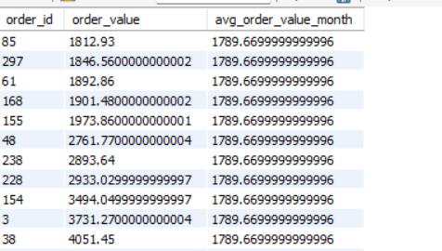
Q19
Orders Above Monthly Average
PROBLEM STATEMENT
Using CTEs, calculate each order's value and the average order value for its month. Return orders whose value is greater than their month's average order value.
FULL SQL QUERY
BUSINESS INSIGHT
with cte as(select o.order_id,
month(o.order_date) as months
,sum(po.quantity*po.unit_price) as order_value
from orders o
join product_orders po
on o.order_id=po.order_id
group by o.order_id,
month(o.order_date))
,avg_order_value as
(select months,avg(order_value) as avg_order_value_month
from cte group by months)
select c.order_id ,c.order_value,av.avg_order_value_month from avg_order_value av
join cte c
on av.months=c.months
where c.order_value>av.avg_order_value_month;
• Orders above the monthly average are unusually large relative to the period in which they occurred. These transactions can reveal successful product combinations, promotions or customer behaviours worth replicating.
OUTPUT SAMPLE
21

Slide 21
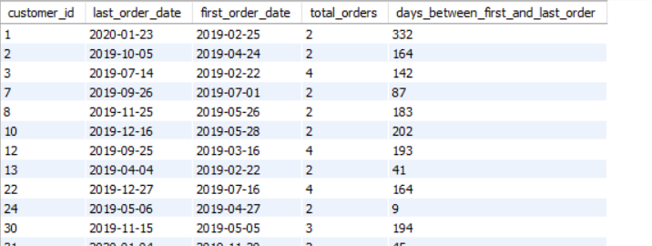
Q20
Customer Retention / Repeat Purchase Analysis
PROBLEM STATEMENT
Using CTEs, find customers who placed at least 2 orders. Show: - customer_id - first_order_date - last_order_date - total_orders - days_between_first_and_last_order
FULL SQL QUERY
BUSINESS INSIGHT
with cte as (select customer_id
,max(order_date) as last_order_date,
min(order_date ) as first_order_date ,
count(distinct order_id) as total_orders
from orders
group by customer_id
having count(distinct order_id)>=2 )
select * ,
datediff(last_order_date,first_order_date) as days_between_first_and_last_order
from cte ;
• Repeat customers have at least two orders, and the first-to-last order span shows how long the relationship remains active in the data. Longer spans can indicate stronger customer retention and provide a basis for lifecycle measurement.
OUTPUT SAMPLE
22

Slide 22
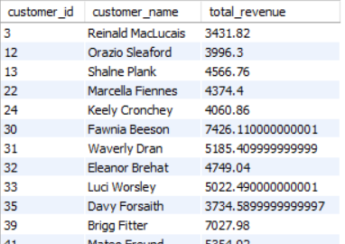
Q21
Customers Spending Above Average
PROBLEM STATEMENT
Find customers whose total revenue is greater than the average revenue of all customers who have placed orders. Show: - customer_id - customer_name - total_revenue
FULL SQL QUERY
BUSINESS INSIGHT
select c.customer_id,
c.first_name,
sum(po.quantity * po.unit_price) as total_revenue
from customers c
join orders o
on c.customer_id=o.customer_id
join product_orders po
on o.order_id=po.order_id
group by c.customer_id,
c.first_name
having sum(po.quantity * po.unit_price)> (select avg(total_revenue) from (select c.customer_id,
c.first_name,
sum(po.quantity * po.unit_price) as total_revenue
from customers c
join orders o
on c.customer_id=o.customer_id
join product_orders po
on o.order_id=po.order_id
group by c.customer_id,
c.first_name) as t);
• Customers above the average customer-revenue benchmark represent the higher-spending part of the customer base. The supplied result includes customers such as Reinald MacLucais and Orazio Sleaford, making them useful candidates for retention and value-growth analysis.
OUTPUT SAMPLE
23

Slide 23
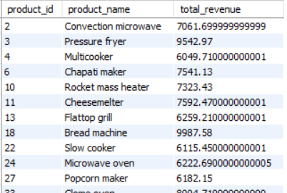
Q22
Products Above Average Revenue
PROBLEM STATEMENT
Find products whose total revenue is greater than the average revenue across all products that have been ordered.
FULL SQL QUERY
BUSINESS INSIGHT
select p.product_id,
p.product_name,
sum(po.quantity * po.unit_price) as total_revenue
from products p
join product_orders po
on p.product_id=po.product_id
group by p.product_id,
p.product_name
having sum(po.quantity * po.unit_price) > (select avg(total_revenue1) from (select p.product_id,
p.product_name,
sum(po.quantity * po.unit_price) as total_revenue1
from products p
join product_orders po
on p.product_id=po.product_id
group by p.product_id,
p.product_name) as t);
• Products above the average product-revenue benchmark are stronger revenue contributors than the typical ordered product. The supplied result includes Bread machine ($9,987.58) and Pressure fryer ($9,542.97), which can inform inventory and promotional priorities.
OUTPUT SAMPLE
24

Slide 24
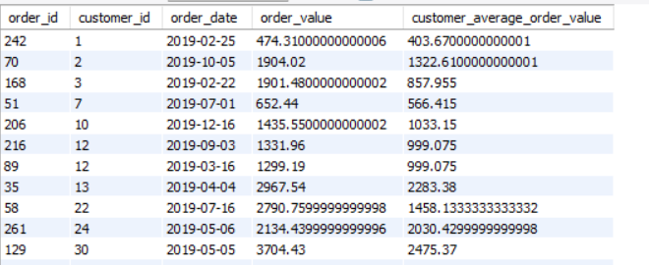
Q23
Orders Above the Customer's Average Order Value
PROBLEM STATEMENT
Find orders whose value is greater than the average order value of the same customer. Show: - order_id - customer_id - order_date - order_value - customer_average_order_value
FULL SQL QUERY
BUSINESS INSIGHT
WITH order_values AS (
SELECT
o.order_id,
o.customer_id,
o.order_date,
SUM(po.quantity * po.unit_price) AS order_value
FROM orders o
JOIN product_orders po
ON o.order_id = po.order_id
GROUP BY
o.order_id,
o.customer_id,
o.order_date
),
cte AS (
SELECT *,
AVG(order_value) OVER (
PARTITION BY customer_id
) AS customer_average_order_value
FROM order_values
)
SELECT *
FROM cte
WHERE order_value > customer_average_order_value;
• Orders above a customer's own average are unusually large for that individual. This is more useful for customer-level analysis than a single overall benchmark because it accounts for differences in normal buying behaviour.
OUTPUT SAMPLE
25

Slide 25
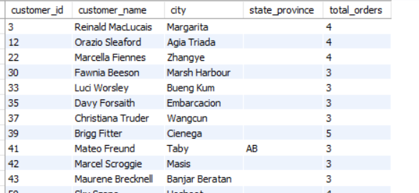
Q24
Customers With At Least 3 Orders
PROBLEM STATEMENT
Find customers who have placed at least 3 orders. Return customer details and their order count. Use a subquery to identify qualifying customers.
FULL SQL QUERY
BUSINESS INSIGHT
SELECT
c.customer_id,
CONCAT(c.first_name, ' ', c.last_name) AS customer_name,
c.city,
c.state_province,
t.total_orders
FROM customers c
JOIN (
SELECT
customer_id,
COUNT(order_id) AS total_orders
FROM orders
GROUP BY customer_id
HAVING COUNT(order_id) >= 3
) AS t
ON c.customer_id = t.customer_id;
• Customers with at least three orders form a high-frequency group. The supplied output includes customers with 3–5 orders, giving the business a practical segment for loyalty, retention and repeat-purchase analysis.
OUTPUT SAMPLE
26

Slide 26
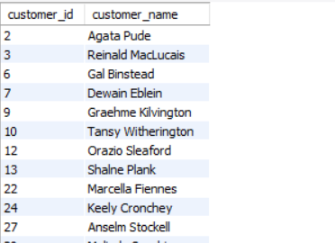
Q25
Customers Who Bought a Specific Product Type
PROBLEM STATEMENT
Find customers who have purchased at least one product from the 'oven' product type. Show each customer only once.
FULL SQL QUERY
BUSINESS INSIGHT
SELECT DISTINCT
c.customer_id,
CONCAT(c.first_name, ' ', c.last_name) AS customer_name
FROM customers c
JOIN orders o
ON c.customer_id = o.customer_id
JOIN product_orders po
ON o.order_id = po.order_id
JOIN products p
ON po.product_id = p.product_id
WHERE p.product_type = 'oven';
• Oven buyers form a product-specific customer segment. This segment can be used for targeted cross-sell, accessory recommendations and future campaigns based on related products.
OUTPUT SAMPLE
27

Slide 27
KEY BUSINESS TAKEAWAYS
01
Customer analysis supports revenue ranking, segmentation and repeat-purchase analysis.
02
Window functions provide ranking, order sequence, purchase-gap and revenue-trend analysis.
03
Product analysis compares revenue and volume at product and product-type level.
04
Monthly analysis makes revenue changes and cumulative performance visible over time.
05
Above-average customer/product queries turn raw transactions into actionable segments.
06
The SQL outputs provide a strong foundation for an Excel dashboard and business presentation.
28

