Slide 1

IILM UNIVERSITY
Greater Noida, Uttar Pradesh
INTERNSHIP EVALUATION PRESENTATION
Customer Segmentation using K-Means Clustering
Leveraging machine learning to understand customer behavior and optimize business strategies
STUDENT NAME
ENROLLMENT NUMBER
ADARSH PRATAP SINGH
25SCS1003001632
PROGRAM & SEMESTER
ORGANIZATION NAME
B.Tech CSE • 2nd Year / 4th Semester
QualityKiosk Technologies Pvt. Ltd.
Role: Python Developer Intern
Internship Period: 10 June 2026 – 10 August 2026
SESSION: 2025 - 29

Slide 2
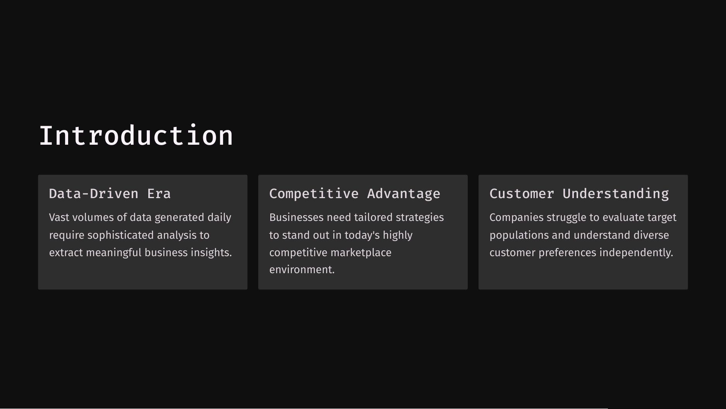

Slide 3
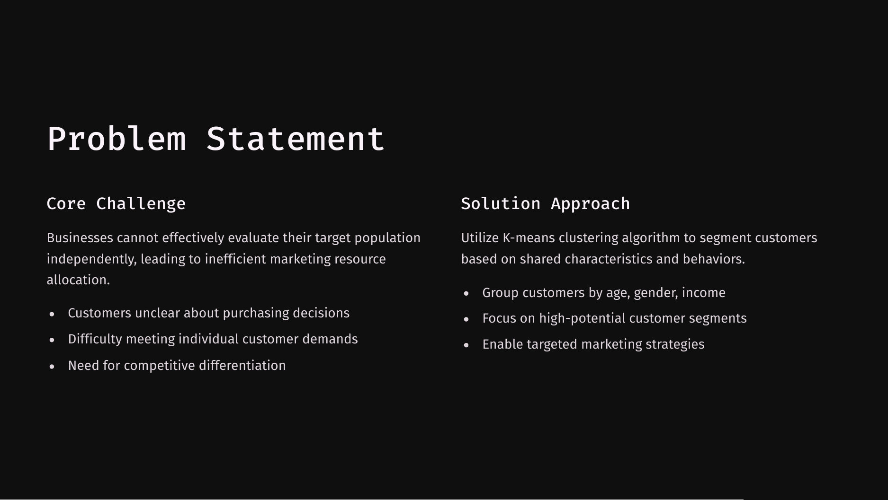

Slide 4
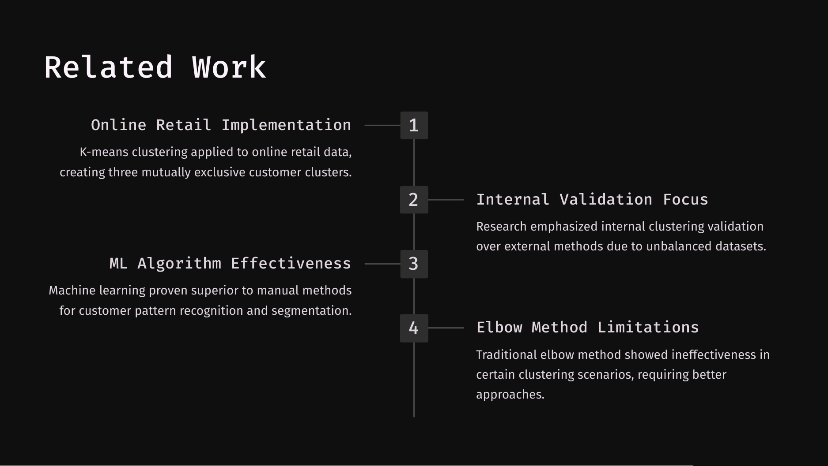

Slide 5
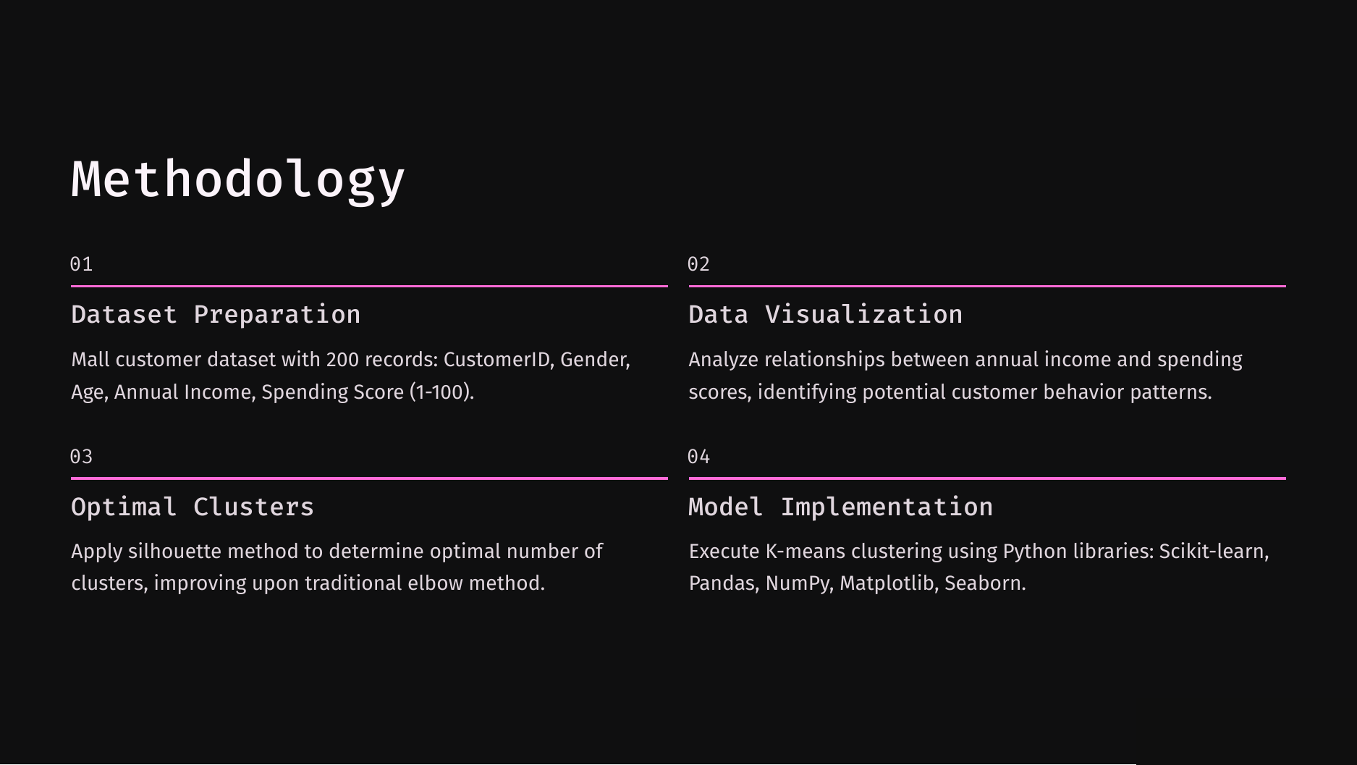

Slide 6
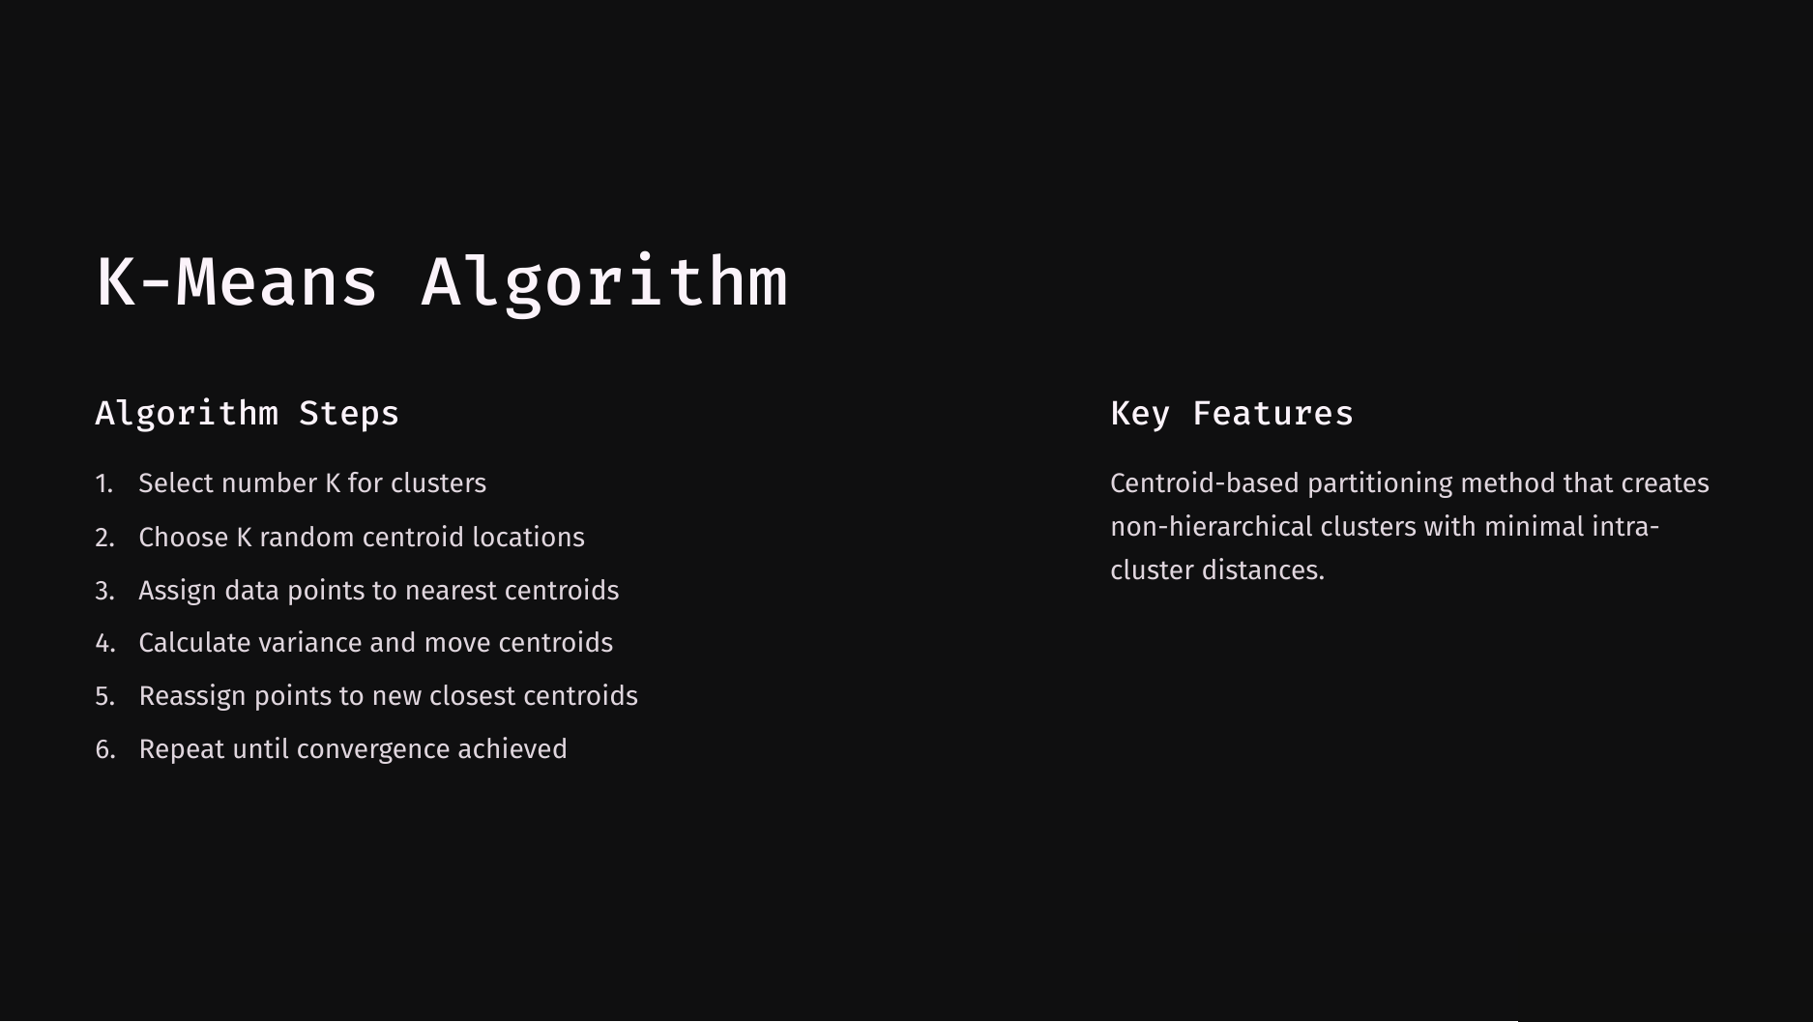

Slide 7
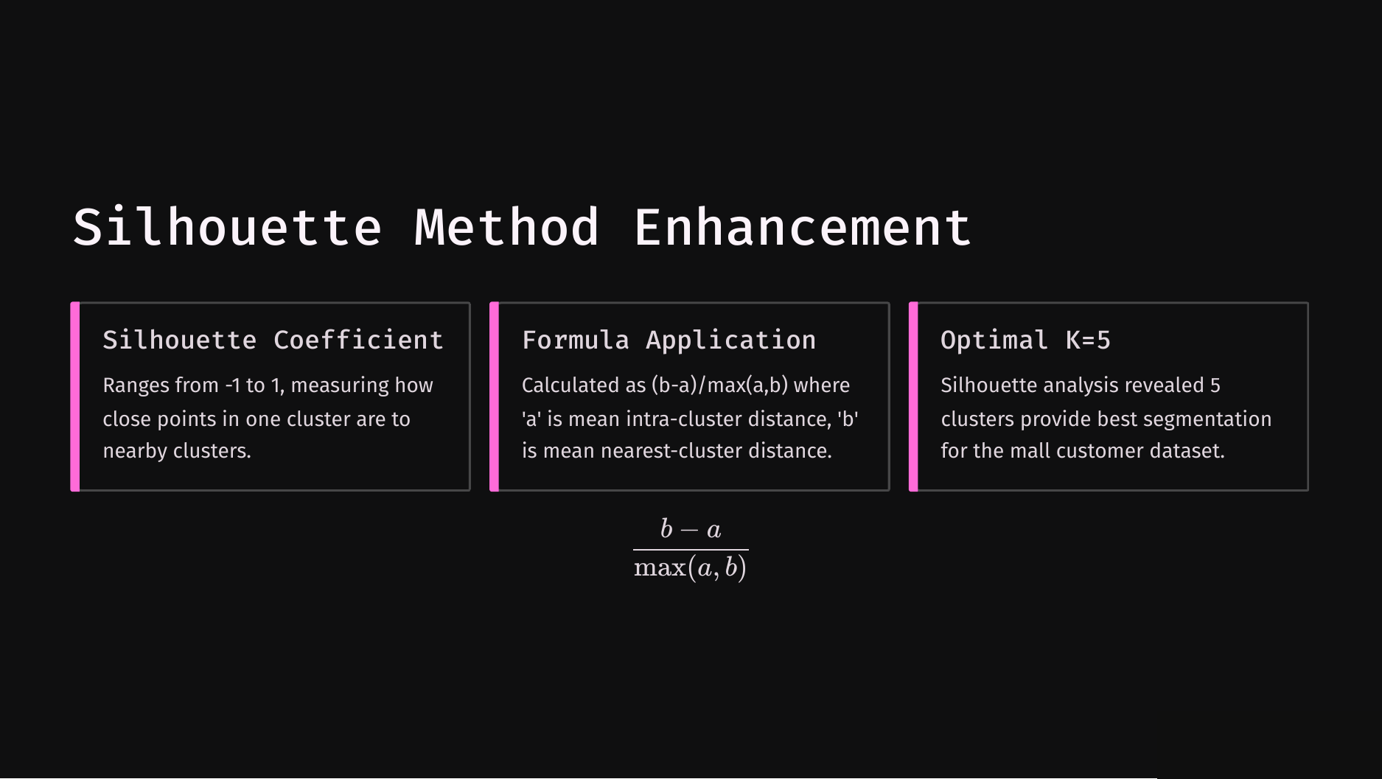

Slide 8
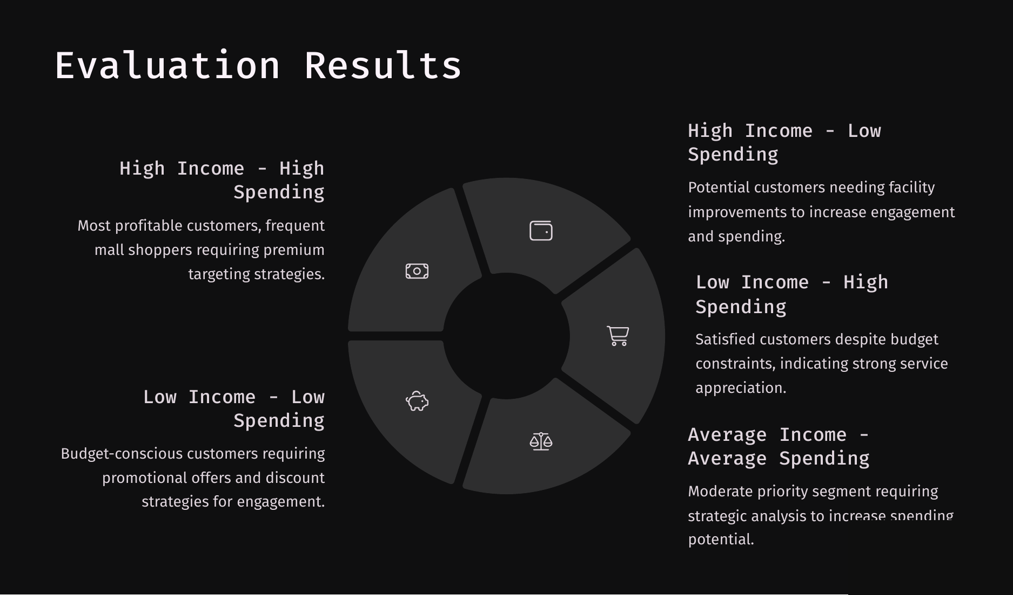

Slide 9
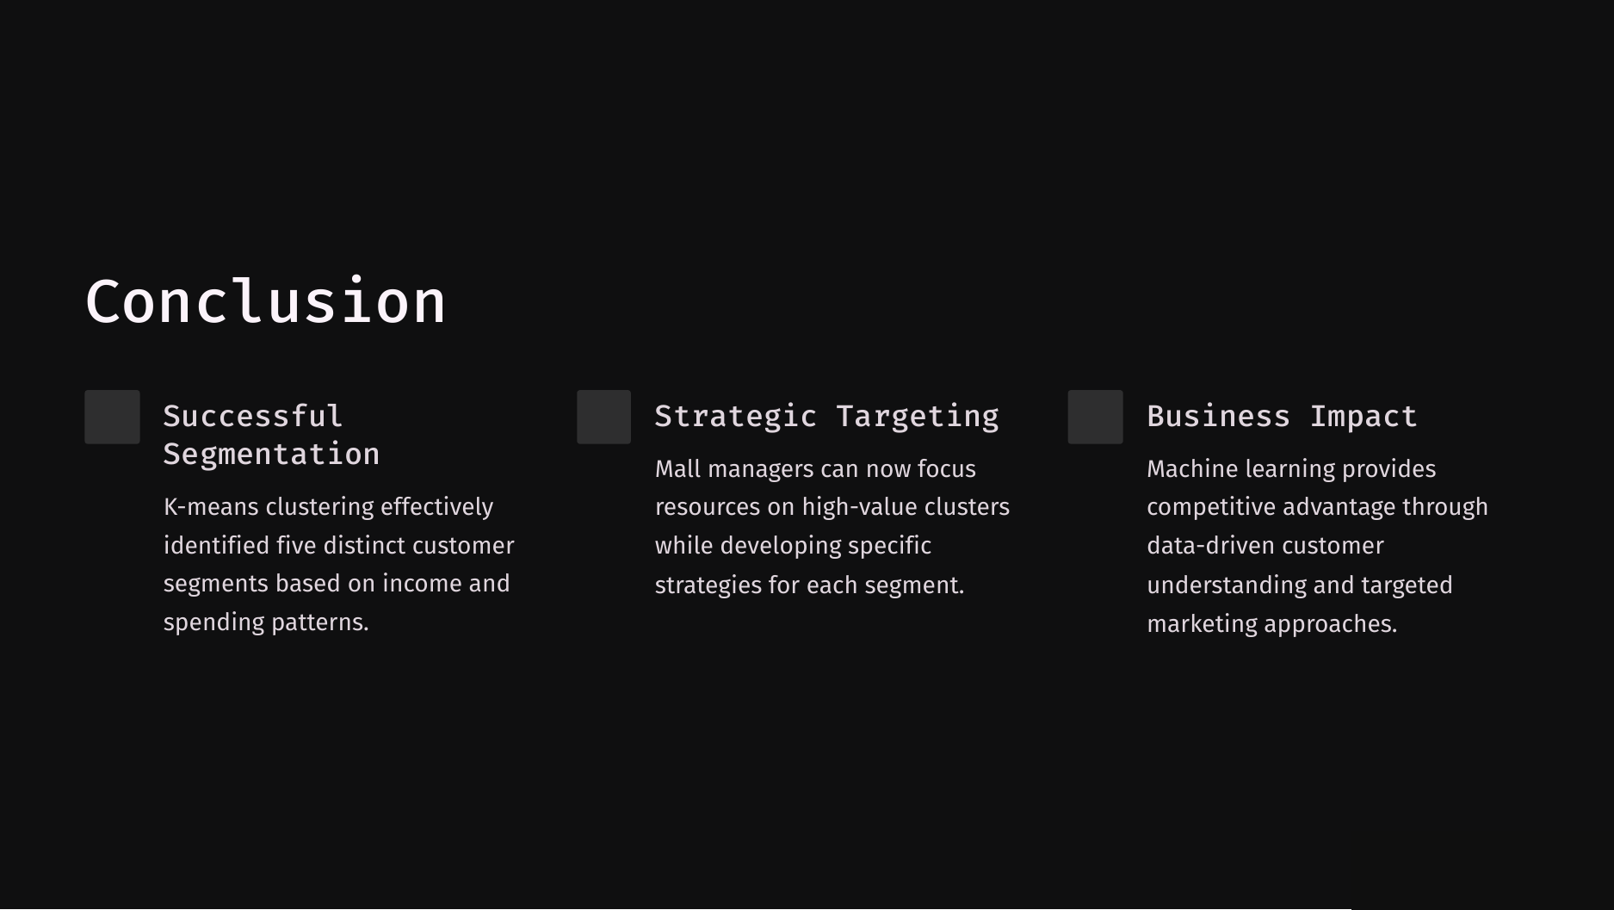

Slide 10
