Slide 1

IILM UNIVERSITY
Greater Noida, Uttar Pradesh
INTERNSHIP EVALUATION PRESENTATION
Customer Segmentation
using K-Means Clustering
Leveraging machine learning to understand customer behavior and optimize business strategies
STUDENT NAME
ENROLLMENT NUMBER
ADARSH PRATAP SINGH
25SCS1003001632
PROGRAM & SEMESTER
ORGANIZATION NAME
B.Tech CSE • 2nd Year / 3rd Semester
QualityKiosk Technologies Pvt. Ltd.
PYTHON DEVELOPER INTERN
25 JUNE 2026 — 25 AUGUST 2026
SESSION 2025–29
Internship Project Presentation

Slide 2
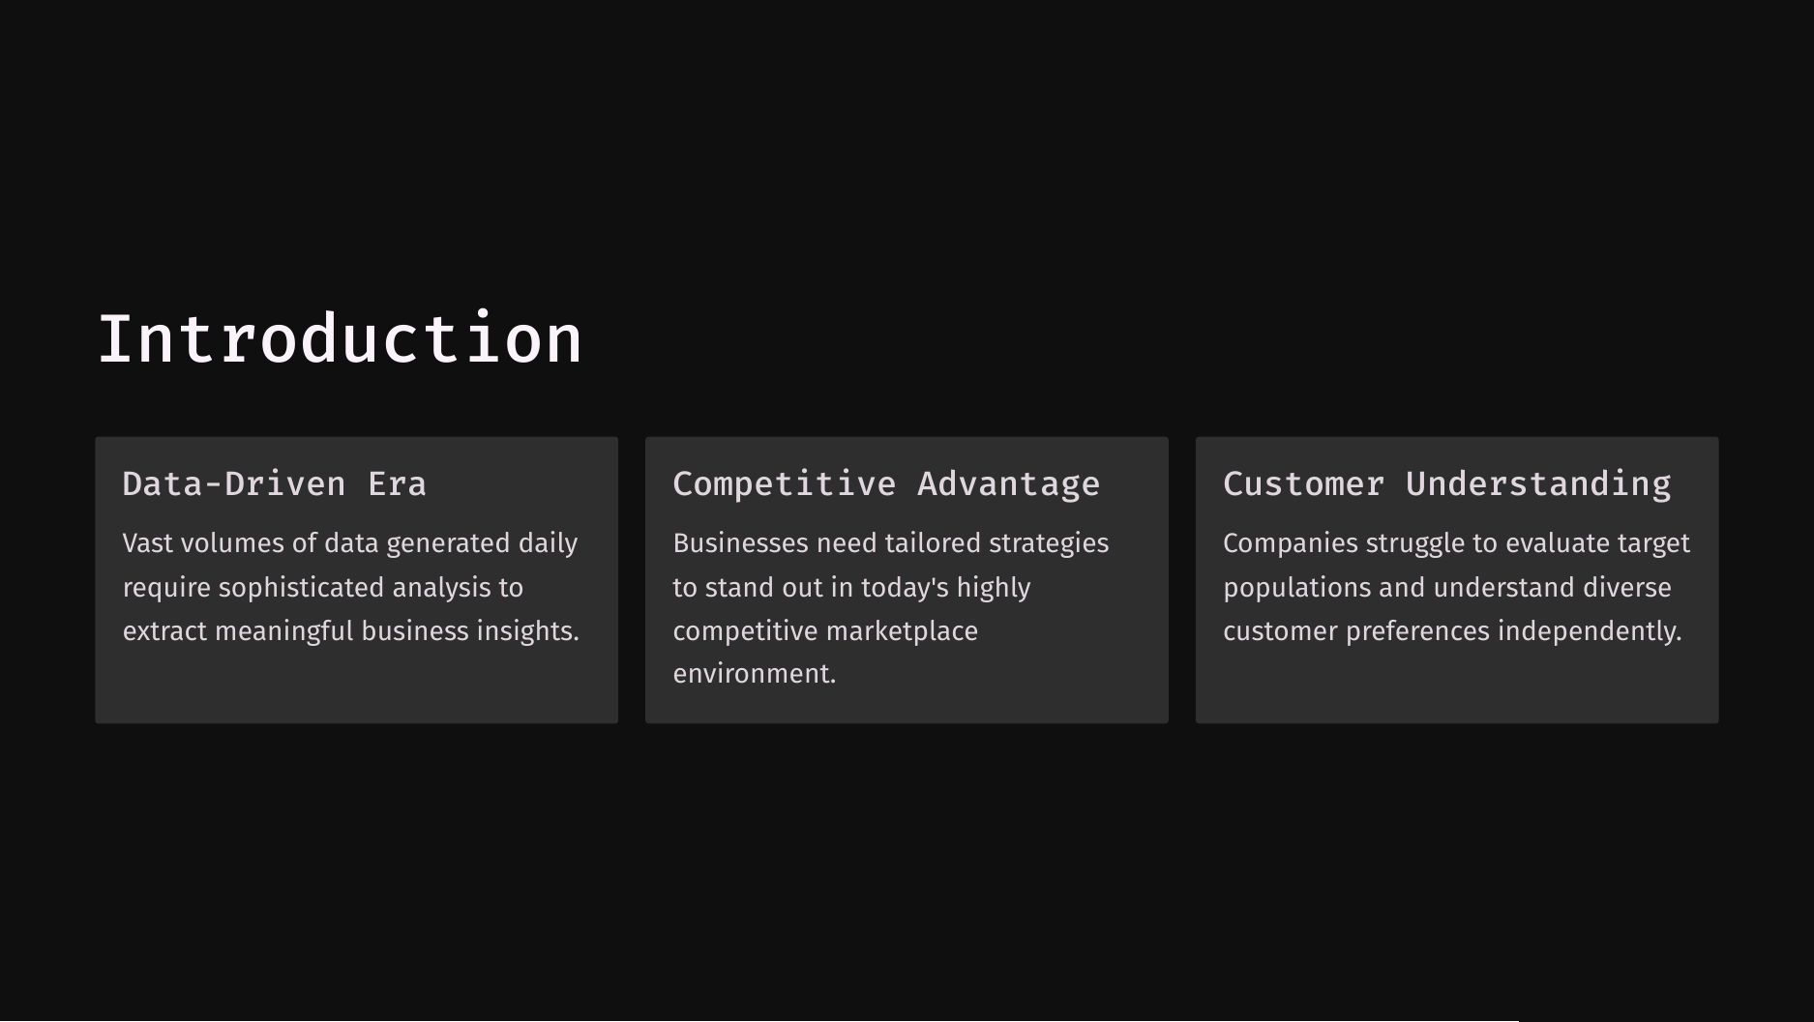

Slide 3
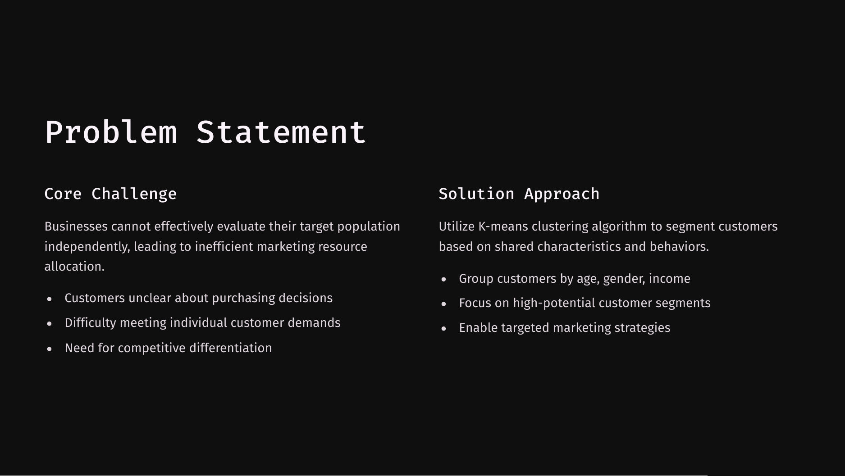

Slide 4
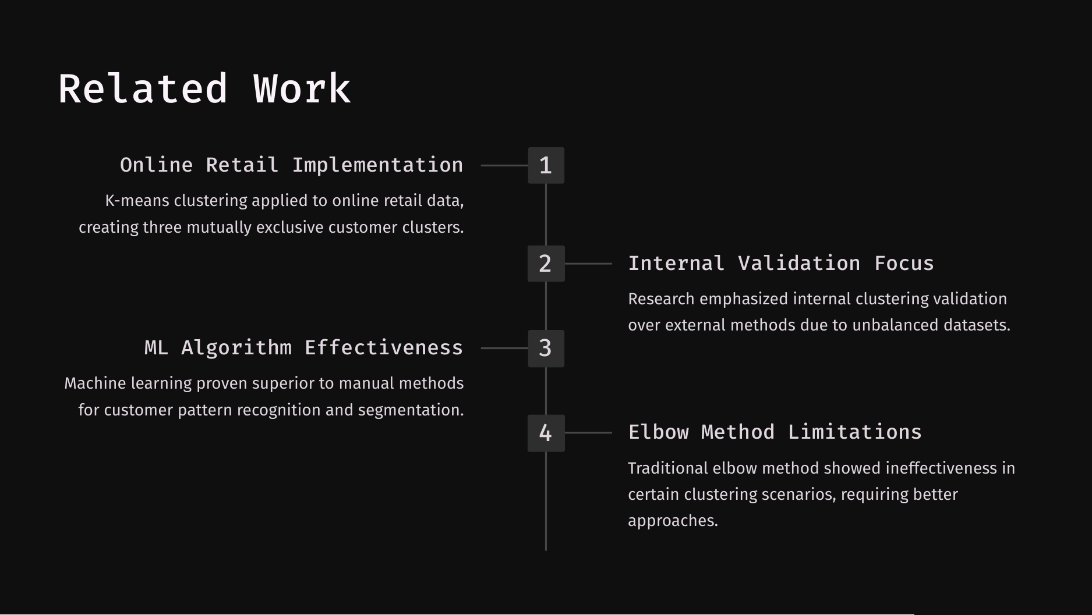

Slide 5
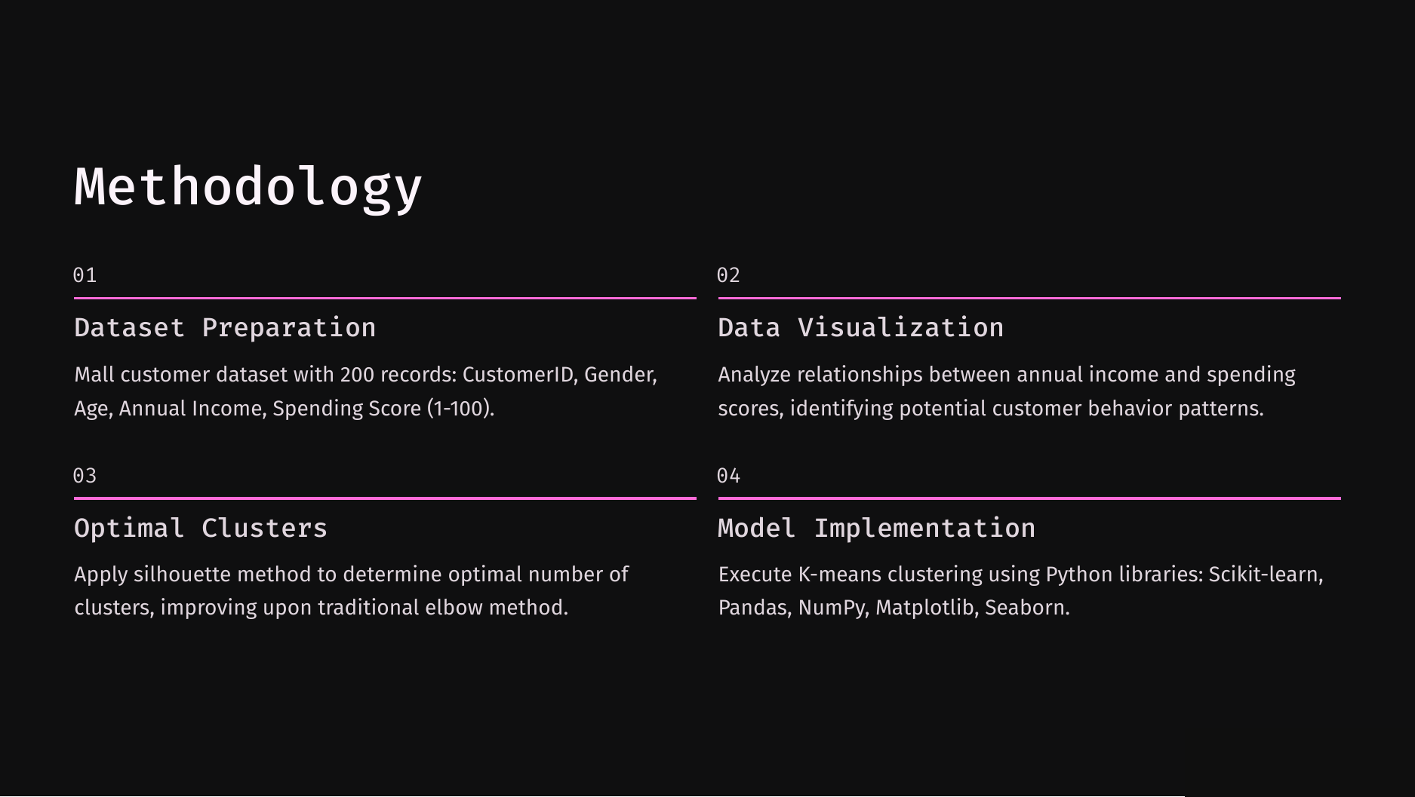

Slide 6
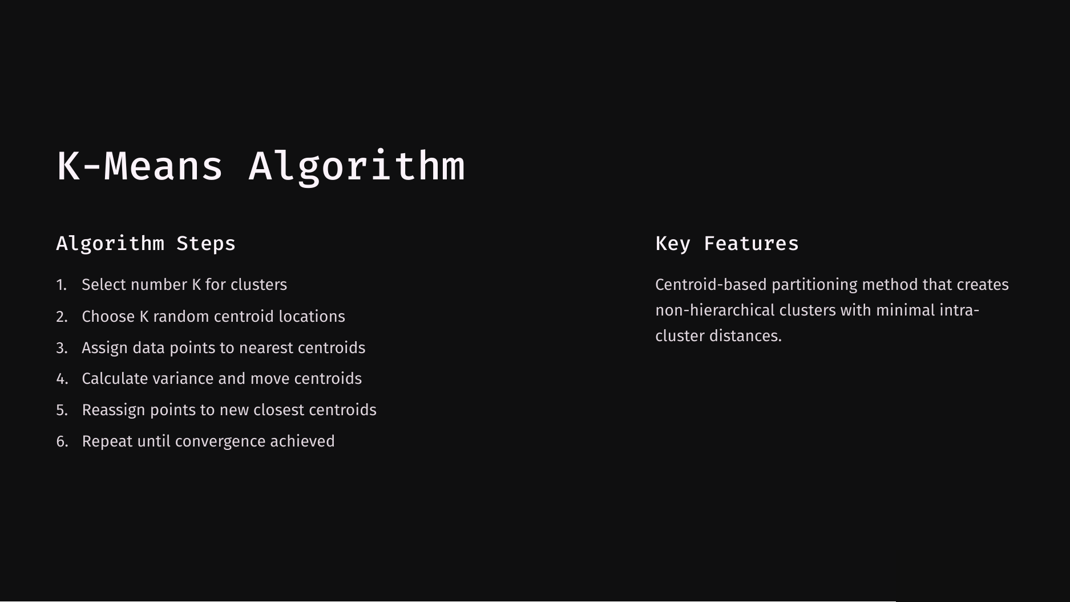

Slide 7
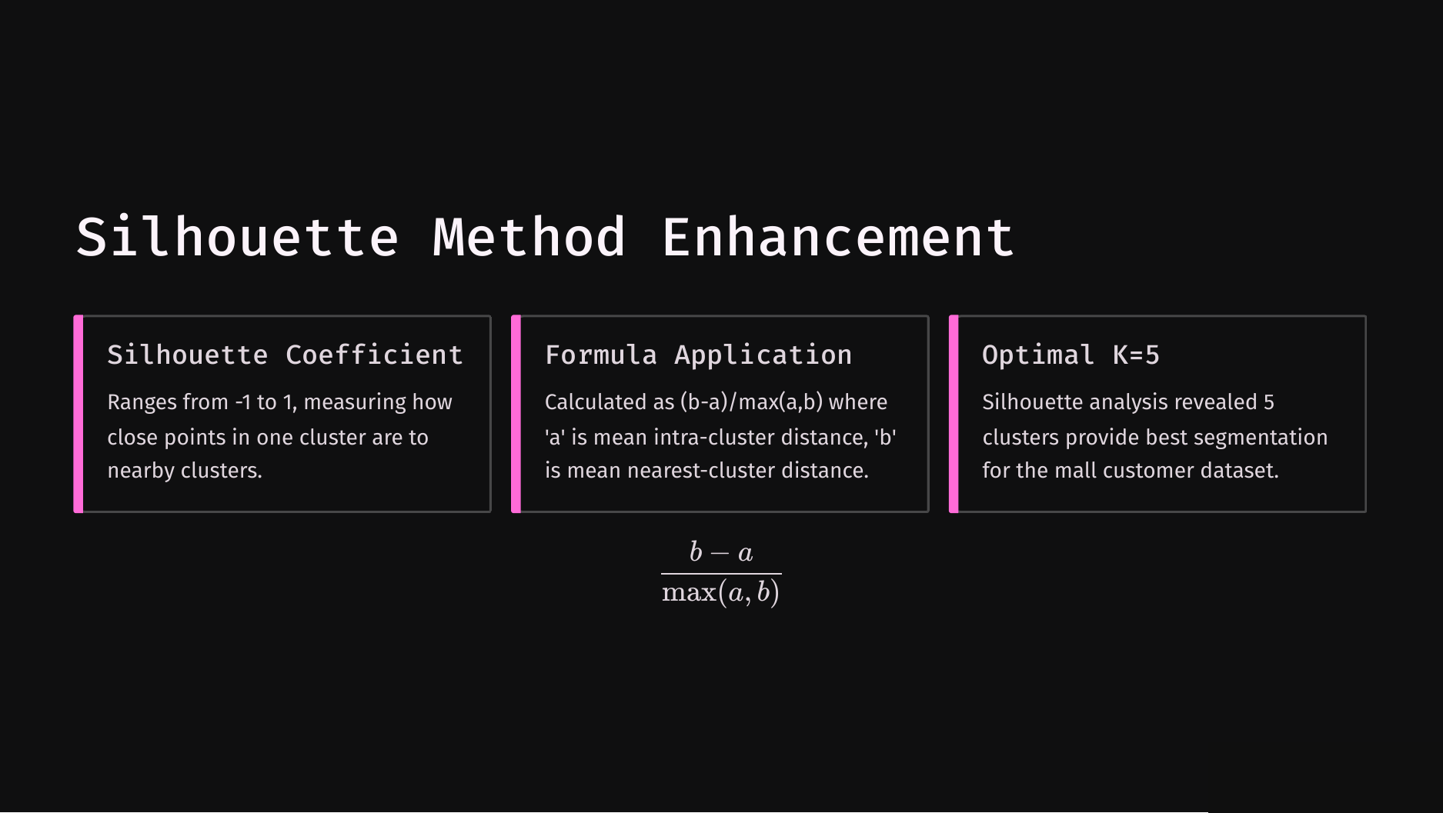

Slide 8
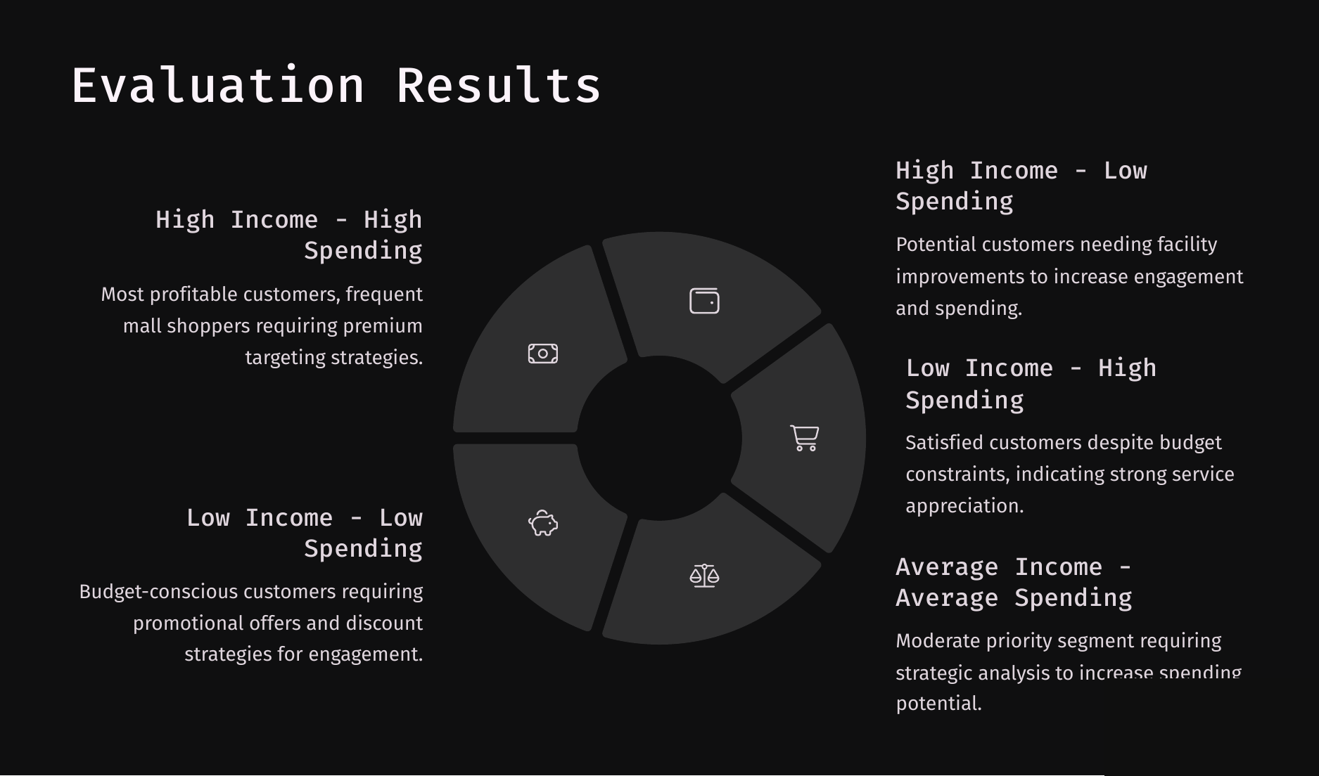

Slide 9
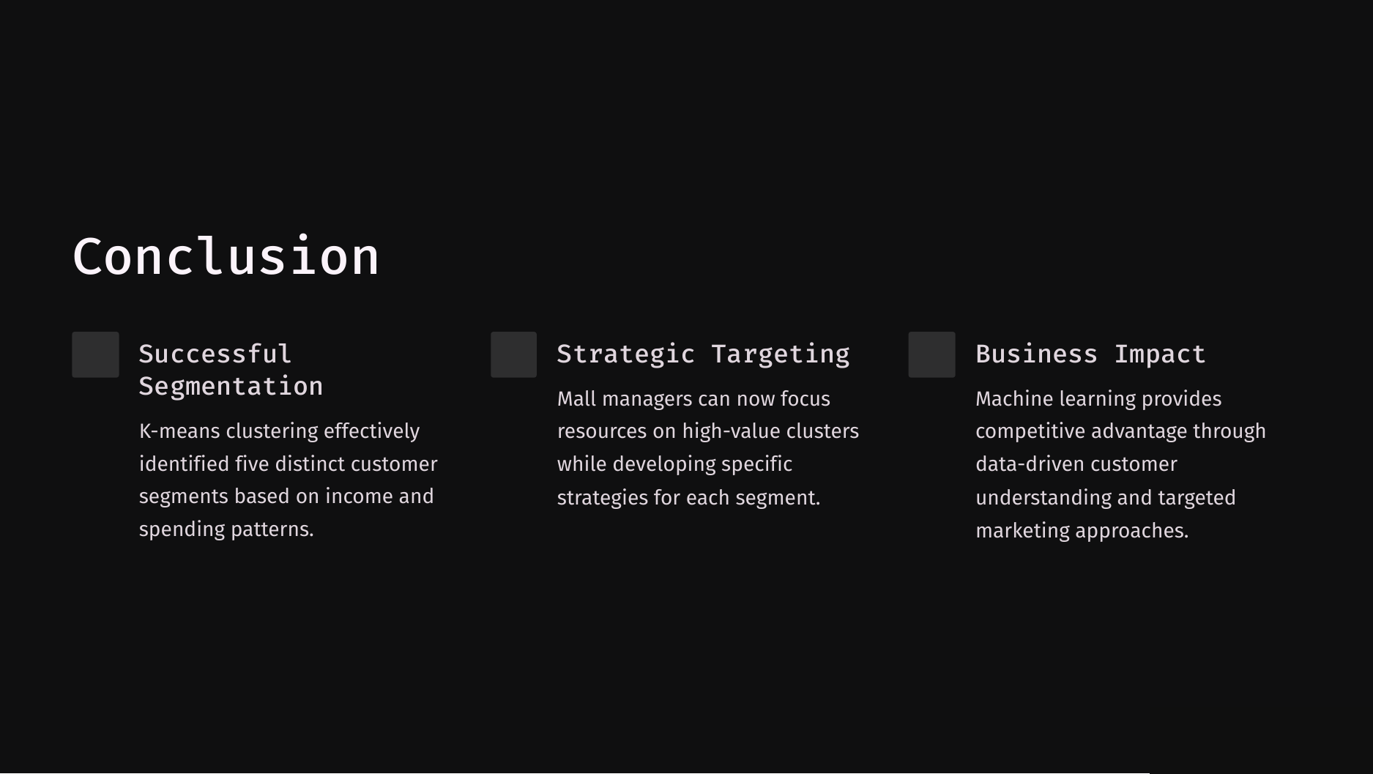

Slide 10
