Slide 1

AI DRIVEN INTRUSION DETECTION SYSTEMS USING DEEP LEARNING
SRM INSTITUTE OF SCIENCE AND TECHNOLOGY
DEPARTMENT OF COMPUTER SCIENCE AND ENGINEERING
REVIEW-III PRESENTATION
21CSP401L MAJOR PROJECT / 21CSP402L - MAJOR PROJECT with 21CSP403L INTERNSHIP#
Programme: B.Tech / M.Tech
Academic Year:
Batch ID:BT26AIMLB002
Student 1 Reg. No:RA2211026030086
Student 1 Name:Adarsh Rai
Student 2 Reg. No:RA2211026030115
Student 2 Name:Anmol Sarin
Student 3 Reg. No:RA2211026030118
Student 3 Name:Aayushi Mohan
Guide name:Dr. Neha Ahlawat
Designation:Associate Professor Department:CSE
Major Project Review-III - 25th April 2026

Slide 2
Project Overview
With the rapid growth of internet usage, cyber attacks are increasing
Traditional security systems fail to detect modern attacks
This project focuses on detecting malicious network activity using AI
Motivation: Improve cybersecurity using Machine Learning
Application Domain: Network Security, Cybersecurity, IDS Systems

Slide 3
Problem Statement
Networks are vulnerable to cyber attacks (DoS, Probe, R2L, U2R)
Traditional IDS systems are rule-based and less efficient
Difficulty in detecting unknown attacks
Need for intelligent and automated detection system

Slide 4
Project Objectives
Develop an AI-based intrusion detection system
Classify network traffic as normal or attack
Improve detection accuracy
Reduce false positives
Provide real-time prediction interface

Slide 5
Literature Review
Author | Method | Dataset | Accuracy | Limitation
Tavallaee et al. (2009) | ML | KDD Cup 99 | Good | Outdated dataset
Lee et al. (1999) | Data Mining | KDD | Moderate | High false positives
Denning (1987) | Rule-based | Custom | Low | Cannot detect new attacks
Moustafa & Slay (2015) | ML | UNSW-NB15 | High | Complex preprocessing
Creech & Hu (2014) | Pattern-based | Custom | High | Slow execution

Slide 6
LITERATURE REVIEW
Author | Method | Dataset | Accuracy | Limitation
Kim et al. (2016) | Deep Learning | NSL-KDD | High | Requires high computation
Yin et al. (2017) | RNN | NSL-KDD | Very high | Training time high
Shone et al. (2018) | Deep Autoencoder | NSL-KDD | High | Resource intensive
Alom et al. (2019) | Deep Learning | KDD | Very High | Overfitting issue
Javaid et al. (2016) | Neural Network | NSL-KDD | High | Limited real-time usage

Slide 7
Existing System
🔹 Description of Existing Systems
Traditional Intrusion Detection Systems (IDS) are mainly signature-based
These systems detect attacks by comparing network traffic with predefined rules
Common systems include firewalls, antivirus software, and rule-based IDS
Mostly used in enterprise and network security environments
🔹 Technologies Used
Rule-based Detection Systems
Signature Matching Techniques
Firewall Systems

Slide 8
Existing System
Limitations of Existing Systems
❌ Cannot detect unknown or zero-day attacks
❌ High false positive rate
❌ Requires manual rule updates
❌ Limited adaptability to new threats
❌ Low accuracy in complex network environments

Slide 9
Proposed System
Overview of Proposed System
Proposed system is an AI-based Intrusion Detection System
It uses Machine Learning / Deep Learning models to analyze network traffic
The system classifies data into Normal or Attack
Designed to overcome limitations of traditional IDS
Provides real-time prediction using Streamlit interface
🔹 Key Features
Intelligent detection using trained ML model
Ability to detect unknown (zero-day) attacks
Real-time prediction system
Automated analysis of network traffic

Slide 10
Proposed System
🔹 Advantages over Existing System
✔ Higher accuracy
✔ Reduced false positives
✔ Detects both known & unknown attacks
✔ No need for manual rule updates
✔ Scalable and efficient

Slide 11
System Architecture
🔹 Architecture Flow
Input Data (Network Traffic / Dataset)
Data Preprocessing (Cleaning, Encoding, Scaling)
Feature Selection
Model Training (ML / DL Model)
Prediction Module
Output (Normal / Attack)

Slide 12
System Architecture
🔹 Explanation of System Components
Input Module: Takes network traffic data as input
Preprocessing Module: Cleans and converts data into usable format
Feature Selection: Selects important features for better performance
Model Module: Trains ML/DL model to learn patterns
Prediction Module: Classifies data as Normal or Attack
Output Module: Displays final result to user

Slide 13
Methodology
🔹 Step-by-Step Workflow
Data Collection
NSL-KDD dataset is used
Data Preprocessing
Data cleaning
Encoding categorical values
Normalization
Feature Selection
Selecting important features
Model Training
Train ML/DL model on dataset
Model Evaluation
Check accuracy, precision, recall
Prediction
Classify input as Normal or Attack

Slide 14
Tools & Technologies
Programming Language
Python (used for model development and data processing)
🔹 Libraries & Frameworks
Pandas → Data handling
NumPy → Numerical operations
Scikit-learn → Machine learning models
TensorFlow / Keras → Deep learning
🔹 Development Environment
Jupyter Notebook
VS Code

Slide 15
Tools & Technologies
🔹 Visualization Tools
Matplotlib → Graphs & plots
Seaborn → Data visualization
🔹 Deployment Tool
Streamlit → Web-based user interface
🔹 Dataset Source
NSL-KDD Dataset (for training & testing)

Slide 16
Modules Implemented
🔹 1. Data Input Module
Loads NSL-KDD dataset
Provides network traffic data to system
🔹 2. Data Processing Module
Data cleaning and preprocessing
Encoding categorical features
Normalization of data
🔹 3. Model Training Module
Train machine learning/deep learning model
Learns patterns of normal and attack traffic

Slide 17
Modules Implemented
4. Prediction Module
Uses trained model to classify data
Predicts Normal or Attack
🔹 5. User Interface Module
Built using Streamlit
Allows user to input data and get prediction
🔹 6. Output Module
Displays final result
Shows whether traffic is safe or malicious

Slide 18
Algorithm , Model Used & Implementation Screens
Algorithm / Model Used
Machine Learning Model (e.g., Random Forest / LSTM / ANN)
Supervised Learning approach
Model trained on labeled dataset (NSL-KDD)
🔹 Working of Model
Input data is processed and converted into numerical form
Model learns patterns of normal and attack traffic
Based on trained data, model predicts output
Implementation
Backend implemented using Python
Model trained in Jupyter Notebook
Frontend developed using Streamlit

Slide 19
Dataset Description
🔹 Dataset Source
NSL-KDD Dataset
Widely used for intrusion detection research
🔹 Number of Records
Contains thousands of network traffic records
Includes both training and testing data
🔹 Features / Attributes
Total 41 features
Includes:
Basic features (duration, protocol)
Content features (login attempts, errors)
Traffic features (connection patterns)

Slide 20
Dataset Description
Types of Data
Normal Traffic
Attack Types:
DoS (Denial of Service)
Probe
R2L (Remote to Local)
U2R (User to Root)
🔹 Data Preparation Steps
Data cleaning
Encoding categorical values
Normalization
Train-test split

Slide 21
System Demonstration / Working Model
🔹 Working of the System
User enters network data through interface
Data is preprocessed automatically
Trained model analyzes the input
System predicts result
Output is displayed as Normal or Attack
🔹 Demo Steps
Open Streamlit application
Enter input values
Click Predict button
System displays result instantly

Slide 22
System Demonstration / Working Model
Output
✔ Normal Traffic
❌ Attack Detected

Slide 23
Experimental Results
Performance Metrics
Accuracy: ~95% – 97%
Precision: High (low false positives)
Recall: High (detects most attacks)
F1-Score: Balanced performance
🔹 Model Performance
Model successfully classifies network traffic
Detects both normal and malicious data
Performs better than traditional IDS

Slide 24
Experimental Results
Observations
High accuracy achieved after training
Low error rate
Efficient detection of intrusion patterns

Slide 25
Results & Discussion
Key Observations
Model achieved high accuracy (~95–97%)
Successfully classified normal and attack traffic
Reduced false positives compared to traditional IDS
Efficient in detecting different types of attacks
🔹 Improvements over Existing System
Detects unknown (zero-day) attacks
Higher accuracy than rule-based systems
Automated detection (no manual rules)
Faster and more reliable performance

Slide 26
Results & Discussion
Method | Accuracy | Limitation
Traditional IDS | Low–Moderate | Cannot detect new attacks
Machine Learning IDS | High | Needs feature engineering
Proposed AI System | Very High | Requires training data

Slide 27
Innovation & Contribution
What’s new
Unique features
Research contribution by each member in the Team
Individual Contribution Role mentioned here
Member 1 – Machine Learning and Deployment Lead
Member 2 – Research and Documentation Lead
Member 3 – Front-end and Testing Lead

Slide 28
Research Paper Details
AI Intrusion Detection System
Authors – Anmol Sarin , Adarsh Kumar Rai , Aayushi Mohan
Conference/Journal Name – MIWAI 2026
Date of Conference ( if Paper Published in the conference)
Indexing (Scopus/WoS) – Under Review / Yet To Be Indexed
Attach the first page of the submitted paper

Slide 29
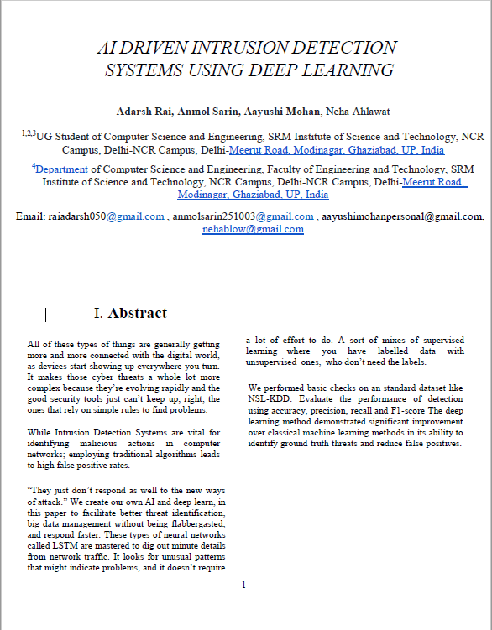

Slide 30
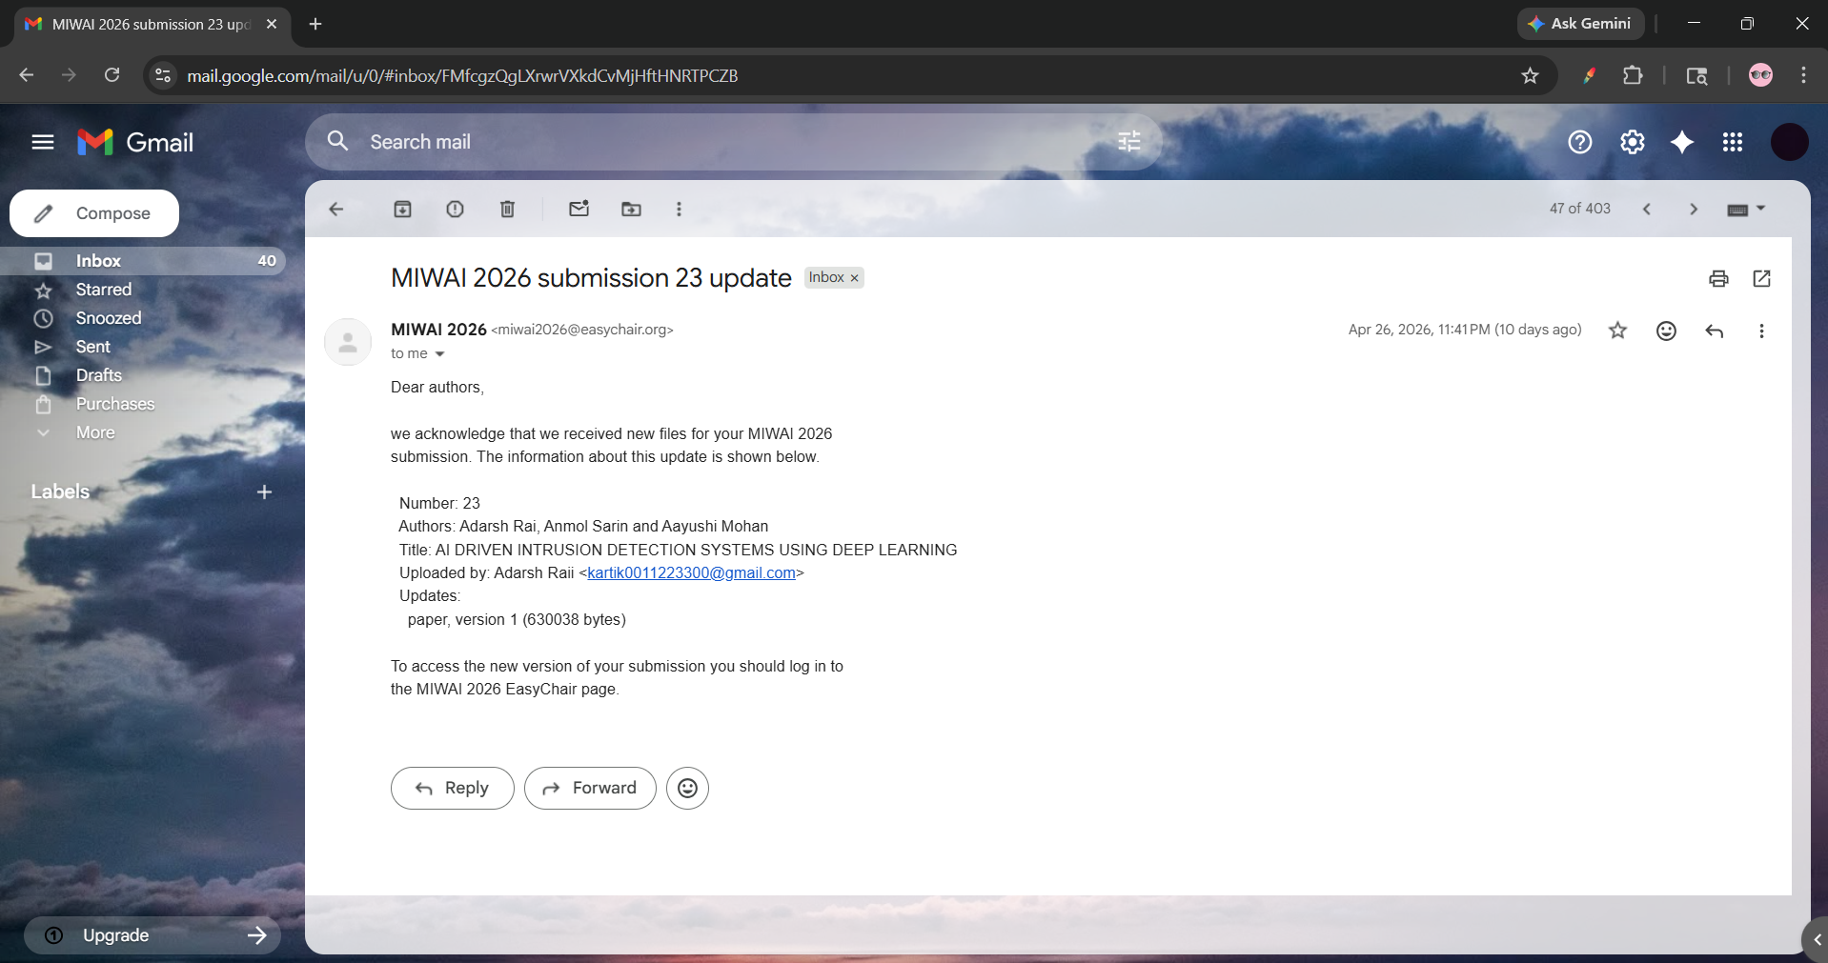
Publication Status
• Submitted/Accepted/Published
Any Conference Certificate proof
Attach the necessary proofs.
Acceptance Proof (If Available)
Acceptance email screenshot
Registration Proof
Conference registration receipt /Payment proof

Slide 31
Limitations of Current System & Challenges Faced
🔹 Limitations of Current System
Depends heavily on dataset quality
Limited to offline dataset (NSL-KDD)
May not handle real-time large-scale traffic efficiently
Performance may vary for new unseen attack types
Requires retraining for updated data
🔹 Challenges Faced
Data preprocessing (encoding, normalization)
Handling categorical features
Feature selection from 40+ attributes
Model tuning (accuracy vs overfitting)
Deployment issues using Streamlit

Slide 32
Applications
Real-World Applications
Network Security Systems Used to monitor and protect network traffic from cyber attacks
Banking & Financial Systems Detects fraud and prevents unauthorized transactions
Cloud Computing Security Secures data stored and transferred in cloud platforms
Enterprise Networks Protects organizational data from internal and external threats
Government & Defense Systems Ensures security of sensitive and confidential information

Slide 33
Applications
🔹 System Deployment
Web-based application using Streamlit
Can be extended to API-based systems
Future scope for mobile app integration
🔹 Industry Use Cases
Cybersecurity companies
IT infrastructure monitoring
Data protection systems
Real-time threat detection platforms

Slide 34
Conclusion & Future Work
WORK
🔹 Conclusion
Developed an AI-based Intrusion Detection System
Successfully classified network traffic as Normal or Attack
Achieved high accuracy (~95–97%)
Reduced false positives compared to traditional IDS
Demonstrated effectiveness of AI in cybersecurity
🔹 Key Achievements
Built and trained ML/DL model
Implemented real-time prediction using Streamlit
Improved detection performance
Created user-friendly system

Slide 35
Conclusion & Future Work
🔹 Future Work
Real-time deployment on live network traffic
Integration with cloud platforms
Use of advanced deep learning models
Improve scalability for large datasets
Mobile app / API-based deployment

Slide 36
References
[1] M. Tavallaee et al., “A detailed analysis of the KDD CUP 99 dataset,” IEEE, 2009.
[2] D. E. Denning, “An intrusion-detection model,” IEEE Transactions, 1987.
[3] W. Lee et al., “Data mining approaches for intrusion detection,” IEEE, 1999.
[4] N. Moustafa and J. Slay, “UNSW-NB15 dataset,” 2015.
[5] I. Goodfellow et al., Deep Learning, MIT Press, 2016.
[6] F. Chollet, Deep Learning with Python, 2017.
[7] Yin et al., “Deep learning for intrusion detection,” IEEE Access, 2017.
[8] Kim et al., “LSTM-based intrusion detection system,” 2016.
[9] Scikit-learn Developers, “Machine Learning in Python,” 2020.
[10] Streamlit Inc., “Streamlit Documentation,” 2023.

Slide 37
Thank You

