Slide 1

INT 331
FUNDAMENTALS OF DEVOPS
Lecture #0

Slide 2

Course Details
LTP – 2 0 2
Text Book and Reference book
. LINUX POCKET GUIDE: ESSENTIAL COMMANDS by DANIEL J. BARRETT, O'REILLY
DEVOPS: A SOFTWARE ARCHITECT'S PERSPECTIVE (SEI SERIES IN SOFTWARE ENGINEERING) by LEN BASS , INGO WEBER, LIMING ZHU, ADDISON-WESLEY

Slide 3
Detail of Academic Tasks
INT331
AT1: Test1 Lecture #11 (Before MTE)
AT2: Test2 Lecture #19 (Before MTE)
AT3: Test3 Lecture #33 (After MTE)

Slide 4
Course Assessment Model
Marks break up
Attendance 5
CA(Best 2out of 3) 20
MTE 25
ETE 50
Total 100

Slide 5
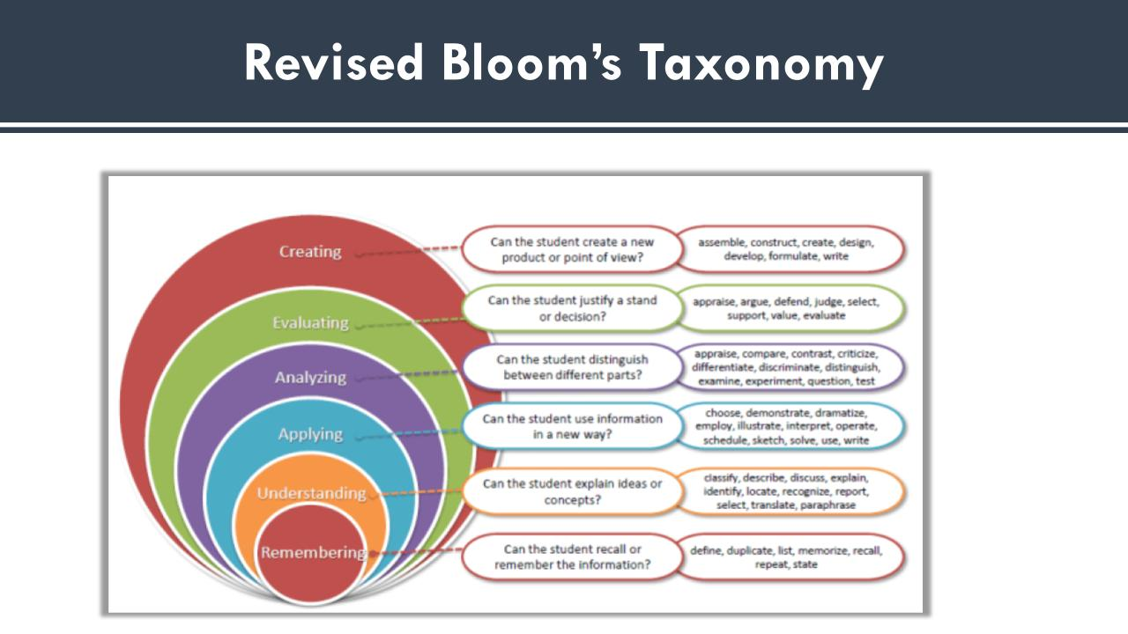

Slide 6
Program Outcomes (POs)
PO1:Engineering knowledge
PO2:Problem Analysis
PO3: Design and Development
PO4:Conduct Investigations
PO5:Modern Tool
PO6:The Engineer and society
PO7:Environment and sustainability
PO8:Ethics
PO9:Individual and Teamwork
PO10:Communication
PO11:Project management
PO12:Lifelong learning
PO13:Competitive skills

Slide 7
Course Outcomes
A student completing this course would be able to:
CO1 ::Illustrate the concept of DevOps.
CO2 :: Understand the concept of DevOps on cloud and basic Linux commands with respect to DevOps .
CO3 :: Understand the concept of DevOps commands and workflow in a systematic way
CO4 :: Apply the advanced concept of DevOps with real time applications.
CO5 :: Analyze the concept of DevOps Methodology and tools in a systematic way.
CO5 :: Understand the concept of maven working in a systematic way.

Slide 8
Program Outcomes achieved from the course
Research and Problem Solving: Ability to independently carry out research /investigation and development work to solve practical problems.
Technical Communication: Ability to write and present a substantial technical report/document.
Comprehensive Discipline Knowledge: Demonstrate a degree of mastery over the area as per the specialization of the program. The mastery should be at a level higher than the requirements in the appropriate bachelor program

Slide 9
Program Outcomes achieved from the course
Comprehensive Discipline Knowledge: Demonstrate a degree of mastery over the area as per the specialization of the program. The mastery should be at a level higher than the requirements in the appropriate bachelor program.
Life-long learning: Recognize the need for, and have the preparation and ability to engage in independent and life-long learning in the broadest context of technological change.

Slide 10
Program Specific Outcomes achieved from the course
Apply skills for configuring and operating complex software systems, packages, tools and applications for sustainability in various domains.
Acquire skills to model, design, develop, manage and resolve issues related to robust computing applications and software solutions.
Able to practice and promote computing technologies for societal needs and contribute to advancement of computer technology by means of research and development.

Slide 11
Academic Tasks
Type of Assessment (Add rows in case some other assessments are applicable) | Type of Assessment e.g. Test/Term Paper/project etc. | Details of academic task | Parameters/Rubric of Evaluation | External/Internal | Details of External Evaluations | References | Quantification
CA1 | BYOD practical | Scenario Based Application Development | Written: 10 Marks Application Development: 20 Marks Note: Marks for Application Development will only be considered if student is able to write basic components in writing part appropriately. | Internal | NA | Self | 1

Slide 12
CA2 | BYOD Practical | Scenario Based Application Development | Written: 10 Marks Application Development: 20 Marks Note: Marks for Application Development will only be considered if student is able to write basic components in writing part appropriately. | Internal | NA | Self-Prepared | 1
CA3 | BYOD Practical | Scenario Based Application Development | Written: 10 Marks Application Development: 20 Marks Note: Marks for Application Development will only be considered if student is able to write basic components in writing part appropriately | Internal | NA | Self-Prepared | 1

Slide 13
Why Star Course?
  Weightage in Gate/Govt. exams
  Industry demand
    Product Based
    Service Based
  Higher Studies
  Government Jobs

Slide 14
EXECUTION STRATEGY
Topic: Activities | Details of the Activities Planned | Is this Activity a part of Evaluation (Yes/No): Which CA/MTE/ETE | Tentative week of conduct of activity | Responsibility: Who will ensure the conduct of the activity (specify the plan for the same) | Expected Outcome | References | Quantification | Start date | End date | Status
Scenario Based Test | Scenario based test will be conducted to test the problem-solving skills of the students | No | 6th Week | Dr. Varsha (28384) | Student will able to learn about development of software application. | Self-Prepared | 1 | 1st week of September | 1st week of September | Pending
Quiz | Quiz will be conducted to test the knowledge of the students | No | 11th Week | Dr. Varsha (28384) | Student will able to learn about the concept of software application. | Self-Prepared | 1 | 2nd Week of October | 2nd Week of October | Pending

Slide 15
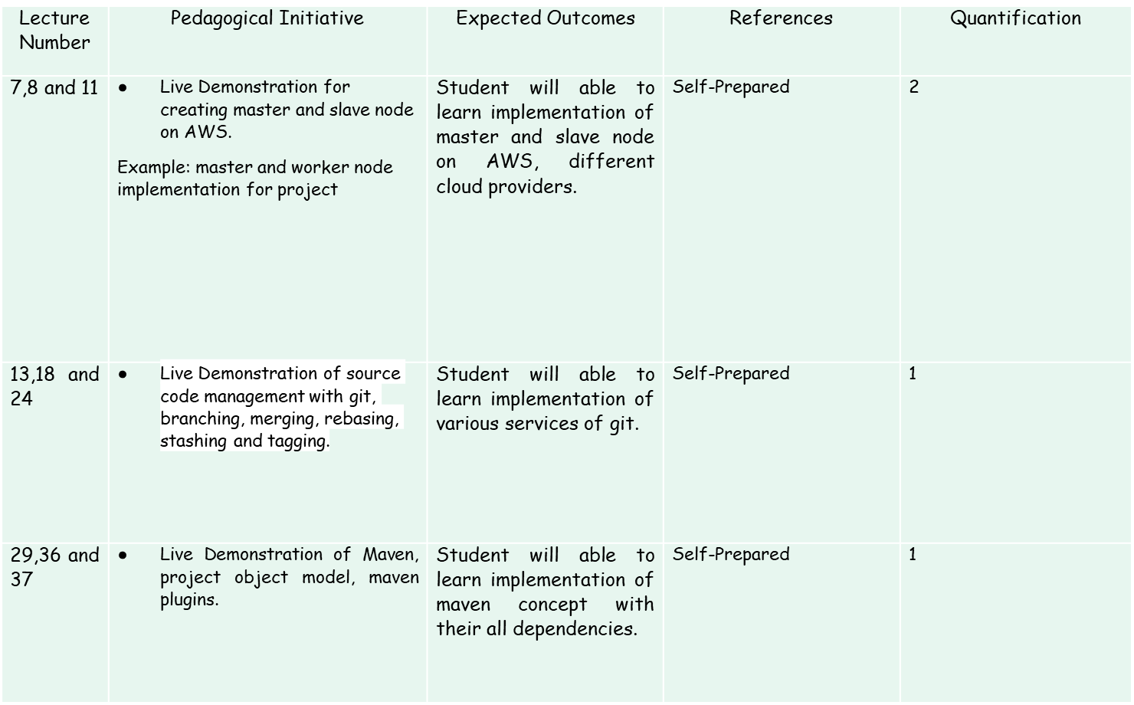
Details for Pedagogical Initiatives for INT331

Slide 16
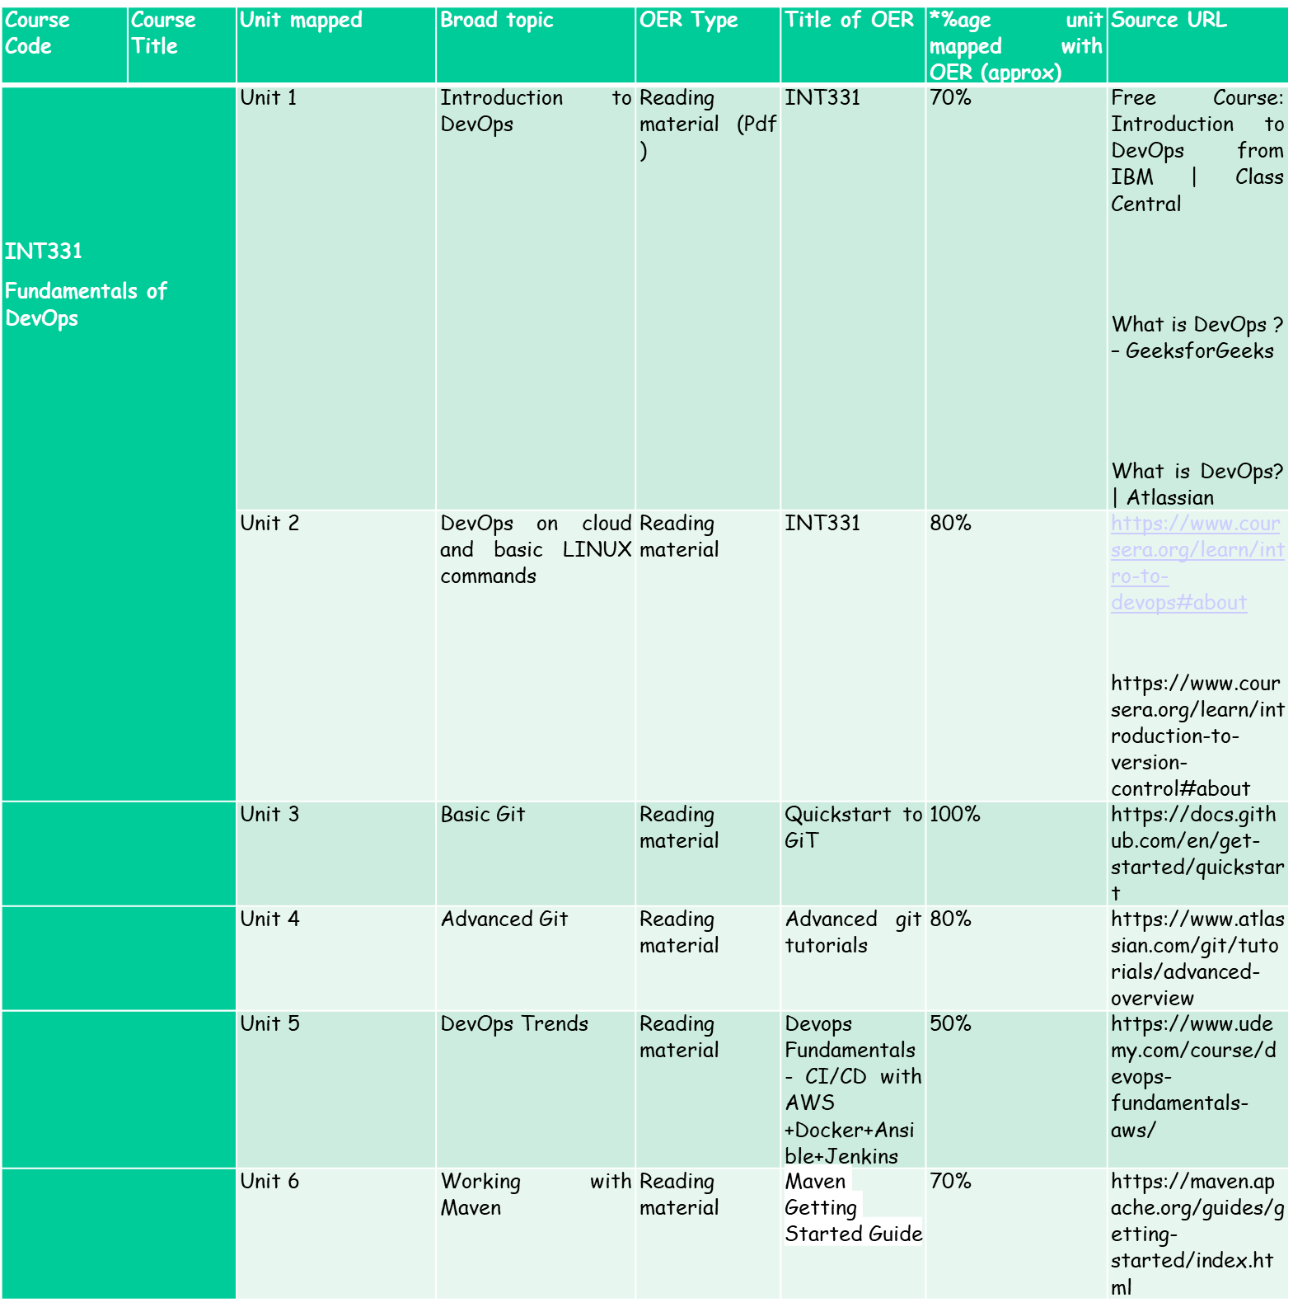
OER

Slide 17
MOOC’s DETAILS
Corse Title:IBM DevOps and Software Engineering Professional Certificate
Duration : 3 months (8 hours in a week)
Course Link: IBM DevOps and Software Engineering Professional Certificate | Coursera
Organisation : Coursera
Academic Benefit : 2ATs ONLY

Slide 18
SkillSet
Programming Skills
Problem solving skills
Analytical skills

Slide 19
Cohort
Software Development
  Software development
  Analyst
  Associate researcher
  Programmer

Slide 20
Main Perspective
Main perspective for the DevOps :
Why we study DevOps?
What would we do with it?

Slide 21

Why Study DevOps?

Slide 22
To understand the need of DevOps , one must now the background .
Before the DevOps - There were two development models:
Waterfall
Agile Method.

Slide 23
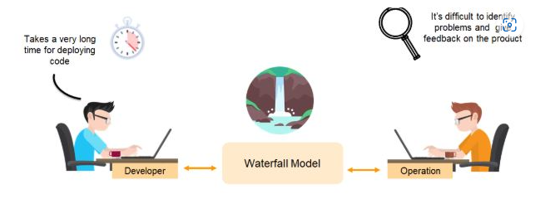
Waterfall Model

Slide 24
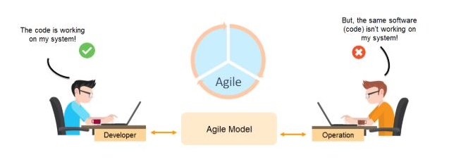
Agile Model.

Slide 25
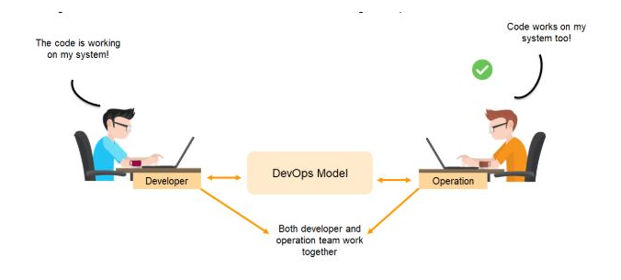
DevOps Model

Slide 26
DevOps is a collaboration between development and operation teams, which enables continuous delivery of applications and services to our end users.

Slide 27
In Summary
From the discussions in the previous slides, nutshell points are as follows that give us an idea that why we need the DevOps over the other methods.
The operation and development team worked in complete isolation.
After the design-build, the testing and deployment are performed respectively. That's why they consumed more time than actual build cycles.
Without the use of DevOps, the team members are spending a large amount of time on designing, testing, and deploying instead of building the project.
Manual code deployment leads to human errors in production.
Coding and operation teams have their separate timelines and are not in synch, causing further delays.

Slide 28

Let’s Start: Basic Description

