Slide 1

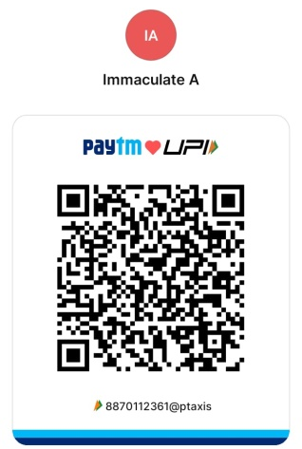
QUIZZARD [Quiz]
TECH-TALK [Poster Presentation]
DEBOGAGE [Debugging]
T- HUNT [Treasure Hunt]
CONNECT- TECH [ConneXions]
ACT- OUT[Dumb Charade]
HENNA-TATTOO [Mehndi Design]
DATE:
25.02.2025
TIME:
10.30 AM – 4.00 PM
VENUE:
CONFERENCE HALL

Slide 2

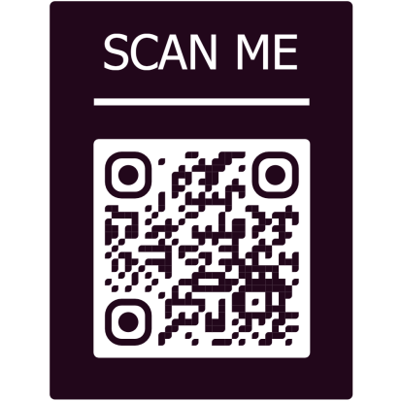
General Rules:
The participants can register using the link :https://forms.gle/LHacXmg53Wu9fF8F6
Registration Fee is Rs.100 per participants
Students can pay the registration fee *******
A participant can participate in maximum of two events
Spot registration will also be considered
The participants must bring their ID card
Participation Certificates will be provided to all the participants
Participants should bring their own materials for the respective events
Decisions made by the Judges will be final
Event Rules:
Event | Team Size | Details
QUIZZARD | 2 members | Written prelims followed by stage finals.
TECH-TALK | 2 members | Theme: Applications of AI (Healthcare, Business, Education, Science, IT).
DEBOGAGE | 2 members | Debugging programs in C, C++, Java, or Python. Duration: 60 minutes.
T-HUNT | 5 members | No mobile phones/electronic devices allowed.
CONNECT- TECH | 2 members | Written prelims followed by stage finals.
ACT-OUT | 3 members | Dumb charade with gestures and guessing.
HENNA- TATTOO | 2 members | Mehndi design competition. Duration: 60 minutes.
For Registration
[STAFF INCHARGE & VOLUNTEERS]
QUIZZARD: B Manogaran (Staff), R Ranith Prawin & G Raja Perarasu (Volunteers)
TECH-TALK: R Pavithra (Staff), D Deepan Raj & V Srimathi (Volunteers)
DEBOGAGE: N Pavyasre (Staff), S K Kishika & T Mahaswetha (Volunteers)
T-HUNT: A Immaculate (Staff), M Diwakar & R Nandhini (Volunteers)
CONNECT-TECH: M Juliet Monolisa Esther (Staff), D Naveen Kumar & V Deepak (Volunteers)
ACT-OUT: Dr. Nithya (Staff), S Naval Sidu & M Chidambaram (Volunteers)
HENNA-TATTOO: N Deepa (Staff), G Nivetha, M Maria Jelina, G Prasana, S Karthika (Volunteers)

