Slide 1
Python 101
high-level, object-oriented, multipurpose

Slide 2
Web Developer App Developer Data Science Cloud Engineering

Slide 3
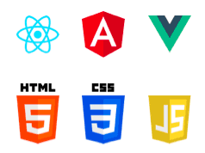
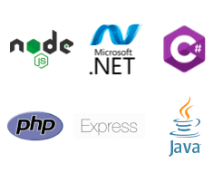

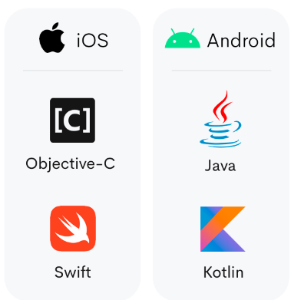




Mobile
Development
Web Development
Frontend
Backend
Database
Cloud Services

Slide 4
