Slide 1
PETSIFY
GROUP MEMBERS:
C Sai Adarsh Varma
Avi Shah
Ayush Jha
Ayushi Kumari

Slide 2

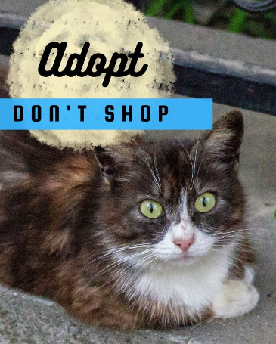
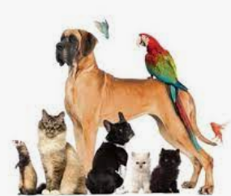

We have designed a website ( Petsify) to help people contact to client who are willing for pet adoption or pet owners to buyers to give their pets for adoption.

Slide 3

SOURCES USED:
VS CODE
Visual Studio Live share(Workspace)
Frontend: HTML, CSS
Backend: Java Script and php
Discord for coordination

Slide 4
The website consists of following webpages
HOME : It comprises of links to adoption, lost and found details of pets from your area, nearby veterinary. Our team members description and contact details.
ADOPTION: It contains details of pets available for adoption and let the person book an appointment with the pet owner.
SUPPLIES: This page will let you buy accessories, food and toys for all the pets.
Lost and Found: The details of animals up for adoption are specified in this page.
VETERINARY: Details of nearby veterinary with direction in google map.

Slide 5
FUTURE PROSPECTS:-
This project being a protype idea can be improvised in many ways in the coming days. We have linked our supplies site with amazon in the future we can make our own cart and sell our items in it.
The Major leap can be taken in the designing part where a proper sign up for every individual where he/she can make a profile and have special access to it.
For the social work to proceed perks and goodies off coupons can be introduced where in the crowd can actively participate
Through This Project we have tried to build a part of the aim we have achieved.

Slide 6
THANK YOU !!!

