Slide 1
LEARNING MODULE 01 · SYSTEM DESIGN REFINEMENT
Katuwang — Finalized System Design
A web-based peer tutoring management platform for Taysan Resettlement Integrated School (Grades 7–12)
Finalized architecture · database schema (ERD) · process & data-flow diagrams · UI/UX refinements · four-part design justification
Katuwang — [John Airo Abion] · [Noriel Harold Malate] · [Jerome Lorejo] · [Rico Miguel Cadag] · [Alejandro Beato]
Notes:
Speaker: Member 1 (~1 min total for slides 1–2).
Open: state the system name (Katuwang, Tagalog for 'helper'/'partner'), that this is
the finalized System Design Document required by Module 01, and that the deck maps
1:1 to the module's suggested outline. Fill in the real group number and member
names in the Group Identification table before presenting. Keep this to ~15 seconds.

Slide 2
1 · INTRODUCTION
The problem Katuwang solves
• Context: Taysan Resettlement Integrated School (TRIS), Legazpi City — a public secondary school in a resettlement community, under classroom overcrowding and split shifts.
• Problem: students reach senior high still lacking basic reading / math skills; teachers are overloaded and often teaching out-of-field; the school has no formal system to organize peer academic support.
• Katuwang connects student tutors (peer volunteers) with student learners so tutoring is organized, tracked, and moderated instead of ad hoc.
• Everything is voluntary and free, no payments or monetization anywhere.
• Privacy mandate (RA 10173): double-blind anonymity, used student and tutor codes instead of real names
END USERS
Student Learner · Student Tutor · Admin
(Grades 7–12)
SIX MODULES
User Mgmt · Session Mgmt · Tutor Matching ·
Assessment · Chatbot · Analytics
SCOPE NOTE
3 roles only and will only be deployed on TRIS
IT 124 | Capstone Project 2 | Module 01 — System Design Refinement | Katuwang
Notes:
Speaker: Member 1.
Recap the problem in plain terms — do not re-defend the whole Capstone 1 proposal,
just enough that the panel recommendations on the next slide make sense. Mention the
RA 10173 double-blind anonymity constraint now because it recurs in the security
justification later. Note the deliberate divergence from the thesis: 3 roles, not 4
(see docs/reference/decisions.md).

Slide 3
2 · PANEL RECOMMENDATIONS
What our Capstone 1 panel asked for
Recorded from the panel recommendation sheet. Each is resolved later in this deck with a specific design change and a named justification.
# | Panel recommendation | Artifact affected
R1 | Use Codes instead of real names of Tutors and Tutees. | Database schema (ERD)
R2 | Justified Security for the System (Bcrypt password hashing) | Architecture, tech stack
R3 | Not use AI Analytics | Tech stack
IT 124 | Capstone Project 2 | Module 01 — System Design Refinement | Katuwang
Notes:
Speaker: Member 1 → hand off to Member 2.
Rubric Criterion 2 (Incorporation of Panel Recommendations, 25 pts) is graded on
whether EVERY recommendation is clearly and specifically addressed. State each
recommendation verbatim from the panel sheet. R1 is confirmed from our written module
answers. R2/R3 are placeholders — fill them from the real sheet; if the panel gave
only the certification recommendation, remove R2/R3 and say "the panel gave one formal
recommendation" so nothing looks unaddressed.

Slide 4
3 · FINALIZED ARCHITECTURE
Pattern: modular monolith (Next.js full-stack)
Next.js 16 App Router — single deployable application
Learner
(browser)
Edge middleware — src/proxy.ts · RBAC route guards (JWT session)
Presentation
Server Components +
"use client" UI
(learner/tutor/admin portals)
Application / business logic
Route Handlers src/app/api/**
matching · assessment · notifications and user code generation
Tutor
(browser)
MySQL
relational database
Data access — Prisma 7 ORM · @prisma/adapter-mariadb
Admin
(browser)
IT 124 | Capstone Project 2 | Module 01 — System Design Refinement | Katuwang
Notes:
Speaker: Member 2 (~2 min for slides 4–6).
Name the pattern: MODULAR MONOLITH — one deployable Next.js app with clearly
separated internal modules (auth, learner, tutor, admin, assessment, notifications,
analytics). Walk the request path left to right. Call out src/proxy.ts as the single
RBAC choke point and the anonymity layer as a first-class architectural component,
not an afterthought. If your panel's architecture recommendation (R2) was about an
unspecified component or a scale-questioned choice, point to exactly where on this
diagram it is now resolved.

Slide 5
3 · FINALIZED ARCHITECTURE
Why modular monolith and each component's job
• Chosen over microservices: at capstone scale a 5-person team cannot operate independent services; the modules are loosely related, not independently scaled or deployed.
• Chosen over a plain layered app on a separate backend: Next.js unifies presentation + API in one codebase and one deploy, which the team can actually build and test in the timeline.
• Internal module separation still gives us layered discipline (presentation / logic / data) without a distributed system.
• Scale target: one school, hundreds of active students, not millions.
Component | One-sentence responsibility
Edge middleware (proxy.ts) | Rejects any request whose JWT role may not reach that route.
Server Components / client UI | Renders each role's portal and collects user input.
Route Handlers (api/**) | Validate (Zod), enforce RBAC, run business rules, return JSON.
Prisma + adapter | Only path to the database; owns transactions.
NextAuth (auth.ts) | Authenticates credentials, mints and verifies JWT sessions.
IT 124 | Capstone Project 2 | Module 01 — System Design Refinement | Katuwang
Notes:
Speaker: Member 2.
Rubric Criterion 3 wants the justification specific, not generic. The "why this
pattern" argument has three named alternatives rejected for concrete reasons. The
responsibility table is the module's requirement of "a one-sentence responsibility
statement for every component" — read two or three, don't recite the whole table.

Slide 6
3 · FINALIZED ARCHITECTURE
Technology stack
Layer | Technology | Role
Framework | Next.js 16 (App Router) | Monolithic full-stack app (RSC + client components)
Language | TypeScript 5 (strict) | Static typing across models, validation, APIs
UI & styling | Tailwind CSS 4 + DaisyUI 5 | OKLCH semantic theme, accessible components
Icons | Lucide React | Action / status / navigation icons
Authentication | NextAuth.js 4 | Credentials provider, JWT session strategy
Database & ORM | MariaDB / MySQL + Prisma 7 | Schema modeling, migrations, @prisma/adapter-mariadb
Validation | Zod 4 | Runtime request-body validation, discriminated unions
Security | Bycrypt.js | Unit + API route integration tests
IT 124 | Capstone Project 2 | Module 01 — System Design Refinement | Katuwang
Notes:
Speaker: Member 2 → hand off to Member 3.
Don't read the table aloud row by row. Say the shape of it: one language end to end,
one framework spanning UI and API, one ORM owning all DB access, Zod on every input.
The module explicitly says to name tool *types* not product names during Q&A.

Slide 7
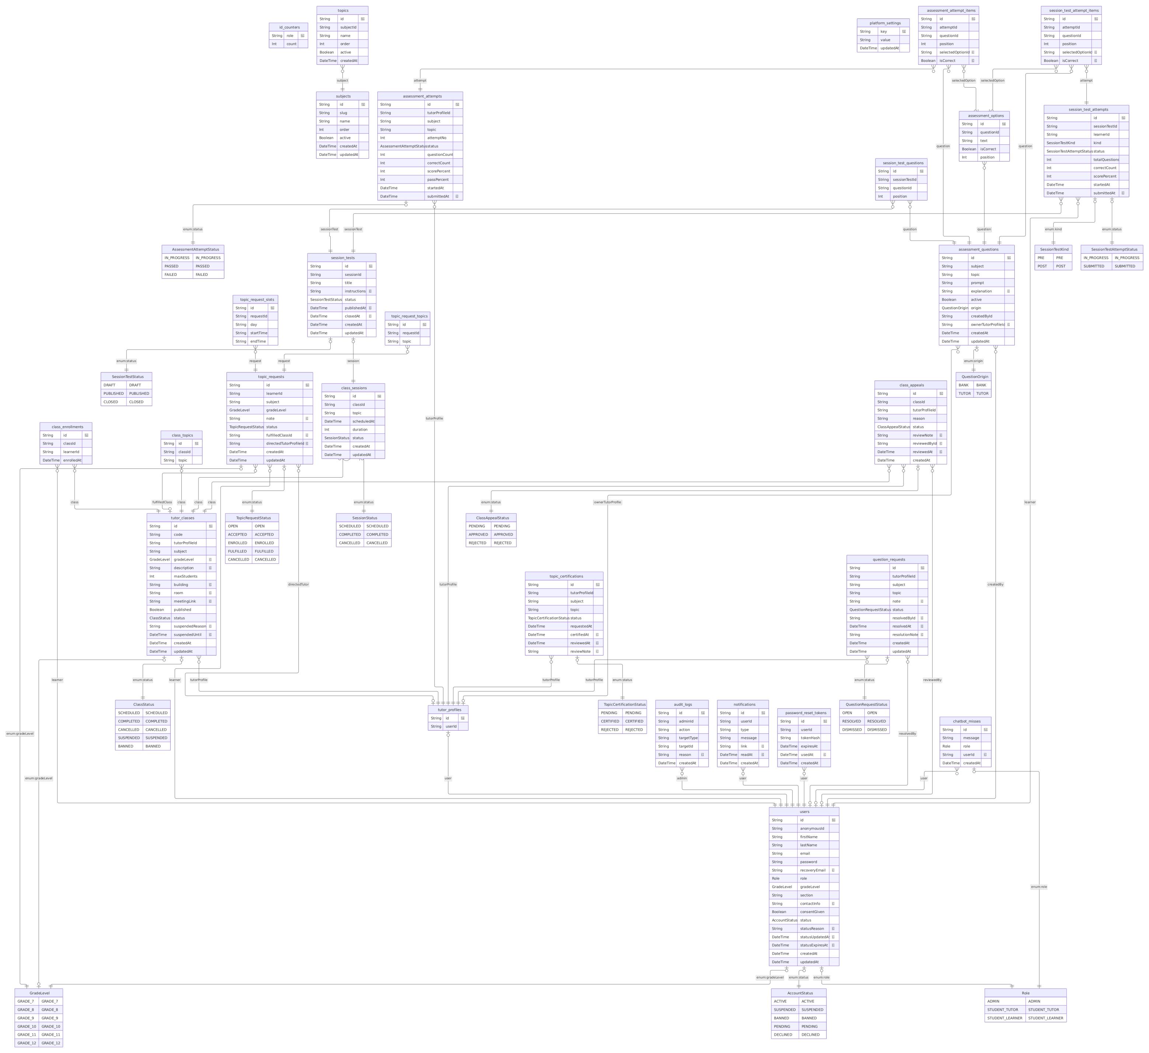
4 · FINALIZED DATABASE SCHEMA
ERD
IT 124 | Capstone Project 2 | Module 01 — System Design Refinement | Katuwang
Notes:
Speaker: Member 3 (~2 min for slides 7–8).
This is the schema change that answers panel recommendation R1. Before: a single
"is a tutor" flag. After: the TopicCertification entity — one row per (tutor, subject,
topic) with an explicit status lifecycle and audit fields (requestedAt, reviewedAt,
certifiedAt, reviewNote). The dashed line to Subject/Topic is a validation dependency,
not a DB foreign key — subject/topic are denormalised slug strings (see
decisions.md, "Subjects & topics: enum → admin-editable tables"). Full 30-entity ERD
is in docs/erd.md and the appendix; this slide is deliberately trimmed for legibility.

Slide 8
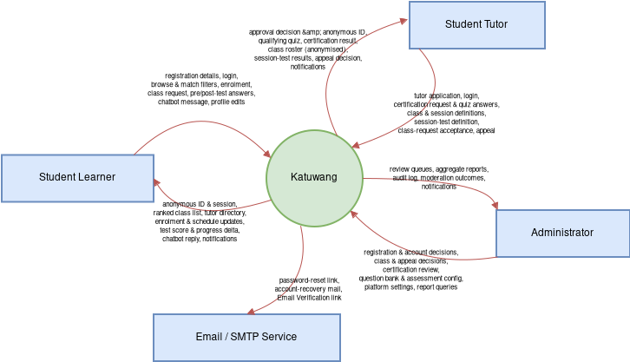
6 · PROCESS & DATA-FLOW DIAGRAMS
Context diagram (Level 0)
IT 124 | Capstone Project 2 | Module 01 — System Design Refinement | Katuwang
Notes:
Speaker: Member 4 (~2 min for slides 10–11).
The context diagram is the whole system as one process with only its boundary and
the three external entities (the three roles). Name the main data flows in and out
for each entity — keep it to one sentence each.

Slide 9
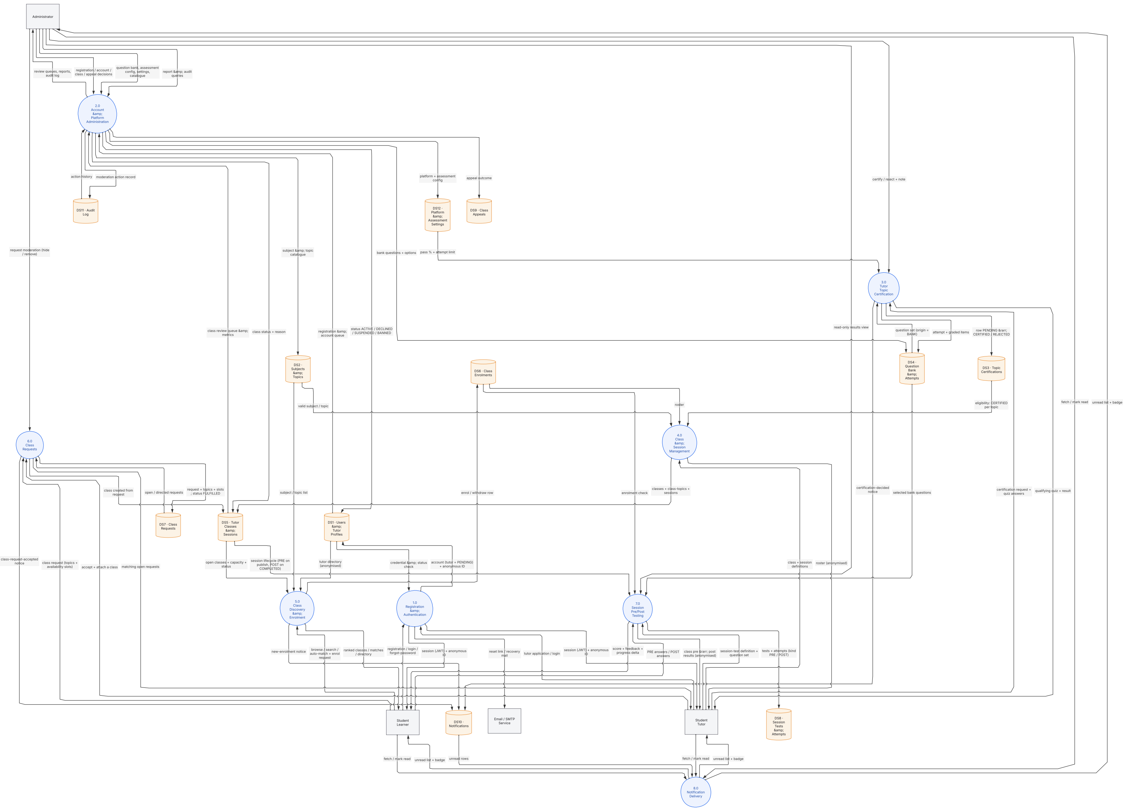
6 · PROCESS & DATA-FLOW DIAGRAMS
Level 1 DFD
IT 124 | Capstone Project 2 | Module 01 — System Design Refinement | Katuwang
Notes:
Speaker: Member 4 → hand off to Member 5.
Walk through subprocess 4.0 Tutor Certification in detail (the module says pick one
subprocess and go deep): tutor requests certification for a topic → row written to
TopicCertifications as PENDING → tutor passes the qualifying quiz in 5.0 (writes
AssessmentAttempts) → admin reviews in 6.0 → status set to CERTIFIED (certifiedAt
stamped) or REJECTED (reviewNote written) → 2.0 now lets that tutor open a class for
the topic. Then state the traceability cross-check explicitly — reviewers look for
exactly this.

