Slide 1
Kings County Housing Forecast
Presented by: Adam Chang

Slide 2
Background
I was asked to build a model that is able to predict house prices given a set of data.
Data included
19 independent variables, or predictors
1 dependent variable, or the target. The house price
The predictors have various levels of impact on the house price
The goal here is to be able to accurately assess house prices to sell at max value

Slide 3
Data Cleaning
All missing data is replaced in a logical fashion
Sqft_basement: Missing data is sqft_living – sqft_above (verified)
Waterfront: Missing data is considered a ‘maybe’
View: Missing data is replaced by never viewed
Yr_renovated: Missing data is assumed to never have been renovated
It is imperative that there is no missing data.
Sqft_living is removed due to multicollinearity
- Problem in assessing price because it overlaps details in other predictors

Slide 4
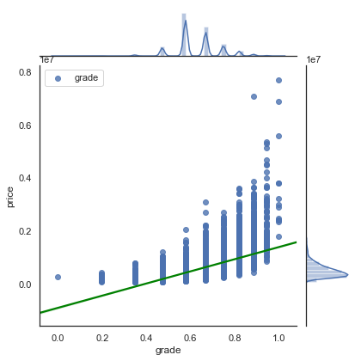
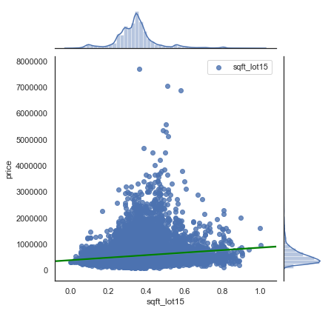
Predictor’s Level of Impact
As mentioned previously, different predictors have different levels of impact on the target price of the house. A way we can visualize this is by using joint plots.
Predictor = Grade
- highly correlated to Price
Predictor = Sqft_lot15
- Slightly correlated to Price
The green line in the joint plots tell us the correlation between the predictor and target
- The steeper the slope, the higher the correlation

Slide 5
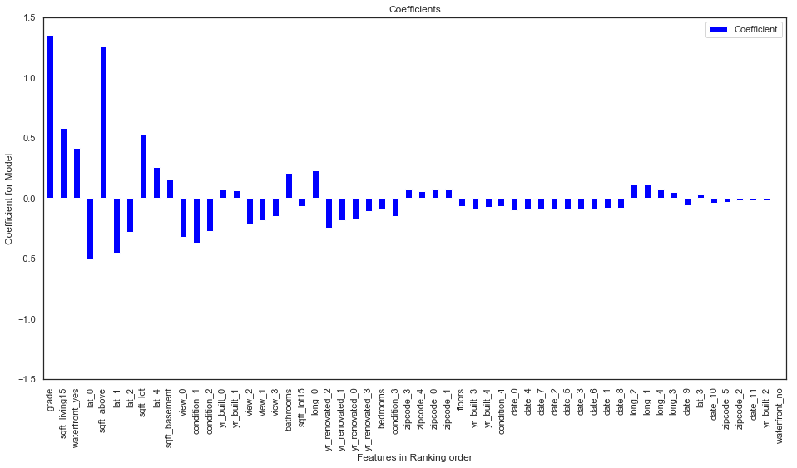
Ranking the Predictors
A significant step in valuing a house’s price is determining which predictors are the important factors.
This can tell us which detail of a house should be improved to maximize the house’s valuation.
The bar graph on the right tells us which predictor has the largest impact
The features aka predictors are in rank order from left to right

Slide 6
Coefficients
Predictor | Ranking | Coefficient
grade | 1 | 1.352032
sqft_living15 | 2 | 0.579779
waterfront_yes | 3 | 0.416853
lat_0 | 4 | -0.509829
sqft_above | 5 | 1.255040
lat_1 | 6 | -0.455841
lat_2 | 7 | -0.280773
sqft_lot | 8 | 0.528000
lat_4 | 9 | 0.253796
sqft_basement | 10 | 0.155366
view_0 | 11 | -0.325886
condition_1 | 12 | -0.370144
condition_2 | 13 | -0.274079
yr_built_0 | 14 | 0.072532
yr_built_1 | 15 | 0.062410
view_2 | 16 | -0.211780
view_1 | 17 | -0.186598
view_3 | 18 | -0.147890
bathrooms | 19 | 0.206214
sqft_lot15 | 20 | -0.071530
long_0 | 21 | 0.227078
yr_renovated_2 | 22 | -0.251314
yr_renovated_1 | 23 | -0.184774
yr_renovated_0 | 24 | -0.172185
yr_renovated_3 | 25 | -0.109265
bedrooms | 26 | -0.091816
R-Squared: 0.84
Constant: 11.54
list of predictors in ranking order
Coefficients are the multipliers for the model
The predictors are ranked based on a number of factors including coefficients
84% of the variations in Price can be explained by the predictors in our model

Slide 7
Conclusion
The equation of our model is as follows
Price = Constant + Coefficient1*Predictor1 + Coefficient2*Predictor2…
More details on the operation of the model will be explained in the demonstration
Key points:
- Negative factors vs Positive factors
Grade, house’s sqft, waterfront, location, and neighbors living space are important predictors
With the current dataset, the model can explain 84% of the variations in Price

