Slide 1
Better Suite2p cell classification with image features
Honest evaluation, new features, neural networks, and what the labels tell us · October 2026
Notes:
Summary of the work on branch feat/image-features: fixing the evaluation, adding image features from ops.npy, testing CNNs and learned embeddings, a model-family comparison, and a hold-out experiment on labelling style.

Slide 2
Image features lift F1 from 0.827 to 0.853
0.827
0.853
0.861
Current 27-feature model
honest F1, threshold tuned on training sessions only
+ 17 image features
ready as the 'image' preset in apply_AI.py
+ CNN embedding
best overall, but needs a CNN at inference
1
The gain comes from images, not traces or model choice
Hand-made trace features beat every learned trace embedding; LightGBM, XGBoost and CatBoost tie within ±0.003
2
The hardest sessions are a labelling-style problem
Inbar3, inbar1 and Stav14 rank well (0.82–0.88 F1 at their own best threshold) but were labelled more or less strictly
Notes:
All numbers are F1 on sessions the model never saw (GroupKFold by session). 0.827 and 0.853 are means over 15 folds (5 folds x 3 repeats); 0.861 is on the 5 repeat-0 folds, where the image-feature model scores 0.853 as well.

Slide 3
29 clean sessions, 84,583 ROIs, trusted labels
29
sessions
Left out, and why
Yael sessions: known bad data
stav22: held-out session in the existing training script
Stav3/21: 70% labelled cells vs 5–28% elsewhere, looks uncurated
Stav1: byte-identical copy of Stav5 (same traces, ROIs, labels) with an ops.npy from another recording
84,583
ROIs
Label bugs fixed
Priority now: iscell_final → iscell_backup_before_AI → iscell
Old train_model.py never read iscell_final, so final-only sessions were skipped
For Inbar6 and inbar4 it trained on an iscell.npy that apply_AI.py had overwritten (8–9% of ROIs differ)
17.6%
labelled cells
Notes:
Stav1 was detected because its image features made no sense: a label-free alignment check between ops.npy and stat.npy scores 0.05 for Stav1 and 0.27 or more for every other session. Its traces, ROIs and labels turned out to be byte-identical to Stav5.

Slide 4
Honest evaluation: the test sessions never touch tuning
1
2
3
4
Split by session
GroupKFold, 5 folds × 3 shuffled repeats: every session is tested by a model that never saw it
Inner CV on training sessions
A second session-grouped CV inside the training folds only
Pick trees and threshold
Early-stopping round and the F1-optimal threshold come from the inner CV
Score the held-out sessions
Precision, recall and F1 per fold; gains are paired fold by fold
Before: the old script tuned early stopping and the threshold on the test fold itself
Same 27 features, same data: tuned on the test fold 0.832 → honest 0.827
The README's 0.856 came from a different session set and labels, so it is not comparable
Notes:
The honest baseline is what every later gain is measured against. ΔF1 values in later slides are paired per fold, which removes most of the fold-to-fold variance between sessions.

Slide 5
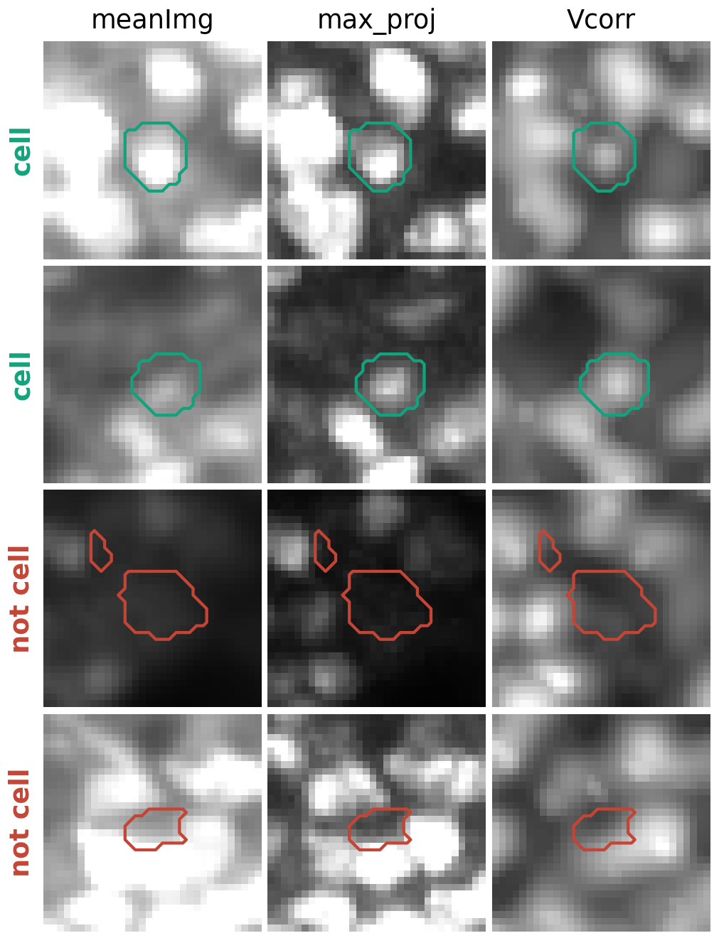
Image features compare each mask with the images
Your morphology features only see the mask's shape (stat.npy). These 17 features look at what the images show inside and around it (ops.npy).
1
Brighter than its surroundings?
Mask vs a 2–7 px ring on meanImg, meanImgE, max_proj and Vcorr; contrast vs Suite2p's neuropil mask (8 features)
2
Does the mask match the blob?
Correlation between the mask weights (lam) and the image, inside the mask and over mask + ring (8 features)
3
Can the images be trusted?
Label-free ops/stat alignment check; failing sessions fall back to the regular model
Illustrative examples from Stav17. Green: labelled cell; red: labelled not-cell.
Notes:
max_proj and Vcorr are cropped by Suite2p to yrange/xrange; they are placed back at that offset rather than resized. Vcorr is the local correlation map, so it carries activity information even though it is an image.

Slide 6
Image features add +0.026 F1, better in all 15 folds
What it means
lam correlation carries most of it: +0.023 alone
Ring contrast alone: +0.015
Intensity-normalized trace features (dF/F, q99 / noise): no gain; the existing ones are already noise-scaled
27 of 29 sessions improve
Notes:
Paired ΔF1 vs baseline: trace-norm +0.001 (8/15 folds up), replace −0.001 (7/15), ring contrast +0.015 (14/15), lam correlation +0.023 (15/15), all image features +0.026 ± 0.008 (15/15).

Slide 7
The biggest gains are on the hardest sessions
The 10 lowest-scoring sessions under the current model. Inbar12 goes from worst (0.685) to 0.805. Inbar3 and Stav14 stay hardest; the labelling slide explains why.
Notes:
Per-session F1 is the mean over the 3 CV repeats. Only 2 of 29 sessions drop, by less than 0.005 (Stav16, Stav20).

Slide 8
What the new model relies on most
Reading it
#1 max_proj_lam_corr: does the mask sit on something that lit up?
3 of the top 6 are new image features
Your morphology (mrs, radius, compact) and trace features (skew, std) stay important; image features add to them rather than replace them
Notes:
SHAP from the model with normalized trace features plus image features, averaged over held-out folds.

Slide 9
A CNN matches the image features, adds 0.007
What it means
The CNN learns about what the 17 image features already capture
Training images and features jointly (fusion) is the best single model, 0.858
Embedding or score on top: +0.007–0.008, a tie between the two
Cost: crops and a PyTorch model at inference, and a less explainable decision
Notes:
CNN input: 32x32 crops of meanImg, max_proj, Vcorr plus the lam mask. CNN scores are nested out-of-fold; embeddings come from one network per outer fold trained on the training sessions only. CPU only, no GPU.

Slide 10
Learned trace embeddings and other models didn't help
Take-aways
Your hand-made trace features beat both learned trace encoders
Model family is worth about ±0.003: keep LightGBM
A lightly tuned LightGBM (real row bagging) is a free +0.002
Notes:
ROICaT result is from a 6-session leave-one-session-out pilot; it was stopped there. Logistic regression and an MLP on the 44 features scored 0.829 and 0.846, below the tree boosters.

Slide 11
Hardest sessions: mostly labelling strictness
Trained on | 4 hard Inbar | Stav14
Stav only | 0.741 | 0.774
Inbar only | 0.782 | 0.744
Both labs | 0.767 | —
Each lab's labels are best predicted by that lab's data
Inbar3: labelled 26.5% cells, models predict 15–17%
inbar1: labelled 5.2%, models predict about 8%
Stav14: labelled 23.5%, models predict 32–35%
Same model, only the cut-off changes. Inbar: trained on Stav + other Inbar; Stav14: trained on other Stav.
Notes:
Hold-out experiment: train on Stav only, Inbar only, or both, and test on Inbar3, Inbar12, inbar1 and Inbar9, with the threshold picked by inner CV on the training sessions. Mirror check on Stav14. Inbar12 and Inbar9 are well calibrated; Inbar3, inbar1 and Stav14 rank well but their labellers drew the line more or less strictly than the rest.

Slide 12
Ready to use: the image preset in apply_AI.py
python apply_AI.py /path/to/suite2p/plane0 image
Without 'image', the current model runs exactly as before; nothing in models/ or any iscell file was changed
1
Model
models/image/suite2p_image_lgb.pkl: 27 + 17 features, 29 sessions, 466 trees
2
Threshold
0.65, chosen by inner CV and stored in the model's JSON instead of hard-coded
3
Same code as training
Inference features computed by the training code; all 44 verified identical
4
Safe fallback
If ops.npy is missing or belongs to another recording, the regular model runs
Notes:
Tested on copies of Inbar2 and Stav11 (end to end) and Stav1 (fallback), with the original iscell files checksummed before and after. Found along the way: the regular model computes some features differently at training and inference time.

Slide 13
Recommendations
1
Ship the image preset
+0.026 F1, cheap, explainable with SHAP
2
Review labels in Inbar3, inbar1, Stav14
Many 'errors' may be labelling calls; fixing them helps scoring and training
3
Use a per-lab or per-session threshold
Worth about +0.015–0.04 F1 on Inbar sessions; the dashboard slider already allows it
4
Add the CNN only if 0.007 matters
Best model is 0.861, but needs a CNN at inference
5
Fix the regular model's feature mismatch
Its cached quantile features are scaled differently at training and inference
Notes:
Code, results and this deck are on the branch feat/image-features in AddadyTom/suite2p-classification (results/REPORT.md and results/*.md for the full tables).

