Slide 1
Three Major Types of Machine Learning
Overview of main machine learning categories
Notes:
AI-generated content may be incorrect. ---

Slide 2
Understanding the Three Major Types of Machine Learning
Notes:
Title and Context: Three Major Types of Machine Learning, Introduction to Machine Learning and Learning Paradigms, High-Level Overview of the Three Learning Types, Supervised Learning: Core Concept and Intuition, Supervised Learning: Three Practical Use Cases, Unsupervised Learning: Core Concept and Intuition, Unsupervised Learning: Three Practical Use Cases, Reinforcement Learning: Core Concept and Intuition, Reinforcement Learning: Three Practical Use Cases, Comparison of Learning Types and Real-World Alignment, Conclusion and Key Takeaways

Slide 3

Title and Context: Three Major Types of Machine Learning
Supervised Learning
Supervised Learning uses labeled data to train models with known correct answers for accurate predictions.
Unsupervised Learning
Unsupervised Learning finds hidden patterns and structures within unlabeled data without predefined answers.
Reinforcement Learning
Reinforcement Learning learns by interacting with environments and receiving rewards or penalties for decisions.
Complementary Paradigms
These learning types are complementary and often combined in real-world applications like recommendation systems.
Notes:
This presentation introduces the three major types of Machine Learning—Supervised Learning, Unsupervised Learning, and Reinforcement Learning—through a practical, show-and-tell-oriented narrative. Machine Learning, at its core, focuses on enabling systems to learn patterns from data and make decisions or predictions without being explicitly programmed for every scenario. The motivation for organizing learning approaches into these three categories comes from how data is provided to the model and how feedback is used to improve performance. Supervised Learning relies on labeled data, where the correct answers are known in advance. Unsupervised Learning works with unlabeled data and focuses on discovering hidden structures or patterns. Reinforcement Learning, in contrast, learns by interacting with an environment and receiving rewards or penalties for actions taken. This slide sets the stage by clarifying that these learning paradigms are not competing ideas but complementary tools used across industries. Real-world systems often combine more than one type, such as recommendation engines that use supervised models for prediction and unsupervised models for customer segmentation. By the end of this presentation, the audience should be able to clearly distinguish between the three types, understand when to use each, and confidently explain their real-world relevance using concrete examples and use cases.

Slide 4

Introduction to Machine Learning and Learning Paradigms
Machine Learning Overview
Machine Learning builds systems that learn from data and improve without fixed rules.
Supervised Learning
Uses labeled data with known inputs and outputs for training predictive models.
Unsupervised Learning
Analyzes unlabeled data to find patterns, clusters, and associations.
Reinforcement Learning
Learns through interaction and feedback by taking actions in an environment.
Notes:
Machine Learning is a subfield of artificial intelligence that focuses on building systems capable of learning from data and improving over time. Instead of writing fixed rules, developers provide data and allow algorithms to identify patterns and relationships. The way in which data is supplied to a model defines the learning paradigm. Broadly, Machine Learning problems can be grouped into three categories based on supervision and feedback. In supervised learning, the model is trained using historical data that includes both inputs and known outputs, making it suitable for prediction tasks. In unsupervised learning, the data contains only inputs, and the algorithm’s goal is to explore the structure of the data to find similarities, clusters, or associations. Reinforcement learning differs significantly, as it is based on interaction rather than static datasets; an agent learns by taking actions in an environment and observing the outcomes. This slide establishes why these paradigms exist and how they address different types of problems. Understanding this foundation is critical, as selecting the wrong learning type can lead to inefficient models, poor accuracy, or misleading insights in real-world applications.

Slide 5
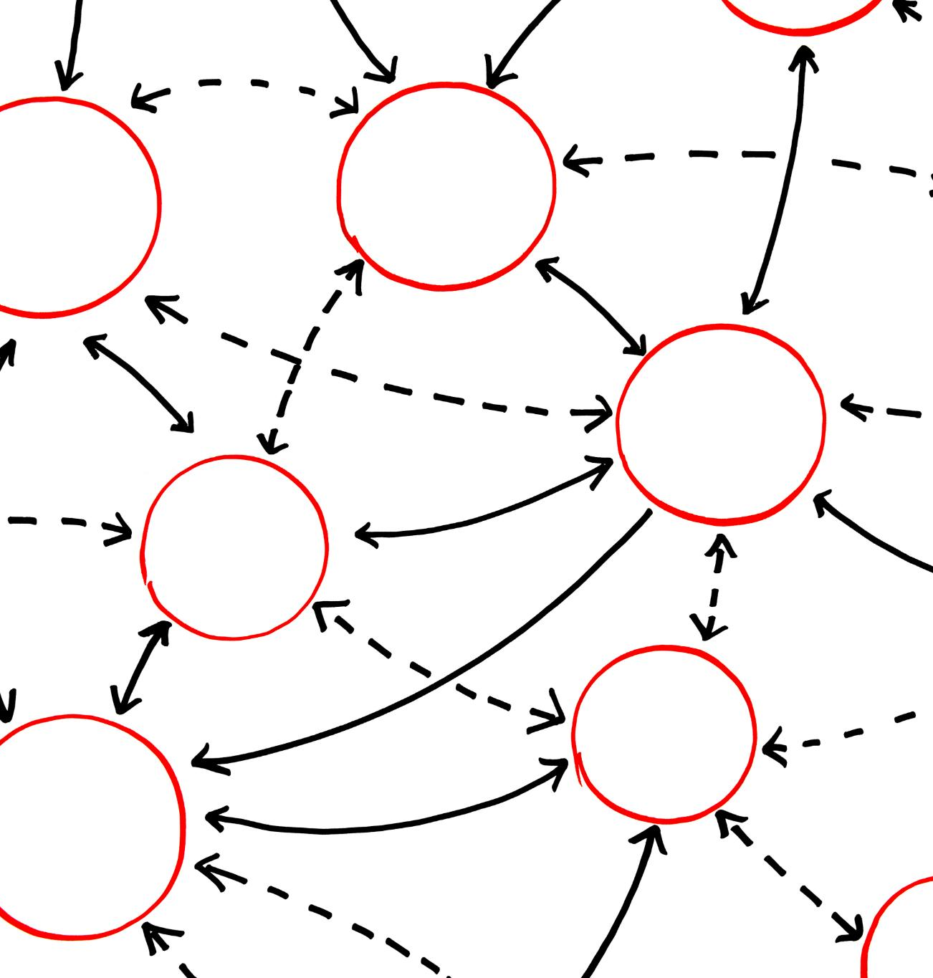
High-Level Overview of the Three Learning Types
Supervised Learning
Uses labeled data to train models to predict outcomes for new, unseen data effectively.
Unsupervised Learning
Works with unlabeled data to discover hidden patterns and groupings without predefined outputs.
Reinforcement Learning
Involves an agent taking actions in an environment to maximize rewards through feedback.
Notes:
At a high level, the three types of Machine Learning can be differentiated by the nature of data and feedback involved. Supervised Learning uses labeled datasets, meaning every training example includes an input and a correct output. The model’s objective is to learn a mapping function that can generalize to new, unseen data. Unsupervised Learning, on the other hand, deals with unlabeled data and aims to uncover hidden patterns, groupings, or relationships without predefined answers. Reinforcement Learning operates in a dynamic environment, where an agent repeatedly takes actions, observes the results, and receives rewards or penalties that guide future behavior. This overview helps frame the rest of the presentation by showing that each learning type solves a fundamentally different class of problems. Predictive tasks such as price estimation typically rely on supervised learning, exploratory tasks such as customer segmentation use unsupervised learning, and decision-making tasks such as game playing or robotics are best suited for reinforcement learning. This structured view allows practitioners to align business problems with the most appropriate Machine Learning approach.

Slide 6
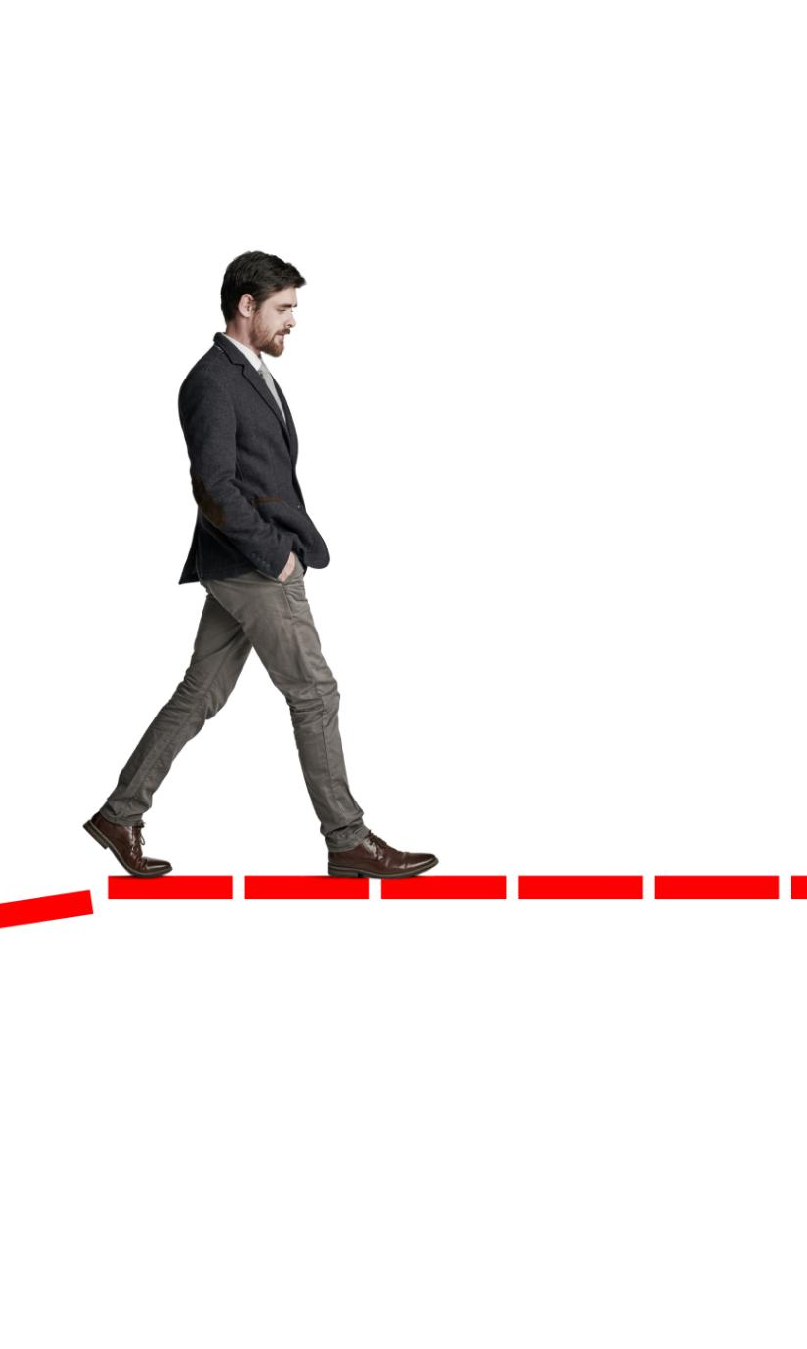
Supervised Learning: Core Concept and Intuition
Definition of Supervised Learning
Supervised learning uses labeled data where the model learns by comparing predictions with actual outputs.
Learning with Feedback
The model receives correction during training like a teacher guiding a student to minimize errors.
Regression vs Classification
Supervised learning includes regression for continuous outputs and classification for categorical outputs.
Strengths and Limitations
Supervised learning produces accurate models but requires costly labeled data preparation.
Notes:
Supervised Learning is the most commonly used Machine Learning paradigm, primarily because labeled data is often available for many business problems. In supervised learning, each data point consists of an input and a known output, and the algorithm learns by comparing its predictions with the actual answers. Over time, the model adjusts itself to minimize prediction errors. A simple intuition is learning with a teacher: the model is shown the correct answer during training and is corrected when it makes mistakes. Supervised learning problems are further divided into regression, where the output is a continuous value, and classification, where the output belongs to a category. The strength of supervised learning lies in its ability to produce highly accurate predictive models when sufficient labeled data is available. However, it also has limitations, such as the cost and effort required to label large datasets. This slide ensures the audience understands both the intuition and the practical implications of supervised learning.

Slide 7

Supervised Learning: Three Practical Use Cases
House Price Prediction
Supervised learning predicts house prices using features like size, location, and number of rooms from historical data.
Email Spam Detection
Classifying emails as spam or legitimate improves user experience and cybersecurity through supervised learning.
Salary Prediction
Estimating salary based on experience, education, and skills using supervised learning enhances compensation forecasting.
Notes:
Supervised learning is widely adopted across industries due to its strong predictive capabilities. The first major use case is house price prediction, where historical data containing house features such as size, location, and number of rooms is used to predict market prices. The second use case is email spam detection, a classic classification problem in which labeled emails are used to train a model to distinguish between spam and legitimate messages. This directly improves user experience and cybersecurity. The third use case is salary prediction, where factors like years of experience, education level, and skill set are used to estimate an employee’s expected compensation. These examples highlight how supervised learning excels when past data with known outcomes is available. In all three cases, the model’s success depends heavily on data quality and proper feature selection, reinforcing why supervised learning is often the first choice for structured prediction problems.

Slide 8

Unsupervised Learning: Core Concept and Intuition
Definition and Purpose
Unsupervised learning extracts insights from data without labeled outputs by identifying hidden patterns and structures.
Common Techniques
Techniques include clustering, association rule mining, and dimensionality reduction to explore data relationships.
Challenges and Value
Unsupervised learning reveals hidden information but evaluating model quality is challenging without labeled data.
Notes:
Unsupervised Learning focuses on extracting insights from data without labeled outputs. Unlike supervised learning, there is no predefined notion of correctness. Instead, the algorithm explores the data to identify patterns, similarities, or structures that may not be immediately obvious. A helpful analogy is discovering natural groupings without guidance, such as organizing books by similarity without knowing their genres in advance. Common unsupervised techniques include clustering, association rule mining, and dimensionality reduction. The value of unsupervised learning lies in its ability to reveal hidden information, making it particularly useful during the exploratory phase of data analysis. However, evaluating the quality of unsupervised models can be challenging, as there is no single correct answer. This slide emphasizes why unsupervised learning is essential for understanding complex datasets where labels are unavailable or impractical to obtain.

Slide 9
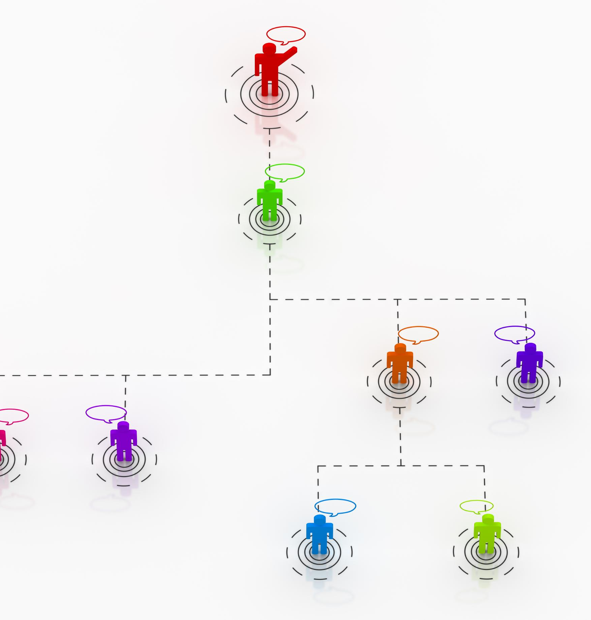
Unsupervised Learning: Three Practical Use Cases
Customer Segmentation
Businesses group customers by behavior and demographics to tailor marketing strategies effectively.
Market Basket Analysis
Identifies product associations to optimize store layouts and improve recommendation systems.
Fraud Detection
Detects anomalies in transaction data to identify potential fraudulent activities without prior labels.
Notes:
Unsupervised learning is commonly used to gain insights and discover patterns in raw data. One key use case is customer segmentation, where businesses group customers based on purchasing behavior, demographics, or engagement levels to tailor marketing strategies. Another use case is market basket analysis, which identifies associations between products frequently purchased together, helping retailers optimize store layouts and recommendation strategies. The third use case is fraud detection, where unusual patterns or anomalies in transaction data are identified without relying on predefined fraud labels. These examples demonstrate how unsupervised learning supports strategic decision-making by uncovering structures that guide further analysis or downstream supervised models.

Slide 10
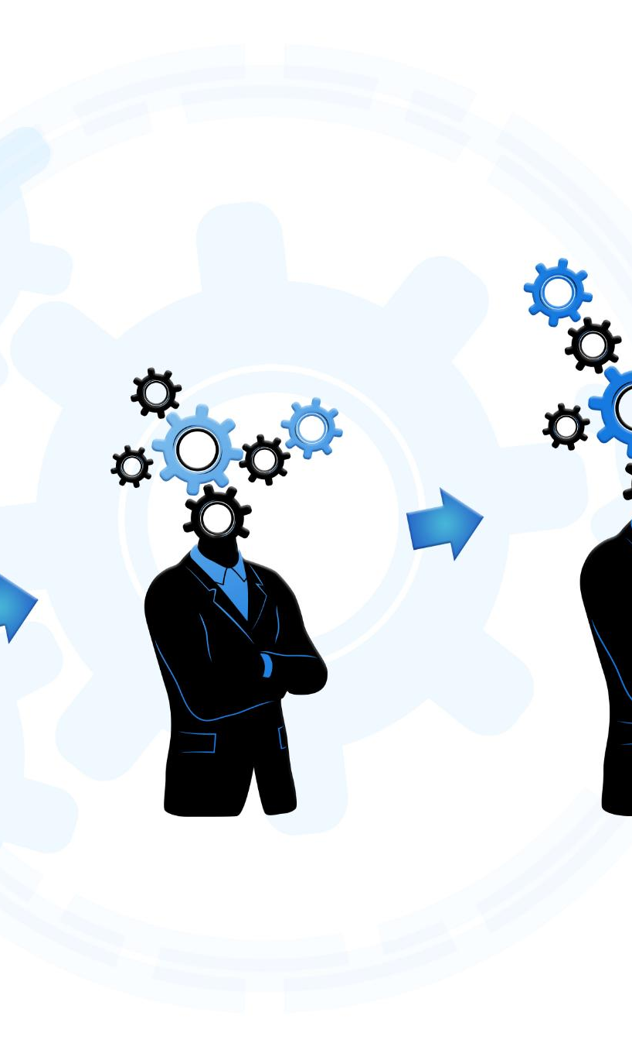
Reinforcement Learning: Core Concept and Intuition
Learning Through Interaction
Reinforcement learning trains agents by interacting with environments and receiving reward-based feedback.
Maximizing Cumulative Reward
The goal is to learn a policy that maximizes cumulative reward over time through experience.
Sequential Decision Making
Reinforcement learning excels at sequential decision-making where actions affect future outcomes.
Computational and Design Challenges
Effective reinforcement learning requires significant computation and well-designed environments.
Notes:
Reinforcement Learning is a distinct Machine Learning paradigm centered on learning through interaction. Instead of learning from a fixed dataset, an agent interacts with an environment by taking actions and receiving feedback in the form of rewards or penalties. The objective is to learn a policy that maximizes cumulative reward over time. This approach closely mirrors how humans and animals learn from experience. Reinforcement learning is particularly powerful for sequential decision-making problems, where current actions influence future outcomes. While it can achieve impressive results, reinforcement learning often requires significant computational resources and careful environment design. This slide clarifies the intuition behind reinforcement learning and why it is uniquely suited for adaptive, real-time decision systems.

Slide 11
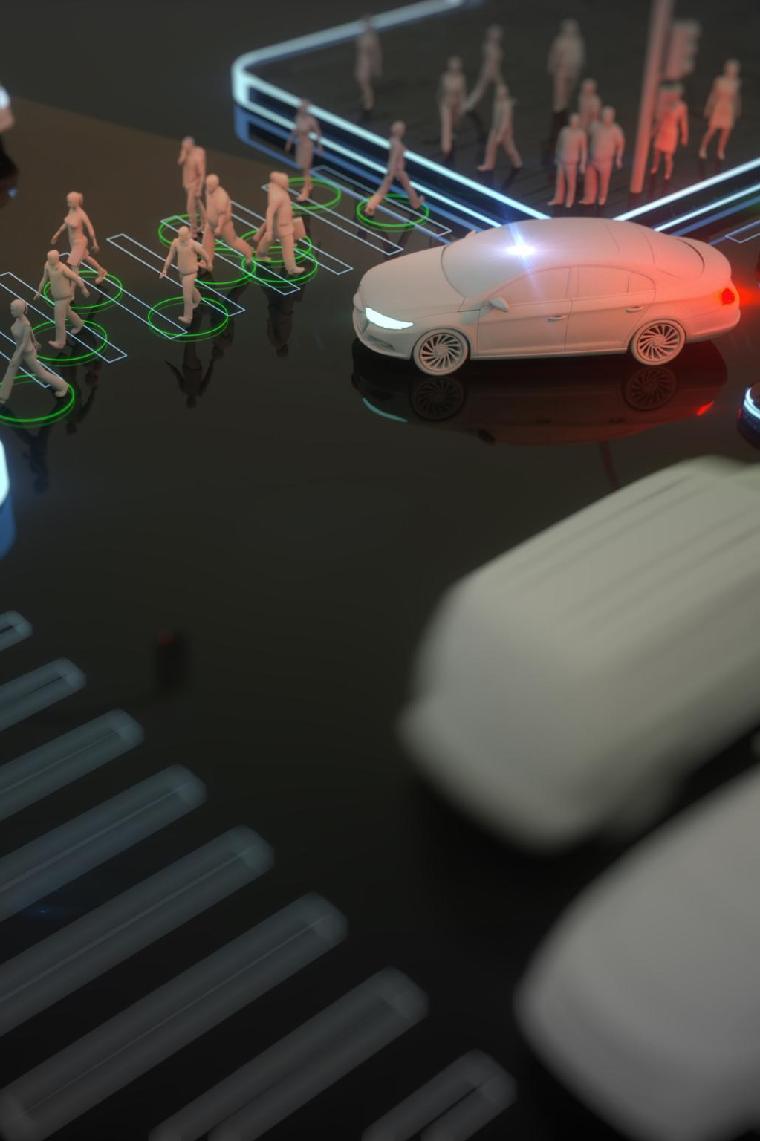
Reinforcement Learning: Three Practical Use Cases
Self-Driving Cars
Reinforcement learning enables self-driving cars to adapt driving strategies by interacting with dynamic traffic conditions continuously.
Game-Playing AI
AI agents learn optimal moves in games like chess through repeated gameplay and feedback, improving strategy over time.
Robotics Applications
Robots use reinforcement learning to master tasks like walking, grasping, and navigation via trial and error methods.
Notes:
Reinforcement learning has gained attention due to its success in complex, dynamic environments. One prominent use case is self-driving cars, where an agent learns driving strategies by continuously interacting with road conditions and traffic scenarios. Another use case is game-playing AI, such as chess or strategy games, where agents learn optimal moves through repeated gameplay and feedback. The third use case is robotics, where robots learn tasks like walking, grasping, or navigation through trial and error. These examples illustrate how reinforcement learning excels in environments that require continuous adaptation and long-term strategy optimization.

Slide 12

Comparison of Learning Types and Real-World Alignment
Supervised Learning
Supervised learning uses labeled data to predict outcomes and improve model accuracy over time.
Unsupervised Learning
Unsupervised learning discovers hidden patterns and structures in unlabeled data sets.
Reinforcement Learning
Reinforcement learning optimizes decision-making through feedback and reward signals.
Real-World Integration
Combining learning types enables robust solutions like segmentation, recommendations, and pricing.
Notes:
Comparing the three Machine Learning types highlights their complementary nature. Supervised learning focuses on prediction with labeled data, unsupervised learning emphasizes pattern discovery in unlabeled data, and reinforcement learning targets optimal decision-making through feedback. Real-world systems often integrate multiple paradigms to achieve robust performance. For example, e-commerce platforms may use unsupervised learning for customer segmentation, supervised learning for product recommendations, and reinforcement learning for dynamic pricing strategies. This comparison reinforces the idea that understanding the strengths and limitations of each approach is critical for building effective Machine Learning solutions aligned with business and operational goals.

Slide 13
Conclusion and Key Takeaways
Types of Machine Learning
Supervised, unsupervised, and reinforcement learning are key paradigms with unique roles in data analysis and decision making.
Choosing Learning Paradigm
Selecting the appropriate type depends on labeled data availability, problem nature, and expected outcomes.
Practical Impact
Understanding these ML types enables designing effective, real-world AI solutions and confident professional communication.
Notes:
In conclusion, the three major types of Machine Learning—Supervised, Unsupervised, and Reinforcement Learning—represent distinct yet interconnected approaches to learning from data. The choice of learning paradigm depends on the availability of labeled data, the nature of the problem, and the desired outcome. Supervised learning excels at prediction, unsupervised learning reveals hidden insights, and reinforcement learning enables adaptive decision-making. Together, they form the foundation of modern intelligent systems. A clear understanding of these concepts empowers practitioners to design solutions that are both technically sound and practically effective. This presentation equips the audience with a structured, real-world understanding that goes beyond definitions and supports confident explanation during interviews, presentations, and professional discussions.

