Slide 1
Support Vector Machine (SVM)
Comprehensive overview of SVM machine learning techniques
Notes:
AI-generated content may be incorrect. ---

Slide 2
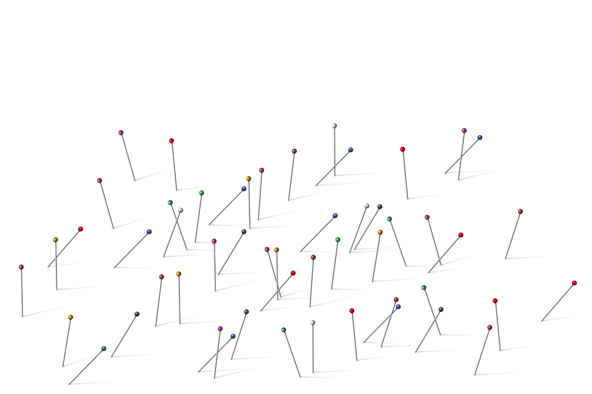
Support Vector Machine (SVM): Overview
Core Concept of SVM
SVM finds an optimal decision boundary that maximizes the margin between classes using geometric principles.
Support Vectors Role
Support vectors are the closest points to the boundary and critically define the SVM model.
Kernel Functions Usage
Kernels enable SVM to handle non-linear data by projecting it into higher-dimensional spaces.
Applications and Strengths
SVM excels in text classification, image recognition, and bioinformatics due to its robustness and accuracy.
Notes:
Support Vector Machine, commonly known as SVM, is a supervised machine learning algorithm primarily used for classification tasks, though it can also be applied to regression problems. The fundamental idea behind SVM is to find a decision boundary that best separates data points belonging to different classes. Unlike simpler classifiers that may choose any separating line, SVM focuses on identifying the most optimal boundary based on geometric principles. This optimal boundary is chosen in such a way that it maximizes the distance between the boundary and the closest data points from each class. These closest data points play a critical role in defining the model and are known as support vectors. SVM is especially powerful when dealing with complex datasets where clear separation is required and when the number of features is high compared to the number of samples. Because of its strong theoretical foundation, SVM is widely used in academic research and industry applications such as text classification, image recognition, and bioinformatics. Another key strength of SVM is its ability to handle both linearly separable and non-linearly separable data through the use of kernel functions. These kernels allow SVM to project data into higher-dimensional spaces where separation becomes possible. Overall, SVM is valued for its robustness, accuracy, and strong generalization capability when properly tuned and applied to suitable problems.

Slide 3
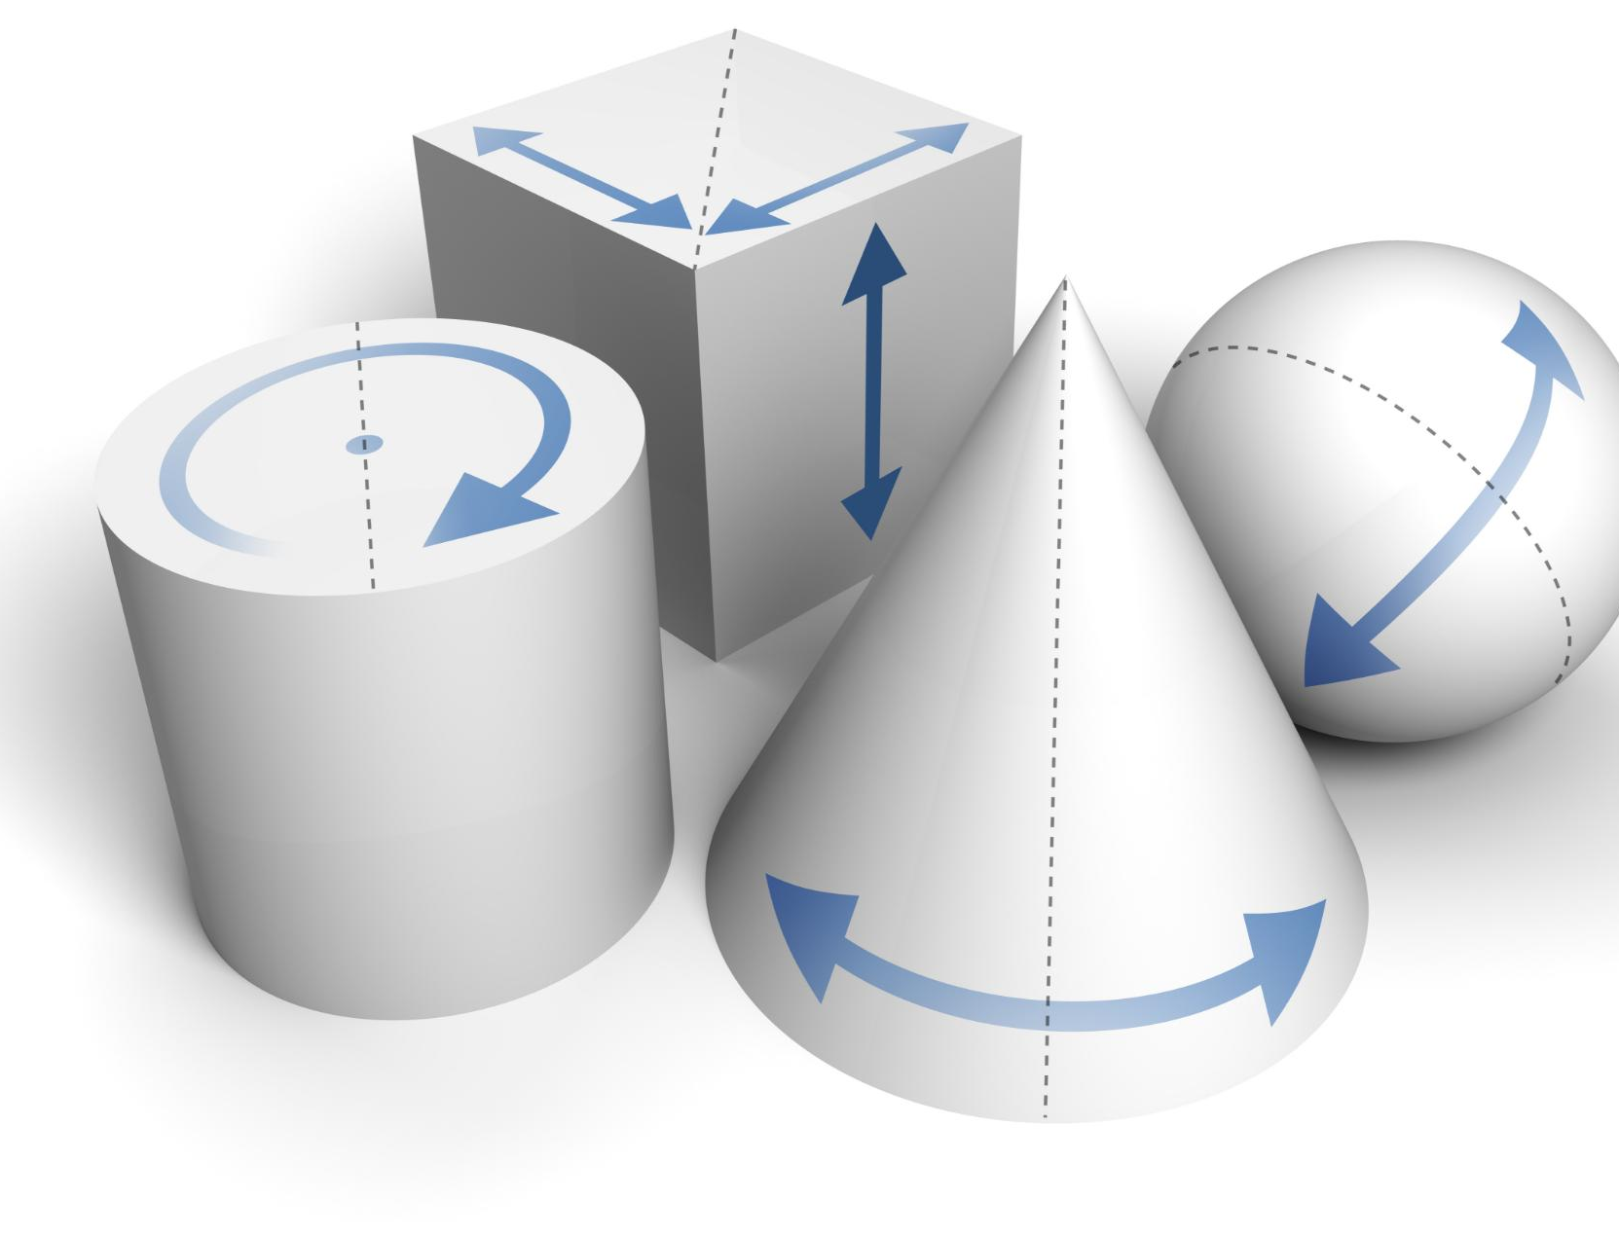
What is SVM and Why It Is Used
Purpose of SVM
SVM solves classification problems by finding patterns to separate different classes effectively.
Generalization Focus
SVM maximizes the margin between classes to improve performance on unseen data and reduce overfitting.
High-Dimensional Data Handling
SVM is effective for high-dimensional data, such as text classification with many features.
Kernel Function Flexibility
Kernel functions allow SVM to adapt to various data distributions and complex patterns.
Notes:
SVM stands for Support Vector Machine and is designed to solve classification problems by finding patterns in data that distinguish one class from another. The reason SVM is widely used lies in its focus on generalization rather than memorization. Instead of simply fitting a model that performs well on training data, SVM aims to build a decision boundary that performs well on unseen data. This is achieved by maximizing the margin between classes, which reduces the risk of overfitting. SVM is particularly effective in scenarios where data is high-dimensional, such as text classification where each word can be treated as a feature. It is also well-suited for cases where the number of samples is relatively small but the feature space is large. Another reason SVM is preferred is its flexibility through kernel functions, which allow it to adapt to various data distributions. In practical applications, SVM is commonly used for spam detection, sentiment analysis, handwriting recognition, and medical diagnosis. Its ability to create clear and mathematically sound decision boundaries makes it a reliable choice for many real-world classification problems where accuracy and stability are critical requirements.

Slide 4
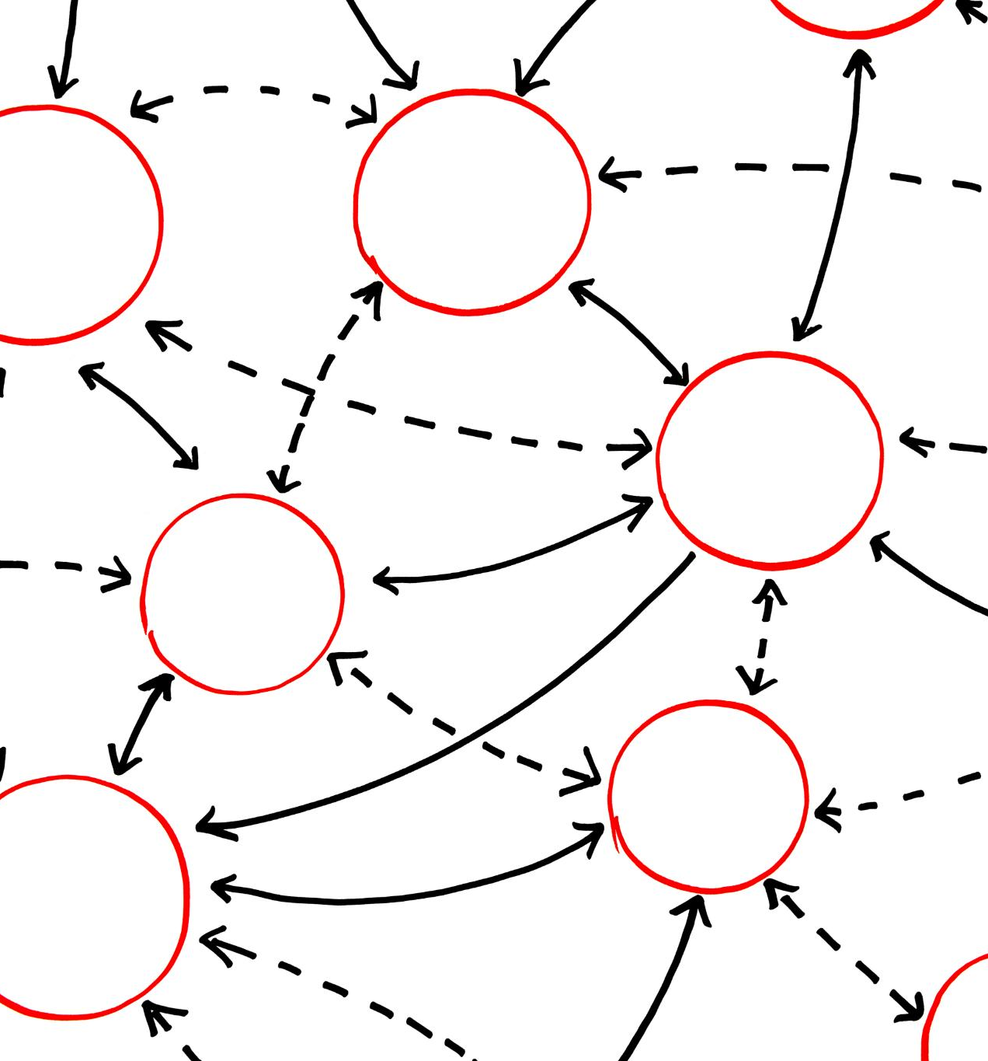
Core Idea Behind Support Vector Machine
Optimal Separating Boundary
SVM identifies the boundary that best separates classes by maximizing the margin between them.
Support Vectors Role
Support vectors are critical points closest to the boundary that define its position and orientation.
Robustness and Efficiency
SVM is robust as small changes in distant points do not affect the decision boundary significantly.
Notes:
The core idea of Support Vector Machine is to identify the best possible boundary that separates data points of different classes. In many datasets, there may be multiple boundaries that can separate classes, but SVM does not choose just any boundary. Instead, it selects the one that maximizes the margin, which is the distance between the boundary and the nearest data points from each class. This approach is grounded in the principle that a larger margin leads to better generalization on unseen data. By focusing only on the critical points closest to the boundary, SVM ignores data points that are far away and less informative. These critical points, called support vectors, effectively define the position and orientation of the boundary. This makes the model efficient and robust, as small changes in distant points do not affect the decision boundary. The emphasis on margin maximization distinguishes SVM from many other classification algorithms and is the reason it often performs well even in complex and noisy datasets when appropriate parameters are selected.

Slide 5
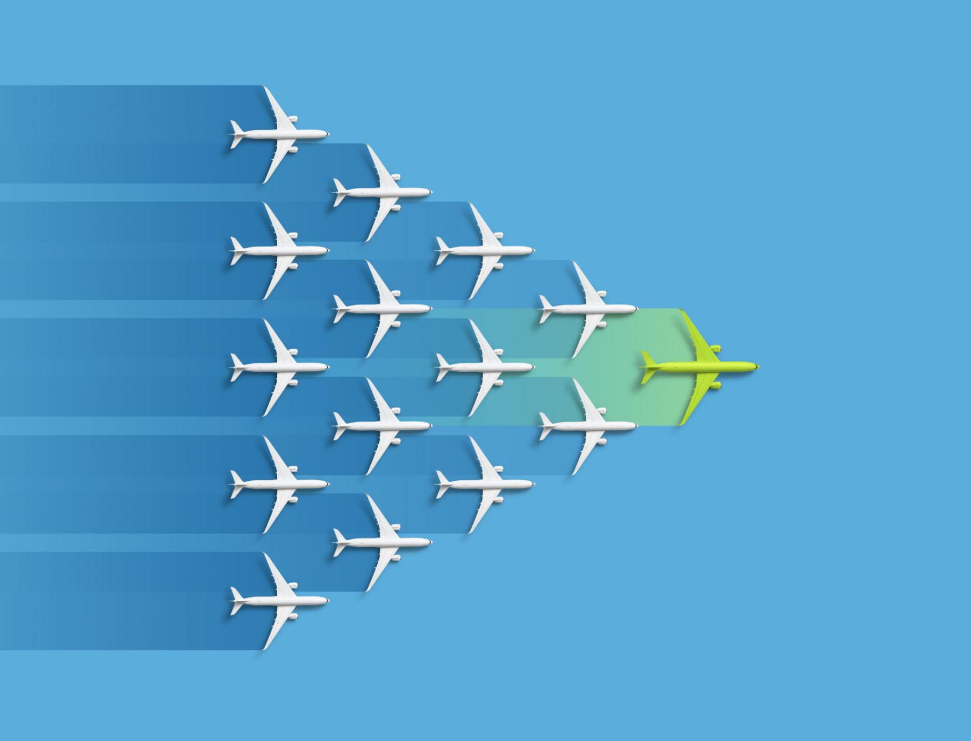
Understanding the Hyperplane
Definition of Hyperplane
A hyperplane is the decision boundary that separates data into classes in SVM, adapting to data dimensionality.
Optimal Hyperplane Selection
SVM finds the optimal hyperplane maximizing the margin between classes using support vectors and optimization.
Classification Using Hyperplanes
New data points are classified based on which side of the hyperplane they fall on in the feature space.
Role in Complex Data Separation
Hyperplanes combined with kernel methods enable SVM to separate complex, non-linear data distributions effectively.
Notes:
A hyperplane is the decision boundary used by SVM to separate data into different classes. The nature of the hyperplane depends on the dimensionality of the data. In a two-dimensional space, the hyperplane is a straight line. In three-dimensional space, it becomes a plane, and in higher-dimensional spaces, it is referred to as a hyperplane. The goal of SVM is to determine the optimal hyperplane that separates classes with the maximum margin. This hyperplane is not chosen arbitrarily; it is calculated using optimization techniques that consider the positions of the support vectors. The hyperplane divides the feature space into regions corresponding to different class labels. Any new data point is classified based on which side of the hyperplane it falls on. Understanding the concept of the hyperplane is essential to grasp how SVM makes predictions and why it is effective in separating complex data distributions when combined with kernel methods.

Slide 6
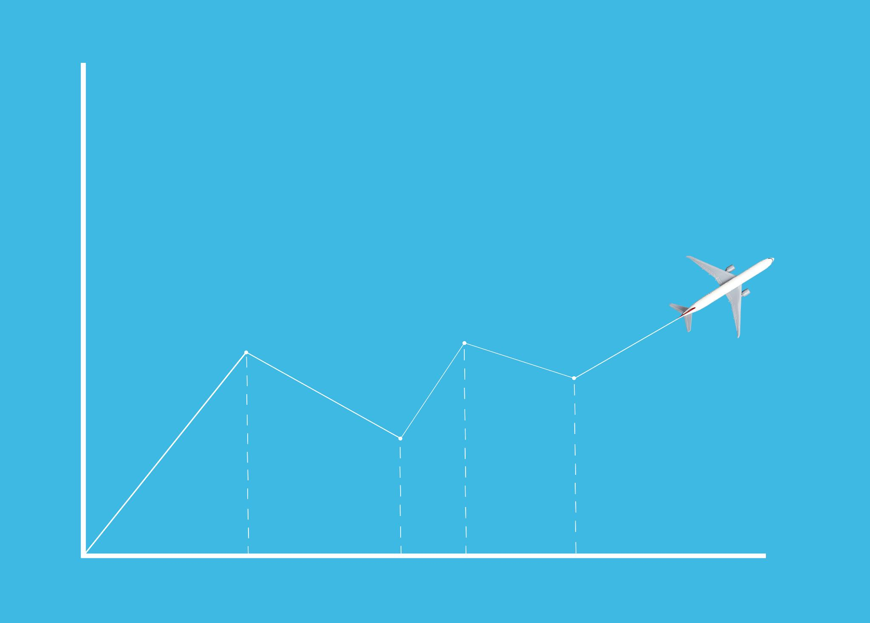
Margin in Support Vector Machine
Definition of Margin
Margin is the distance between the decision boundary and closest data points from each class in SVM.
Importance of Large Margin
A larger margin improves classifier tolerance to data variations and enhances generalization to unseen samples.
Role of Support Vectors
Support vectors lie on margin edges and determine the size of the margin in SVM.
Margin Maximization Optimization
SVM uses constrained optimization to maximize margin, enabling strong performance even with overlapping data.
Notes:
Margin refers to the distance between the decision boundary, or hyperplane, and the closest data points from each class. In SVM, maximizing this margin is a primary objective. A larger margin implies that the classifier has a greater tolerance to variations in the data, which leads to improved generalization on unseen samples. If the margin is too small, even minor noise in the data can lead to misclassification. By contrast, a large margin creates a buffer zone around the decision boundary, reducing sensitivity to noise. The margin is determined by the support vectors, which lie exactly on the edges of this buffer zone. SVM mathematically formulates the problem of margin maximization as a constrained optimization task. This focus on margin distinguishes SVM from other classifiers and is a key reason for its strong performance in practice, especially in scenarios where data points are not perfectly separable.

Slide 7

Support Vectors and Their Importance
Definition of Support Vectors
Support vectors are data points closest to the decision boundary in an SVM model that influence the hyperplane placement.
Influence on Decision Boundary
Movement of support vectors changes the decision boundary, unlike non-support vectors which have no effect.
Efficiency and Robustness
SVM focuses on critical support vectors, making it efficient and robust by using only informative samples.
Generalization and Interpretation
Support vectors represent challenging cases and help SVM achieve strong generalization and easier model interpretation.
Notes:
Support vectors are the data points that lie closest to the decision boundary in an SVM model. These points are crucial because they directly influence the position and orientation of the hyperplane. Unlike other algorithms that may consider all data points equally, SVM focuses primarily on support vectors to define the classifier. If a support vector is moved, the decision boundary will change accordingly. However, moving non-support-vector points usually has no effect on the boundary. This property makes SVM efficient and robust, as it concentrates on the most informative samples in the dataset. Support vectors represent the hardest cases to classify, and by ensuring these points are correctly handled, SVM achieves strong generalization. Understanding support vectors helps in interpreting the behavior of the model and explains why SVM can perform well even when trained on relatively small datasets.

Slide 8

Step-by-Step Working of SVM
Plotting Training Data
Training data is visualized in the feature space to understand class distributions.
Identifying Candidate Boundaries
SVM considers all possible boundaries that can separate different classes effectively.
Selecting Maximum Margin Boundary
The algorithm chooses the boundary that maximizes the margin between classes for better classification.
Handling Misclassifications
SVM uses a regularization parameter to allow some misclassifications when perfect separation is not possible.
Notes:
The working process of Support Vector Machine can be understood through a series of logical steps. First, the training data is plotted in the feature space. Next, the algorithm identifies all possible boundaries that can separate the classes. Among these, it evaluates which boundary provides the maximum margin between classes. The data points closest to each candidate boundary are identified as potential support vectors. Using optimization techniques, SVM selects the boundary that maximizes the margin while correctly classifying as many training points as possible. In cases where perfect separation is not possible, SVM allows some misclassifications using a regularization parameter. Once the optimal boundary is determined, the model can classify new data points by checking which side of the boundary they fall on. This systematic process ensures both accuracy and robustness in classification tasks.

Slide 9
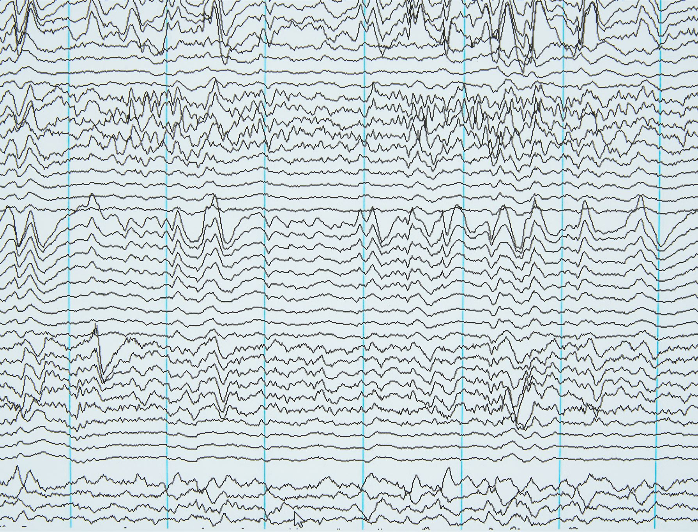
Practical Example of SVM Classification
Feature Space Representation
Students are plotted as points based on study hours and attendance features in a two-dimensional space.
SVM Decision Boundary
SVM finds the optimal boundary that separates pass and fail students, maximizing the margin between groups.
Support Vectors Role
Points closest to the boundary are support vectors that influence the position of the separating boundary.
Real-World Applications
SVM classification is widely used in loan approvals, medical diagnosis, and customer segmentation for reliable predictions.
Notes:
Consider a practical example where SVM is used to classify students as pass or fail based on features such as study hours and attendance. Each student is represented as a point in a feature space. The SVM algorithm analyzes these points and determines a boundary that best separates passing students from failing students. The students closest to the boundary become support vectors. The resulting model can then be used to predict whether a new student is likely to pass or fail based on their input features. This example demonstrates how SVM translates abstract mathematical concepts into practical decision-making tools. Similar approaches are used in real-world applications such as loan approval, medical diagnosis, and customer classification, where accurate and reliable predictions are essential.

Slide 10

Advantages of Support Vector Machine
High-Dimensional Effectiveness
SVM excels in handling high-dimensional spaces common in text and image classification tasks.
Strong Theoretical Foundation
SVM has a solid theoretical basis ensuring good generalization with proper parameter tuning.
Memory Efficiency
Only support vectors are used to define the decision boundary, making the model memory efficient.
Kernel Function Versatility
Kernel functions allow SVM to handle complex, non-linear relationships effectively.
Notes:
Support Vector Machine offers several advantages that make it a popular choice for classification tasks. It is highly effective in high-dimensional spaces, which is common in text and image data. SVM has a strong theoretical foundation that ensures good generalization when parameters are properly tuned. The use of support vectors makes the model memory efficient, as only a subset of training data is required to define the decision boundary. SVM is also versatile due to kernel functions, which allow it to handle non-linear relationships. These advantages make SVM suitable for complex real-world problems where accuracy and robustness are critical requirements.

Slide 11
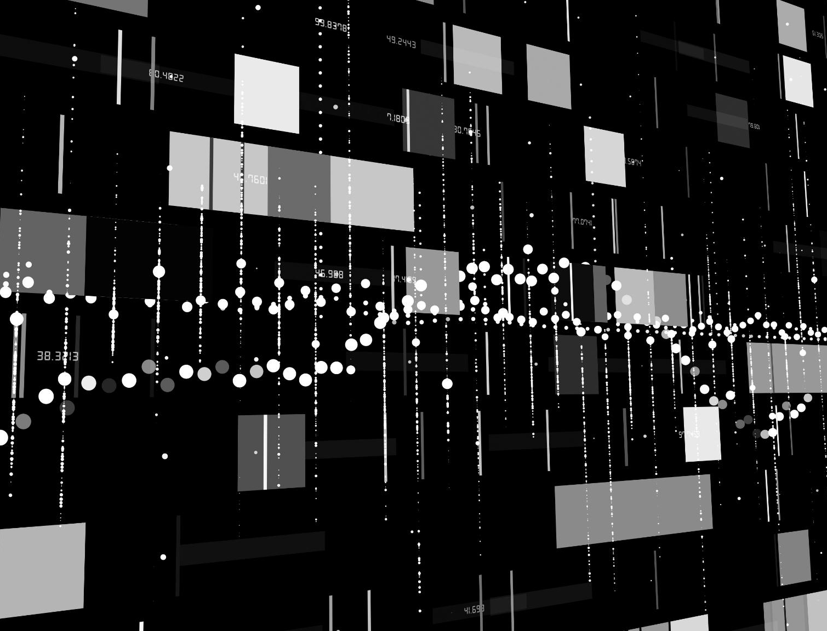
Limitations of Support Vector Machine
Computational Cost
SVM can be computationally expensive, especially with large datasets, due to increased training time.
Kernel Selection Challenges
Choosing the right kernel and tuning hyperparameters requires expertise and can be challenging.
Sensitivity to Noise
SVM is sensitive to noise, especially when data classes overlap, affecting classification accuracy.
Model Interpretability
SVM models are less interpretable compared to simpler models, complicating explanation of results.
Notes:
Despite its strengths, Support Vector Machine has certain limitations. It can be computationally expensive, especially for large datasets, as training time increases with the number of samples. Selecting the appropriate kernel and tuning hyperparameters such as regularization and kernel-specific parameters can be challenging and requires expertise. SVM is also sensitive to noise, particularly when classes overlap significantly. In such cases, the choice of parameters becomes critical to balance margin maximization and misclassification tolerance. Additionally, SVM models are less interpretable compared to simple models like decision trees, which can make explanation and communication of results more difficult.

Slide 12
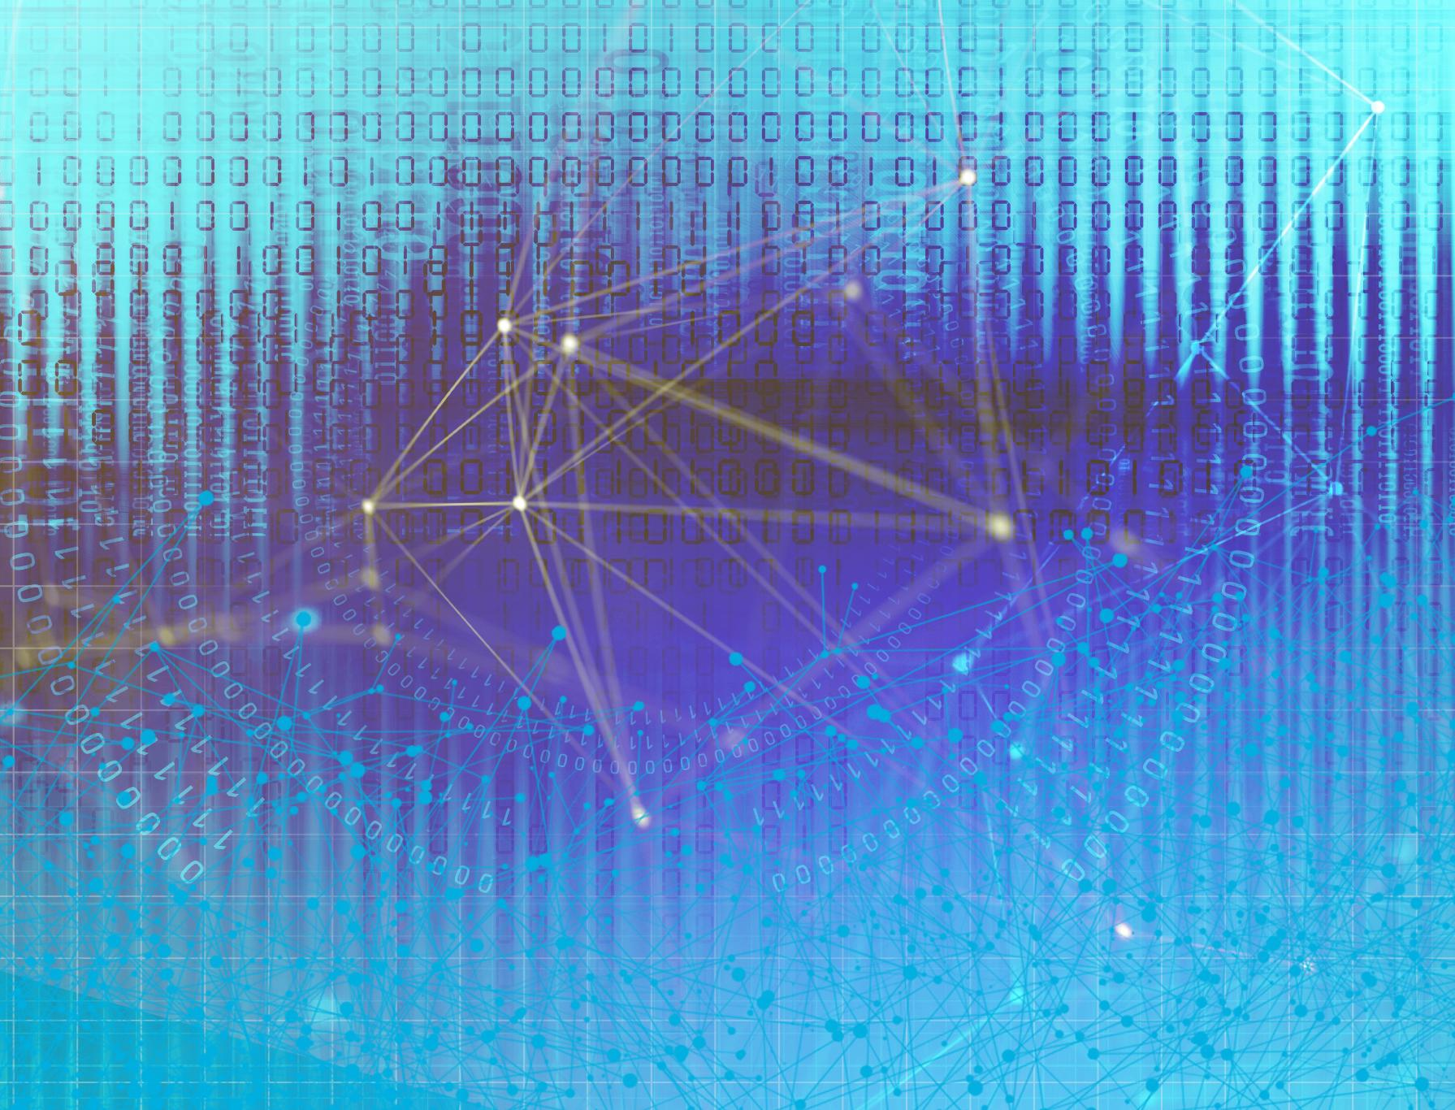
Applications of Support Vector Machine
Text Classification
SVM excels in text classification tasks like spam detection, sentiment analysis, and topic categorization.
Computer Vision
Applied in image classification and face detection, enhancing computer vision capabilities.
Bioinformatics Applications
Used for protein classification and gene expression analysis in bioinformatics research.
Finance Sector Use
SVM helps assess credit risk and detect fraud, improving financial security systems.
Notes:
Support Vector Machine is widely used across various domains due to its strong classification capabilities. In text classification, SVM is used for spam detection, sentiment analysis, and topic categorization. In computer vision, it is applied to image classification and face detection tasks. SVM is also used in bioinformatics for protein classification and gene expression analysis. In finance, it helps in credit risk assessment and fraud detection. These applications highlight the versatility of SVM and its ability to deliver reliable performance in diverse and complex problem settings.

Slide 13

Conclusion and Key Takeaways
Core SVM Concepts
SVM operates on concepts like hyperplane, margin, and support vectors, forming its classification foundation.
Strengths of SVM
Emphasizing margin maximization enables SVM to generalize well and remain robust in classification tasks.
Considerations and Limitations
SVM requires careful parameter tuning and may be computationally intensive in some cases.
Practical Applications
Understanding SVM equips learners to solve real-world classification problems using geometric approaches.
Notes:
Support Vector Machine is a powerful and well-established machine learning algorithm for classification tasks. Its emphasis on maximizing margin and focusing on support vectors enables strong generalization and robustness. Key concepts such as hyperplane, margin, and support vectors form the foundation of how SVM operates. While it requires careful parameter tuning and may be computationally intensive, its advantages often outweigh its limitations in suitable applications. Understanding SVM provides valuable insight into geometric approaches to machine learning and equips learners with a versatile tool for solving real-world classification problems.

