Slide 1
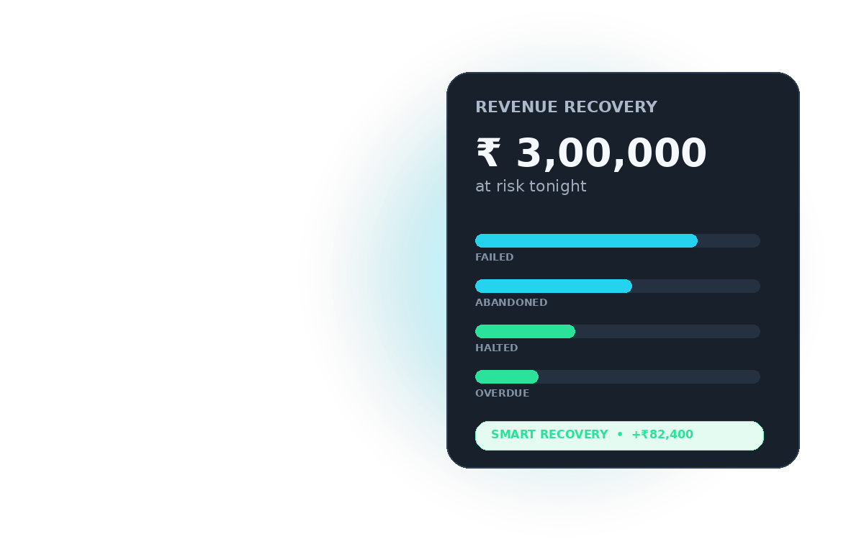
TRACK 03
RevRecover
AI Revenue Recovery Operator
Find revenue slipping away. Decide what is worth chasing. Win it back.
DETECT → DIAGNOSE → DECIDE → EXECUTE → PROVE
01
REVRECOVER • RAZORPAY AI BUILDATHON • TRACK 03

Slide 2
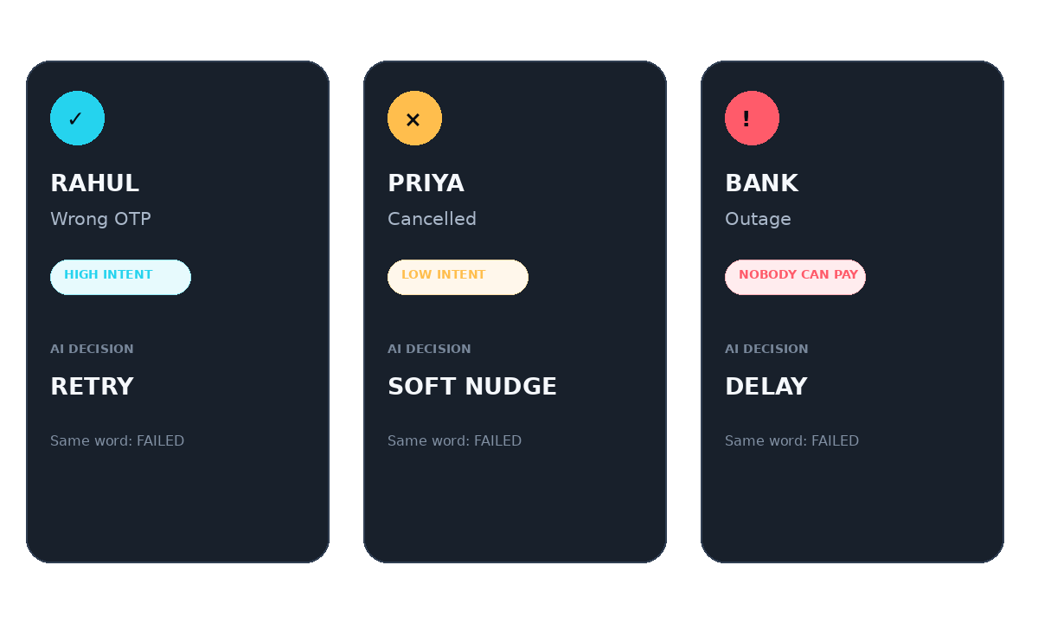
01 • THE HOOK
11 PM. Flash sale. ₹3 lakh at risk.
Three customers. Same word: FAILED. Three completely different stories.
One generic “please retry” message = spam + wasted recovery spend + lost revenue.
02
REVRECOVER • RAZORPAY AI BUILDATHON • TRACK 03

Slide 3
02 • THE MERCHANT GAP
Razorpay moves the money. Who decides what happens after it slips?
RAZORPAY GIVES
MERCHANT GAP
Webhooks: payment.failed, subscription.halted, etc.
Interpret error_reason: OTP vs cancelled vs outage
Payment Links + customer notify
Choose channel + timing — SMS, email, voice, wait
Subscription retry schedules
Know when NOT to nudge
Sandbox, APIs, test mode
Prove which intervention recovered ₹
RevRecover is the decision + recovery layer on top.
03
REVRECOVER • RAZORPAY AI BUILDATHON • TRACK 03

Slide 4
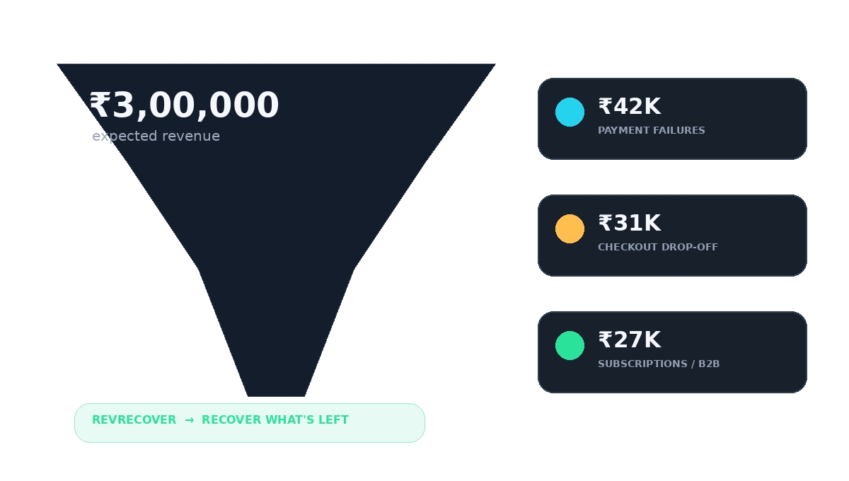
03 • SILENT REVENUE BLEED
Revenue loss rarely happens in one clean step.
B2B link expires. Subscription halts. Checkout drops. The money doesn't announce when it's about to disappear.
04
REVRECOVER • RAZORPAY AI BUILDATHON • TRACK 03

Slide 5
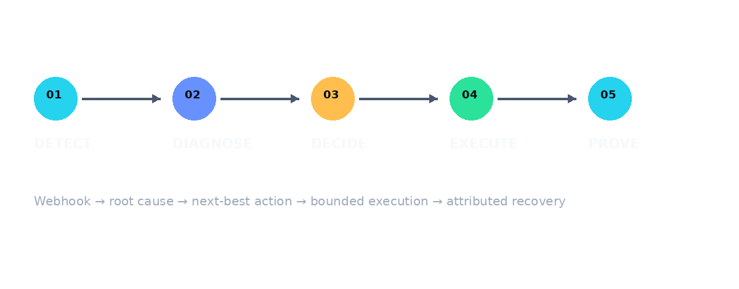
04 • WHAT WE BUILT
RevRecover turns revenue-risk events into bounded recovery decisions.
Not a reminder bot. A revenue operator.
110+
0–100
ERR
ROI
failure reasons mapped
recovery score
expected recoverable
recovery spend
05
REVRECOVER • RAZORPAY AI BUILDATHON • TRACK 03

Slide 6
05 • THE INTELLIGENCE LOOP
Every case follows the same control plane — but not the same playbook.
01
02
03
04
05
DETECT
→
DIAGNOSE
→
DECIDE
→
EXECUTE
→
PROVE
Webhook / event
110+ reasons
score + policy
best channel
attributed ₹
CONTROLLED AUTONOMY
Stopping caps • outage delay • promise-to-pay • human escalation • idempotent attribution
06
REVRECOVER • RAZORPAY AI BUILDATHON • TRACK 03

Slide 7
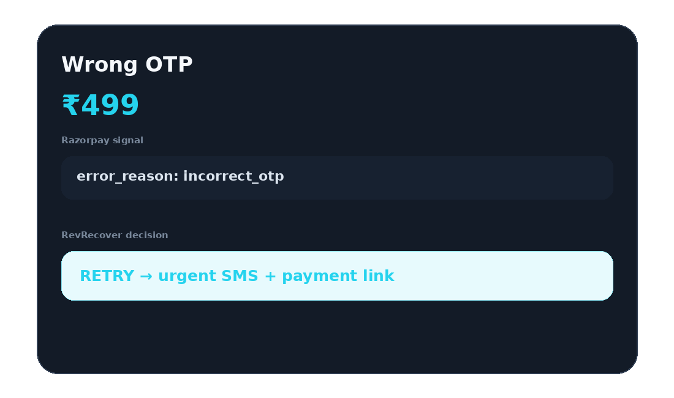
06 • LIVE DEMO
Scenario 1 — Wrong OTP
Customer-side failure. High intent. Recover now.
AI DECISION
RETRY
Urgent SMS
Fresh payment link
High-priority chase
Stop after policy cap
Razorpay = thermometer. RevRecover = doctor.
07
REVRECOVER • RAZORPAY AI BUILDATHON • TRACK 03

Slide 8
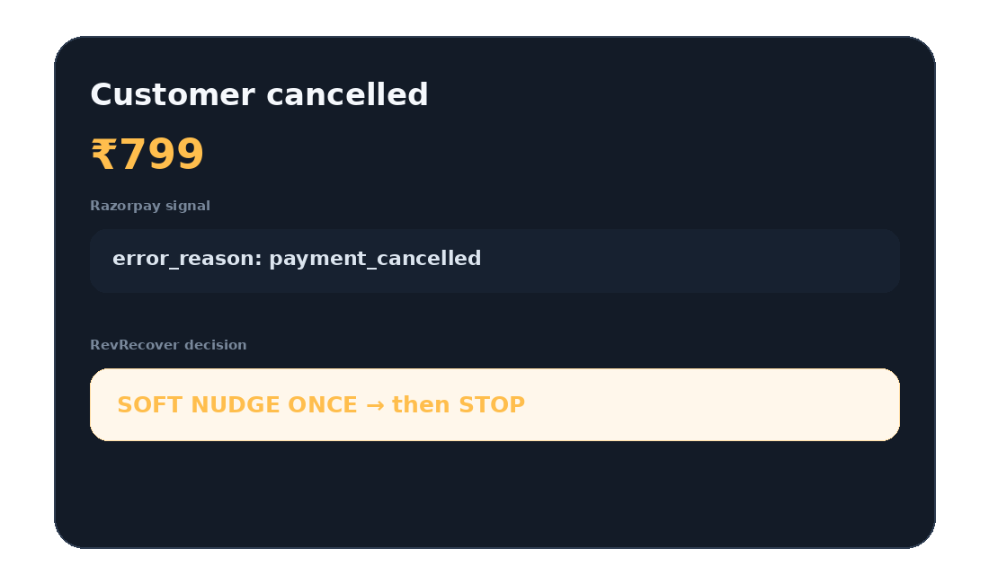
07 • LIVE DEMO
Scenario 2 — Customer cancelled
Same checkout. Opposite intent. Don't turn recovery into spam.
AI DECISION
SOFT NUDGE ONCE
One gentle email
No aggressive retry loop
If already nudged → STOP
Protect customer trust
Recover intent — don't manufacture pressure.
08
REVRECOVER • RAZORPAY AI BUILDATHON • TRACK 03

Slide 9
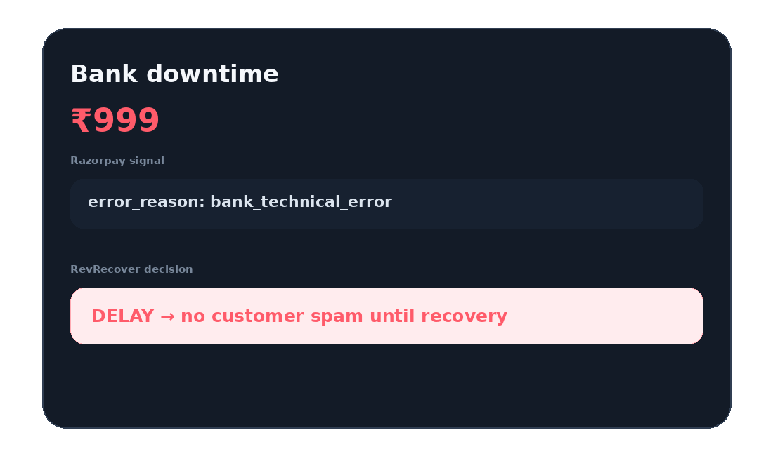
08 • LIVE DEMO
Scenario 3 — Bank downtime
The customer cannot fix an outage. So we don't chase them.
STATUS
DELAYED
No SMS / email during outage
Wait for bank recovery
Retry after the window
Avoid wasted spend + fatigue
Smart pause is a recovery decision.
09
REVRECOVER • RAZORPAY AI BUILDATHON • TRACK 03

Slide 10
09 • MORE THAN FAILED PAYMENTS
One operator. Multiple revenue leaks.
SUBSCRIPTION HALTED
MANDATE DECLINED
Voice + Hinglish IVR + promise-to-pay
SMS → email → re-register → STOP
LATE AUTH PENDING
B2B LINK EXPIRED
WATCHING — poll only, no customer nudge
New link + human escalation queue
14 curated lab scenarios • Razorpay error taxonomy • bounded playbooks
10
REVRECOVER • RAZORPAY AI BUILDATHON • TRACK 03

Slide 11
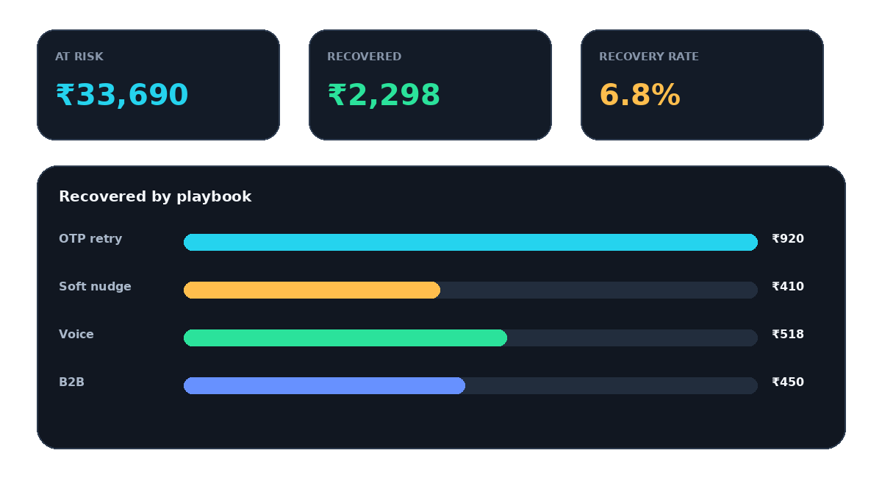
10 • THE PROOF
The judge should see money move — not just AI text.
₹ recovered is attributed to the intervention, channel and case that caused it.
11
REVRECOVER • RAZORPAY AI BUILDATHON • TRACK 03

Slide 12
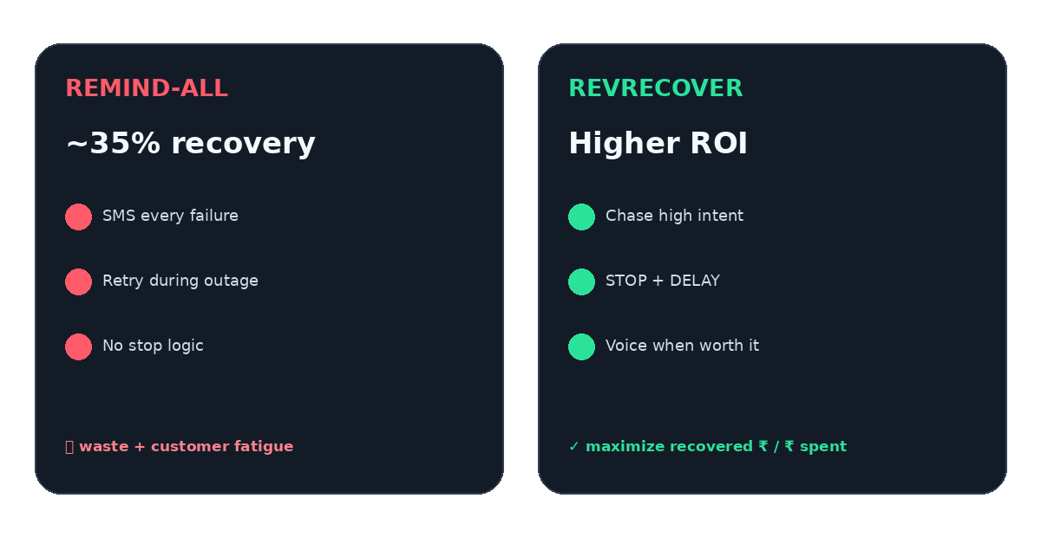
11 • WHY THE AGENT MATTERS
Same revenue pool. Better decisions. Less wasted recovery spend.
Optimize recovered revenue per rupee spent — not the number of reminders sent.
12
REVRECOVER • RAZORPAY AI BUILDATHON • TRACK 03

Slide 13
12 • TRUST LAYER
Every money action is explainable, bounded and auditable.
EXPLAIN
BOUND
ESCALATE
PROVE
Why this customer? Why this channel? Why now?
Retry caps Nudge caps ROI gates Outage pause
High-value B2B Promise-to-pay Human handoff
Payment success Idempotent attribution Audit trail
Example audit: ₹499 → incorrect_otp → retry_with_new_otp → payment_link → order.paid → ₹499 recovered
13
REVRECOVER • RAZORPAY AI BUILDATHON • TRACK 03

Slide 14
Razorpay shows money at risk.
RevRecover shows what you can still win back — and what you already won.
We don't chase every failed payment like an ex who won't read the hint.
We chase the ones who want to pay — and stop when they swiped left on checkout.
CHASE HIGH INTENT
STOP SPAM
DELAY OUTAGES
PROVE ₹ RECOVERED
REVRECOVER • RAZORPAY AI BUILDATHON • TRACK 03
THANK YOU
14
REVRECOVER • RAZORPAY AI BUILDATHON • TRACK 03

