Slide 1
BotXGraph:
Explainable Twitter Bot-Detection using Heterogeneous Social Knowledge Graphs
https://github.com/AddictivelyRecursive/BotXGraph
Presented by: Mehul Srivastava 2022B3A70604P

Slide 2
From Profile Signals to Network Behavior
Moving from profile-only detection toward a post-injection-into-network task.
Extends beyond numerical profile stats and textual embeddings.
Adds social/graph structure as an important signal.
Captures post content, targeted narratives, topics, and follower–followee patterns.
Twitter offers richer public benchmarks; LinkedIn data is harder to access at scale.

Slide 3
Where the Novelty Lies
Explainable graph Learning
explaining the graph evidence behind each decision.
suspicious neighbors, relation types, URLs, hashtags, or subgraph patterns
Schema-Adaptable Knowledge Graph
One heterogeneous schema that can absorb users, posts, hashtags, URLs, topics, and relations.
portable across TwiBot-22, MGTAB, and Sybil graphs
Multi Modal Fusion
Joint embeddings of Social Network and Account Content
Bot behavior is modeled by what accounts say and how they interact.

Slide 4
Datasets Used for Schema Validation
1. TwiBot-22, Main Build Dataset
Large heterogeneous Twitter benchmark: 1M users, bot/human labels, tweets, lists, hashtags, and relations.
Unique value: richest fit for building the full user–tweet–hashtag–URL graph.
2. MGTAB, Generalization Benchmark
Multi-relational account detection dataset with 10K expert-annotated users and 7 relation types.
Useful signals such as stance / sentiment
3. Twitter Sybil Graph: Structure only
Follower-followee graph with 250K nodes and 6.8M edges, labeled benign/Sybil.
Useful for explainability, isolates whether graph structure alone can detect suspicious accounts.

Slide 5
Methodology

Slide 6
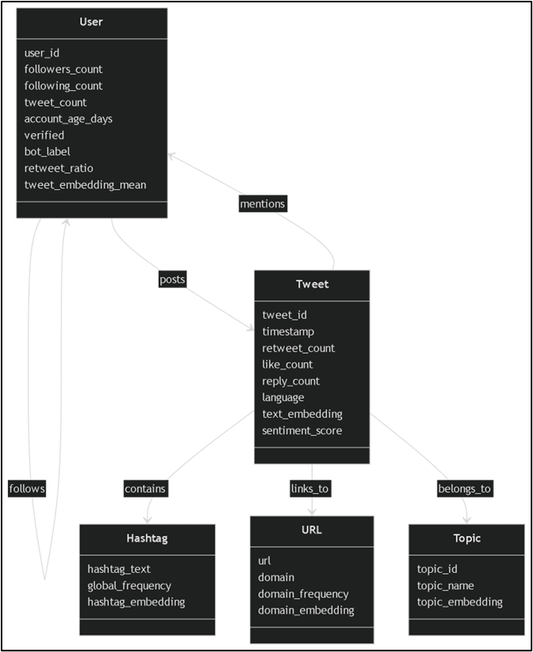
Heterogeneous
KG Schema Design
5 Nodes = {User, Tweet/Post, Hashtag, URL, Topic}
6 Edges = {follows, posts, contains, links_to, belongs_to, mentions}
Target Node = User
Prediction = Bot / Human
Core idea = combine profile + content + network behavior

Slide 7
Training Setup
Heterogeneous GNN for User Node Classification
Task = classify User nodes as Bot / Human
Graph subset = 40K users, 120K tweets, 25K hashtags, 2K URLs (5% of 1M users-big Twibot-22 dataset)
Edges = posts, contains, links, follower-following, belong to,mentions
Split = 70% train, 15% validation, 15% test
Model = 2-layer relation-aware Hetero-GNN, hidden dim = 64, dropout = 0.5
Loss = weighted cross-entropy; optimizer = AdamW

Slide 8
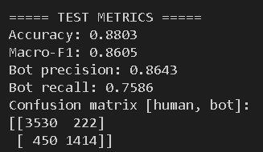
Preliminary Results
Preliminary Hetero-GNN Run
Accuracy = 88.03%
Macro-F1 = 86.05%
Bot precision = 86.43%
Bot Recall = 75.86%
Interpretation
Hetero-GNN pipeline is functional, but not yet optimized. (BERT for tweets, profile-feature normalization for users, and domain-level URL features)
Current bottleneck is majorly sparse heterogeneous edges, bigger subset or entire data.

Slide 9
Next Step: Explainability
Moving from Prediction to Reasoning
Everybody Needs a Little HELP (https://arxiv.org/abs/2311.15112, ICLR ‘24)
Explains graph predictions using hierarchical graph concepts.
Useful for discovering bot-like patterns such as URL-sharing or hashtag coordination.
Explainable GNNs via Structural Externalities (https://arxiv.org/abs/2507.17848, IJCAI ‘25)
Explains predictions through subgraph / structural contribution.
Useful for identifying which neighbors, relations, or local structures increase bot probability.
Planned Direction
Add explanations after stable GNN training.
Goal: not just Bot / Human, but why this user looks bot-like in the graph.

Slide 10
Thank you!

