Slide 1
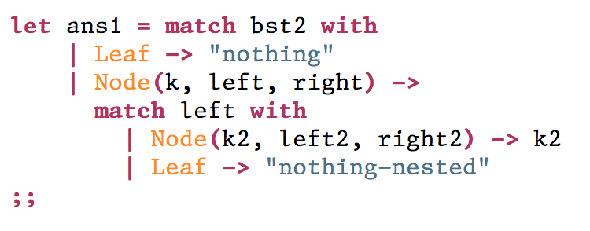
What will ans1 hold?
A: "nothing"
B: "nothing-nested"
C: "h"
D: "g"
E: "f"

Slide 2
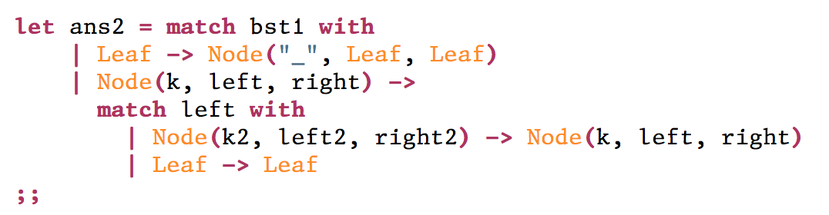
What will ans2 hold?
A: Node ("c", Node ("a", Leaf, Leaf), Node ("d", Leaf, Leaf))
B: Node ("a", Node ("a", Leaf, Leaf), Node ("d", Leaf, Leaf))
C: Node ("a", Leaf, Leaf)
D: Node ("d", Leaf, Leaf)
E: Node("c", Leaf, Leaf)

