Slide 1
Sequence
A reusable 16:9 template — ten layouts, one theme, everything editable
Notes:
Cover layout. Type over the two placeholders; the styling holds.

Slide 2
Three kinds of slide carry most decks
01
02
03
Argue
Show
Turn
A claim in the title, evidence underneath. The title is the message, not a label.
A chart, table or screenshot with commentary beside it.
A divider that resets attention and tells the room where it is.
Notes:
Content layout. Cards are composed over the body area in scheme colours.

Slide 3
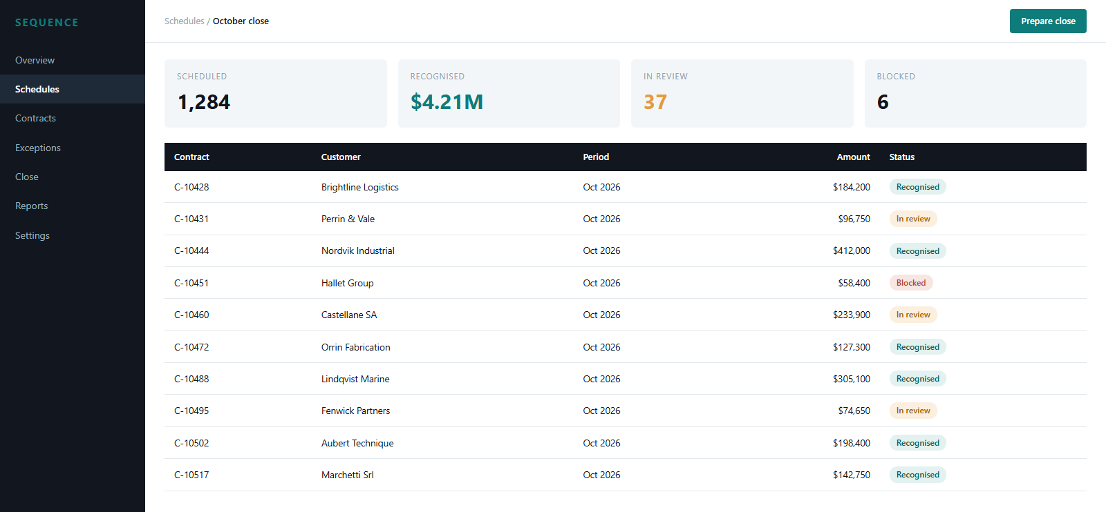
The schedule view at month end
What to notice
Status is a pill, not a column of words, so the exceptions are findable at a glance.
Amounts use tabular figures so the column scans vertically.
Interface shown is a demo mock for this template.
Notes:
Product screenshot layout: picture placeholder left, commentary right.

Slide 4
Close effort falls as layouts take over
What this shows
Effort per deck drops as formatting moves out of the slide and into the layout.
The fall is steepest once chart and table styling is standardised.
Illustrative data for this template.
Notes:
Data layout. Native PowerPoint chart — the data behind it stays editable.

Slide 5
Everything here stays editable
Text, shapes, tables and charts are native PowerPoint objects. Change the theme and the whole deck follows.

