Slide 1
CASE STUDY
Designing My Portfolio
How I scoped, designed, and shipped addytish.github.io — solo, fast, and with AI as my build partner.
Aditi Sharma · Senior Product Manager · 2026
1 / 13

Slide 2
THE BRIEF
My resume said what I'd done. It didn't show how I think.
The problem
The constraint
The opportunity
A PDF resume and a generic template portfolio could list my work, but not demonstrate product judgment — the thing hiring managers actually evaluate.
No design or engineering team. One person, evenings and weekends, shipping to GitHub Pages.
Use AI tools (Claude, Figma-style iteration, code) as a force multiplier — and let the build process itself become part of the pitch.
2 / 13

Slide 3
GOALS & AUDIENCE
Designed for a recruiter with 30 seconds and a closed laptop in mind.
If I only get 30 seconds, the site needs to do three things immediately:
01
Prove product craft
The site's own structure and interactions should read as a product decision — not just claim PM skill in a bullet point.
02
Show concrete impact
Lead with real numbers — revenue generated, tests shipped, users reached — before anything else.
03
Signal modern fluency
Make it obvious this was built hands-on with today's AI tools, not outsourced or templated.
3 / 13

Slide 4
INFORMATION ARCHITECTURE
One scroll, six purposeful sections — no nav-click required.
Hero
Work
How I Build
Products
Skills &
Tools
About
Contact
Hook + headline
with proof stats
Career case
studies, fly-in
Signature
process circle
Scrolling
tool fluency
Personal
voice
Clear single
CTA
Decision: a single continuous scroll beats a multi-page nav — recruiters scan, they rarely click.
4 / 13

Slide 5
EXPLORATION
Three layout directions for the homepage, before committing.
A — Card grid
B — Vertical timeline
C — Radial loop
Process as a static grid
Process as a linear list
Process as a circle
SELECTED
5 / 13

Slide 6
VISUAL SYSTEM
A gradient identity, a type pairing, and one illustration call.
COLOR
TYPE
ILLUSTRATION
Plus Jakarta Sans
Display / headlines
Instrument Sans
#A855F7
#06B6D4
#3B82F6
Used sparingly — on the hero headline and on hover states only, so it reads as a signature, not noise.
Body / UI text
Rejected
Selected
Full-body Notion-style characters over generic line icons — they make the process feel human, not corporate.
6 / 13

Slide 7
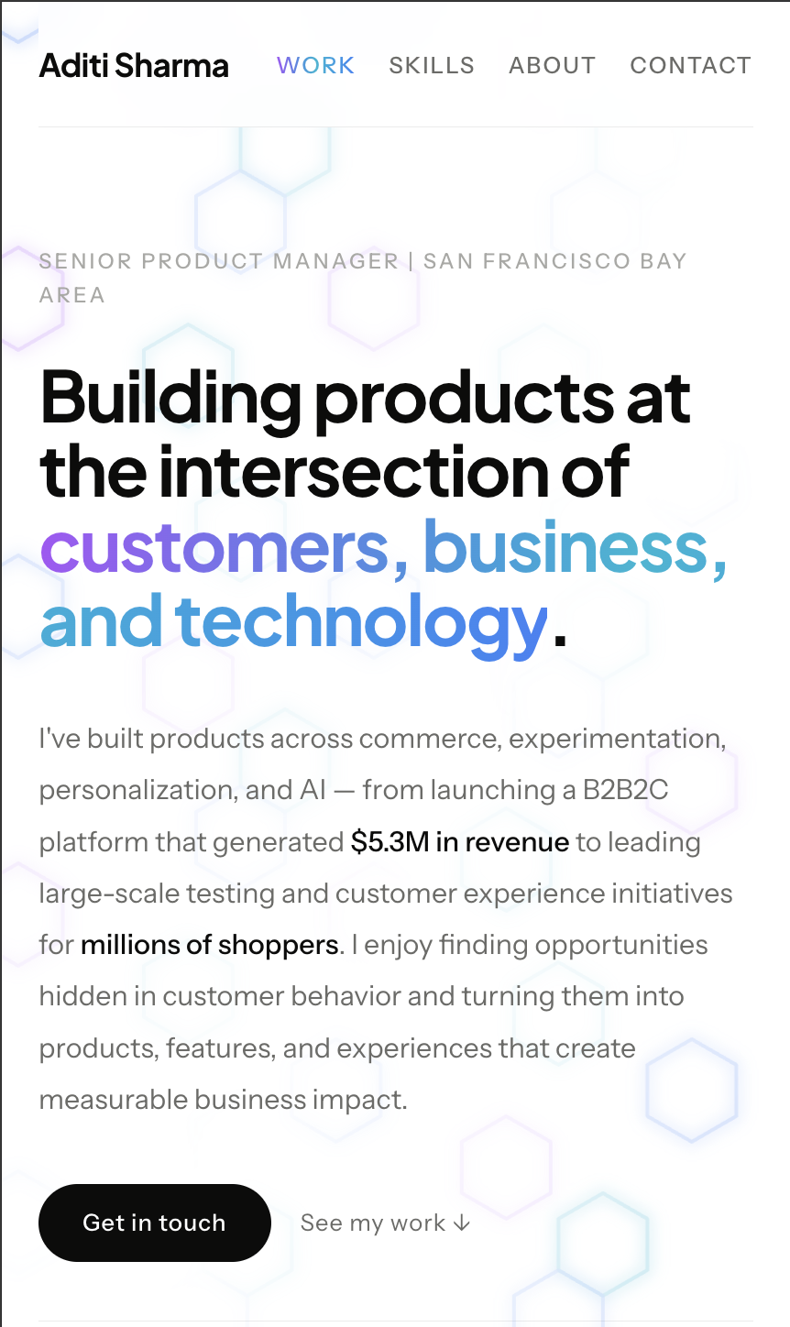
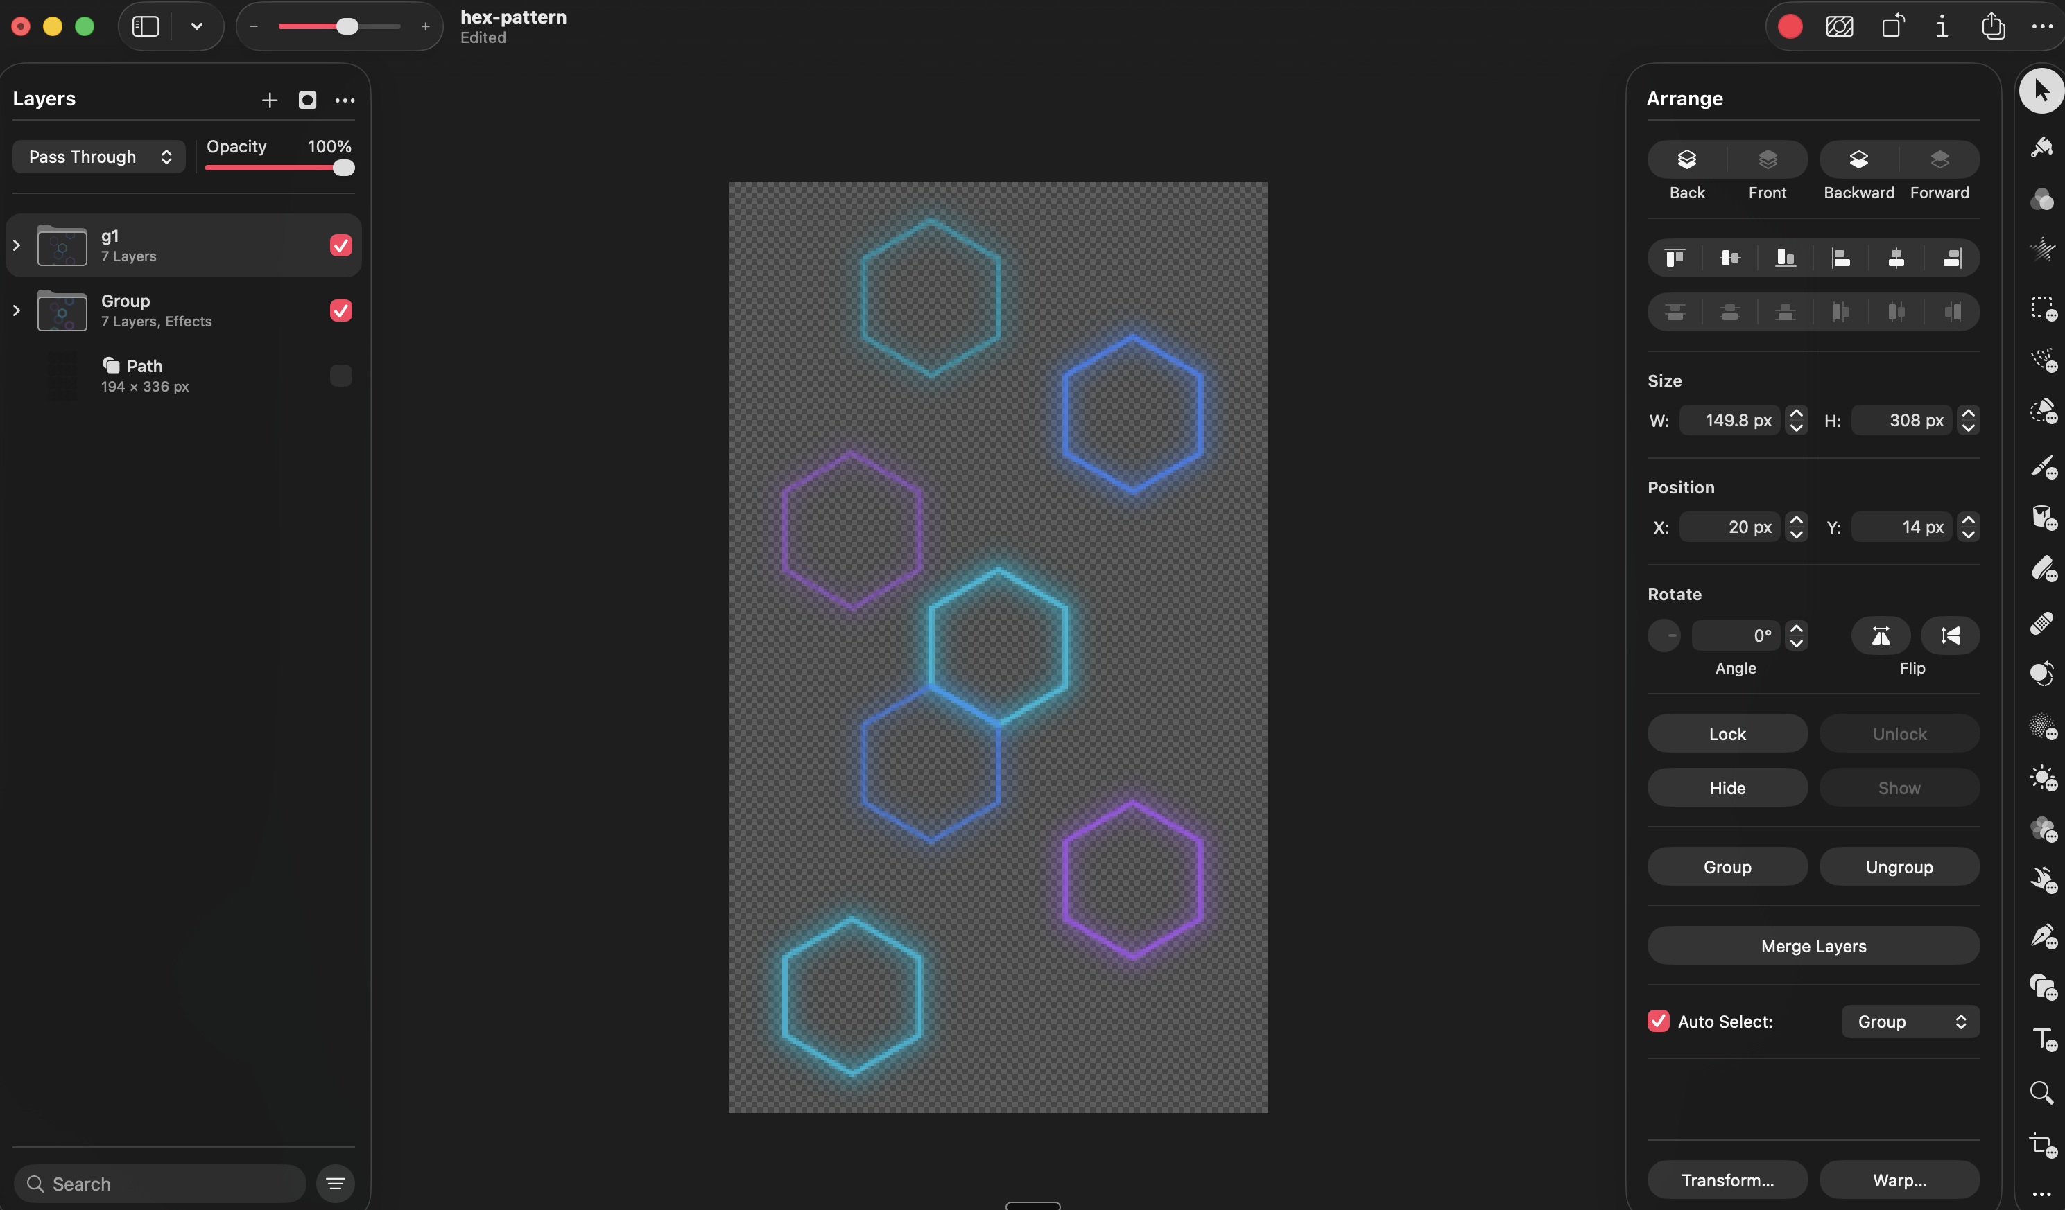
SIGNATURE MOMENT · AMBIENT BACKGROUND
A background that came from direction, not a prompt.
found online
→
→
→
→
shipped
V1 — first pass
Built in Pixelmator
Reference sourced
Palette applied
Final — shipped
Five directed rounds, zero templates.
I called the shape, sourced and shared the reference image, set the exact brand palette, specified the sizing and density, and directed the final faded-pixel, semi-transparent finish. The AI executed every round — the taste behind each decision was mine.
7 / 13

Slide 8
FINAL DESIGN · 01
Hero — proof before pitch.
Home / Desktop — hero
Work
Skills
About
Contact
Building products at the
intersection of customers, business & technology
headshot /
portrait area
$5.3M+
40–45
500K+
Revenue, 0→1 build
A/B tests / brand / yr
Users reached
Decision: lead with quantified impact, not a job title — recruiters credit numbers faster than adjectives.
8 / 13

Slide 9
FINAL DESIGN · 02
Work — case studies that fly in, one at a time.
Home / Desktop — work
Williams-Sonoma
Zenni Optical
Rodan + Fields
Earlier Career
Decision: cards fly in one-at-a-time on scroll-into-view — motion earns attention without feeling gimmicky.
9 / 13

Slide 10
SIGNATURE MOMENT · HOW I BUILD PRODUCTS
The one part of the site built to make a point.
Home / Desktop — circle
Why a circle, not a list
Product work doesn't end at launch — it loops back into discovery. A linear list implies a finish line; this never finishes, which is the actual point I wanted to make about how I operate.
8 stages, equal 45° spacing — solved with rotate() + counter-rotate() math, not a layout hack
How I
Work
Auto-plays once on scroll-into-view, then settles to hover-driven exploration
Testimonial bubbles float in the side whitespace, never competing with the circle
10 / 13

Slide 11
FINAL DESIGN · 03
Skills, voice, and a single clear next step.
Skills & Tools — scrolling marquee
Figma
Jira
SQL
Claude
Notion
ChatGPT
Looker
Zapier
About
Contact
Get in touch
11 / 13

Slide 12
OUTCOME
What building this proves, beyond the portfolio itself.
Scoped ambiguity solo
Shipped fast with AI as a partner
No brief, no team — I defined the problem, the audience, and the success criteria myself.
Used AI tools hands-on through every stage — not as a novelty, but as a real execution multiplier.
Sweated the craft details
Owned it end-to-end
Circle math, animation timing, background removal on illustrations — the kind of polish that's easy to skip and easy to notice.
Design, content, interaction, and deployment — one person, one decision-maker, one shipped product.
12 / 13

Slide 13
Let's build what's next.
addytish.github.io · addytisharma@gmail.com
Aditi Sharma · Senior Product Manager
13 / 13

