Slide 1

Learning Center MVP
Discovery Readout
Liz Lantz
liz.lantz@adhocteam.us
August 21, 2020

Slide 2
Background & Goals

Slide 3
Product Background
Background & Goals
The learning center will be the new home for benefit-adjacent content on VA.gov.
Getting/managing a benefit tools and content migration is nearly complete.
Learning center comes out of the effort of migrating benefit-adjacent content for beneficiaries, and people who work with beneficiaries.

Slide 4
Product Goals
Background & Goals
The learning center MVP is designed to support the following goals:
Help Veterans find Tier 2 content without cluttering benefit top task content and UX.
Increase self-service for Veterans, and those who support them.
Reduce calls to the call center and the need for in-person visits to VA locations to answer questions about benefits or to troubleshoot VA account problems.

Slide 5
Research questions
Background & Goals
Is the information easy to find using this search-focused, tag-based navigation?
How easily are people able to navigate between learning center articles, and topics?
Are the template labels (ex: FAQs, Checklist, About, Step-by-step, etc.) useful?
What do people see as the difference between the learning center search and overall site search?
Do people get confused if they click on a content link or CTA button in the learning center and it takes them to a benefit hub page? And vice versa?
Do people understand that information they don't find in the learning center might be in the benefit hub?
Where would the most useful place be to provide links to the learning center?
Notes:
Essentially getting at core questions:
Can people easily find information? What helps them find it?
Do people get confused going between learning center articles, topics, and/or the benefit hub?
Do people understand info that isn’t in the learning center might be in the benefit hub?
Where might people expect to find links to the learning center?

Slide 6
Hypotheses to be tested
Background & Goals
People will easily understand how to use the search functionality.
Template labels will help people determine which search result is most relevant to their search.
People will understand the difference between the learning center search and global site search.
People won't explicitly differentiate between the benefit hub and the learning center; they'll default to using overall site search if they can't find what they're looking for in either place.
Our proposed IA will be effective for Veterans and those who support Veterans.
Notes:
We hypothesized that
people would understand the search design,
that template labels would be helpful,
that people wouldn’t differentiate between the benefit hub and the learning center
and that our proposed IA would make sense to participants

Slide 7
Methodology

Slide 8
Method and Participants
Methodology
We conducted remote sessions over Zoom and asked people to review a clickable prototype.
8 people
3 women, 5 men
2 participants age 35-44, 3 participants age 55-64, and 2 participants age 65-74. 1 participant did not disclose their age.
5 Caucasians, 2 African-Americans, and 1 participant who self-identified as Other.
50% identified as having cognitive and/or functional disabilities.
All had at least one benefit and an account with a va.gov website (eBenefits, MHV, and/or VA.gov).
Notes:
We ran our study over Zoom and had people review a clickable prototype in Invision
8 participants in total, which were fairly demographically diverse.
One thing to note, we weren’t able to recruit any participants under 35.

Slide 9
Research Findings

Slide 10
Key Findings
Research Findings
The design of the learning center pages makes it easy to navigate and find information for most people.
The taxonomy seemed to match the mental models of our participants.
Having to go through multiple resources to get answers to questions is frustrating to Veterans.
People perceived that all benefit information would be available in the learning center, and experienced no confusion when going to the benefit hub.
3 of 8 participants expected the audience and topic tags to be clickable.
Template labels were helpful for most people when reviewing a list of articles.
People understood the search functionality, but the various search options caused some confusion.
Most people would look for a link to the learning center on the homepage or in the sitewide header.
Notes:
The sessions revealed 8 key findings which we’ll go into detail and a few additional insights I thought were worth mentioning

Slide 11
The design of the learning center pages makes it easy to navigate and find information for most people.
Research Findings
Design made it easy for people to scan information and understand next steps.
Some people said their expectations were exceeded!
“It's not quite what I expected - It's cleaner. I"m used to seeing a jumble of links that's hard to understand.”
H1 and intro text were helpful on the first page, but skipped over on subsequent pages.
Notes:
Overall, the study tells us that the layout and typography patterns in the designs will help Veterans search for and find information.
Design made it easy for people to scan information and understand next steps. - We were wondering if people would get confused going over an “Articles tagged” page - No one did
Two people thought the homepage was overwhelming and disorganized during their initial review of the homepage. Yet, as we moved through the session, they could easily find information.
We should evaluate whether or not this is problematic in future studies to see whether or not this is a larger trend.
h1 and intro text were quickly skipped past as we got into the sessions. One person commented that the header and intro made it seem like they didn't go to the right place when landing on Articles Tagged: Vietnam War Veterans:

Slide 12
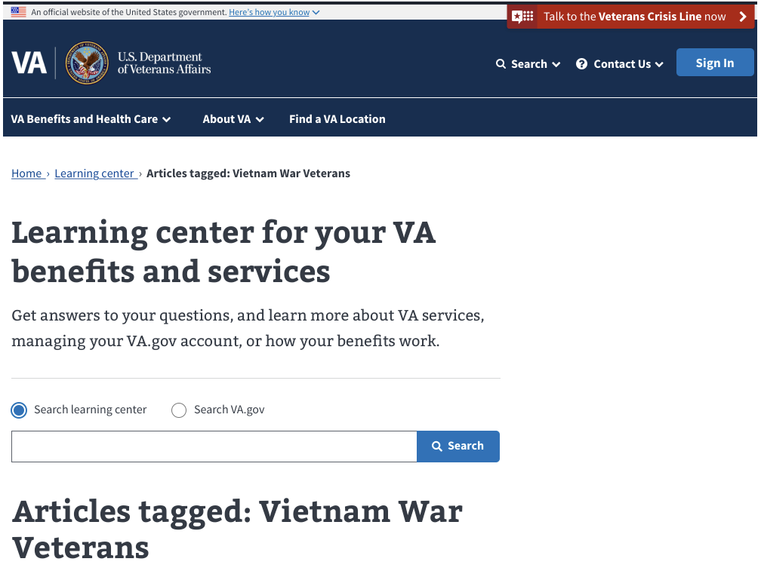
Research Findings
“First off, this thing at the top (*mouses over header and intro text*), you don't even need that. It doesn't even seem like it went where I need to be when I clicked.”
Learning center h1, and intro text remain static on all pages in the prototype.
Notes:
We should consider an alternative approach to the h1 and intro text, for two reasons:
People skipping over the h1 and intro text on every page after the homepage suggests this information is redundant.
That content will fill the viewport on smaller screens. Depending on scroll position and how we handle page changes with React, it has the potential to make people feel like nothing happened after they click on something.

Slide 13
The taxonomy seemed to match the mental models of our participants.
Research Findings
The audience and topics categorization were easily understood.
Most people went to a benefit category under Topics on the homepage when asked to show us how they would find something. “I like the way that it's broken into different benefits - I think a lot of Veterans don't understand that.”
In the audience section, 3 people expected the “show more” link to reveal personalized options.
Template labels were more helpful than the tags on search results pages.
Notes:
The audience and topics categorization on the homepage gave people an easy-to-understand overview learning center content.
When scanning the page, most people read links under the Articles by Audience, and then lingered in the Topics section the rest of the time on the page.
Most people went to a benefit category under Topics on the homepage when asked to show us how they would find something.
Three people skipped over the `Find Articles by Audience` heading and went straight to the `You're a Veteran` heading. The word "You're" set the expectation for them that clicking the `Show More` button would reveal personalized options for them such as check their claim status, or updating their address.
6 of the 8 people didn't mention the topic and audience tags as something helpful in determining which article to choose on a search results page. The template labels on the results set an expectation of the article format, although there was uncertainty about what a few of them meant.
We should consider updating the copy around the Audience links, possibly by re-enforcing the word articles or removing the You're..., to minimize confusion that the content is personalized to an individual Veteran.

Slide 14
“It [the layout] makes it very simple and easy for somebody to use, regardless of your age, or how you are associated with the military or the VA.”

Slide 15
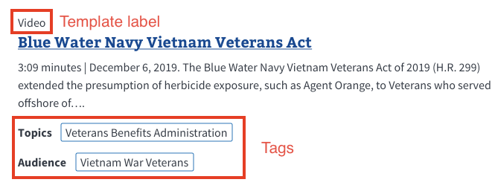
Research Findings
Example of template labels and tags.

Slide 16
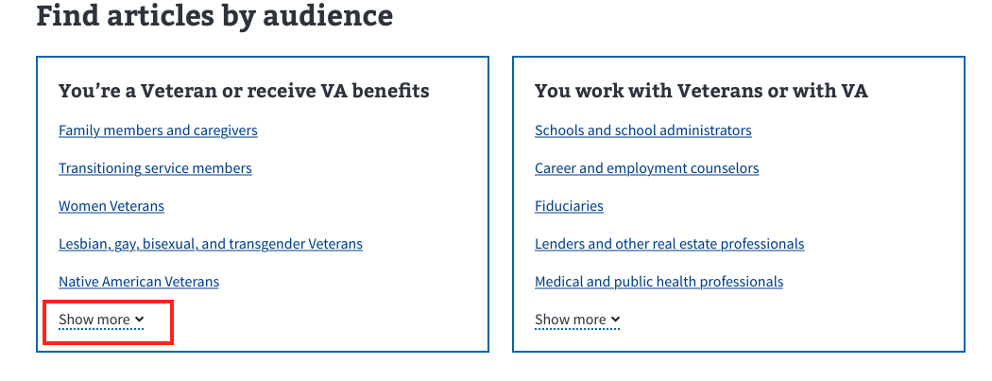
Research Findings
“It’s where you can get into your personal information. Cause it really doesn’t have a...up at the top...a place to go to ‘your information’. It lets you sign in but it doesn’t give you a place to go to ‘your information’.” - Person talking about what they expect if they click ‘show more’.

Slide 17
Having to go through multiple resources to get answers to questions is frustrating to Veterans.
Research Findings
People shared stories of frustration navigating multiple VA websites to get answers to their questions.
“The way we perceive it is that the VA is trying to cause us to say "Screw it" that way they won't give us our benefits. They're intentionally trying to make it more difficult for us.”
Template labels helped people differentiate between articles with similar or identical titles, but 2 people were frustrated and confused by the fact that the articles were there at all. “That can be quite confusing, especially to folks that have TBI [traumatic brain injury] like me. That would be extremely confusing and very frustrating. You're sending us to more places than we need to go.”
7 of 8 participants felt that the learning center concept would be an improvement over the multiple-website experience they have today.
Notes:
Many people shared their previous frustrations at having to navigate multiple VA websites to get answers to questions about their benefits or VA.gov accounts (VA.gov, MHV, or eBenefits).
4 participants shared prior experiences of having to call someone after struggling to find answers online.
We wanted to see whether or not template labels would help people articles with similar or identical titles - we hypothesize this will happen once the learning center is populated by content authors.
While the labels did help 5 participants differentiate, 2 participants were still frustrated and confused by the fact that there were two seemingly identical articles in the first place.
That confusion, combined with the frustration almost everyone talked about at one point or another during a session, suggests that implementing guardrails to prevent duplicative or conflicting articles will really help Veterans by reducing their cognitive load and streamlining the process of finding the best article for their
At the end of the session, the majority of people felt like this would a big improvement for Veterans looking for answers to questions, so generally affirms we’re om the right track to improve self-service and reduce frustration.

Slide 18
"You know the term Rosetta Stone? I think this is strong enough, and organized well enough that it could be that for Veterans."
Notes:
Participant’s comment when asked what he thought of the concept overall.

Slide 19
People perceived that all benefit information would be available in the learning center, and experienced no confusion when going to the benefit hub.
Research Findings
We asked people at multiple points in the session to find benefit application or eligibility info. 7 of 8 participants said they’d look in the learning center:
By returning to the home page and browsing links by topic, or
By searching with the `Search learning center` radio button selected.
50% of participants expected to find benefit applications under the `View all articles` link in a topic section.
No one acknowledge anything had changed going between the benefit hub and learning center.
Notes:
At multiple times during the session, participants were asked where they would find Tier 1 information .
7 of 8 participants said they would look in the learning center for this information:
- By returning to the home page and browsing links by topic, or
- By searching with the `Search learning center` radio button selected.
50% of participants expected to find benefit applications under the `View all articles` link in a topic section.
2 of the 8 participants would use search with the learning center option selected.
None of the participants experienced confusion, or noticed a change, when going between the benefit hub and learning center.
- Tell us that Veterans don't differentiate between the two areas of the site. What matters most is getting their question answered.
- The study suggests that as long as we make it easy for Veterans to find what they're looking for, it won't matter if it lives in the learning center or benefit hub.
- However, this should be re-evaluated when we have a live environment that allows people to look for information like they normally would.

Slide 20
3 of 8 participants expected the audience and topic tags to be clickable.
Research Findings
Most people didn't comment on the audience and topics tags on the search results or article pages until prompted.
Less than half expected the tags to be clickable.
“Are those viable links? What are you trying to get across with that? How are you trying to guide us?”
Notes:
Most people didn't comment on the audience and topics tags on the search results or article pages until prompted.
Less than half expected the tags to be clickable.
Once they realized they were clickable, and clicked through, 6 of 8 participants felt it aligned with their expectations.
2 participants expected the tags to behave as a layer on top of the Agent Orange content they were viewing.
- We should revisit the design of the tags to make sure people know they're clickable.
- Layering tags to refine results may be useful to people; the question of whether or not the tags were layered has come up internally with team members during design reviews as well. We should explore this for future iterations of the learning center if data indicates that many users want this.

Slide 21
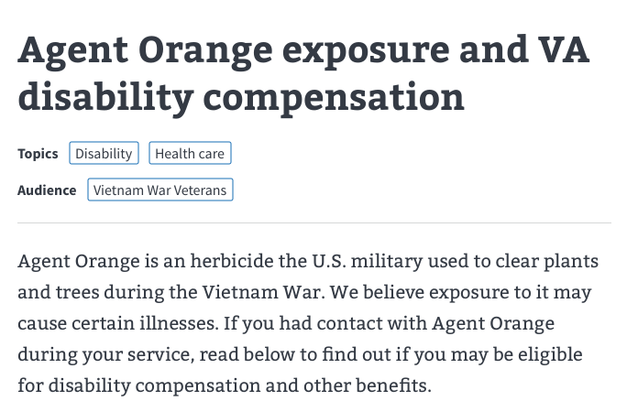
Research Findings
“It doesn't look like it's clickable. It just looks like this is the audience.”
Example of tag design; the majority of participants didn’t realize they were clickable.

Slide 22
Template labels were helpful for most people when reviewing a list of articles.
Research Findings
7 of 8 people noticed them right away on the search results page.
3 people were confused by the difference between the Question and answer and FAQs labels.
1 person wanted to filter search results by template type.
Notes:
7 of 8 participants noticed the template labels right away when reviewing the search result pages.
The labels helped them understand there was a difference between similar sounding articles, and set an expectation for what they might find once they clicked.
This tells us the labels are helpful to people looking at search results.
- 3 participants were unsure about the difference between `Question and answer` vs `FAQs` . We should consider clarifying this
- 1 participant wanted to be able to filter results by template labels so they could find only checklists and step-by-step articles.
- Filtering or sorting by template type to refine results may be useful to Veterans; we should consider exploring this in future versions of the learning center if data indicates that many users want this functionality.

Slide 23
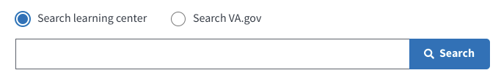
People understood the search functionality, but the 2 search options caused some confusion.
Research Findings
Search was not wired up in the prototype.
Everyone understood the search was keyword based and thought the selected option would search within the learning center.
Less confidence about what would happen if the radio button was changed.
4 people’s expectations aligned with intended design.
3 people thought they could find any benefit info with ‘Search learning center’ selected.
1 person struggled to articulate what they thought might happen.
Notes:
Everyone understood that the search functionality was keyword based, and expected the `search learning center` radio option would search within the learning center.
They were less confident about what would happen if they changed the radio option to `search VA.gov` . 7 of 8 participants expected it to conduct a broader search beyond the learning center content (like global site search), but the expectation about the type of content returned in that broader search varied across participants.
- Half of the people expected it to work the way we intended.
- 3 people thought they’d find **any** benefit related information with `Search learning center` selected.
- 1 person was very confused by the two options. They struggled to articulate what they thought would happen, but eventually came to the correct conclusion.
- from this study we know the “search learning center option” is clear, but there might be some opportunity to reduce the cognitive load for people by re-considering the search VA.gov option.
- I don’t have a hard recommendation on making changes based on this study alone, but definitely want to re-test this when it’s in a live environment.

Slide 24
Most people would look for a link to the learning center on the homepage or in the site wide header.
Research Findings
6 of 8 people said they'd expect to see something about the learning center prominently displayed on the homepage, or somewhere in the site header.
“Put it at the top of this page [mouses over sitewide header], because that's where people are going to look.”
Notes:
During the post-task interview at the end of each session, we asked *"Say you went to VA.gov today and knew we had launched this product. How would you find it on the website?"*.
6 of 8 people said they'd expect to see something about the learning center prominently displayed on the homepage, or somewhere in the site header once it becomes available.
3 people said if they didn't see it on the homepage, and they knew what it was called, they would use the site search in the global nav to find it.
**Implication**
We should consider providing access to the learning center from the homepage and the site wide navigation, and evaluate which location is most effective with Veterans in a future research study.

Slide 25
Additional Insights
Research Findings
50% of people browsed Articles by Topic links rather than use search.
The name "learning center" resonated with half of the participants after reviewing the prototype. “The thing will be getting Veterans that deal with short term [memory loss] like I do. You need something that drives us *toward* the learning center, because I wouldn't automatically go there to find these answers. ‘Learning center’? We're thinking, 'What kind of baloney is this? How's this going to answer my question?'.”
When viewing the prototype's only benefit hub page, multiple participants did not think the body copy links were clickable.
Notes:
50% of people browsed Articles by Topic links rather than use search.
We prompted people to show us how find information at 3 points in each session, and half of the participants confidently returned to the learning center homepage `Articles by Topic` section (via the browser back button or breadcrumb) to find what they were looking for.
The other half of participants said they would use the learning center search bar for at least 1 of the 3 "find information" tasks.
The organization of the Articles by Topic section resonated with Veterans, and was perceived as a comprehensive source of information.
Because the tasks weren't search focused, and the prototype wasn't wired for search, the study didn't thoroughly evaluate the learning center search design. We should retest search functionality in a live environment to better evaluate people's search behaviors and expectations.
The name "learning center" resonated with half of the participants after reviewing the prototype.
Before seeing the prototype, we asked participants what they expected would be contained something called "learning center".
1. 50% expected the learning center to be benefit-focused.
2. 50% had varied expectations that ranged from educational content such as "how to use Microsoft word" to a personalized center where they could "learn about" the status of items they had in progress with the VA (e.g. claims or prescription refills).
At the end of the session, we asked if the name "Learning Center" felt right, now that they had seen the type of content it contains.
1. The same participants who expected the learning center to benefit-focused felt the name matched the content in the learning center.
2. The participants who had varied (not benefit-focused) expectations did not think the name "learning center" was appropriate.
The name "Learning center" resonated only 50/50. We should explore and test other names that would set better expectations for the content contained in the learning center.
It will be critical that the contextual language driving people to the learning center sets the right expectations. When viewing the prototype's only benefit hub page, multiple participants did not think the body copy links were clickable.
The blue text wasn't sufficient enough to signify to them that the headings were interactive. All of the participants who struggled with this identified as having cognitive or functional impairments.

Slide 26
Recommendations

Slide 27
Recommendations
Move forward with the overall design concept. We’re on the right track!
Iterate on 2 aspects of the design:
h1 and intro text to help people understand they’re on a new page.
design of the tags to ensure people know they’re interactive.
Search update: suggest to search va.gov when no results are returned
Create guardrails to minimize duplicative content in the learning center.
Consider updating copy around the Articles by Audience links to minimize any confusion that the content is personalized to the user.
Consider providing access to the learning center from the homepage and the site wide navigation.
Consider clarifying or combining Question and answer and FAQs.

Slide 28
Recommendations
Explore names other than “learning center”
Re-evaluate a few key items in future studies, when we have a live environment:
Search learning center vs Search va.gov vs global site search
Navigating between the benefit hub and learning center
Presentation / amount of links on the homepage - do people get overwhelmed?
Update benefit hub pages so that it is more clear that link headings are interactive, or move the link to the description under the heading

Slide 29
Next Steps

Slide 30
Next Steps
Card sort
Evaluate audience and topic tags with Veterans and content authors.
Design iterations
Based on study outcomes
Learning Center 1.0
Search result page changes based on search.gov integration
Mobile versions for homepage and tag designs
Mobile audit
Audit learning center templates; create mobile templates as needed (e.g. homepage, video template, about with tables, etc)
Map out flows
What are all the ways a user could move through/from the learning center?

Slide 31
Appendix

Slide 32
Appendix
Product Outline
Research Plan
Conversation Guide
Prototype
Findings Summary
Session Notes
Synthesis Workbook

